Slide 1
Design of a Multiple-Output Voltage Generator PCB for a Comprehensive Verification of the PSEC6, a 1-ps Resolution Mixed-Signal ASIC
FERMILAB-SLIDES-26-0148-V
Aug 6, 2026
Hector Daniel Rico-Aniles
PhD

Slide 2
Agenda
Introduction
Wire bonded and packaged chip testing boards design
The multiple-output voltage generator system
The power and biasing board
The digital device
The graphical user interface
Cost comparison
Conclusions
Future work

Slide 3
Introduction
Large Area Picosecond Photo-Detectors (LAPPDs) are among the most promising technologies for ultra-fast particle detection.
PSEC5 was an ASIC designed to be the core of a readout system to achieve 1ps sampling time resolution on an LAPPD sensor.
The chip was first tested in 2025 and preliminary results were generated.
The testing setup was based on two National Instruments source measure units (SMU), PIXe-4140 and PIXe-4141 which cost >$30,000.
PSEC6 is an enhanced version of PSEC5 which requires similar testing set up.
In this project two test boards for PSEC6 were designed and sent for fabrication. A low-cost user-friendly testing setup was designed and assembled.

Slide 4
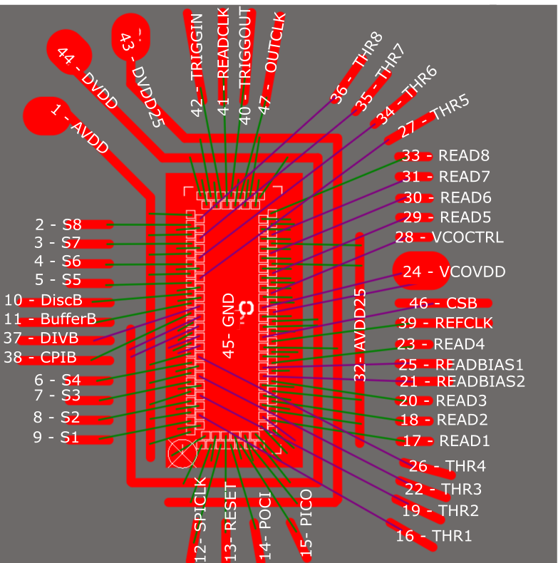
Wire bonded Testing Board
Four new pads were added to the chip layout:
CSB functions as the local reset for SPI communication only.
OUTCLK replaces the functionality of REFCLK on PSEC5.
REFCLK on PSEC6 is a reference clock for the PLL circuit.
CPIBIAS and DIVBIAS are two additional biasing voltage for a charge pump and the clock divider circuit, respectively.
Location of the pads was modified and a new footprint for the PCB was necessary to facilitate wire bonding.
See Appendix 1 for pad identification on the footprint.
Figure 1 PSEC6 footprint and wire bonding diagram

Slide 5
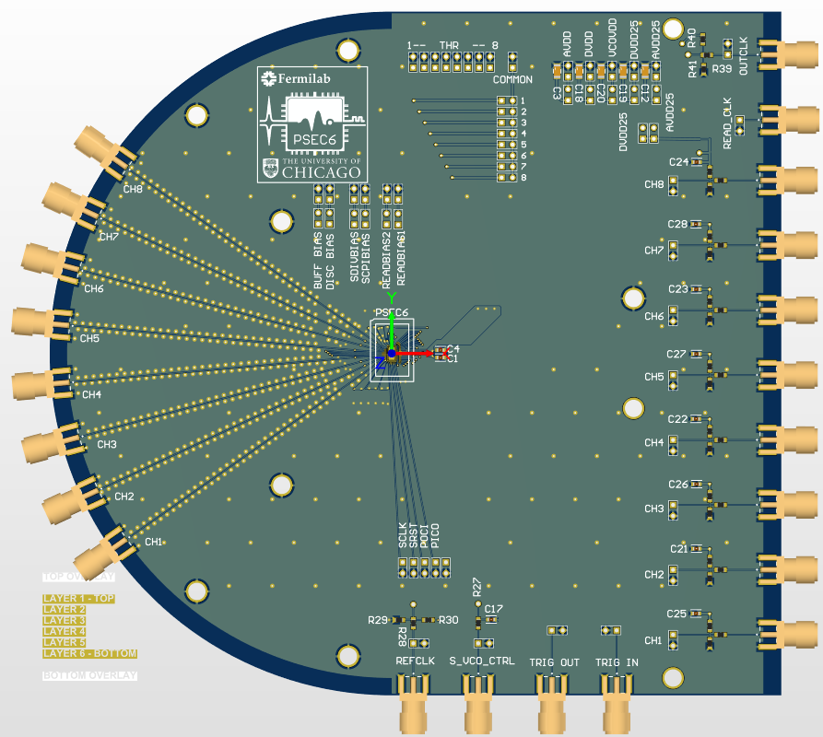
Wire bonded Testing Board
Both boards, wire bonded and packaged chip have
an additional SMA connector, needed for OUTCLK, and
two extra pin headers on each power and biasing voltage connection to measure current.
Figure 2 PSEC6 wire bonded COB

Slide 6
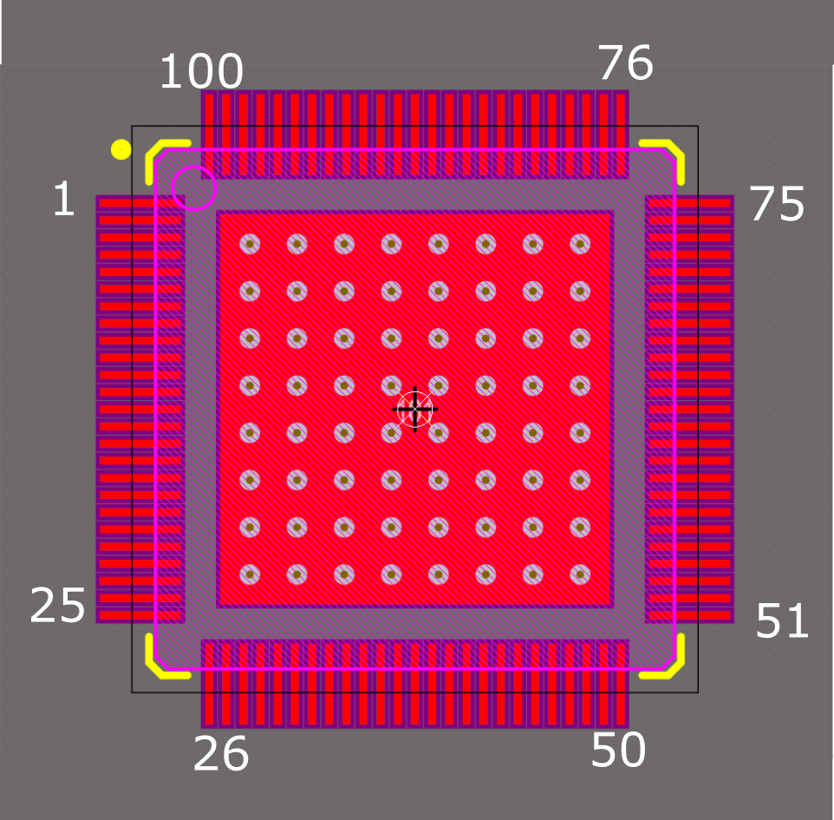
Packaged Testing Boards
A 12mmx12mm 100 lead open cavitiy QFN package was used.
Model QP-QFN100-12MM-.4MM.
See Appendix 2 for pin identification information
Figure 3 PSEC6 packaged chip footprint

Slide 7
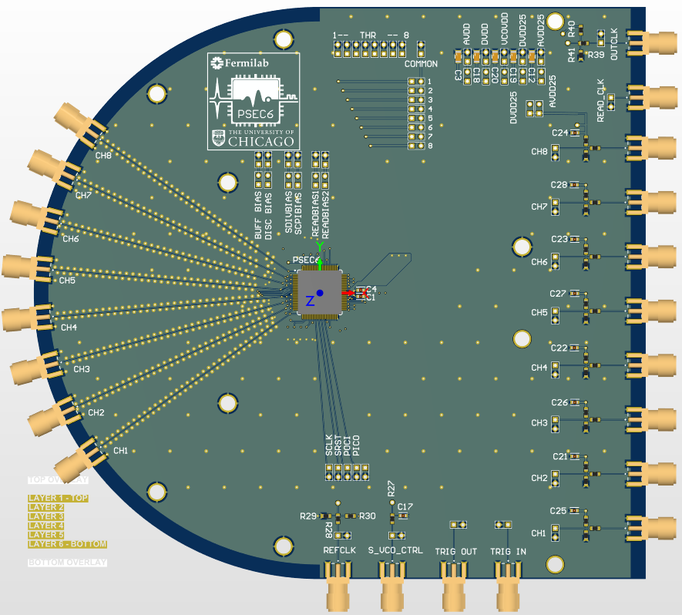
Packaged Testing Boards
Figure 4 Packaged PSEC6 testing board.

Slide 8
The Multiple-Output Voltage Generator
The multiple-output voltage generator generates 12 reference voltages, and 3 level of power voltages. It is conformed by three main components:
a power and biasing board,
a digital device (microcontroller, microprocessor, or FPGA),
and a graphical user interface (GUI).
Power
GUI
Digital Device
Power and Biasing Board Device
Ref voltages
PSEC6
Control
Figure 5 Multiple-output voltage generator block diagram.

Slide 9
Power and Biasing Board
The board generates twelve 0-5V reference voltages using DAC70501 IC.
The DACs are controlled with I2C or SPI.
DACs are divided into 3 Banks.
DAC Bank 3
DAC Bank 2
DAC Bank 1
Figure 6 Power and biasing board.

Slide 10
Power and Biasing Board
Provides 1.2V, 2x 2.5V and 2x 5V power voltages. Using AMS1117 voltage regulator IC.
Three ICs (TXB0108) provide 24 level shifted pins for communication.
These ICs were are not good with long wires and traces.
The board can be battery powered.
Power outputs
Level Shifter
Figure 7 Power and biasing board.

Slide 11
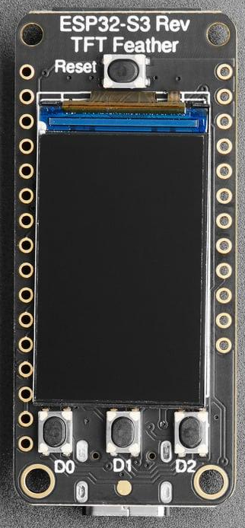
Digital Device for the Multiple-Output Voltage Generator System
The system requires a digital device (microcontroller, microprocessor, or FPGA) to interface between the GUI in the computer and the hardware (DACs) on the power and biasing board and the PSEC6 chip.
The Adafruit Feather ESP32-S3 RevTFT. It uses UART to communicate with the GUI, I2C to control the DACS, and SPI to send commands to PSEC6. See appendix 3 for pins used for I2C and SPI
Hardware description to implement I2C on an FPGA is being developed.
Figure 8 Adafruit ESP32-S3 TFT feather board

Slide 12
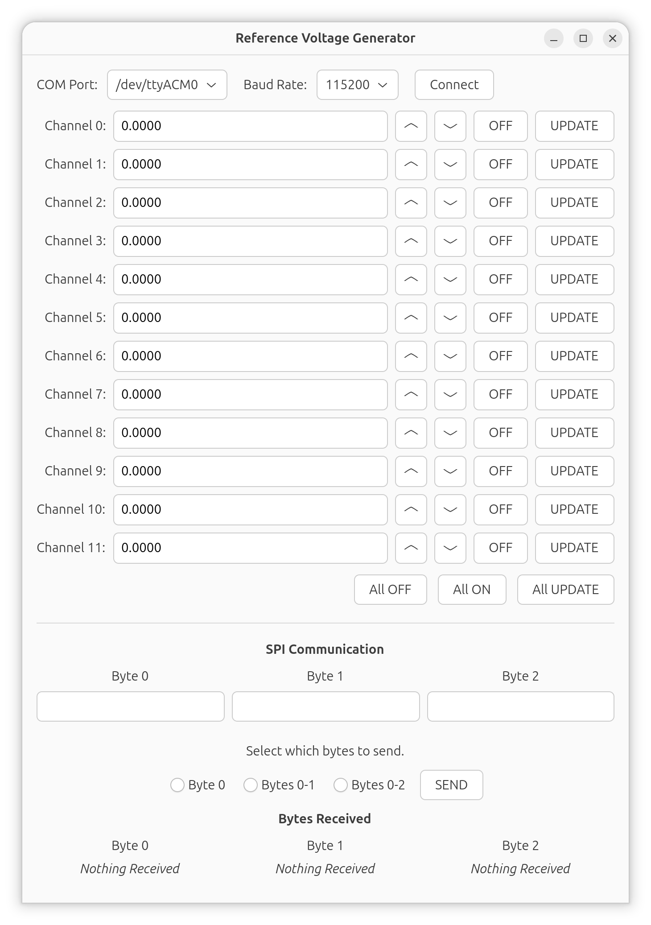
Graphical User Interface
The GUI was written in C using GTK4, a Linux-based widget library.
It was compiled for Windows and Linux OS.
When running it on Windows all .dll files must be on the same folder as the executable.
It sends the data through RS232 port.
It has three main sections
COM port configuration,
Channel voltage adjustment, and
SPI communication
Figure 9 Graphical User Interface

Slide 13
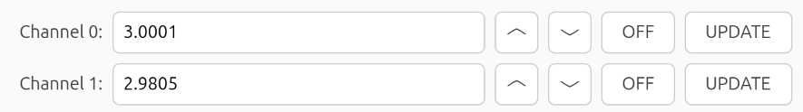
Graphical User Interface
The channels represent the reference voltage to be generated.
In the text box get a floating-point voltage value between 0 and 5V.
The up and down arrows, increase or decrease the voltage by 100µV.
The off button sends a command to the DAC to connect its output to ground through an internal resistor.
The UPDATE button sends the command to set the DAC output to the current voltage value on the textbox.
Figure 10 Channel control on GUI.

Slide 14
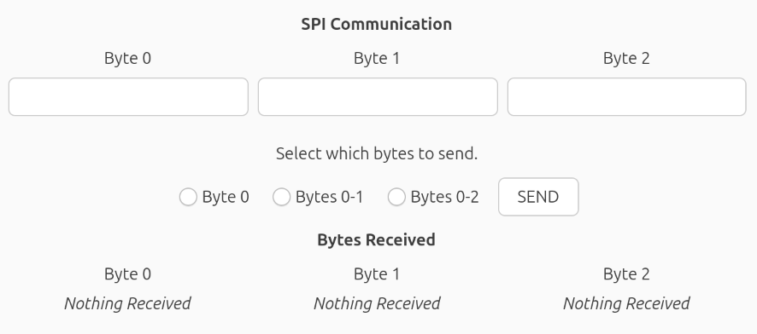
Graphical User Interface
The SPI communication section represents the communication protocol of the digital device.
It can send up to three bytes in a single click.
The data is written as hexadecimal value.
If there is a reading command, data received will be display on the labels at the bottom.
Figure 10 SPI on the GUI.

Slide 15
Cost Comparison of Testing Setup
PSEC5 (Summer 2025)
Item | Unit Cost | Quantity | Total
NI PIXe-1662Q Chassis | $3450 | 1 | $3,450
NI PXIe-4141 SMU | $20,841 | 1 | $20,841
NI PXIe-4140 SMU | $12,350 | 1 | $12,350
 |  | Total | $36,641
PSEC6 (Summer 2026)
Item | Unit Cost | Quantity | Total
PCB | $70 | 1 | $70
DAC | $6.04 | 12 | $72.48
Adafruit ESP32-S3 | $24.95 | 1 | $24.95
Level Shifter | $2.06 | 3 | $6.18
0805 Capacitors | $0.67 | 24 | $16.08
0805 resistors | $0.1 | 12 | $1.2
Voltage regulators | $0.3 | 7 | $2.1
 |  | Total | $192.99

Slide 16
Conclusions
Two PCBs were designed to test a bare die wire bonded to the board and a packaged chip soldered.
A low-cost, open-source, and user-friendly testing setup was designed to test the PSEC6. It can run on batteries.
It features a multiple-output voltage generator capable of supplying 1.2V, 2.5V, and 5V supply voltages and twelve adjustable reference voltages.
It features a GUI to adjust the reference voltages and to send hexadecimal commands to PSEC6 to operate it.
Level shifters did not work as expected using jumper wires to connect to them. They are better for onboard connection.
The cost of the testing setup was reduced from ~$36,000, when PSEC5 was tested, to ~$200.

Slide 17
Future Work
Testing of PSEC6
Suggested modification to the power and biasing board.
Fix digital channel labels.
Replace level shifters with a more powerful chip that handles longer cables and traces and lower voltage level for the input. (TSB0108E??)
Replace through hole capacitor by SMD.
Add onboard on/off physical switches.
Remove pin headers place holder next to the DACs.
Add more and better distributed ground pins.
Add a header connector and a switch to select between on-board battery and external power supply.
Add pull up resistors for the software I2C pins or a MUX to use a single I2C bus.
Add current sensing capabilities (nAs to ~10mA) for the output voltages.

Slide 18
Acknowledgement
To the University of Chicago and Fermilab PSEC5 and PSEC6 research group.
This manuscript has been authored by FermiForward Discovery Group, LLC under Contract No. 89243024CSC000002 with the U.S. Department of Energy, Office of Science, Office of High Energy Physics.
This work was supported in part by the U.S. Department of Energy, Office of Science, Office of Workforce Development for Teachers and Scientists (WDTS) under the Visiting Faculty Program (VFP).

Slide 19

Thank you for your attention!
Questions?

Slide 21
Appendix 1 – Wire Bonded Footprint Identification
Designator | Chip label | Pads Connected to designator number
1 | AVDD | W1, W5, W9, W13, W29, W33, W37, W41, W45
2 | SIGNAL 8 | W3
3 | SIGNAL 7 | W7
4 | SIGNAL 6 | W11
5 | SIGNAL 5 | W15
6 | SIGNAL 4 | W31
7 | SIGNAL 3 | W35
8 | SIGNAL 2 | W39
9 | SIGNAL 1 | W43
10 | DISCBIAS | W17
11 | BUFFERBIAS | W19
12 | SPICLK | S5
13 | RESET | S6
14 | POCI/MISO | S7
15 | PICO/MISO | S9
16 | THRES1 | W42
17 | READOUT1 | E3
18 | READOUT2 | E7
19 | THRES2 | W38
20 | READOUT3 | E11
21 | READBIAS2 | E12
22 | THRES3 | W34
23 | READOUT4 | E15
24 | VCOVDD | E25, E26

Slide 22
Designator | Chip label | Pads Connected to designator number
25 | READBIAS1 | E14
26 | THRES4 | W30
27 | THRES5 | W14
28 | VCOCTRL | E29
29 | READOUT5 | E33
30 | READOUT6 | E37
31 | READOUT7 | E41
32 | AVDD25 | E5, E9, E35, E39
33 | READOUT8 | E45
34 | THRES6 | W10
35 | THRES7 | W6
36 | THRES8 | W2
37 | DIVIBIAS | W20
38 | CPIBIAS | W21
39 | REFCLK | E19
40 | TRIGGEROUT | N7
41 | READCLK | N8
42 | TRIGGERIN | N9
43 | DVDD25 | S3, S11, E18, N3, N11
44 | DVDD | W22, W24, S1, S13, E22, E23, N1, N13
 |  | W(4, 8, 12, 16, 18, 23, 25, 26, 27, 28, 32, 36, 40, 44), S(2, 4, 8, 10, 12),
45 | GND | E(1, 2, 3, 4, 6, 8, 10, 13, 16, 17, 21, 24, 27, 28, 30, 31, 32, 34, 36, 38, 40, 42, 43, 44), N(2, 4, 6, 10, 12)
46 | CSB | E20
47 | OUTCLK | N5

Slide 23
Appendix 2 – Package Pins Identification
Pin # | Name | Pin# | Name | Pin# | Name | Pin# | Name
1 | THRES7 | 14 | DVDD | 27 | THRES1 | 40 | GND
2 | AVDD | 15 | DVDD | 28 | AVDD | 41 | PICO/MOSI
3 | SIGNAL 7 | 16 | AVDD | 29 | GND | 42 | GND
4 | THRES6 | 17 | SIGNAL4 | 30 | GND | 43 | DVDD25
5 | AVDD | 18 | THRES4 | 31 | DVDD | 44 | GND
6 | SIGNAL6 | 19 | AVDD | 32 | GND | 45 | DVDD
7 | THRES5 | 20 | SIGNAL3 | 33 | DVDD25 | 46 | GND
8 | AVDD | 21 | THRES3 | 34 | GND | 47 | GND
9 | SIGNAL5 | 22 | AVDD | 35 | SPICLK | 48 | GND
10 | DISCBIAS | 23 | SIGNAL2 | 36 | GND | 49 | GND
11 | BUFFERBIAS | 24 | THRES2 | 37 | RESET | 50 | GND
12 | DIVBIAS | 25 | AVDD | 38 | GND
13 | CPIBIAS | 26 | SIGNAL1 | 39 | POCI/MISO

Slide 24
Appendix 2 – Package Pins Identification
Pin # | Name | Pin# | Name | Pin# | Name | Pin# | Name
51 | READOUT1 | 64 | GND | 77 | GND | 90 | GND
52 | AVDD25 | 65 | VCOVDD | 78 | GND | 91 | TRIGGERIN
53 | READOUT2 | 66 | VCOVDD | 79 | GND | 92 | GND
54 | AVDD25 | 67 | VCOCTRL | 80 | GND | 93 | DVDD25
55 | READOUT3 | 68 | GND | 81 | DVDD | 94 | GND
56 | READBIAS2 | 69 | READOUT5 | 82 | GND | 95 | DVDD
57 | READBIAS1 | 70 | AVDD25 | 83 | DVDD25 | 96 | GND
58 | READOUT4 | 71 | READOUT6 | 84 | GND | 97 | GND
59 | DVDD25 | 72 | AVDD25 | 85 | OUTCLK | 98 | THRES8
60 | REFCLK | 73 | READOUT7 | 86 | GND | 99 | AVDD
61 | CSB | 74 | GND | 87 | TRIGGEROUT | 100 | SIGNAL8
62 | DVDD | 75 | REAOUT8 | 88 | GND
63 | DVDD | 76 | GND | 89 | READCLK

Slide 25
Appendix 3 – Adafruit ESP32-S3 feather pins for I2C and SPI
I2C
DAC Bank | ESP32-s3 pins
1 | SDA | 3
 | SCL | 4
2 | SDA | 5
 | SCL | 6
3 | SDA | 9
 | SCL | 10
SPI
Function | ESP32-s3 pins
PICO/ MOSI | 35
SCK | 36
POCI / MOSI | 37

