Slide 1


Testing PSEC5, an 8-Channel, 40 Gs/s waveform digitizing ASIC with a 204 ns long buffer
Andrew Arzacª , Evan Angelico^{d} , Ahan Dattaª , Troy England^{b}, Alexander Fahey^{c}, Henry J. Frischª , Nathan Gehlª , Mary Heintzª , Ava Lalichª , Eric Oberlaª, Nathaniel J. Pastika^{b} , Jinseo Park^{d} , Hector D. Rico-Aniles^{c} , Paul M. Rubinov^{b} , Maresa Wyndª , Y.M. Richmond Yeungª,
ªEnrico Fermi Institute, the University of Chicago, 933 East 56th Street, 60637, Chicago, IL, USA
^{b}Fermi National Accelerator Laboratory, 60510, Batavia, IL, USA
^{c}North Central College, 30 N. Brainard Street, 60540, Naperville, IL, USA
^{d}Stanford University, 450 Jane Stanford Way, 94305, Stanford, CA, USA
Ref: PSEC5 Physical Verification, H. D. Rico-Aniles et al.

Slide 2
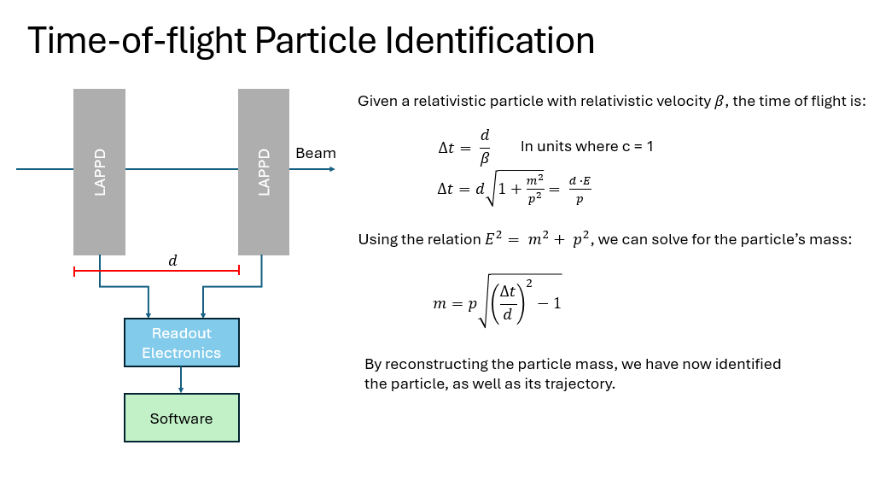

Slide 3
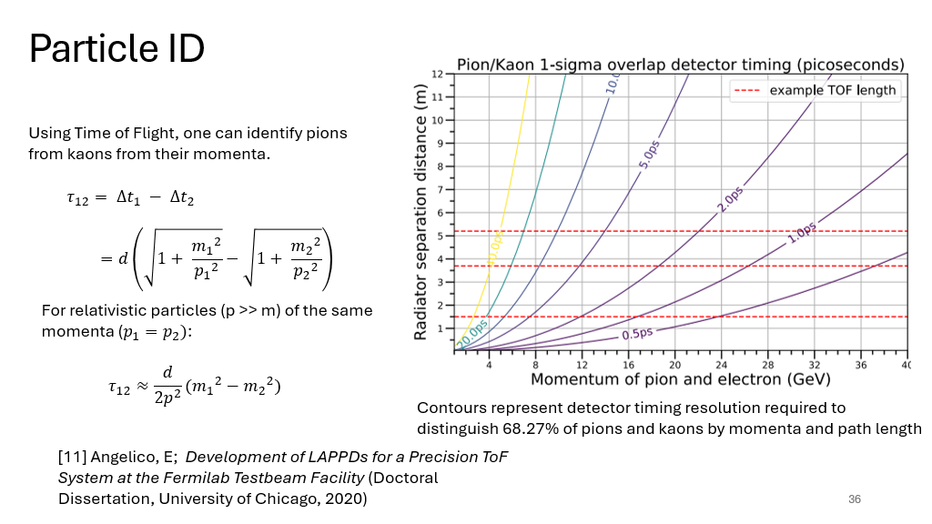

Slide 4
Outline
PSEC5 Overview
Current Test Setup
Initial test setup results
Problems and Resolutions for PSEC6
Design of a Modular Kria Readout system
Moving forwards

Slide 5
PSEC5
8 Channel Waveform Sampling ASIC
Switched Capacitor Array (SCA) Architecture
4 Fast, 1 Slow buffer
Fast sampling rate and long buffer
Low power
Pathfinder Chip
Process | TSMC 65 nm
Fast Buffer Sampling Rate | 40 GSa/s
Slow Buffer Sampling Rate | 5 GSa/s
Buffer Length | Fast: 6.4ns Slow: 204.8ns
Multi Hit Capability | 4 fast buffers of 1.6 ns
Analog Bandwidth | >4 GHz
Channels/Chip | 8
Area | 2.4 mm²
Power | ~ 20 mW / Channel
Goal: < 5 ps time resolution

Slide 6
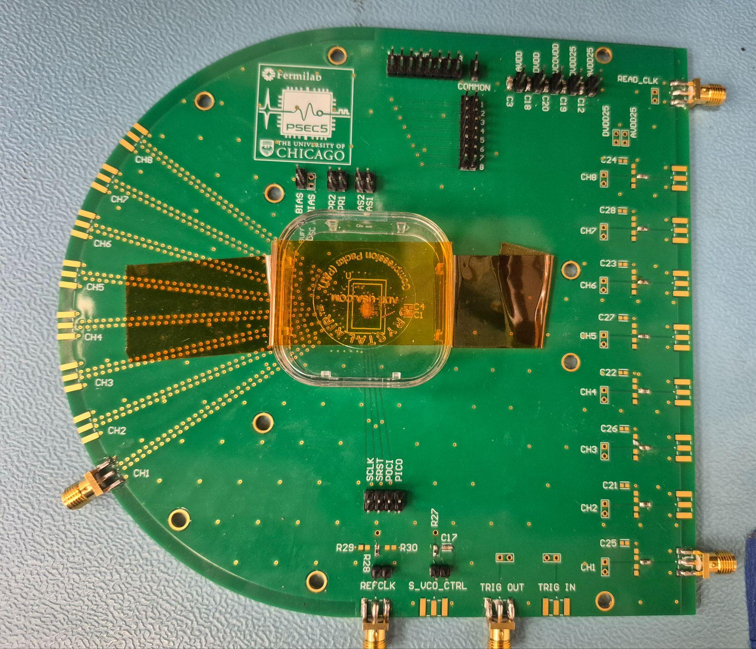
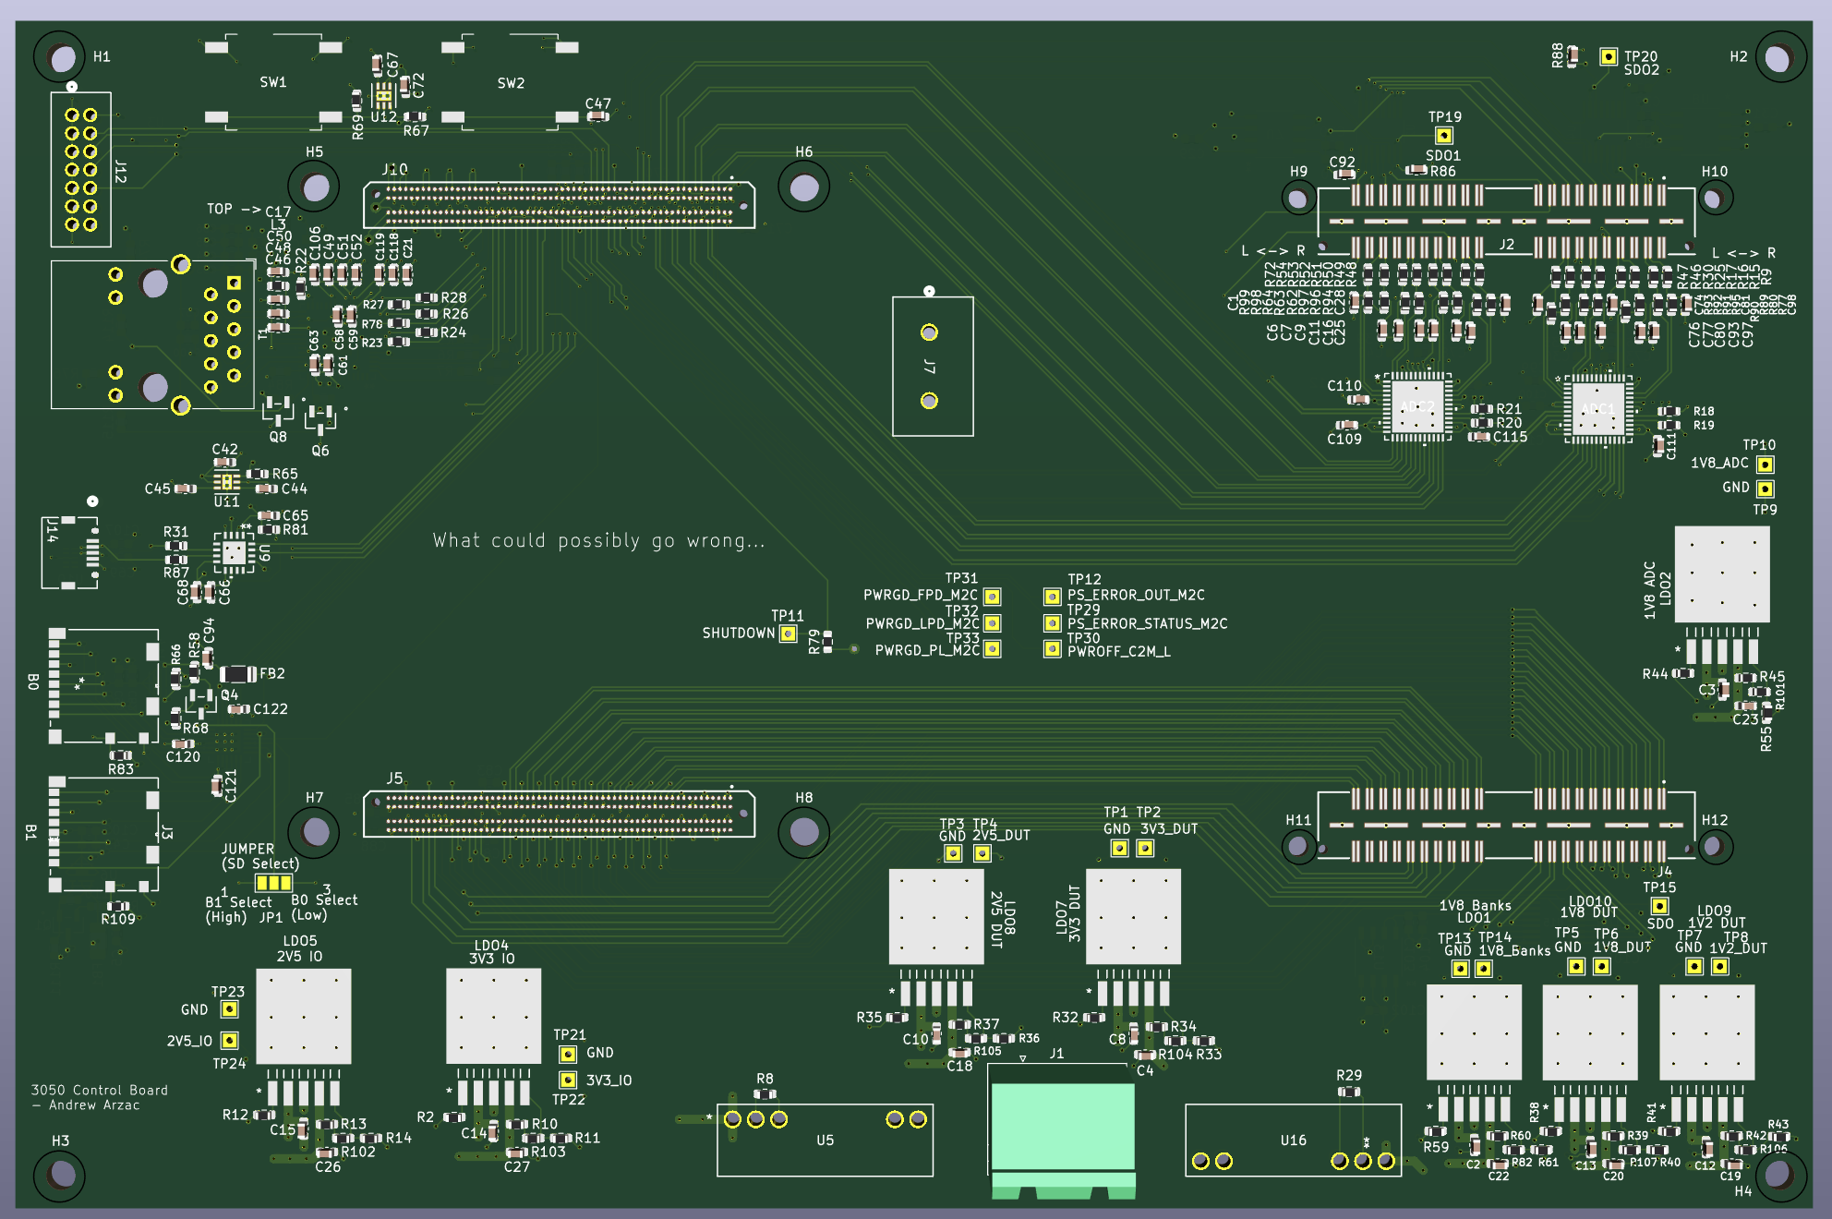
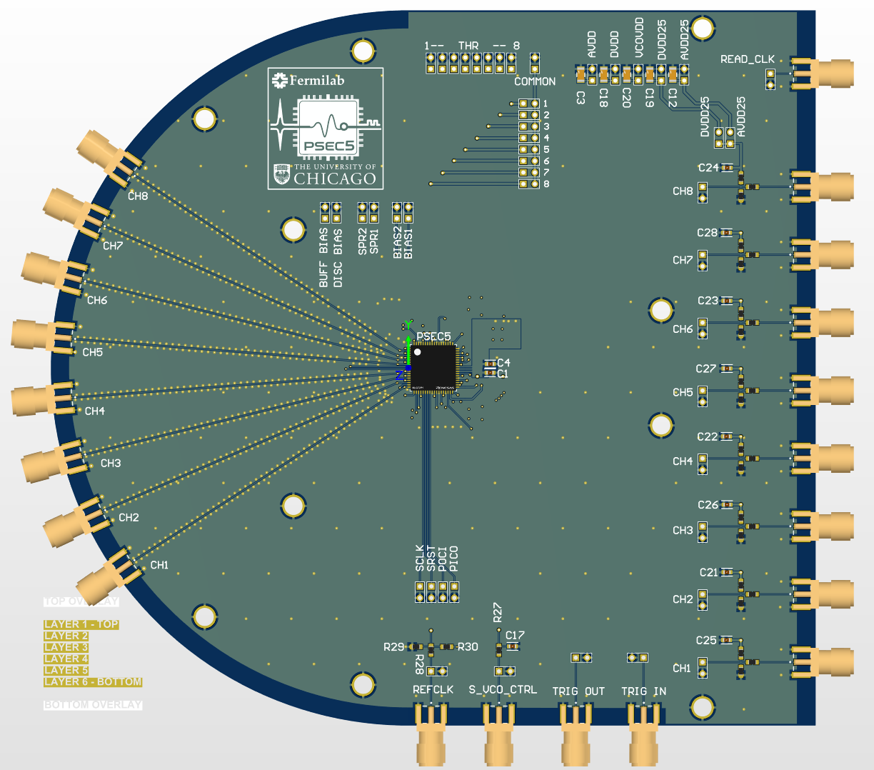
Current Test Systems
Chip on Board (COB)
PSEC5 Wire Bonded onto PCB
Packaged Chip on Board
PSEC5 in SMD package on Board
Modular Readout System using Kria K26 FPGA
Initial test setups to test basic functionality of PSEC5

Slide 7
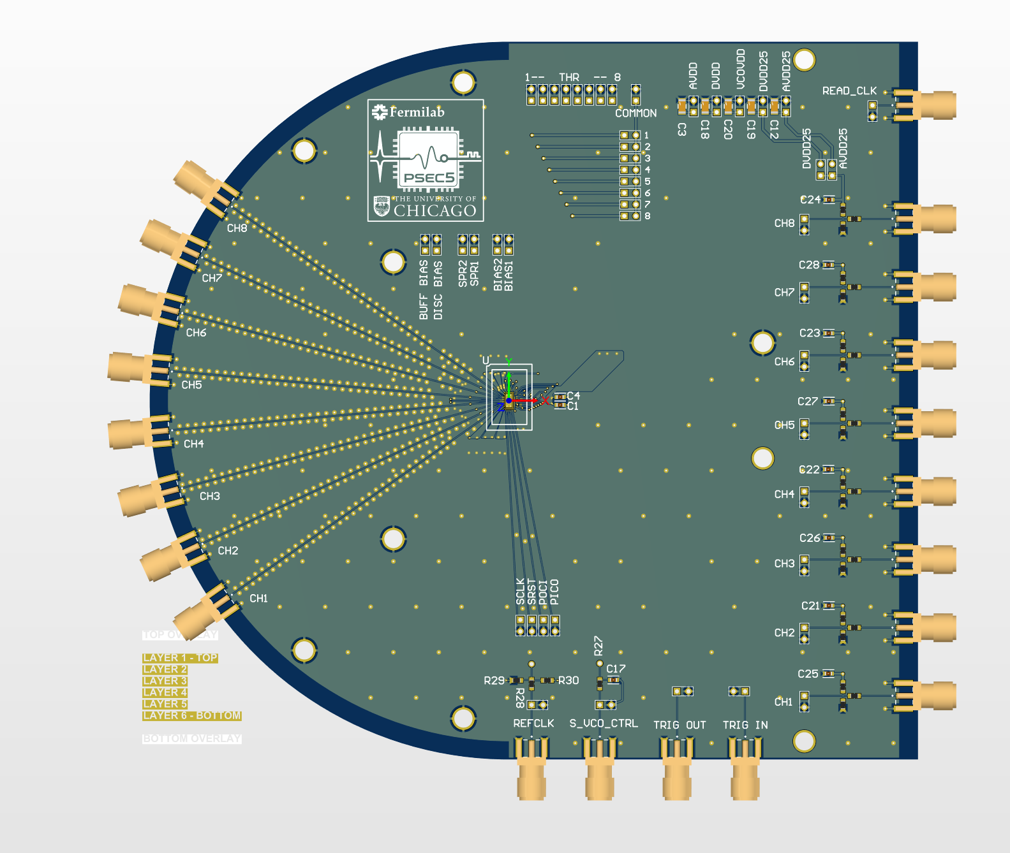
Testing PSEC5
PSU’s
Clocks
FUNCTION GENERATOR
SCOPE
(ADC)
PULSE GENERATOR
(Channel Input)
FPGA required for readout
Can’t test external PLL on PSEC5
Arduino
Designed by Paul Rubinov^{b}

Slide 8
Tests for PSEC5
PSEC5 is a pathfinder chip. The following are some of the main tests to confirm PSEC5’s technology before PSEC6.
Power Test
SPI Testing
Signal Buffer Testing
Controllable Clock Dividers
VCO
First stage Dlock Divider
SCA Readout
Status | Results
 | Tested and Works
 | Tested and Doesn’t Work
 | Currently Testing

Slide 9
Power Test
The board has 5 different supply voltages: AVDD, DVDD, VCOVDD, AVDD25, and DVDD25.
On the PCB
  DVDD ←→ AVDD shorted
  DVDD25 ←→ AVDD25 shorted
Wirebond shorts
  DVDD25 connected to DVDD wirebond N3.
  VCOVDD connected to DVDD wirebond E17.
  AVDD connected to DVDD wirebond N13.
Supply | Nominal Voltage (V) | Current (mA) | Power (mW)
AVDD | 1.2 | 0.6 | 0.72
DVDD | 1.2 | 2.0 | 2.4
VCOVDD | 1.2 | ~6.09 | 7.308
DVDD25 | 2.5 | 0.05 | 0.125
AVDD25 | 2.5 | 4.34 | 10.85
The quiescent power consumption is ~21.4mW

Slide 10
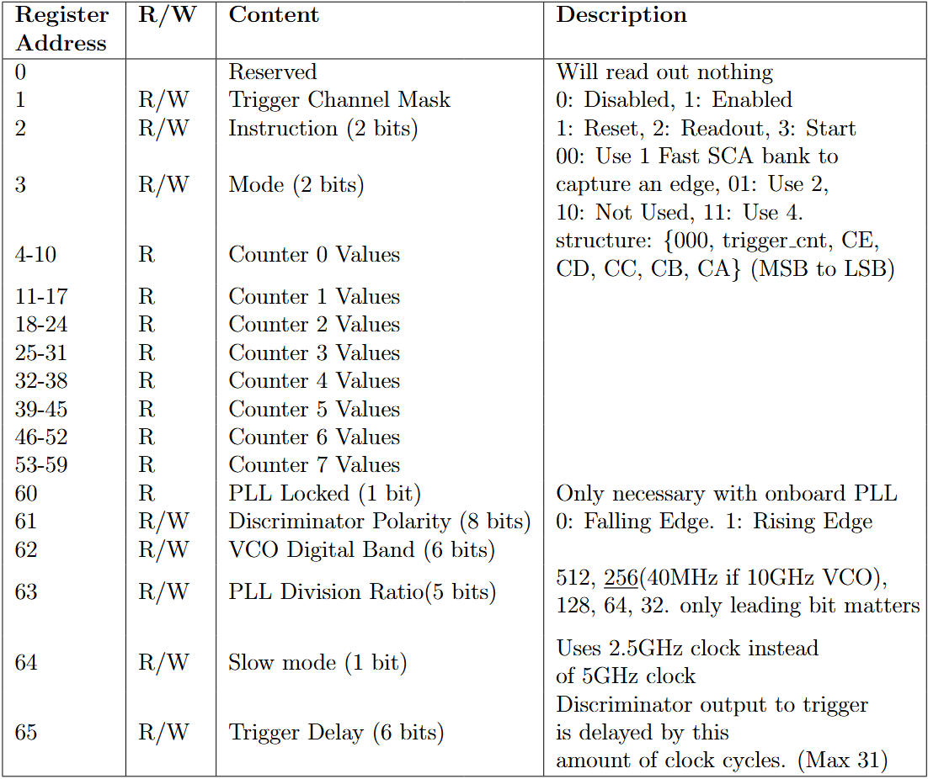
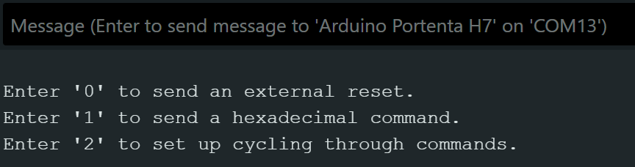
Digital Control (SPI) Testing
The SPI controller was an Arduino Pro Portenta H7 board.
Sends 2 byte commands in hexadecimal. Ex: 3F01
Arduino Control interface with SPI
Data can be written to R/W registers
Data can be read from all registers
PSEC5 Register Map

Slide 11
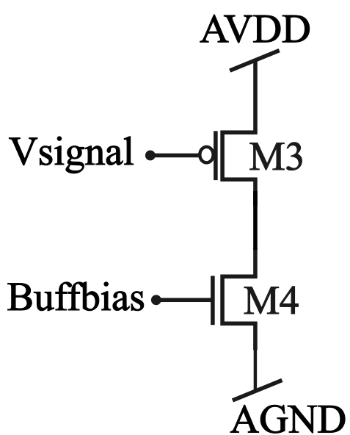
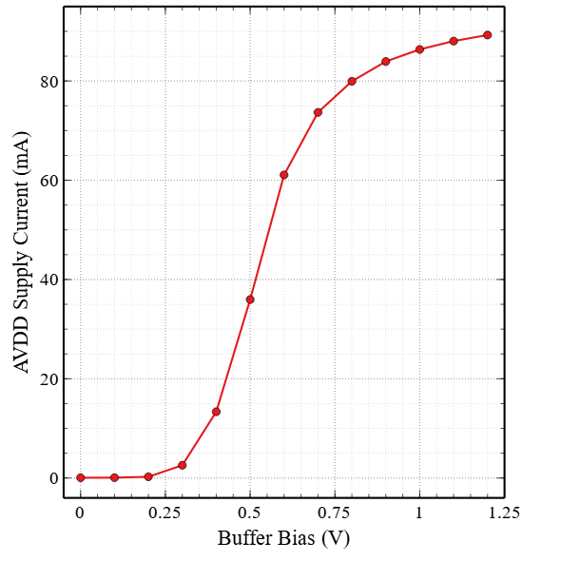
Signal Buffer Power Test
Source follower buffer to interface input signal with SCA’s
4 fast buffers (~5GHz), 1 slow buffer (~2GHz) per channel
Powered by AVDD, biased via Buffer Bias pin
Signal buffer schematic.
When Biased, AVDD quiscent current increases by ~ 85mA
Buffers assumed to be working as they draw current when biased

Slide 12
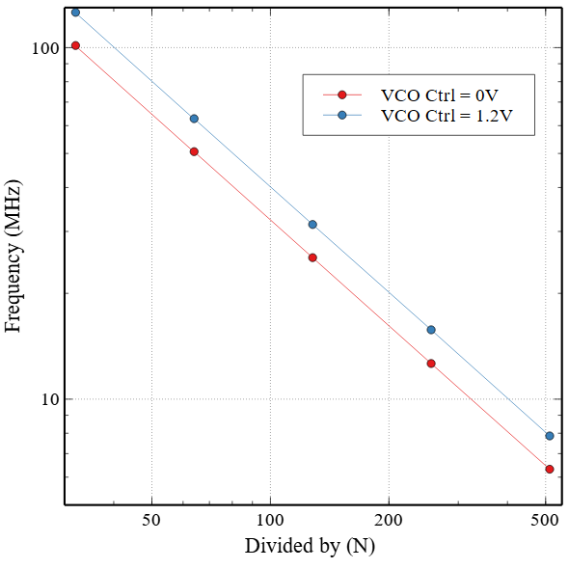
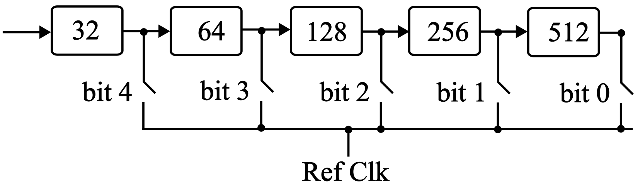
Controllable Clock Divider Test
These are digitally controlled through SPI
For verification of VCO
  SPI Clock reliant on division speed
VCO/16
VCO Frequency with divisions 32, 64, 128, 256, 512
The 5 controllable clock dividers work properly

Slide 13
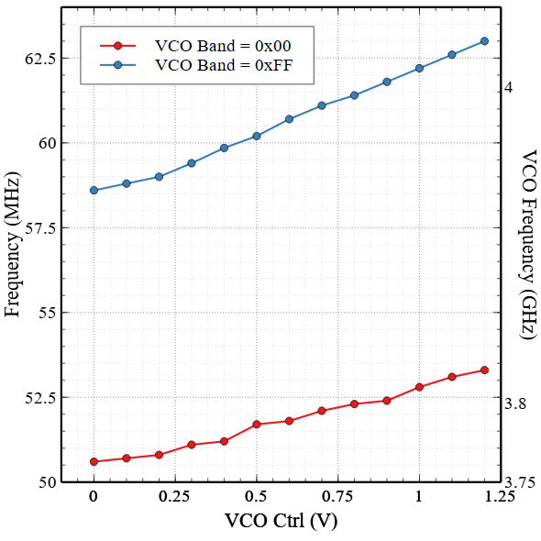
VCO Results
VCO Frequency Controlled By:
VCO Control Voltage
  Pin on Chip
Digitally Controlled Capacitors
  SPI
Control Capacitors OFF
Controls of VCO work, VCO is Robust
Max Frequency ~ 4GHz, simulation shows 10GHz.
*First divider likely failing
Control Capacitors ON
VCO Frequency Range: 3.2 GHz - 4.04 GHz

Slide 14
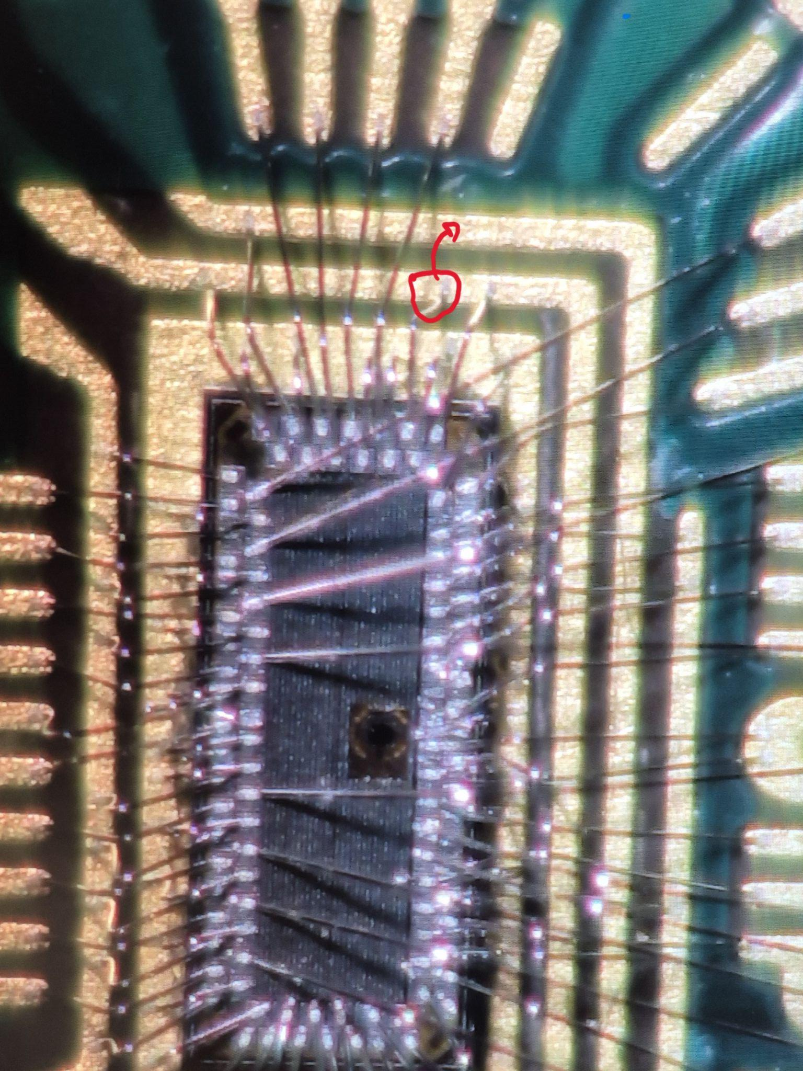
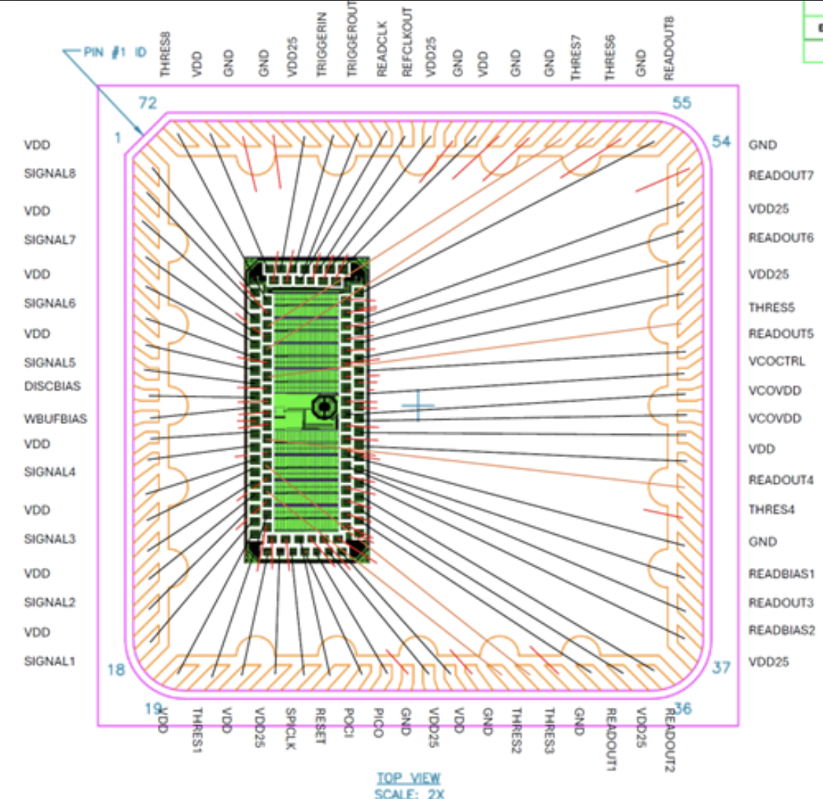
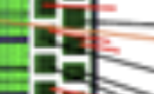
Testing readout with PSEC5
Testing bottlenecked by wire bond shorts related to readout
  COB has short between BufferBias ←→ GND
  PCOB has short between READBIAS1 ←→ GND
Readout test ready to be performed
New batch of PSEC5 currently being wirebonded to packages by QP technologies.
Zoom in of wire bonds on COB, short on BufferBias
Readout and SCA’s ready to be tested, waiting on fixed wire bonds and soldering. ETA for new boards and wire bonds ~ 1-2 weeks
Original wire bonding diagram with short on READBIAS

Slide 15
PSEC5 Status/Results + Fixes for PSEC6
Working
Not Working
Power up with 21.4mW quiescent current
SPI communication works
  Data reading/writing to registers
  Start command draws current
Full Control over VCO works
  Digitally Controlled Capacitors
  Tuning voltage from external pin
Buffer is assumed to be working as it draws current when biased
While VCO controls work, and the VCO is robust, the output frequency is only ~4GHz
Wirebond shorts along biases preventing readout
  New chips are currently being wire bonded with corrected bonding diagram, should be back ~ 1 - 2 weeks
Main Fixes for PSEC6
New robust clock divider design to keep first division
Revised digital block to make SPI more standard

Slide 16
Design of a Modular Test/Readout System
FPGA based readout system
Uses AMD’s Kria K26 - Custom Zynq™ UltraScale+™ MPSoC
Customizable DUT board design
8 Channel 65MSPS ADC readout to FPGA
Kria K26 SOM
DUT Board

Slide 17
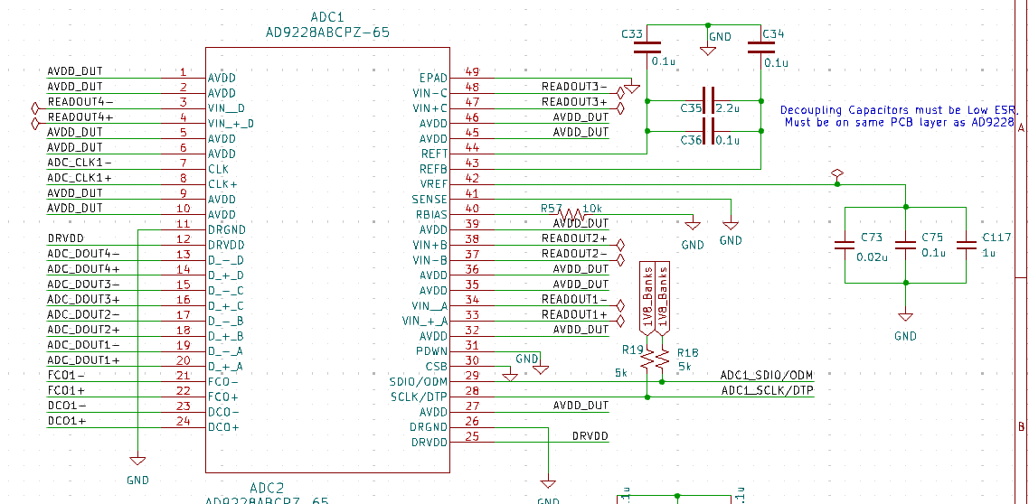
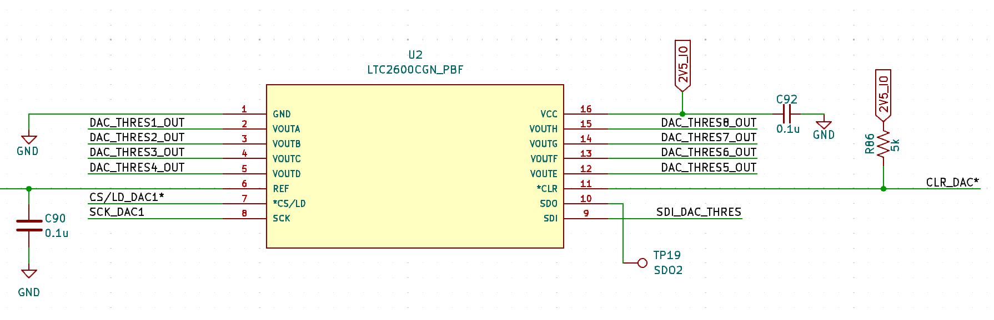
Communication To and From FPGA
DUT→ FPGA
FPGA → DUT
I/O to Kria
AD9228: Quad, 12-Bit, 65 MSPS
LTC2600CGN: 16-Bit DAC
4 IO connections to FPGA
Ethernet: Primary Data Communication
SD Card → Secondary firmware boot and OS
JTAG: Debugging
USB: Extra
Schematic of LTC2600CGN#PBF in KiCad
Schematic of AD9228 in KiCad
2x ADC’s = 8 Channles at 65MSPS
119 mW power consumption per
channel at full 65MSPS readout
Controlled through SPI from FPGA

Slide 18
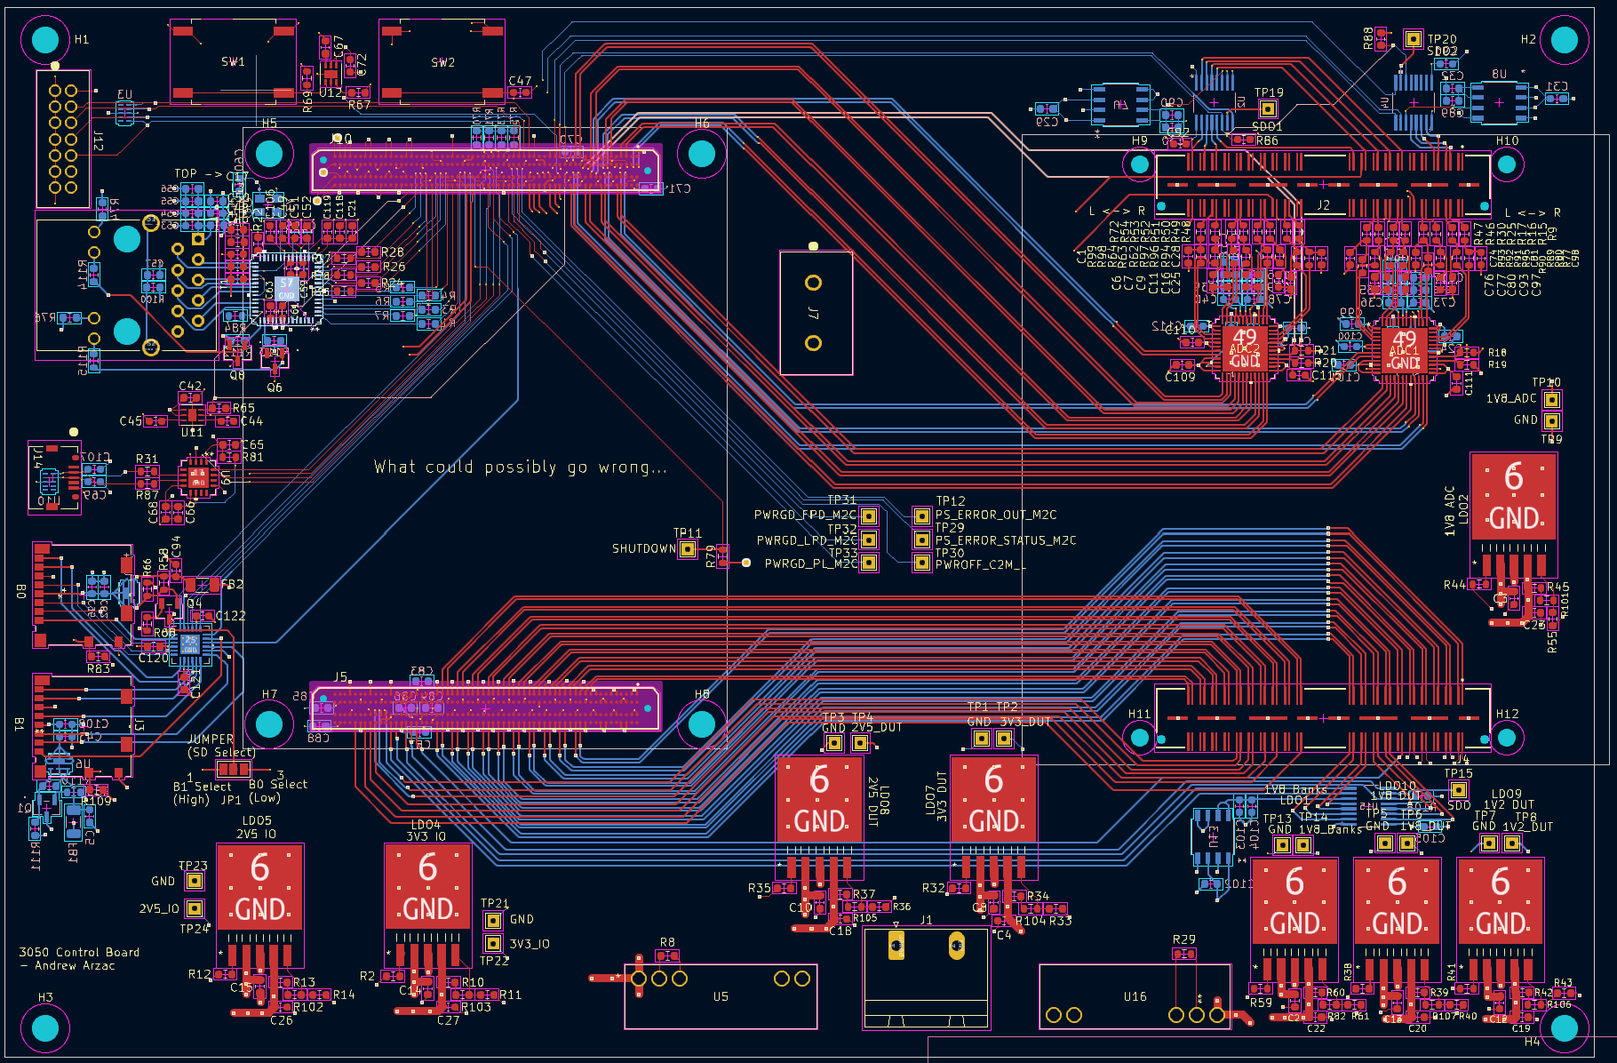
Layout + Full Connection Scheme
Connections
  DUT Card
  Power Plug
  5V Fan
  I/O to Kria
Dimensions
  1.6mm
  10 Layers
  197 x 130mm
Control Board V1 Layout

Slide 19
Readout System Typical Power Consumption
Location | Device | Typ, Max power consumption
Control Board | FPGA (Kria K26) | 7.5 W (typical)
Control Board | External ADC | 119 mW x 8
Control Board | ADC LDO | 60 mW x 8
DUT Board | PSEC5 | ~ 20mW x 8
Total |  | ~ 9-10 Watts
Main Power Drawing Devices
Power is distributed from 2 buck regulators (5V and 2.5V) into LDO’s at desired voltages
DUT Boardhas its own power rails
2.7V Buck
LDO’s (1.2-2.5V)
Power Connector
5.0V Buck
LDO’s (3.3-5.0)

Slide 20
Next Steps
Broaden scope of readout system to fit future use with PSEC6
Develop firmware for readout system in Vivado
Test functionality of PSEC6
Integrate system with PSEC6 and LAPPD’s for readout at FTBF
Work on calibration and readout software for waveform reconstruction
LAPPDs
Beam
Readout System with PSEC6
Software
Reconstructed Waveforms

Slide 21


Thank you for listening!

Slide 22
Additional Slides

Slide 23
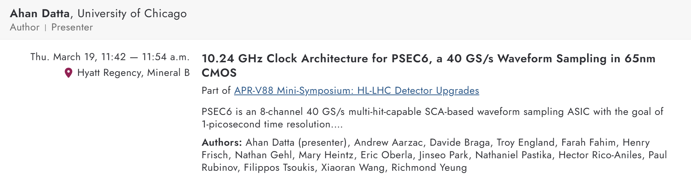
Clock Divider Fix in PSEC6
VCO was being used as single ended
LC VCO’s rarely fail, and typically do so by a little, not over half the frequency
Potential Power limiting on the layout of the power rail
Further simulation showed 1st divider failing
New Design uses power hungry but robust first divider with a CMOS → CML → CMOS buffer and is very robust
For a more detailed talk about the main upgrades with PSEC6 see:

Slide 24
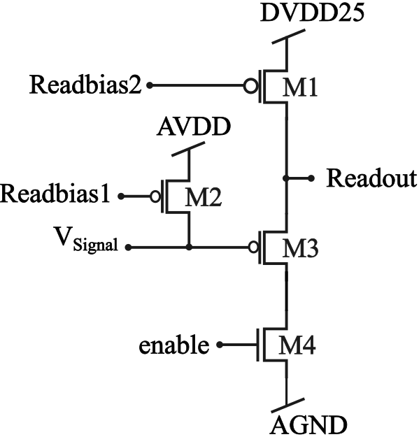
Shorts preventing Readout
Readout Buffer Schematic
Signal Buffer Schematic
Readbias1 Grounded = V_signal HIGH
Loses signal, bad for 2.5V source follower
Buffbias Grounded = V_signal floating, can’t drive SCA

Slide 25
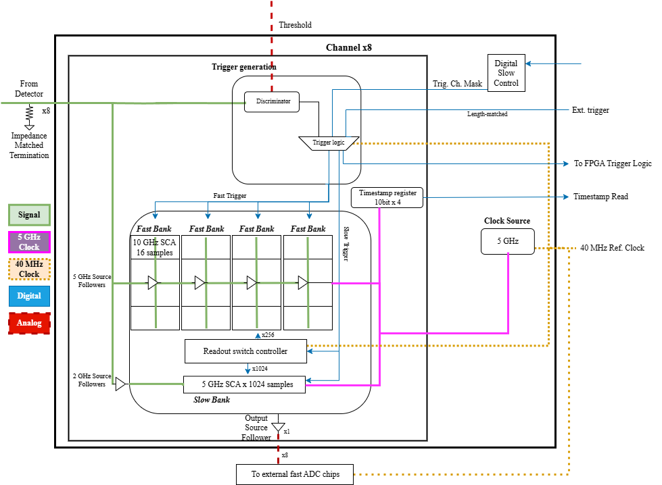
PSEC5 Functional Block Diagram

Slide 26
Differences Between PSEC4 and PSEC5
PSEC4 uses a DLL
Input clock for sampling frequency, no VCO
PSEC4 max sampling rate of 10 GSPS (40 MHz input clock)
PSEC4 uses a ring buffer to continuously sample a 256 cap SCA

Slide 27
SCA Readout Procedure
Test conditions
Set Disc. thresh to 700mV.
Set Disc. Bias and input buffer Vbias to 490mV
Set Readbias1 to 600mV
Set Readbias2 to 1.4V
Channel 1 Input signal 100kHz, 1.2Vpp, and 0.6V offset
Read Clk is 1MHz 2.5Vpp 50% duty cycle Square wave with 1.25V offset.
Procedure
Send a reset
Set the clock division ratio to divide 128 (SPI data 0x3F04)
Set the VCO digital band to 00011100 (SPI data 0x3E1C).
Set slow mode to 0 (SPI data 0x4000)
Set trigger mask to 01111111 (SPI data 0x017F)
Set mode to 00000010 (SPI data 0x0302)
Set disc polarity to 11111111 (SPI data 0x3DFF)
Send the instruction START to register 2.
Send and external trigger.
Send the instruction READOUT to register2.
Read with the oscilloscope the output of Channel 1.

Slide 28
Read Counter Registers
Reading counter registers when a READOUT instruction has not been given, they always return 0xFF.
If a READOUT instruction is given, the reference clock output goes high and the SPI is unresponsive; register cannot be read.
Sending a RESET instruction or and external RESET does not change the value 0xFF from the counter registers.
Never trigger due to failed trigger logic, and no data to read

