Slide 1

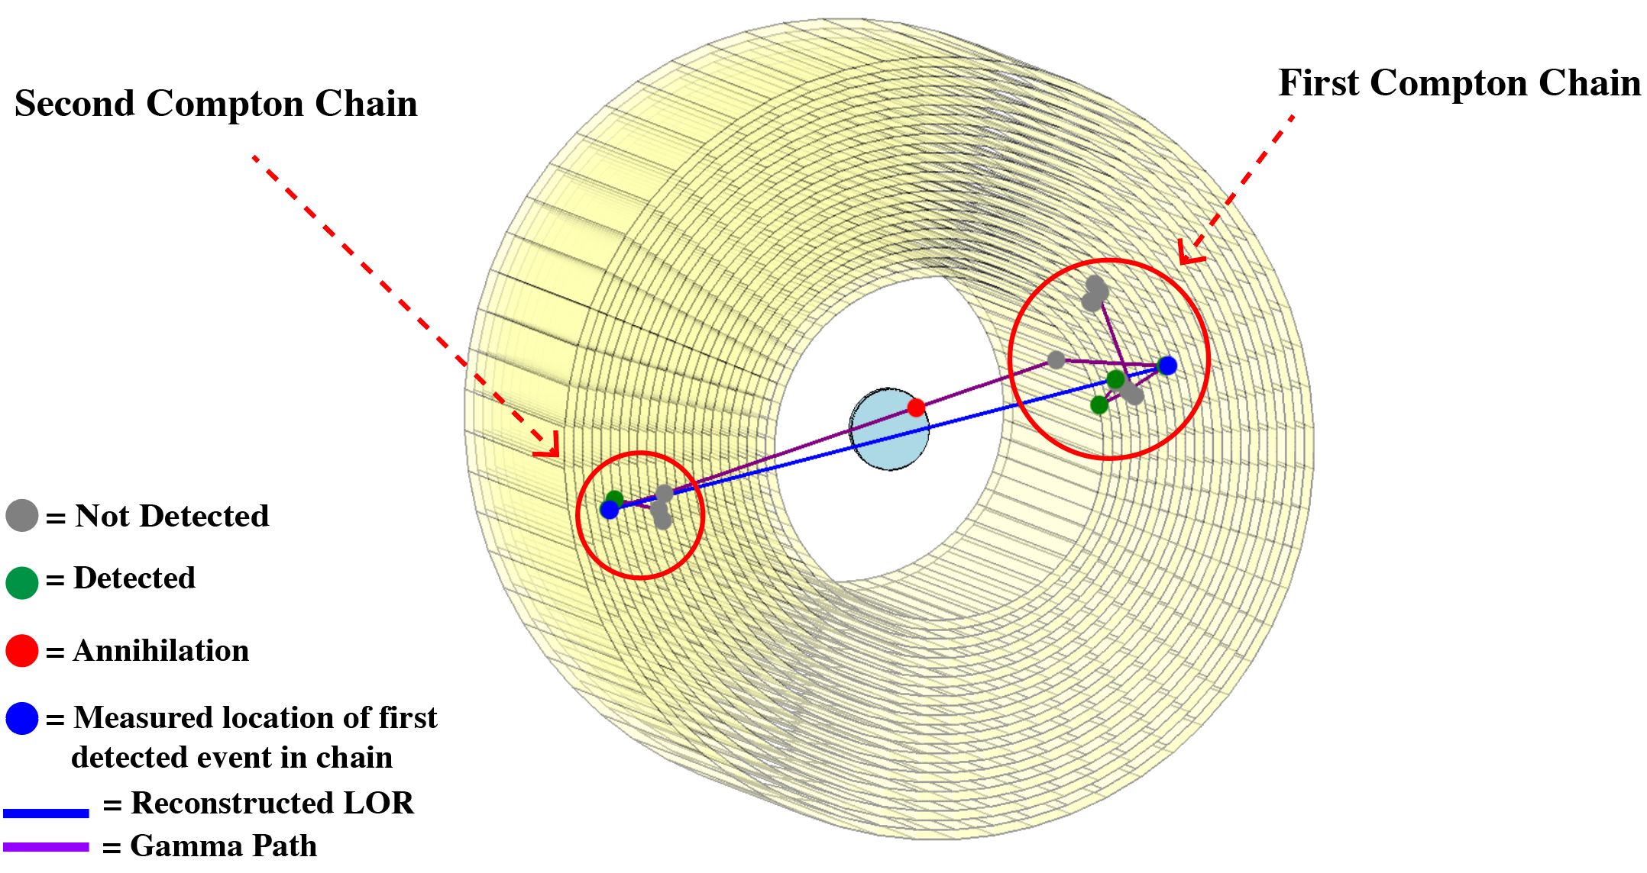
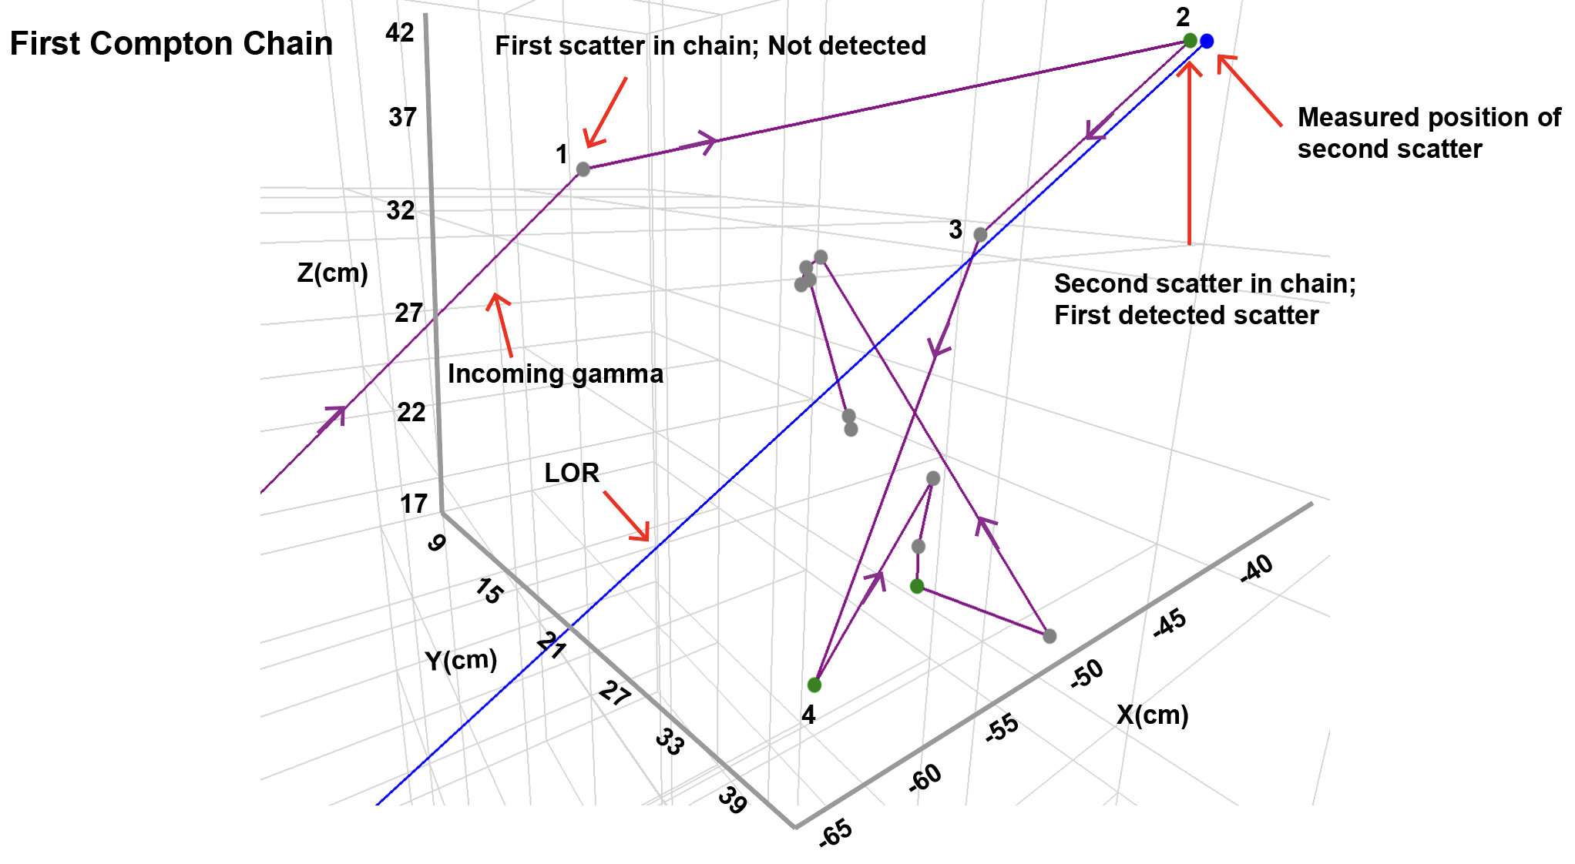
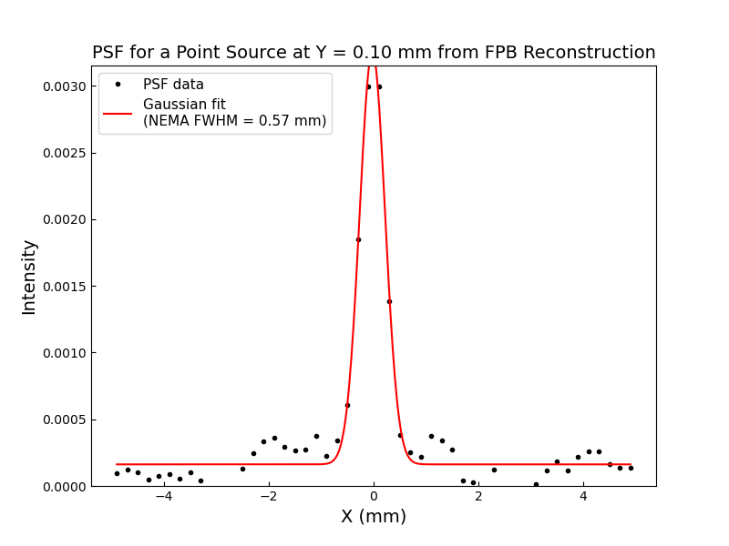
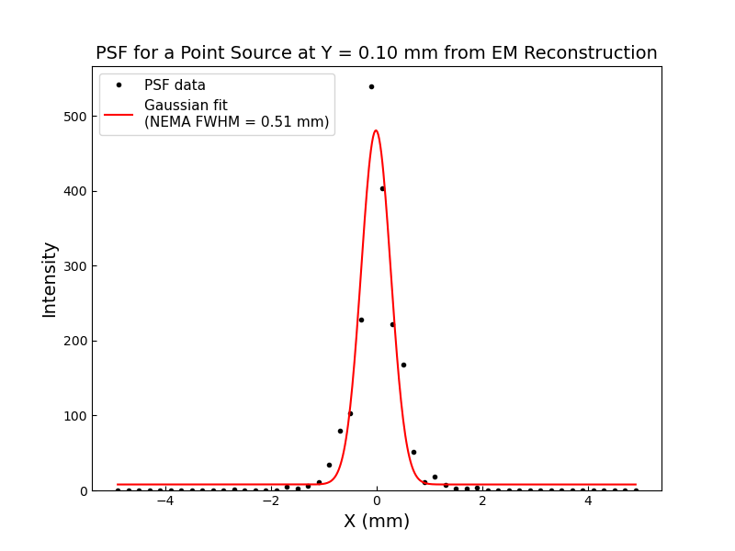
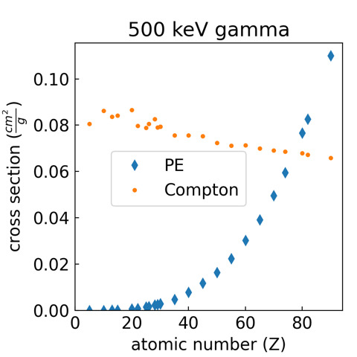
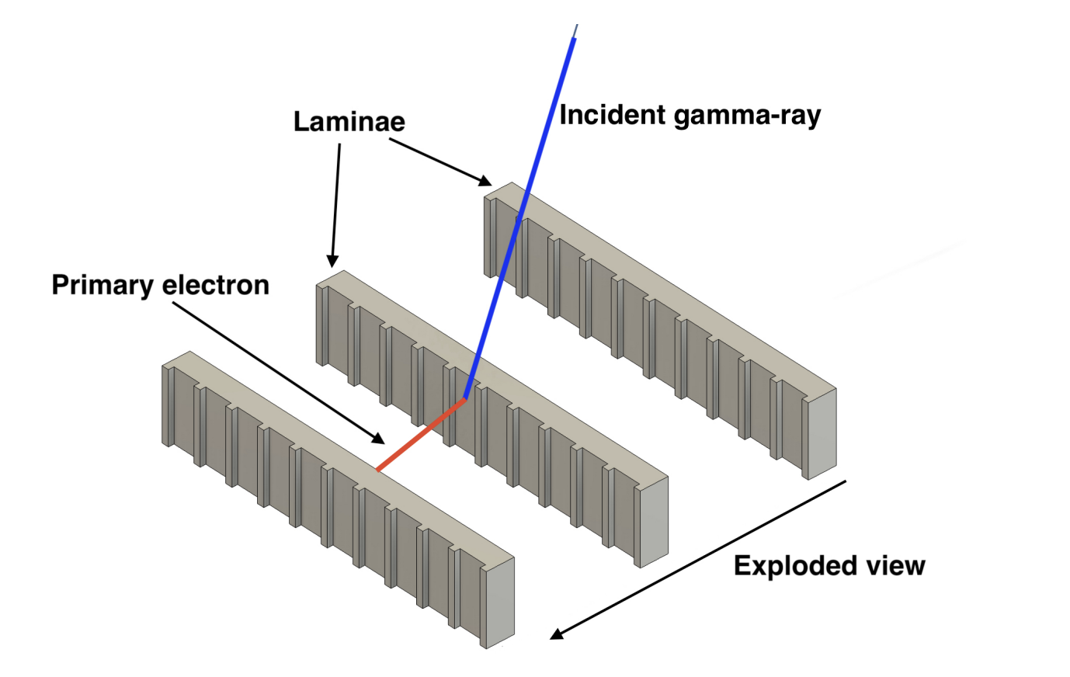
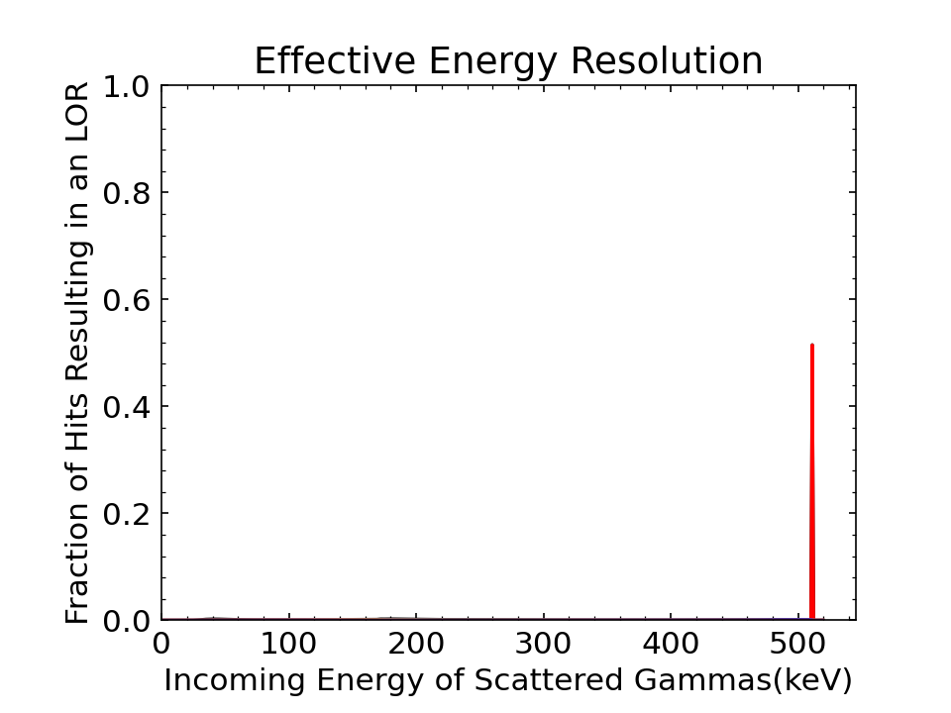
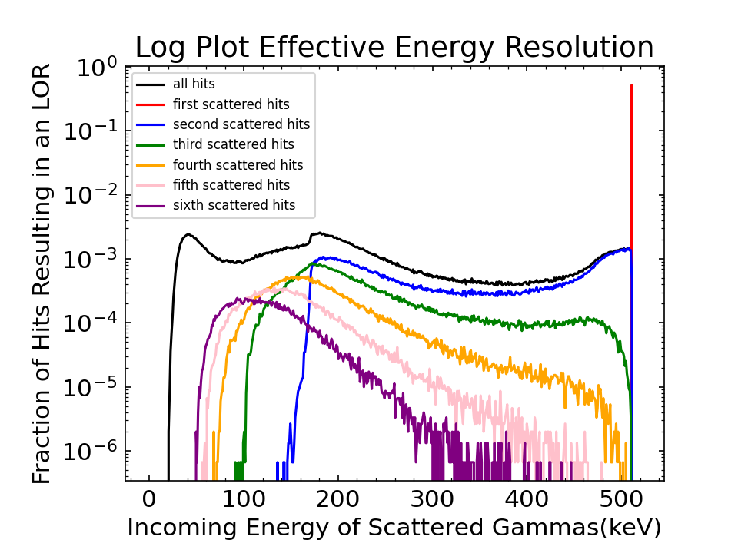
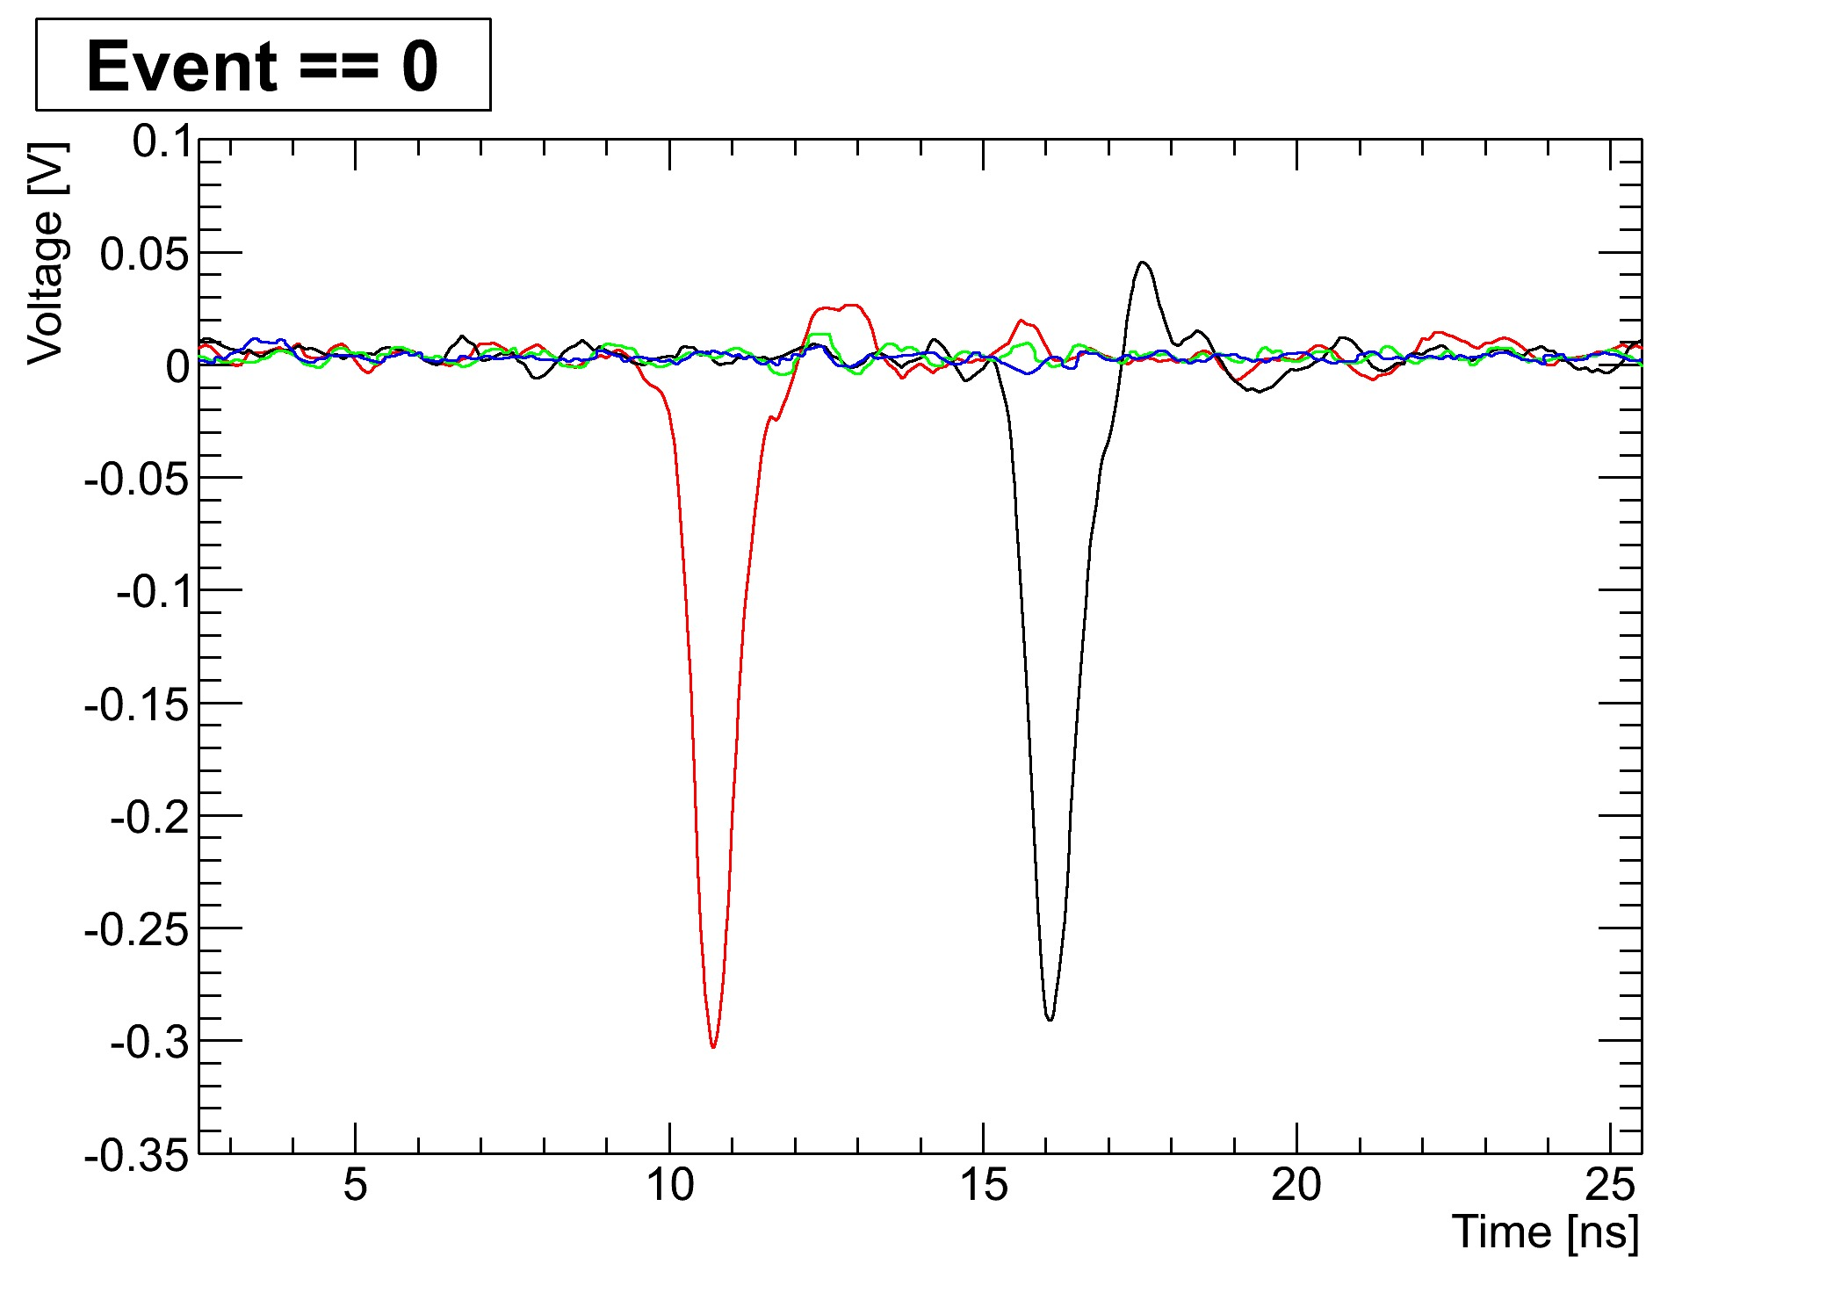
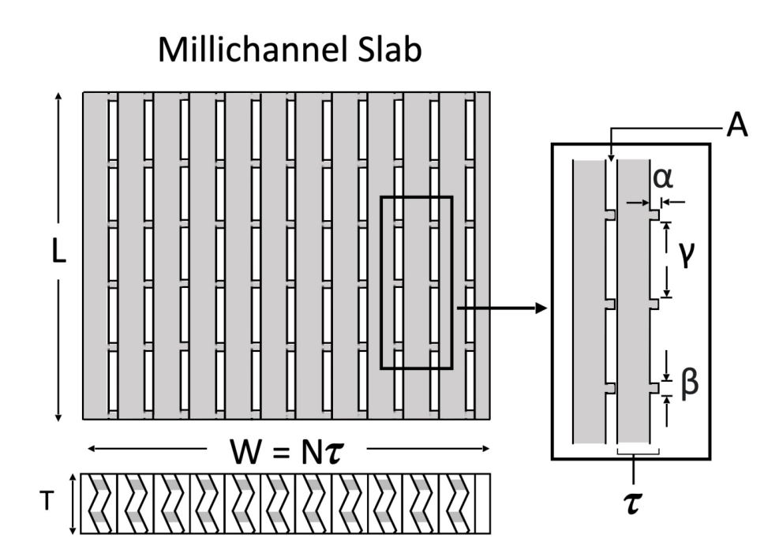
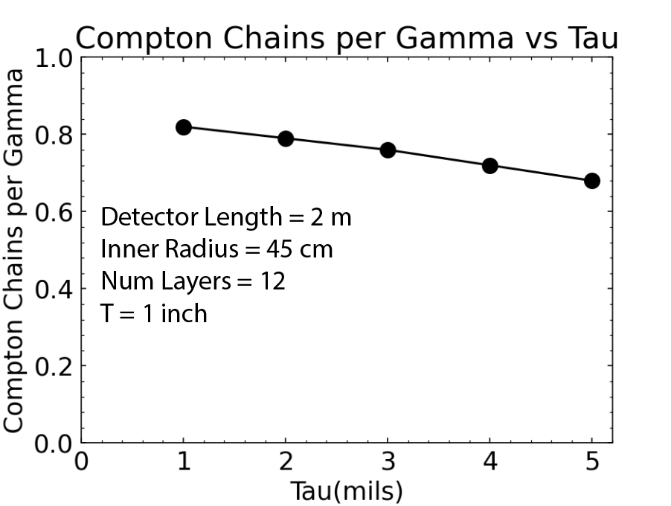
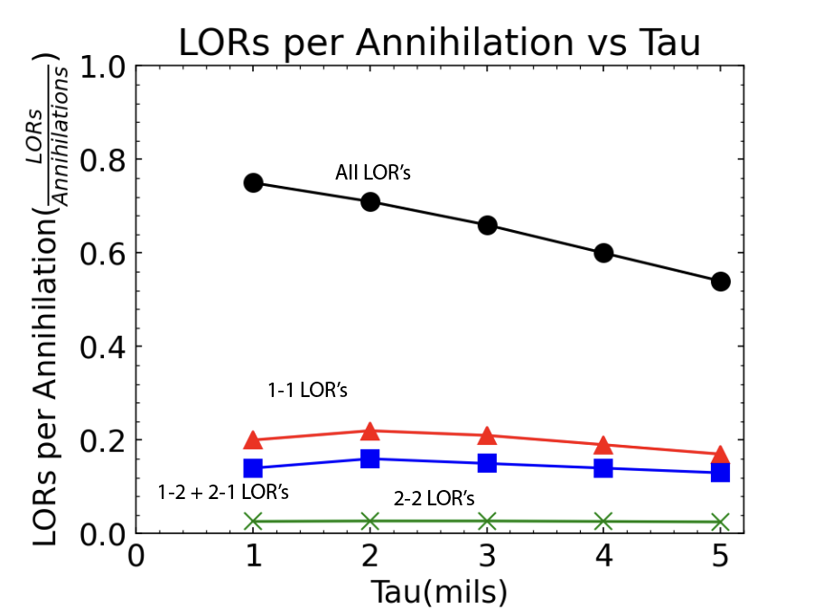
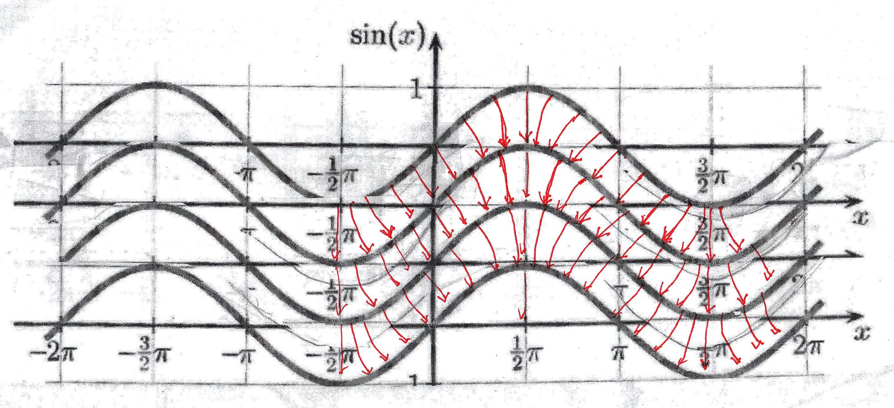
Simulation of Low Dose TOF PET Based on Compton Scattering of 511 keV Gamma Rays in Kapton Laminar MCPs
Arjun Kulkarni¹ Henry Frisch²
¹Department of Physics ²Enrico Fermi Institute
Our Goal: Low Dose High Res. TOF-PET at Low Cost
TOPAS Simulation
Spatial Resolution
Use TOPAS to simulate a detector made of concentric printed Kapton LMCPs with an axial length of 2 meters
Uncertainty at LOR endpoints for time, axial, tangential, and radial coordinates are given by 𝜎_{t} = 0.1 ns, 𝜎_{z} = 0.3 mm, 𝜎_{ᵩ} = 0.3 mm, and 𝜎_{r} = 7.3 mm respectively.
Uncertainties motivated by previous work with MCP anode configurations^{1,2}
Simulate a capillary source of Flourine-18 at the center of the detector with a radius of 0.1 mm and an axial length of 0.25 mm
Reconstruct the source with a filtered back projection with no smoothing or apodization and an expectation maximization algorithm fixed at 5 iterations
Reconstruct with a resolution of 0.2 mm per pixel
Measure point spread functions along the x axis.
Observe a FWHM of 0.57 mm from FBP and 0.51 mm from EM.
FWHM still dependent on iteration number and pixel size(requires further work)
High resolution on the LOR endpoints
High resolution time of flight
High reliability, long lifetime, low maintenance
Economical mass production of the detector elements
Goal is factor of > 1000 reduction in radiation dose
Localizing the Endpoint of the LOR
In low z material, Compton scattering by 511 keV gammas heavily dominates the photoelectric effect. We propose a detection scheme that takes advantage of this, eliminating the need for a scintillation crystal.
Simulation Results
Time Resolution
Picosecond res. Readout and Electronics
Psec 5/6: long buffer, 40 GS/s, 8 channels³
Stripline or shared pad anodes^{2,4}
Extensive experience with anode designs
Observed 𝜎_{t} < 70 psec from MCP with stripline anode¹
We have access to the channel faces
Energy of incoming gammas resulting in 1-1 LORs
Laminar MCPs
511 keV
Form MCPs from thin laminae of glass or Kapton
Have complete access to the face for channels and coatings
3D print spacers to make channels or slits
Use flex circuit technology to deposit equipotentials on the face
Use roll to roll processing to automate coating and assembly
Major Challenges
Tau is the laminae thickness
Backside SEY(work function modification)
Roll to roll fabrication and assembly
Program of prototyping
Testing of prototypes
Birdseye view of LMCP layer
Example equipotential trace on
channel surface replacing resistive layer
Bibliography
HV
[1] B. W. Adams et al., “Timing characteristics of Large Area Picosecond Photodetectors,”
Nucl. Instrum. Methods Phys. Res. A 795 (2015) 1–11.
[2] J. Park et al., “Patterned anodes with sub-millimeter spatial resolution for large-area MCP-based photodetector systems,” Nucl. Instrum. Methods Phys. Res. A 985 (2021) 164702.
[3] J. Park et al., “Design of an 8-Channel 40 GS/s 20 mW/Ch Waveform Sampling ASIC in 65 nm CMOS”, arXiv:2407.09575 (2024).
[4] H. J. Frisch et al., “A Brief Technical History of the Large-Area Picosecond Photodetector(LAPPD) Collaboration,”
arXiv:1603.01843 (2016).
Ground
Acknowledgements
Thank you to the University of Chicago Enrico Fermi Institute and the Metcalf research grant program. Thank you to my research mentor, Professor Henry Frisch, for his support and guidance throughout the project. I would also like to thank UChicago students Claudio Bastiani Fonck, Kepler Domurat-Sousa, and Cameron Poe for there contributions to the simulation work. Finaly, I would like to thank Oliver Moreno, Neal Sullivan, and John Shelton from Engenius Micro for their work on manufacturing.

