Slide 1


10.24 GHz PLL for PSEC6, a 40 GSa/s Waveform Sampling ASIC in 65nm CMOS
Ahan Dattaª, Evan Angelico^{d}, Andrew Arzacª, Gordon Chen ª, Troy England^{b}, Henry J. Frischª, Nathan Gehlª, Mary Heintzª, Sumin Kim^{d}, Ava Lalichª , Nathaniel J. Pastika^{b}, Jinseo Park^{d}, Hector D. Rico-Aniles^{c}, Paul M. Rubinov^{b}, Y.M. Richmond Yeungª,
ªEnrico Fermi Institute, the University of Chicago, 933 East 56th Street, 60637, Chicago, IL, USA
^{b}Fermi National Accelerator Laboratory, 60510, Batavia, IL, USA
^{c}North Central College, 30 N. Brainard Street, 60540, Naperville, IL, USA
^{d}Stanford University, 450 Jane Stanford Way, 94305, Stanford, CA, USA
March 19, 2026

Slide 2
Outline
Motivation for Picosecond Timing Resolution
PSEC5 and PSEC6
10.24 GHz Phase Locked Loop (PLL) Overview
LC Voltage-Controlled Oscillator (VCO)
Divider Blocks
Phase Frequency Detector (PFD)
Charge Pump (CP)
Loop Filter (LPF)
PLL Simulation Results
Outlook

Slide 3
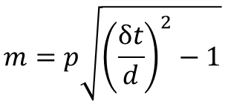
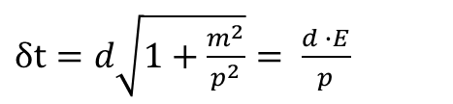


Time-of-flight Particle Identification
Given a relativistic particle with relativistic velocity $β$, the time of flight is:
$$δt= \frac{d}{β}$$
*in units of ns and feet
Beam
LAPPD
LAPPD
$δt=d\sqrt{1+\frac{m^{2}}{p^{2}}}= \frac{d ∙E}{p}$
Using the relation $E^{2}= m^{2}+ p^{2}$, we can solve for the particle’s mass:
$$d$$
$$m=p\sqrt{{\left(\frac{δt}{d}\right)}^{2}−1}$$
Readout Electronics
By reconstructing the mass with time-of-flight, we can identify the particle.
Software
Notes:
Using time-of-flight, we can reconstruct a particle’s mass and thus identify the particle.

Slide 4
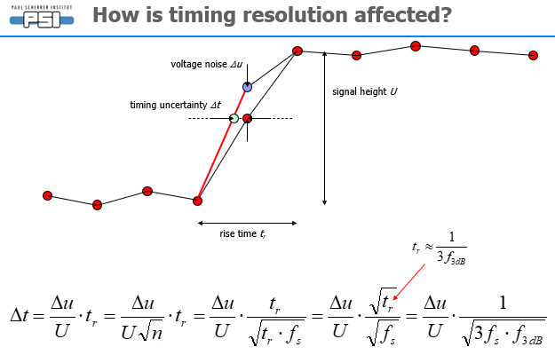
Primary goal – Picosecond Timing Resolution
[1]Stefan Ritt; The role of analog bandwidth and signal-to-noise in timing for waveform digitizing; Timing Workshop, Chicago April 28th 2011,
https://psec.uchicago.edu/workshops/fast_timing_conf_2011/system/docs/18/original/ritt_analog_bw.ppt
Where $f_{s}=$ Sampling Rate and$f_{3 dB}=$ Bandwidth
Therefore, an improved Δt can be achieved by:
Low Noise (from samples)
High Analog Bandwidth
Minimizing Sampling time jitter
High Sampling Rate
Require fast, stable sampling clock
Notes:
The main factors affecting timing resolution are noise, sampling time jitter, sampling rate and analog bandwidth. The last two require a fast, stable sampling clock

Slide 5
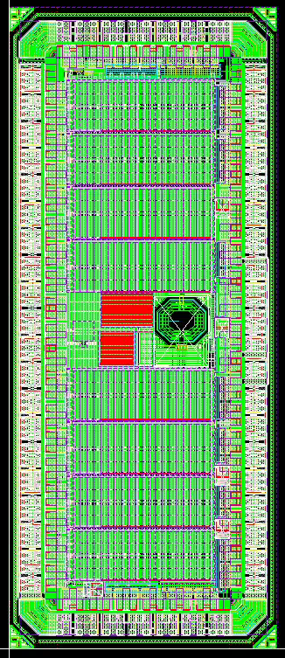
PSEC5 and PSEC6
PSEC5 Full Chip layout:
PSEC5 is a pathfinder 40 GSa/s waveform sampling ASIC that was taped out in August 2024
Made to test the new sampling architecture
For the first submission, we decided to not include a PLL
It didn’t perform as we hoped, particularly due to issues with the clock dividers
→ We added a redesign of the clock dividers + PLL to PSEC5, calling it PSEC6
Notes:
PSEC5 was primarily intended to test the sampling architecture, and thus we only included an oscillator without a PLL. Unfortunately, PSEC5 didn’t work as expected due to issues with the clock dividers. We both fixed the clock dividers and added a PLL to PSEC5, calling it PSEC6.

Slide 6
PSEC6 Specifications
Process | 65nm TSMC
Signal to Noise | 1000
Sampling Rate | 40GSa/s (5GSa/s)
Fast Buffer Length | 6.4ns
Slow Buffer Length | 204.8ns
Analog Bandwidth | 4.9 GHz
Channels/Chip | 8
Area | 2.6 mm²
Max. Readout Rate | 40KHz
Institutions | UChicago & Fermilab
Switched Capacitor Array (SCA) based waveform-sampling ASIC
Designed in TSMC 65nm process
Requires stable 5.12 GHz sampling clock → PLL
First 10 GHz PLL in 65 nm for HEP experiment
Notes:
PSEC6 is a Switched Capacitor Array, or SCA, based waveform-sampling ASIC designed in TSMC 65 nanometer. It’s maximum sampling rate is 40 Gigasamples per second with a baseline rate of 5 Gigasamples per second, which requires a 5 Gigahertz stable sampling clock. Thus, we need to make a PLL, which is the first 10 gig PLL in 65 nm for HEP experiment to our knowledge.

Slide 7
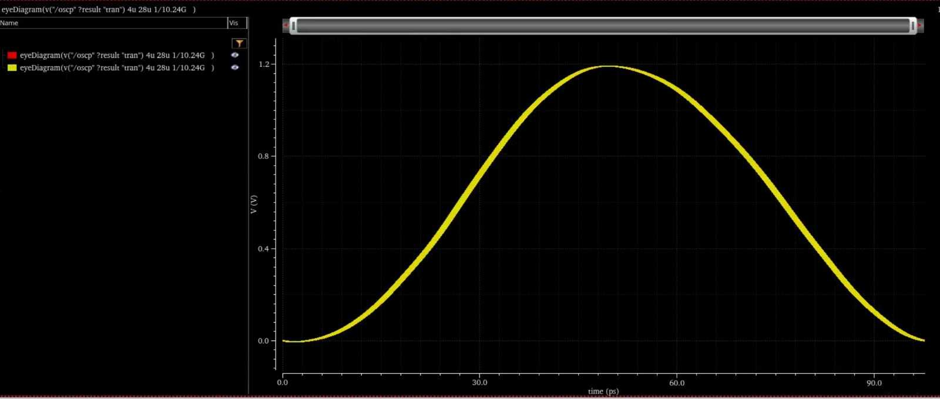
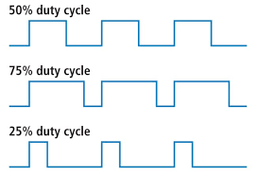
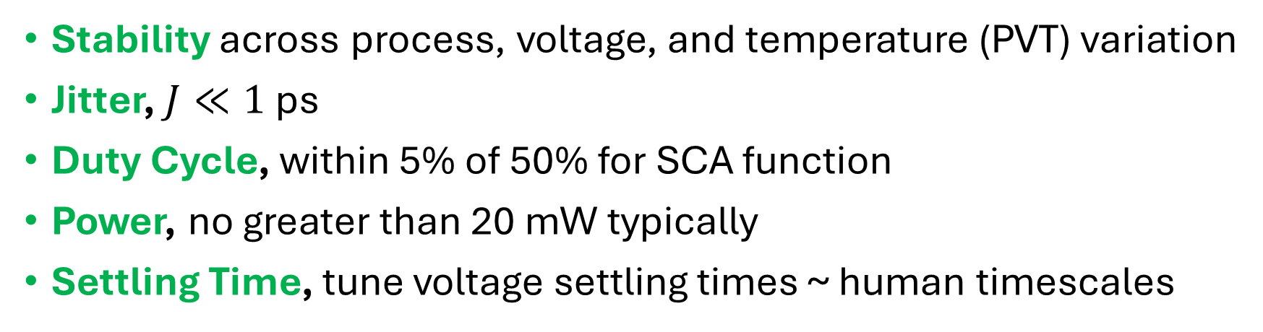
Design Targets for the 10.24 GHz PLL
Stability across process, voltage, and temperature (PVT) variation
Jitter, $J≪1$ps
Duty Cycle, within 5% of 50% for SCA function
Power, no greater than 20 mW typically
Settling Time, tune voltage settling times ~ human timescales
Finite Width Eye Diagram → Jitter
Notes:
The design targets for the PLL are as follows. Primarily, we need the PLL to be stable across process variations. Secondly, we need the PLL jitter to be much less than a picosecond. Furthermore, we need a duty cycle near 50% for proper operation of the SCAs, and we want power under 20mW with at least human timescale settling.

Slide 8
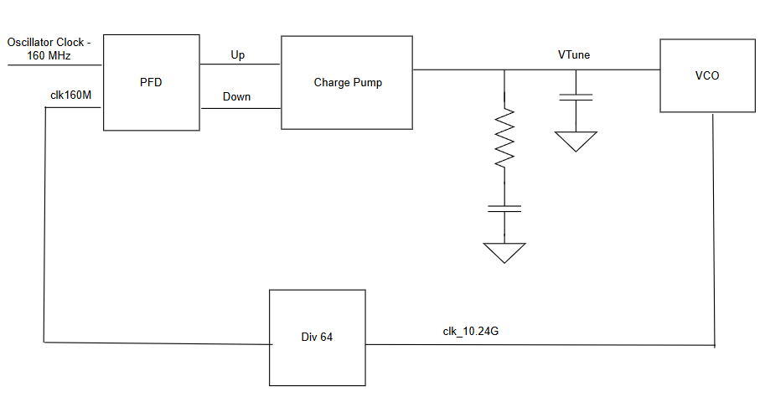


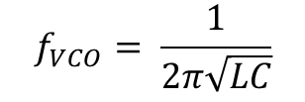
Phase Locked Loop (PLL)
Phase Frequency Detector (PFD)
Loop Filter (LPF)
Voltage-Controlled Oscillator (VCO)
Charge Pump (CP)
C2
$$C∝{−V}_{tune}$$
R
$$f_{VCO}= \frac{1}{2π\sqrt{LC}}$$
C1
Linear approximation:
Clock Dividers
$f_{VCO}≈ K_{VCO}⋅V_{tune}+$const.
Block diagram for 10.24 GHz PLL

Slide 9
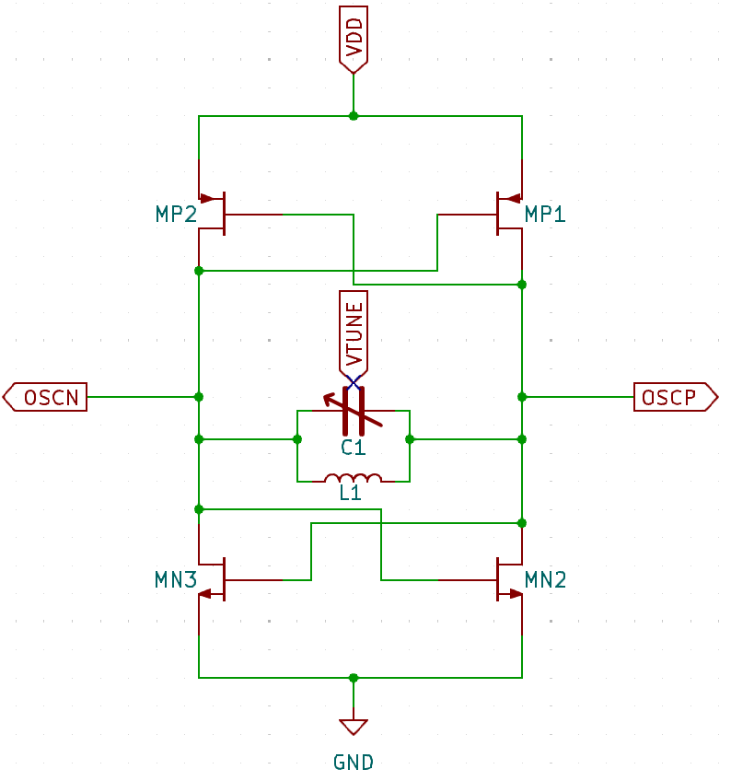
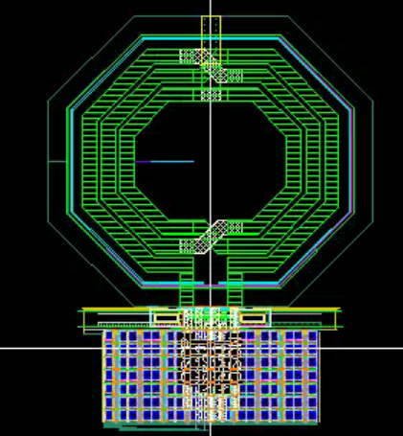
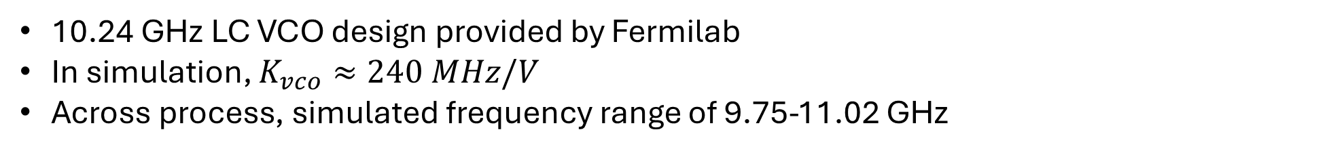
10.24 GHz LC VCO
10.24 GHz LC VCO design provided by Fermilab
In simulation, $K_{vco}≈240 MHz/V$
Across process, simulated frequency range of 9.75-11.02 GHz
L
PLL designed around 10.24 GHz LC VCO
C

Slide 10
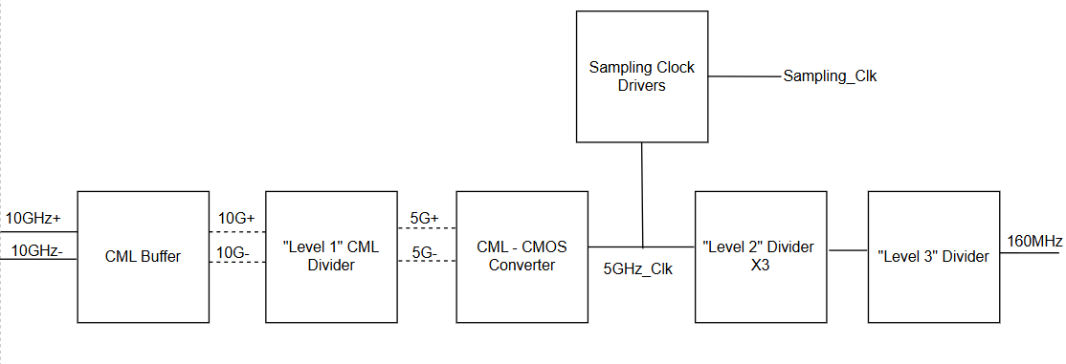
PSEC6 Divider Architecture
New
Redesigned for robustness
PSEC6:
The clock path is CMOS → CML → CMOS

Slide 11
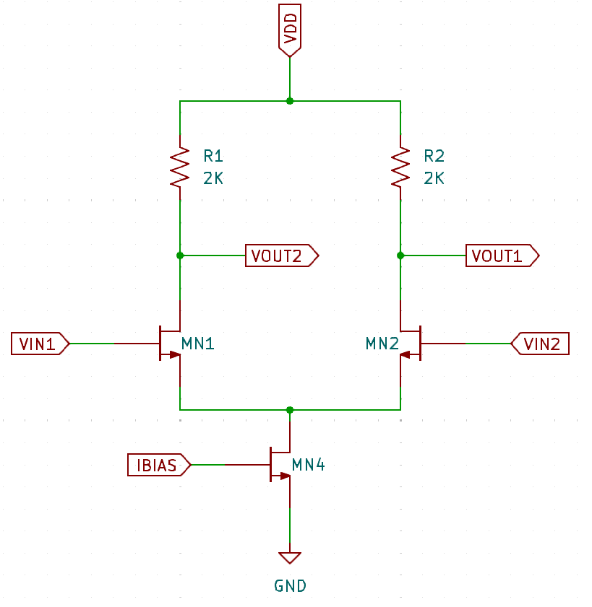
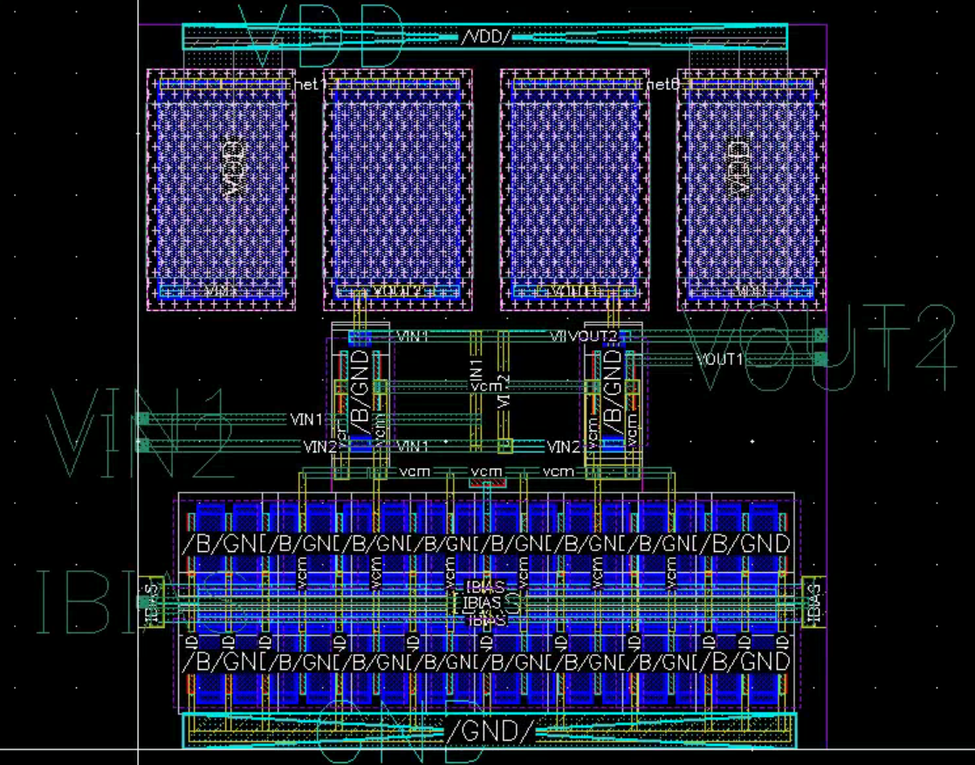
Current Mode Logic (CML) Buffer
Current Sink
Resistors
Input Transistors
Single differential pair with large current source
Purpose of this stage is to reduce swing and wave shape into a square wave
CML Buffer
CML Divider
CML→ CMOS
Level Two Divider x3
Level Three Divider x2

Slide 12
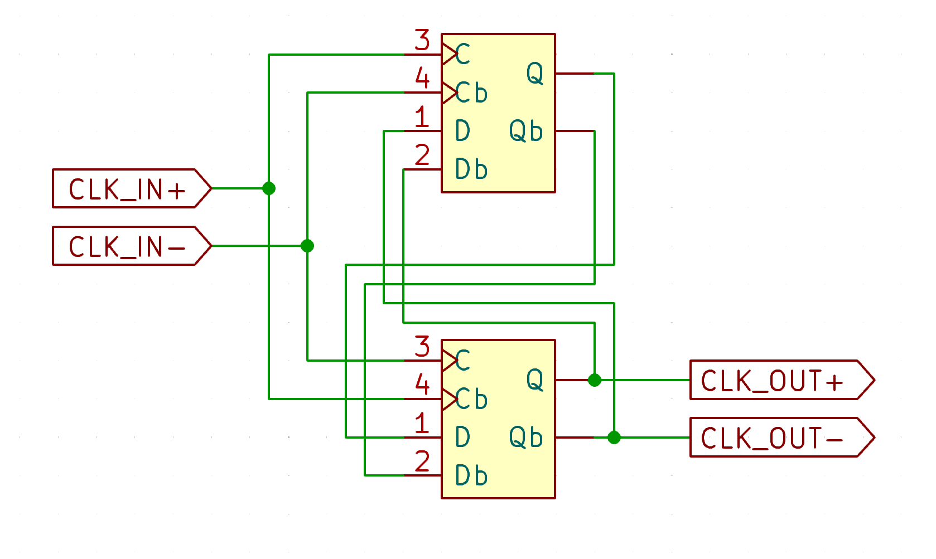
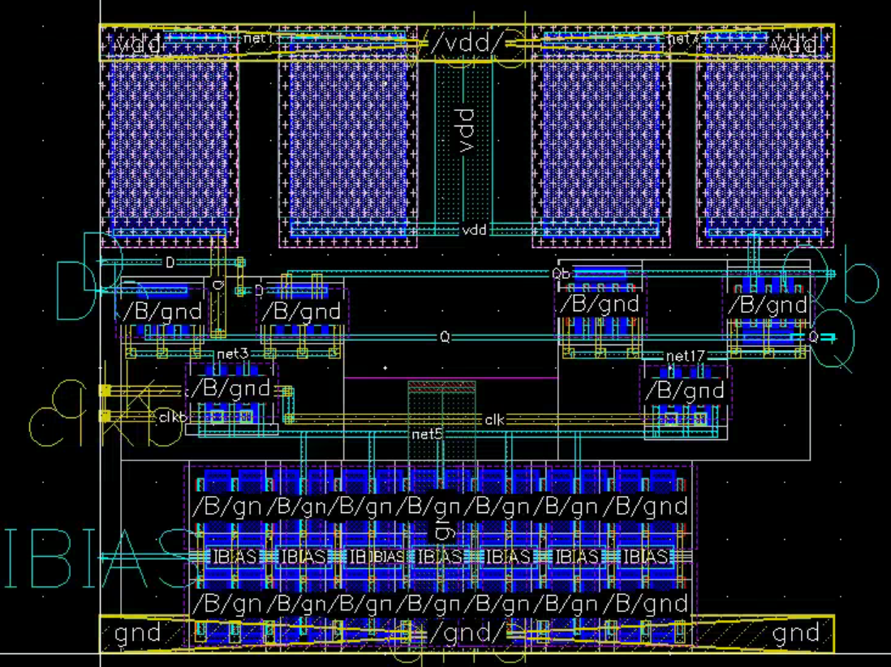
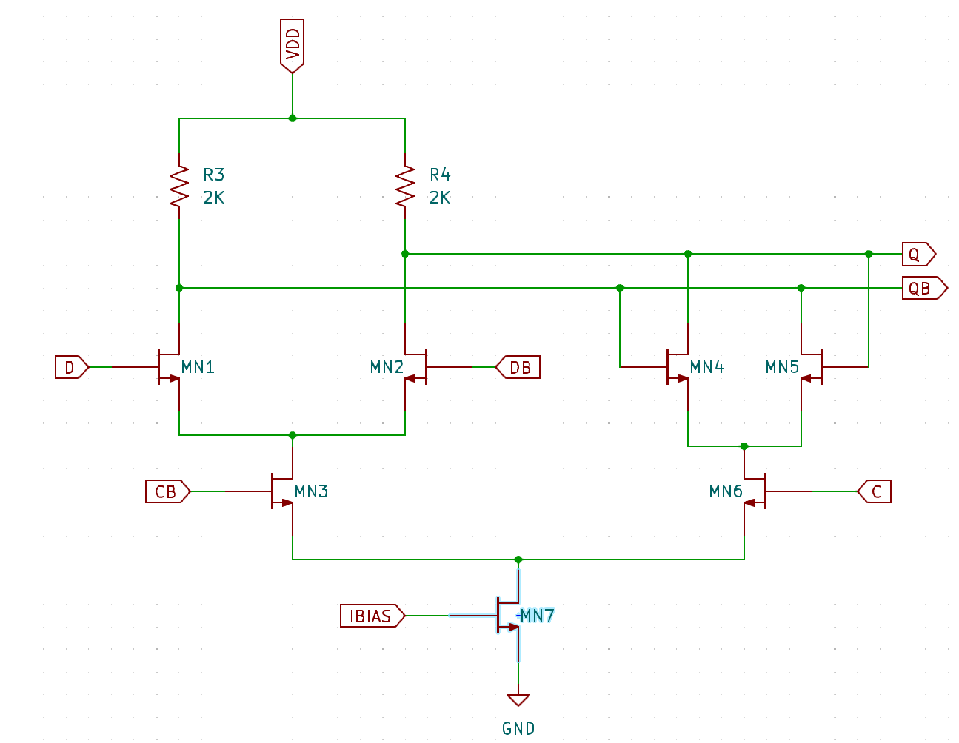
Level One CML Divider → CML D Flip Flop
Sense
Latch
Single DFF layout
Level One CML Divider schematic
Differential CML DFF schematic
Divides the frequency by two (hard at 10.24 GHz!) using Two flip-flop (DFF) topology
Transistor sizing had to be tuned to balance input capacitance of the “sense” stage with the “latch” stage strength
CML Buffer
CML Divider
CML→ CMOS
Level Two Divider x3
Level Three Divider x2

Slide 13
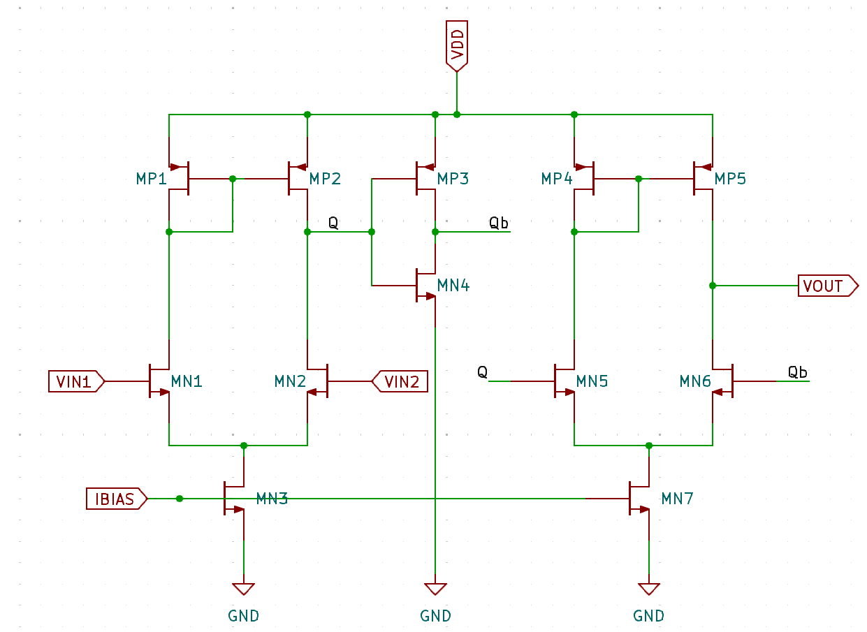
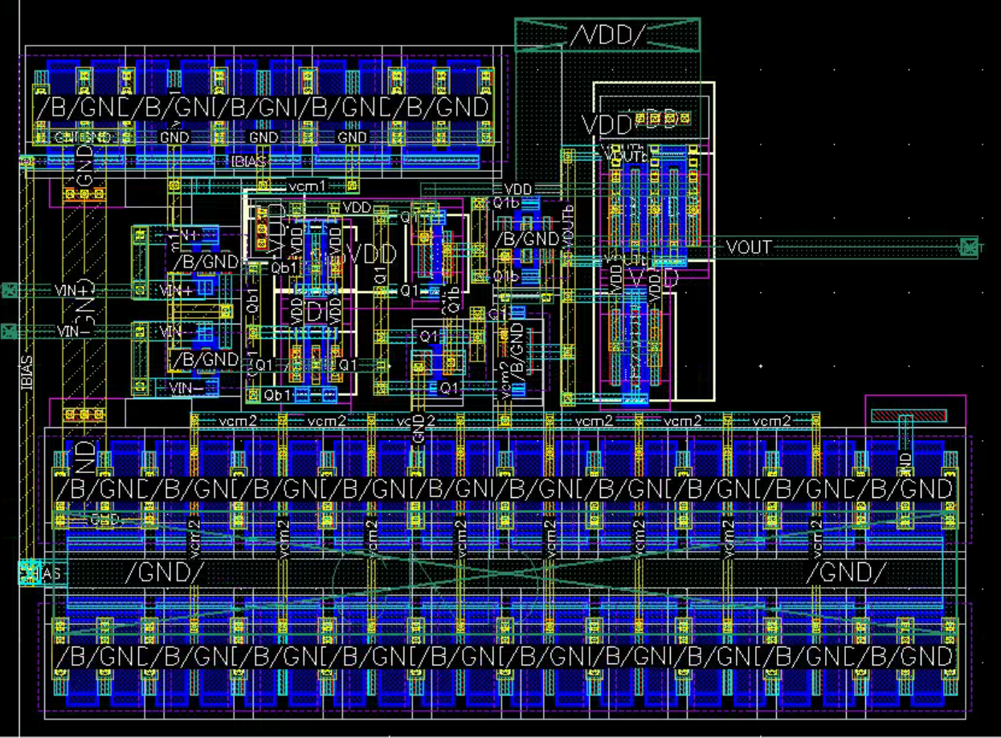
CML -> CMOS Converter
Converts the 5.12 GHz clock signal from CML to CMOS logic Two stage amplifier to maximize gain-bandwidth product
Converts 5.12 GHz clock to CMOS logic for compatibility with SCA sampling
CML Buffer
CML Divider
CML→ CMOS
Level Two Divider x3
Level Three Divider x2

Slide 14
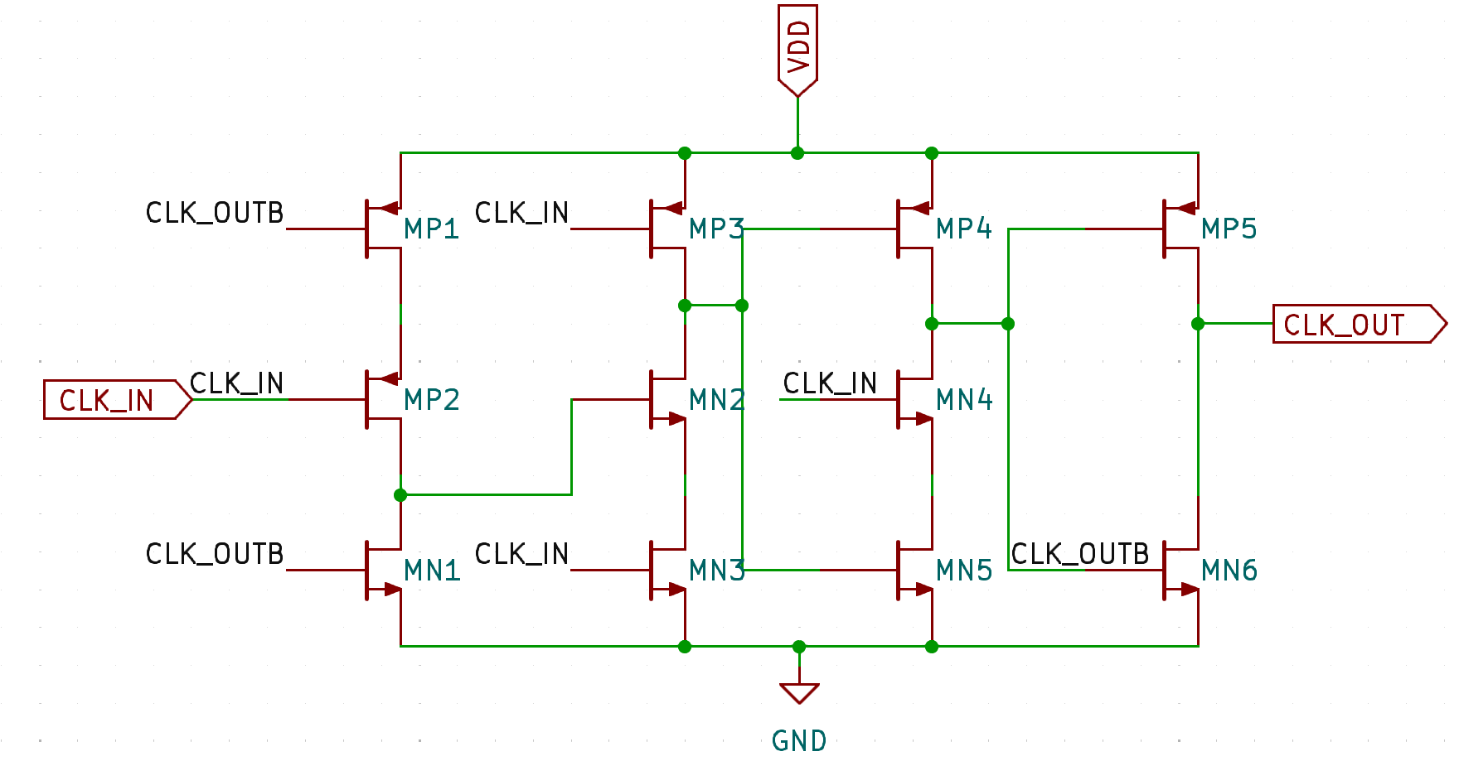
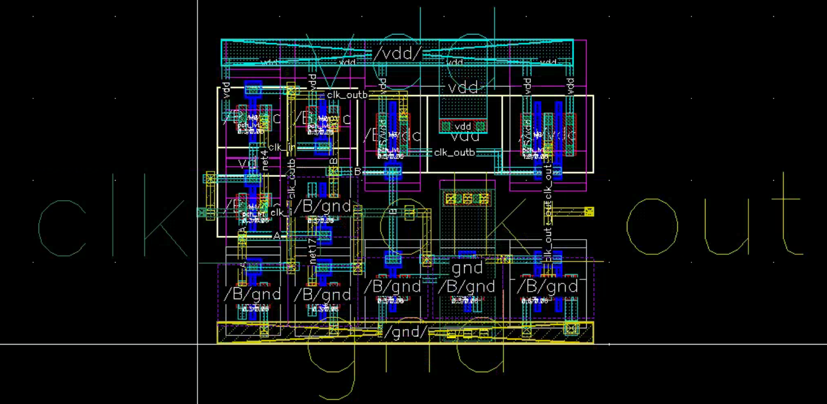
Level Two TSPC Clock Divider
Divide by two circuit used from 5.12 GHz → 1.2 GHz
Standard True Single-Phase Clock (TSPC) Divider is smaller and lower power than CML divider
TSPC divider balances speed, power consumption, and layout area for middle frequencies
CML Buffer
CML Divider
CML→ CMOS
Level Two Divider x3
Level Three Divider x2

Slide 15
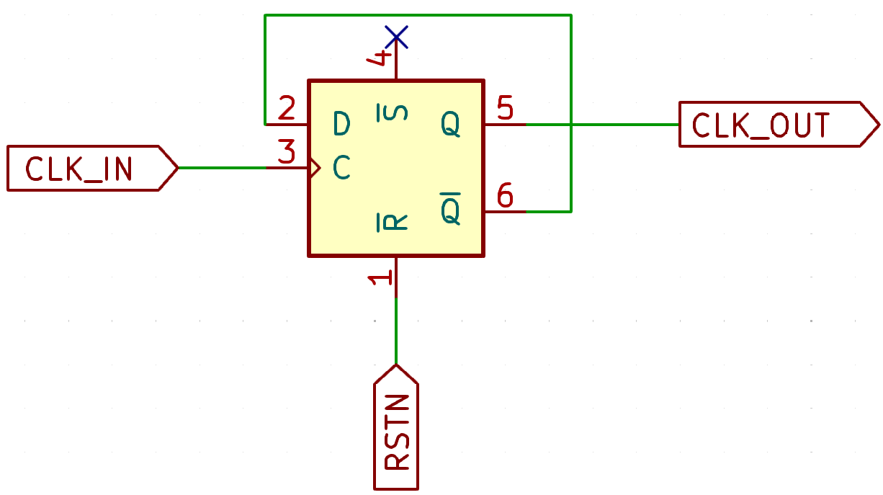
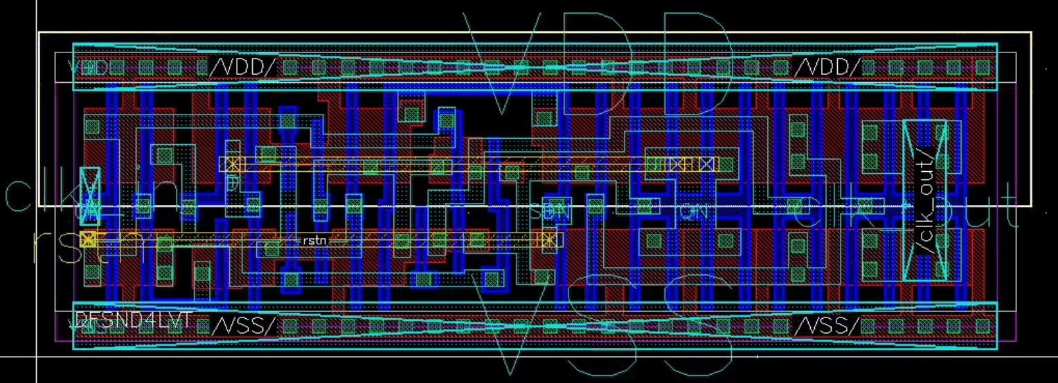
Level Three Clock Divider
Divide by two from 1.2 GHz → 20 MHz using single flip-flop topology
Is the final division stage before the phase-frequency detector
Simple low-power single-FF divider for the slower final division stages
CML Buffer
CML Divider
CML→ CMOS
Level Two Divider x3
Level Three Divider x2

Slide 16
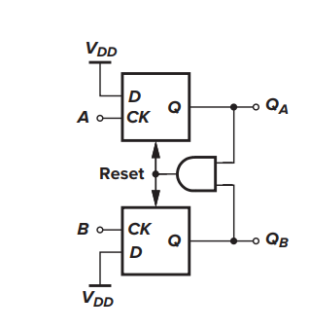
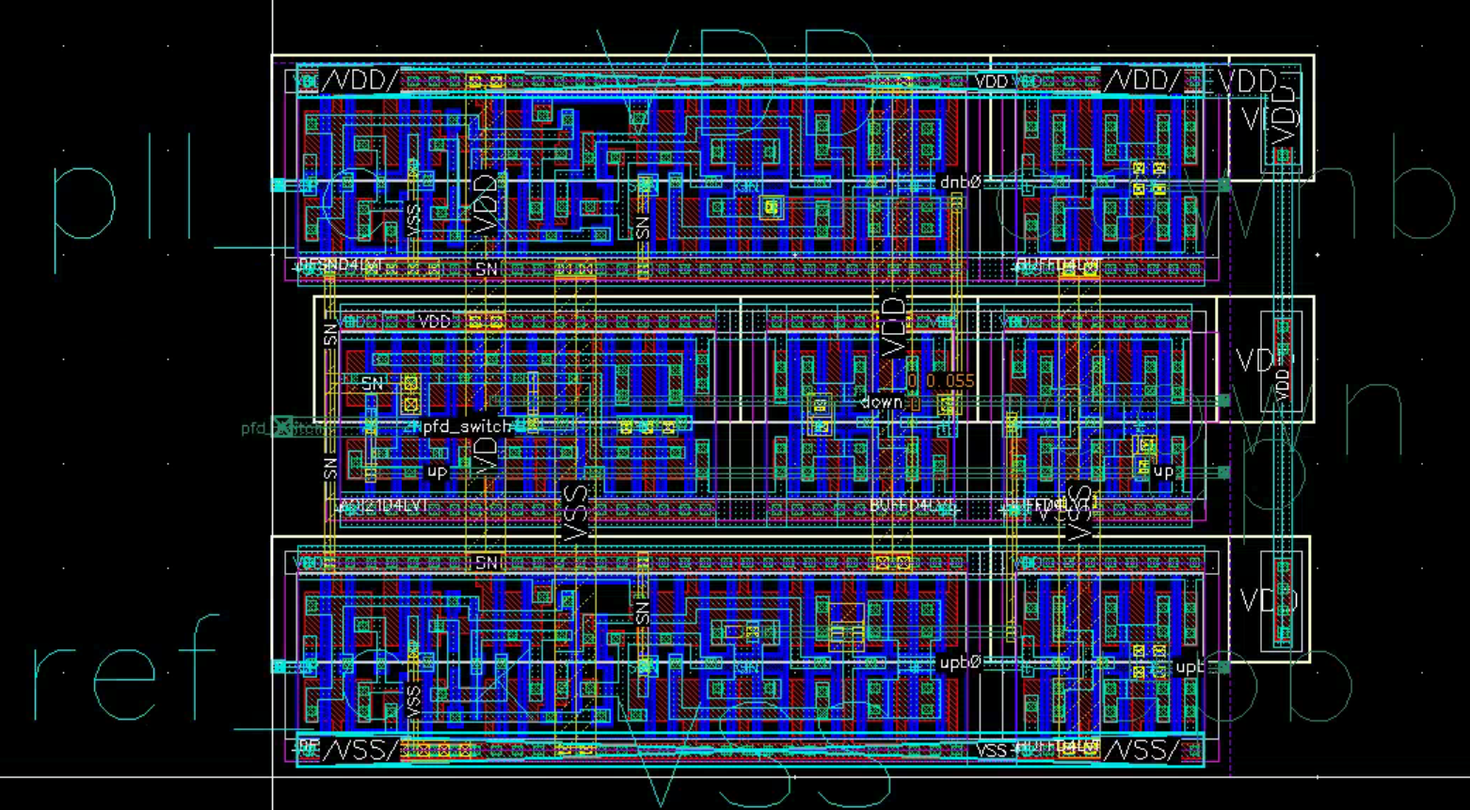
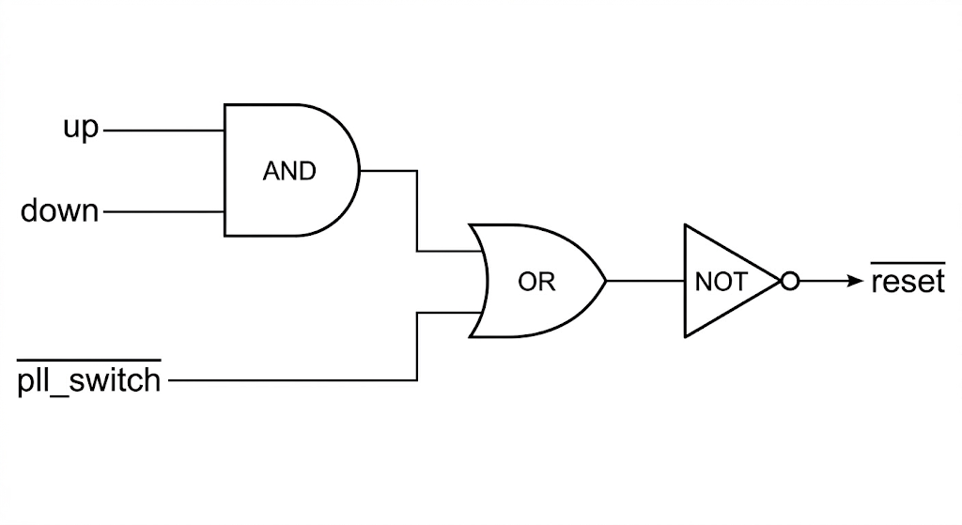
Phase Frequency Detector (PFD)
Generates the phase error signal for PLL feedback
Uses And-Or-Not digital standard cell for the reset path
Uses standard cell D flip flops, buffers, and gates for stability
[3] Behzad Razavi, Design of Analog CMOS Integrated Circuits, 2nd ed. (New York: McGraw-Hill, 2016).
Active Low Reset Path
The PFD is the primary feedback generator, and is therefore highly symmetric and designed for fast signal paths

Slide 17
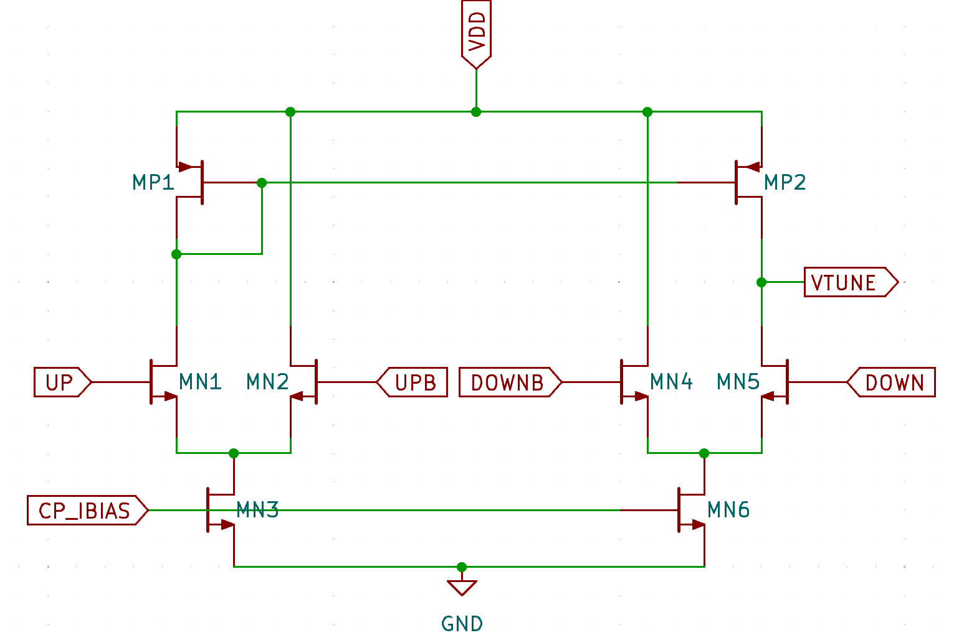
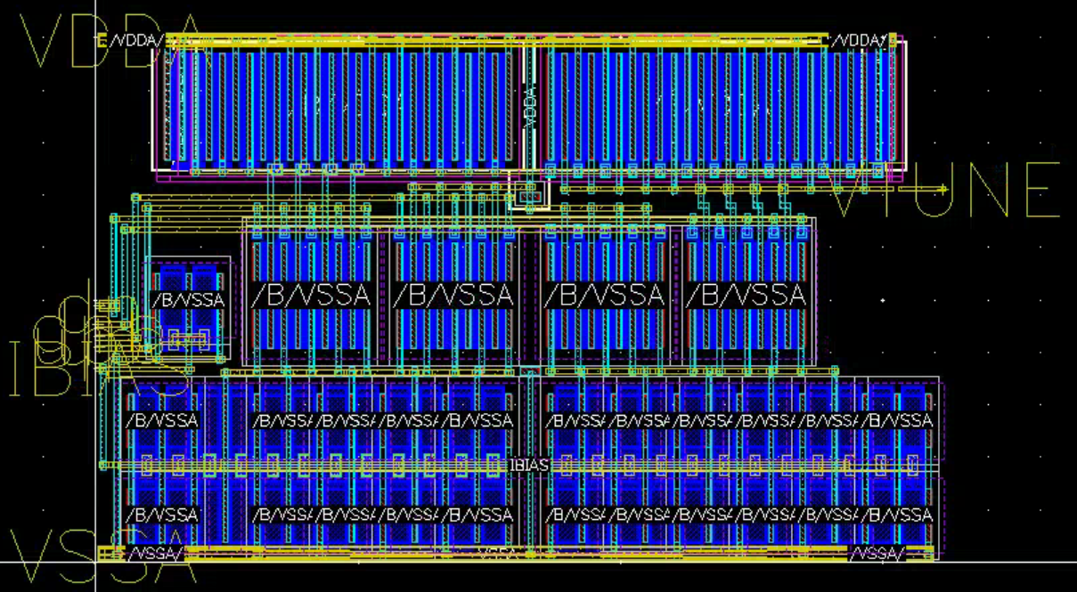
Charge Pump (CP)
Converts phase error into current to drive the loop filter
Using only-NMOS current-steering design to improve matching for the up and down paths
CP current is configurable with a current bias input
The charge pump must be symmetric since it contributes primarily to the jitter, power consumption, and stability of the loop

Slide 18
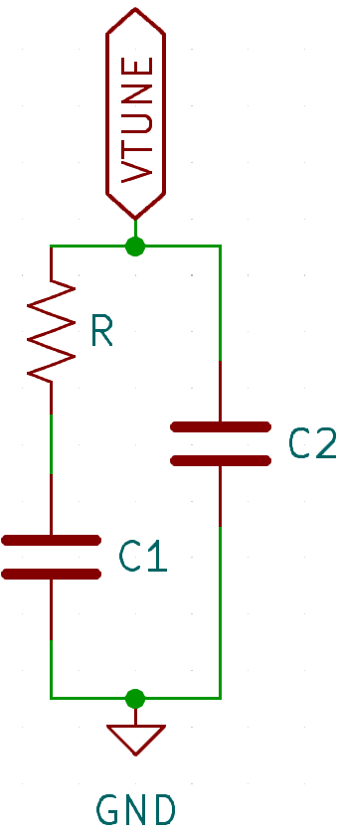
Loop Filter (LPF)
Works as a transconductance low pass filter, smoothing out the output of the charge pump
Directly holds the value of the tuning voltage, and is thus a critical component to tune for minimal jitter
Is critical for loop stability, settling time, and jitter
800-1600 Ω
12 pF
120 pF
The LPF was carefully tuned to balance phase margin, damping factor, and the loop frequency

Slide 19
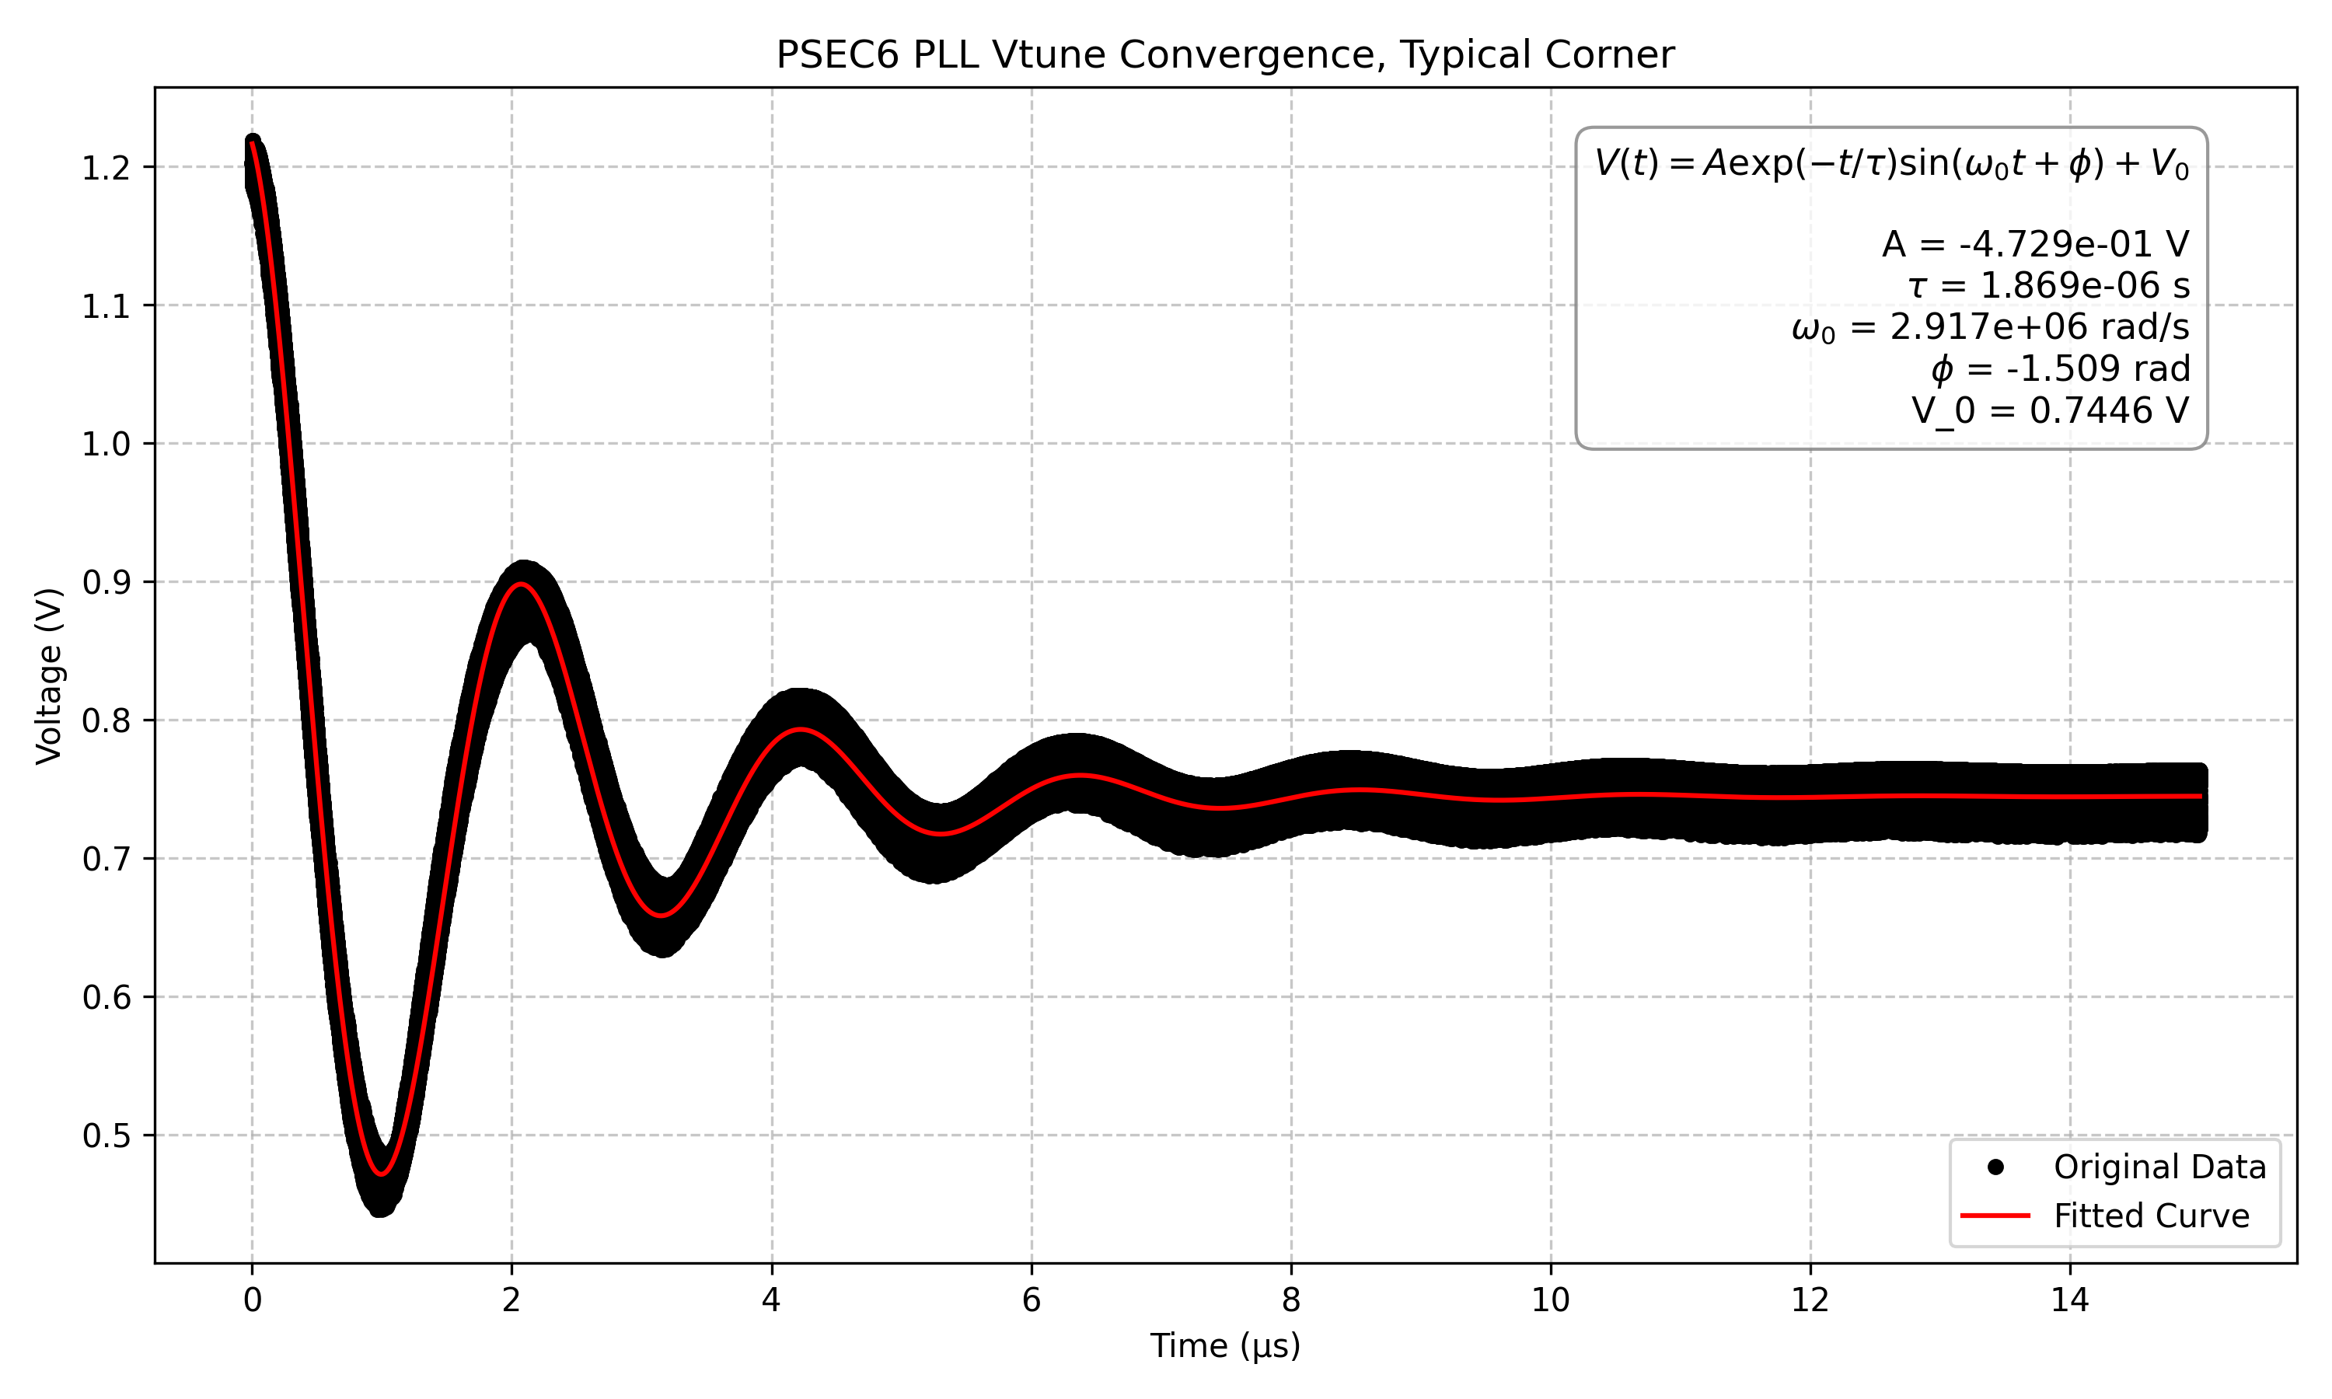
PLL Simulation Results: Vtune Convergence
Vtune converges to 744.6 mV, roughly mid-rail (0.6V) → good tuning range
Finite thickness of Vtune is from a mysterious 20.48 GHz “harmonic noise”
The tuning voltage converges, and thus the PLL locks

Slide 20
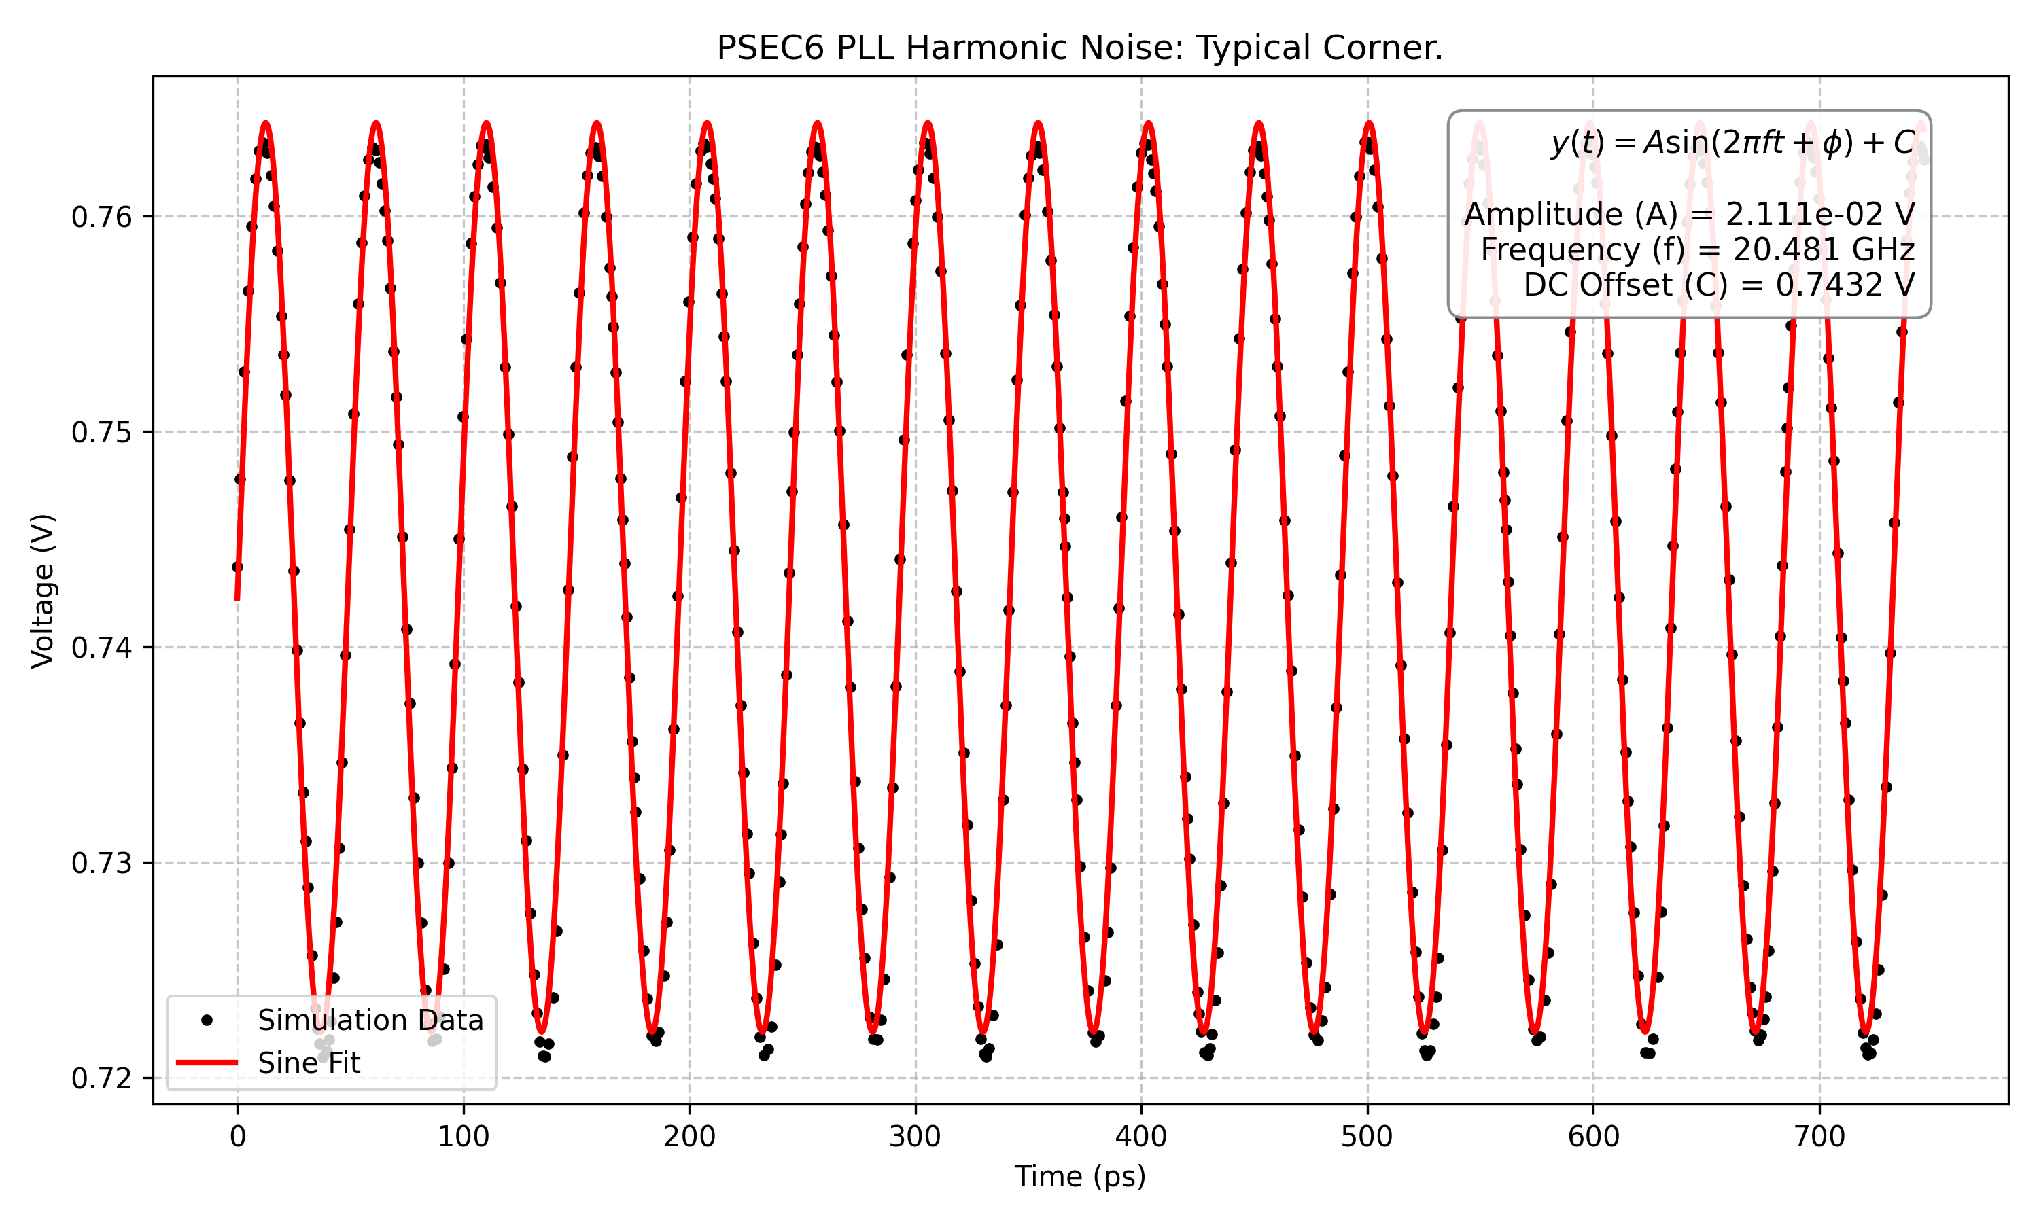
PLL Simulation Results: Harmonic Noise
There is a 20.48 GHz 41 mV peak-to-peak harmonic in the tuning voltage. Why?
We expect this noise to “alias to DC” in the sampling.
20.48 GHz harmonic noise is strange, but won’t affect sampling jitter

Slide 21
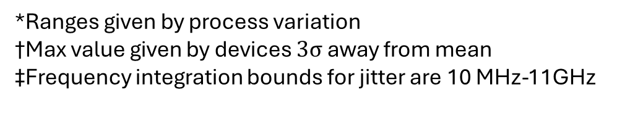
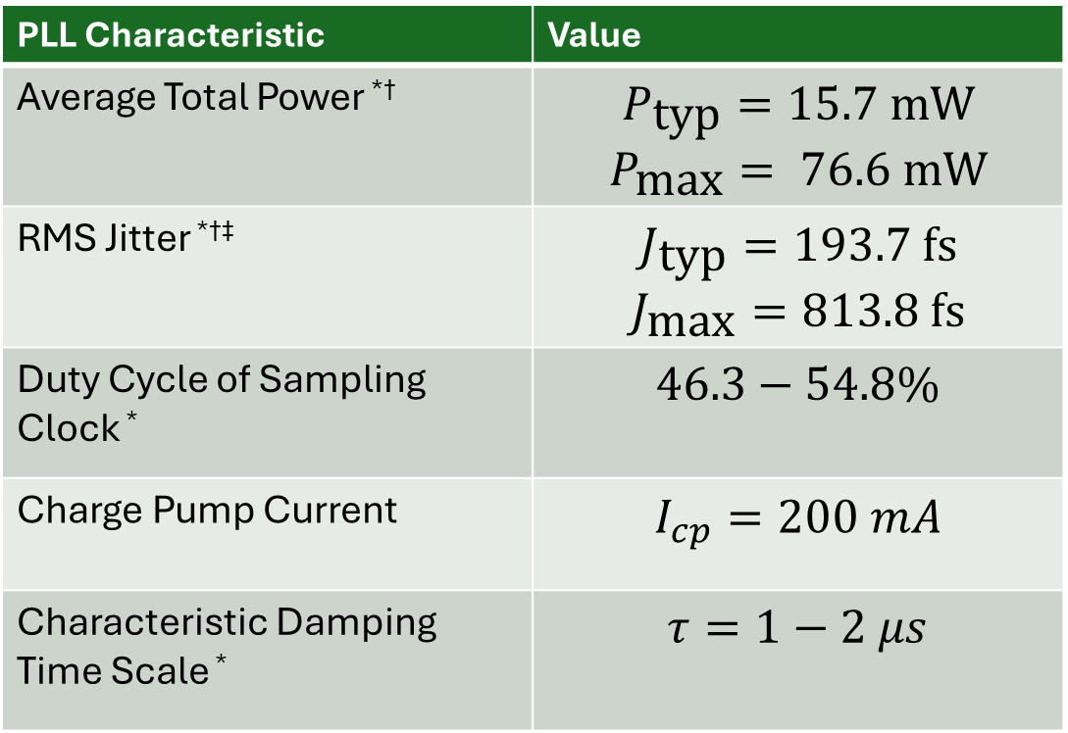
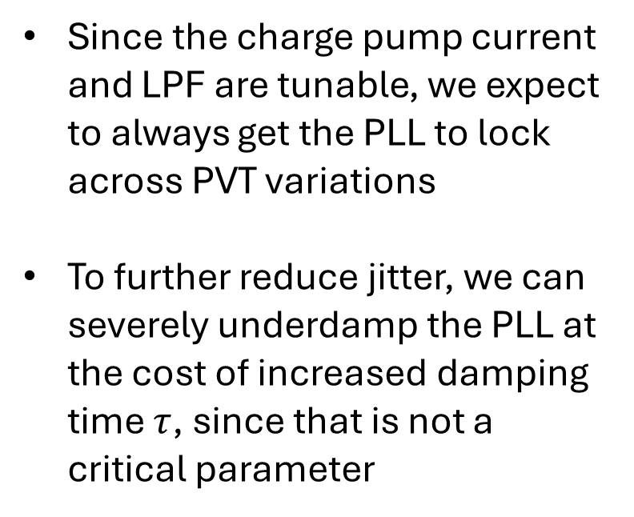
PLL Simulation Results: Specifications
PLL Characteristic | Value
Average Total Power *† | $$P_{\text{typ}}=15.\text{7 }\text{mW}$$ $$P_{\text{max}}=\text{ 76.6 }\text{mW}$$
RMS Jitter *†‡ | $$J_{\text{typ}}=193.7 \text{fs}$$ $$J_{\text{max}}=\text{813.8 }\text{fs}$$
Duty Cycle of Sampling Clock * | $46.3−54.8\%$
Charge Pump Current | $I_{cp}=200 mA$
Characteristic Damping Time Scale * | $τ=1−2 μs$
Since the charge pump current and LPF are tunable, we expect to always get the PLL to lock across PVT variations
To further reduce jitter, we can severely underdamp the PLL at the cost of increased damping time $τ$, since that is not a critical parameter
Our PLL satisfies our design specifications!
*Ranges given by process variation
†Max value given by devices $3σ$ away from mean
‡Frequency integration bounds for jitter are 10 MHz-11GHz

Slide 22
Summary and Future – March 2026
We have developed a 10.24 GHz PLL in TSMC 65nm with 194 fs jitter
Tapeout for PSEC6 is scheduled for April 2026
We are currently finishing floorplan and layout of the full PLL
We expect the chip back for physical testing in July

Slide 23
Supplementary Slides

Slide 24
Alias to DC?
Time of Sample (5.12 GHz)
The frequency variation per sample is the same
In other words, the 20.48 GHz jitter is “averaged out”
20.48 GHz harmonic noise on Vtune doesn’t affect the sampling jitter

Slide 25
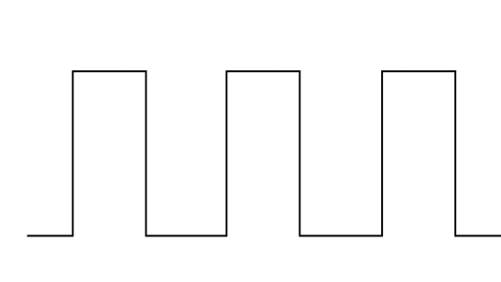
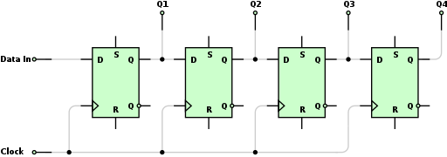
How is 40 GS/s achieved with a 10 GHz clock?
Interleaving SCAs, delayed clock
Dual Edge Triggered Flip Flops allow for the use of both clock edges for sampling
We only need a 5GHz sampling clock for 40 Gsa/s sampling rate
Triggering on the rising edge
Using both edges

Slide 26
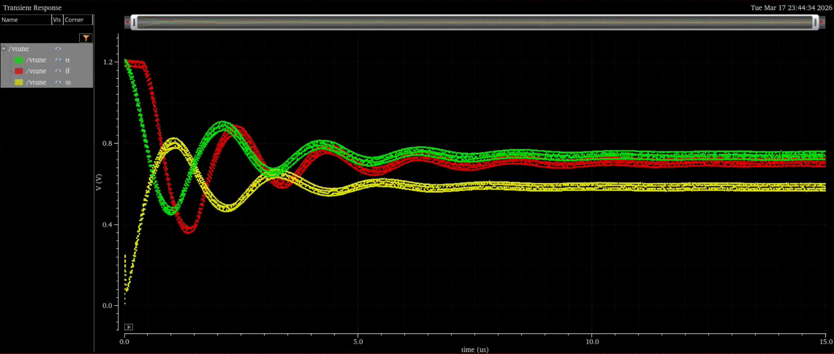
PLL Corner Results: Vtune Convergence
Green = Typical; Red = Fast; Yellow = Slow.
Converges in all corners

Slide 27
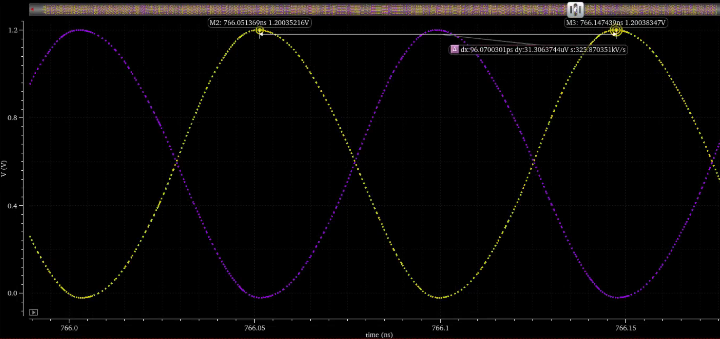
VCO Output
1.2 V peak-to-peak differential sine wave → Needs to be divided

Slide 28
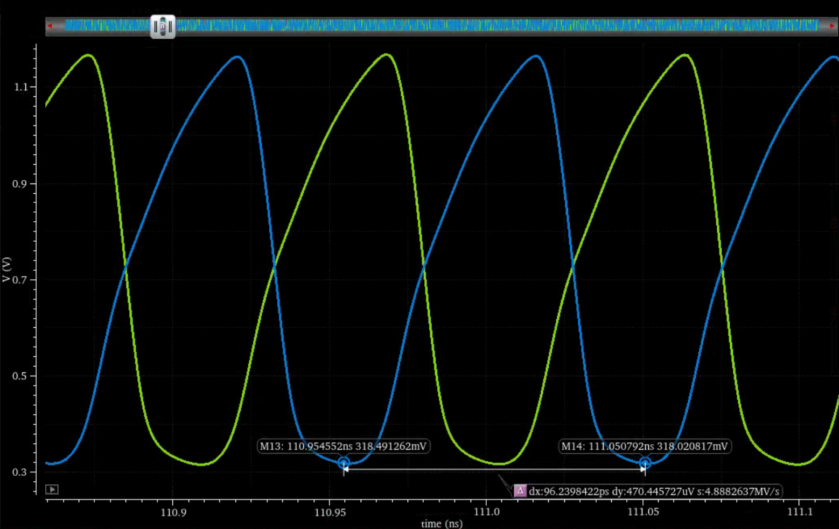
CML Buffer Output
0.4 V – 0.8 V swing depending on corner
~10.24 GHz

Slide 29
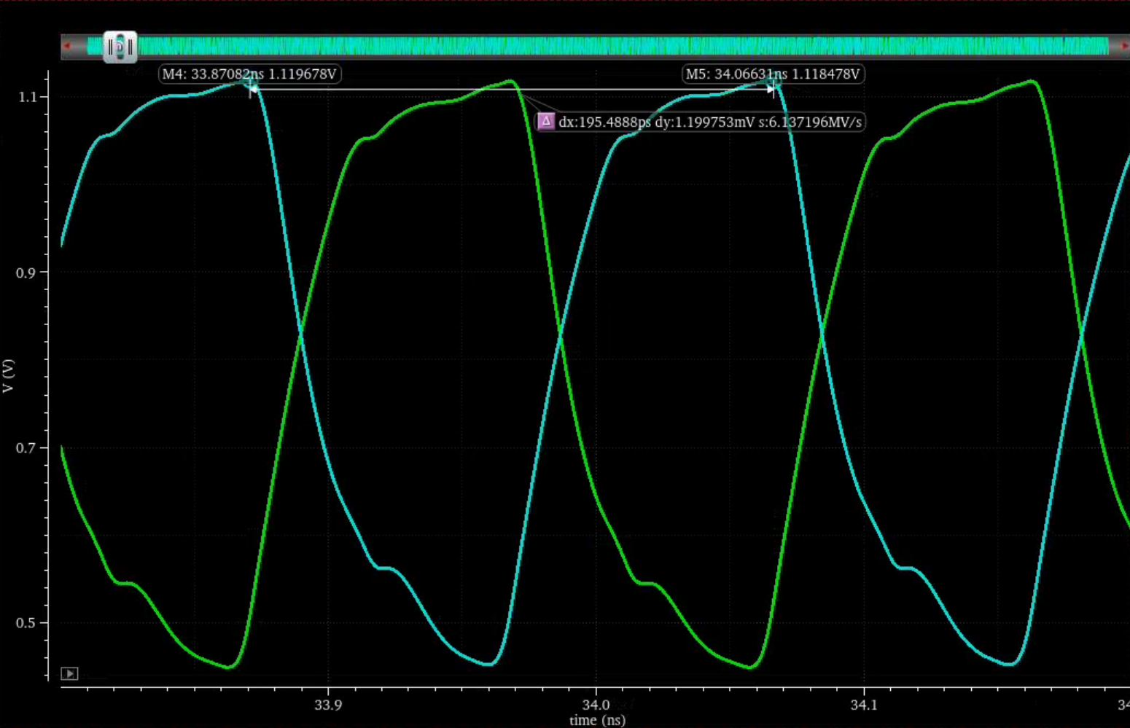
Level One Divider Output
600-800 mV peak-to-peak swing across PVT variations
~5.12 GHz Frequency

Slide 30
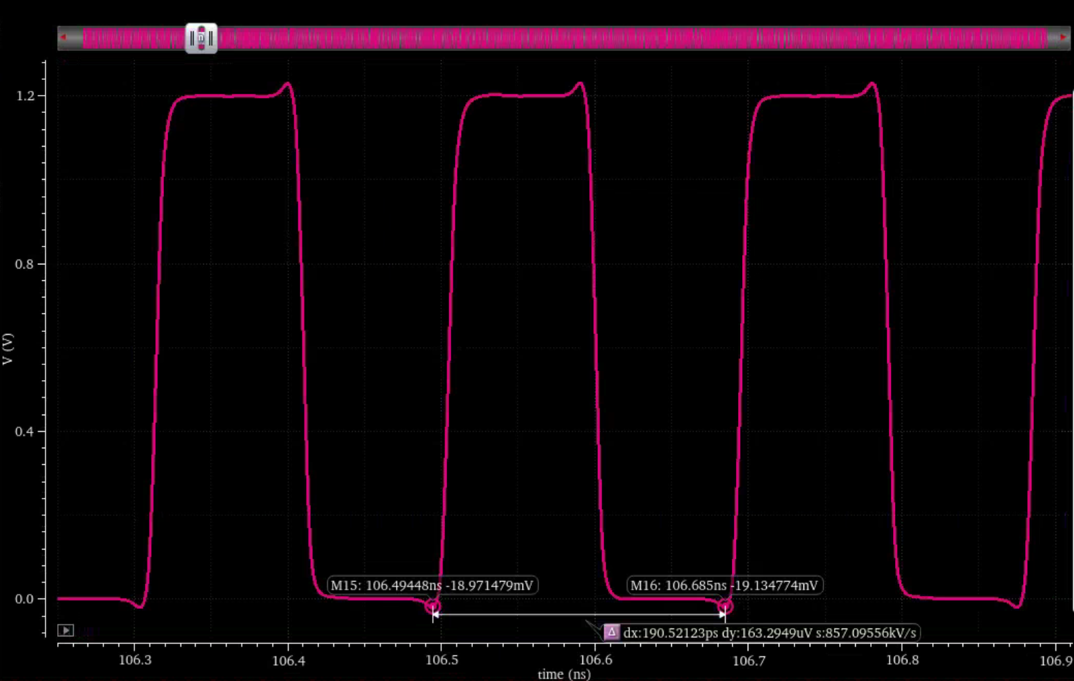
CML→CMOS Buffer Output
5.12 GHz Square Wave
Duty cycle within 5% of 50% across all PVT variations
Used for the sampling clock!

Slide 31
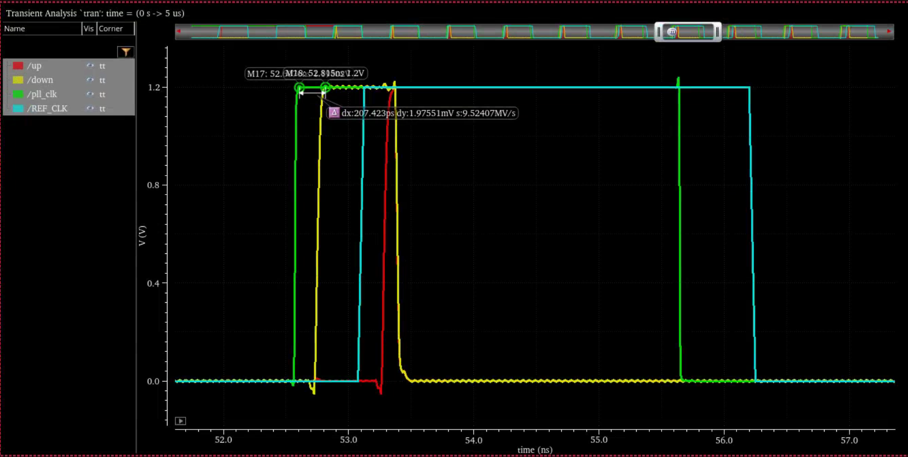
PFD Output
~200 ps reset path delay
Phase Error

Slide 32
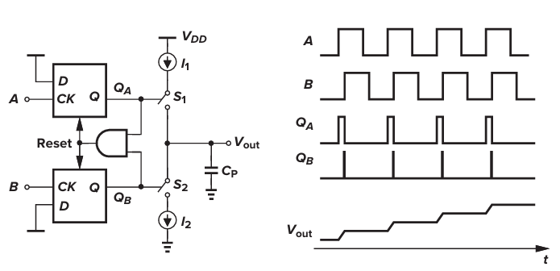
Ideal Phase-Frequency Detector
“Up”
“Down”
Left: a PFD implemented as two flip flops and a reset with a Charge Pump, Right: Behavior when Clock A is ahead of Clock B
[3] Behzad Razavi, Design of Analog CMOS Integrated Circuits, 2nd ed. (New York: McGraw-Hill, 2016).

Slide 33
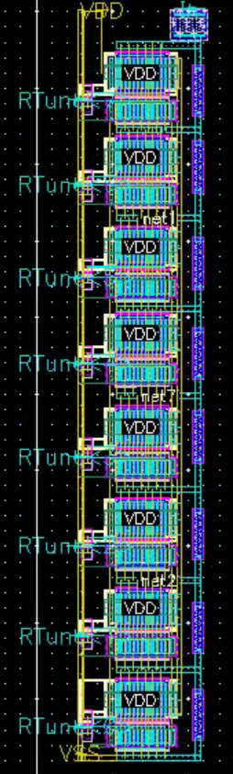
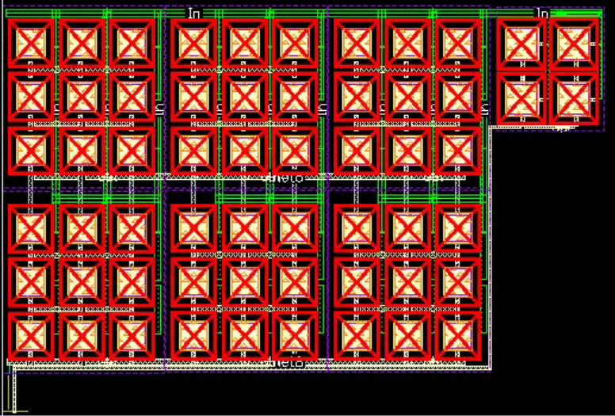
LPF Layout
Tunable Resistor layout
The C1 capacitor is 120 pF and C2 is 12 pF, both implement using MIMCAPS
The resistor can be tuned between 850 and 1650 Ohms
Main Filter Resistor
C1
C2
Pass Gate
Polysilicon Tuning Resistor
R

Slide 34
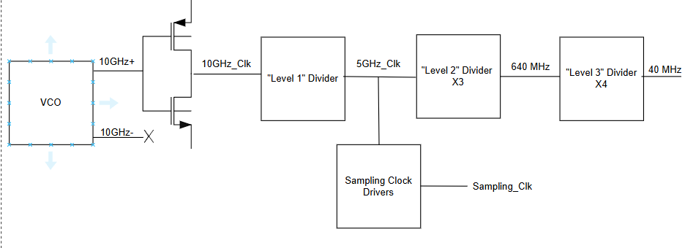
Improved Clock Divider Architecture
IR Drop
~15 MHz
PSEC5:
Small
Single Ended
New
Redesigned for robustness
PSEC6:

Slide 35
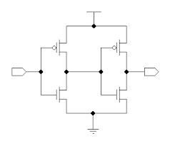
Sampling Buffer Architecture
Channel
Uses different sized buffers for main chain and channel input
Multiple buffers to minimize the parasitic capacitance from the buffers themselves
Channel
Channel
Sampling Clock ~5.12 GHz
Channel
PLL
Channel
Channel
Channel
Multi-stage buffering required to drive 5.12 GHz clock across 8 channels
Channel

Slide 36
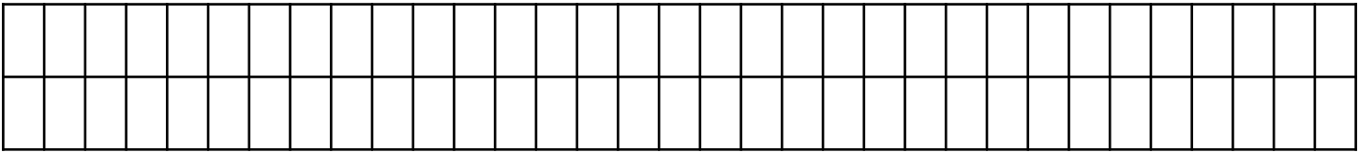
Architecture: Fast and Slow SCAs
A solution to the fast sampling and long analog buffer problem:
Fast Banks x4:
  64 samples each
  1.6 ns Buffer length
  Can be configured to run sequentially
Propagation delay ~800ps
A
Slow Bank:
  Up to 1024 samples
  204.8 ns Buffer length
  Captures the entire signal.
10bit counter
B
Hold delay ~800ps
Ref. [2] Jinseo Park, Design of an 8 Channel 40 GS/sec 20 mW/Channel Waveform Sampling ASIC in 65 nm CMOS, PM 2024

Slide 37
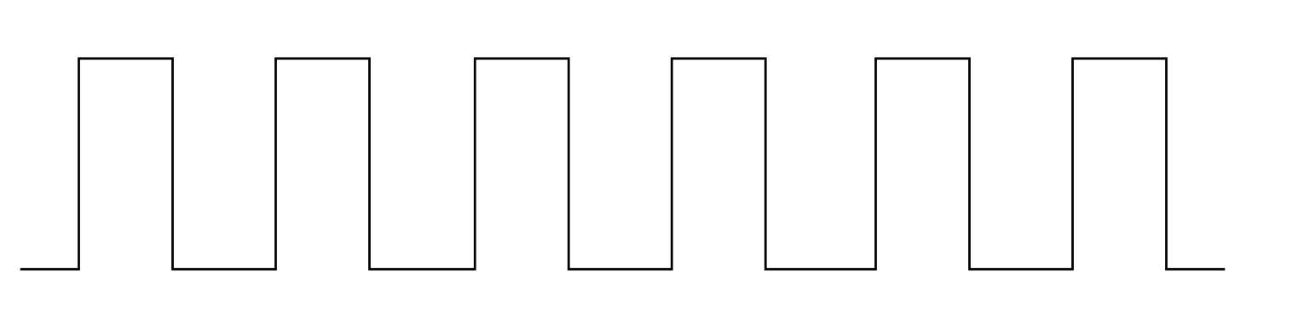




Controlling the Switches: Clock Signal
Clocks in electronics are just square waves with a known frequency:
“High”
Threshold
“Low”
Crystal Oscillators are extremely precise but cannot reach GHz frequencies.
RLC Circuits can be arranged to oscillate if they meet the Barkhausen Criteria:
Loop Gain = $\left|A\left(ω_{0}\right)β\left(ω_{0}\right)\right|≥1$,
Loop Phase =$∠A\left(ω_{0}\right)β\left(ω_{0}\right)=0°$
Vout:
E.g. 160 MHz – 6.25 ns period:
0.1ps jitter
LCs can oscillate at the GHz range, but the frequency is under-determined.
[3] Behzad Razavi, Design of Analog CMOS Integrated Circuits, 2nd ed. (New York: McGraw-Hill, 2016).

Slide 38



Phase Margin, Trade-offs
Phase Margin is the degrees of loop phase above -180 (where the loop is unstable), when the loop gain is 0. Mathematically:
$$φ_{m}=\arctan\left(\frac{\sqrt{1+4ζ^{4}}−2ζ^{2}}{2ζ}\right) + arctan\left(2ζ\right)$$
Where:
$$ζ=\sqrt{\frac{I_{cp}K_{VCO}RC_{1}}{8πN\left(C_{1}+C_{2}\right)}}$$
C2 adds an extra pole that reduces the ripples in Vtune, but destroys the phase margin
Bode plot: Loop Phase, and Loop Gain
Old Phase margin was 4 deg – It was very unlikely to be stable! We correct for this by increasing the size of C1 and R. We now have a 47 deg margin.

Slide 39






PLL Dynamics
Consider an ideal PLL with a linear VCO:
$$\frac{dφ_{out}}{dt}≈K_{VCO}⋅V_{tune}+ ω_{0}$$
And a loop filter with Impedance (Z):
$$Z\left(s\right)=R+ \frac{1}{sC}$$
The Phase detector compares the reference with the divided VCO output:
$$φ_{e}= φ_{ref} − \frac{φ_{out}}{N}$$
Taking the derivative of the phase error:
$$\frac{dφ_{e}}{dt}=\frac{dφ_{ref}}{dt} −\frac{1}{N}\frac{dφ_{out}}{dt}=ω_{ref}−\frac{ω_{0}}{N}−\frac{K_{VCO}}{N} V_{ctrl}$$
From the loop filter, the control voltage takes:
Convergence of Vtune, and thus the VCO frequency, in time
A PLL is a PI loop tuned by the resistance and capacitance
$$V_{tune}= \frac{I_{p}}{2π}\left(R φ_{e}+\frac{1}{C}∫φ_{e}dt\right)$$

Slide 40







Damped, Driven Oscillator
A direct comparison gives the natural frequency and damping factor:
Define $Δω= ω_{ref}− \frac{ω_{0}}{N}$ (the frequency offset as seen as the PFD) and the loop gain $K= \frac{I_{cp }K_{VCO}}{2πN}:$
$$ω_{n}=\sqrt{\frac{K}{C}}= \sqrt{\frac{I_{cp}K_{VCO}}{2πC}}$$
$$\frac{dφ_{e}}{dt}=Δω−KR φ_{e} − \frac{K}{C}∫φ_{e}dt$$
$$ζ=\frac{KR}{2ω_{n}}= \frac{R}{2}\sqrt{\frac{I_{cp}K_{VCO}C}{2π}}$$
Differentiating:
Where $ζ<1$ is underdamped – causes ringing,
$ζ>1$ is overdamped – overshoot, and $ζ≈0.707$ is critically damped.
$$\frac{d^{2}φ_{e}}{dt}+KR\frac{dφ_{e}}{dt}+ \frac{K}{C}φ_{e}=\frac{d(Δω)}{dt}$$
A mechanical 2nd order oscillator can be described as:
$$\frac{d^{2}x}{dt}+2ζω_{n}\frac{dx}{dt}+ {ω_{n}}^{2}x=f(t)$$
Damping factor is critical to determine settling time
Ringing from an underdamped PLL.

Slide 41






Stability
The First Convergence looked healthy, but the Laplace domain was concerning:
$$Φ_{e}\left(s\right)=Φ_{ref}\left(s\right)−\frac{Φ_{out}\left(s\right)}{N}$$
The forward path (PFD -> Charge Pump -> Loop Filter -> VCO) gives:
$$Φ_{out}\left(s\right)=\frac{K_{VCO}}{s}∙Z(s)∙\frac{I_{cp}}{2π}∙Φ_{e}\left(s\right)$$
With $Z\left(s\right)=R+ \frac{1}{sC}$ , we get the open loop transfer function:
$$G\left(s\right)=\frac{K_{VCO}I_{cp}}{2πN}∙\frac{sRC+1}{s^{2}C}=K∙\frac{sRC+1}{s^{2}C}$$
And a closed-loop transfer function of
$$H\left(s\right)= \frac{Φ_{out}}{Φ_{ref}}= \frac{N∙G(s)}{1+G(s)}$$
Nyquist plots for a PLL open-loop transfer function. [5]
The loop is unstable if the $H_{open}$ contour hits (-1,0)
Open loop analysis: Will the loop be stable?
Closed Loop analysis: If the loop is stable, how does it respond?
[3] Behzad Razavi, Design of Analog CMOS Integrated Circuits, 2nd ed. (New York: McGraw-Hill, 2016).

Slide 42

Extra pole from C2
Yes, C2 also introduces a pole from its own impedance.
This would call adjustments in the loop parameters. (PLL is now third-order)
However, keeping C2 >> C1: We are using a ratio of 1:10, we can keep the second order approximation.
[13] Xiaoran Wang, “A 10 GHz Low-Jitter Cryogenic PLL for Quantum Applications in 22 nm” (presentation, CPAD 2024, Oak Ridge National Laboratory / University of Tennessee, Knoxville, TN, November 19, 2024),

Slide 43





Particle ID
Using Time of Flight, one can identify pions from kaons from their momenta.
$$τ_{12}= Δt_{1} − {Δt}_{2}$$
$$=d\left(\sqrt{1+ \frac{{m_{1}}^{2}}{{p_{1}}^{2}}}−\sqrt{1+ \frac{{m_{2}}^{2}}{{p_{2}}^{2}}}\right)$$
For relativistic particles (p >> m) of the same momenta ($p_{1}=p_{2})$:
$$τ_{12}≈\frac{d}{{2p}^{2}}({m_{1}}^{2}−{m_{2}}^{2})$$
Contours represent detector timing resolution required to distinguish 68.27% of pions and kaons by momenta and path length
[11] Angelico, E; Development of LAPPDs for a Precision ToF System at the Fermilab Testbeam Facility (Doctoral Dissertation, University of Chicago, 2020)

Slide 44


LAPPDs
MCPs: Small pores (high spatial resolution)
Charged Particle -> Cherenkov -> electrons
Cherenkov radiation: “Sonic boom” for light in a medium
An LAPPD, by component.
Spatial Resolution along the anode stripline is reconstructed by measuring the time difference of signals on the same line
[12] Incom, Inc., “LAPPD – Large Area Picosecond Photodetector,” (webpage), accessed December 1, 2025,

Slide 45

Full system block diagram
Detector
Device Board
Reconstruction
Software
Control Board
FPGA
Data Analysis
Block Diagram of PSEC5 [2]

Slide 46
References
[1] Stefan Ritt; The role of analog bandwidth and signal-to-noise in timing for waveform digitizing; Timing Workshop, Chicago April 28th 2011 https://psec.uchicago.edu/workshops/fast_timing_conf_2011/system/docs/18/original/ritt_analog_bw.ppt
[2]Park, J., et al. 2025. “Design of an 8-Channel 40 GS/s 20 mW/ sampling ASIC in 65nm CMOS.” Nuclear Instruments and Methods in Physics Research Section A: Accelerators, Spectrometers, Detectors and Associated Equipment 1072 (2025)
[3]Behzad Razavi, Design of Analog CMOS Integrated Circuits, 2nd ed. (New York: McGraw-Hill, 2016).
[4] Niner, E; “Fermilab Test Beam Facility” , Fermilab ACE Science Workshop, June 2023
[5] Inami, K., et al. “A 5 ps TOF-counter with an MCP–PMT.” Nuclear Instruments and Methods in Physics Research Section A 566, no. 1 (2006): 52–56.
[6] Unknown Author. “Chapter 1: Introduction.” Lecture slides, PS412, Embry-Riddle Aeronautical University, undated. https://physicsx.erau.edu/Courses/CoursesF2025/PS412/Lectures/Chapter%201%20Introduction.pdf
[7] D. A. Stricker-Shaver, S.Ritt, B. J. Pichler; Novel Calibration Method for Switched Capacitor Arrays Enables Time Measurements with Sub-Picosecond Resolution https://arxiv.org/pdf/1405.4975

Slide 47
[8] Oberla, E; Charged Particle Tracking in an Optical Time Projection Chamber (Doctoral Dissertation, University of Chicago, 2015)
[9] Yeung, et al. “Design of an 8-channel 40 GS/s 20 mW/Ch waveform sampling ASIC in 65nm CMOS”, FAST 2025, Elba. https://indico.cern.ch/event/1445926/contributions/6400606/
[10] Arzac et al, “A Modular Test System for the PSEC5 40 GS/s waveform sampling ASIC” FAST 2025, Elba
[11] Angelico, E; Development of LAPPDs for a Precision ToF System at the Fermilab Testbeam Facility (Doctoral Dissertation, University of Chicago, 2020)
[12] Incom, Inc., “LAPPD – Large Area Picosecond Photodetector,” (webpage), accessed December 1, 2025,
[13] Xiaoran Wang, “A 10 GHz Low-Jitter Cryogenic PLL for Quantum Applications in 22 nm” (presentation, CPAD 2024, Oak Ridge National Laboratory / University of Tennessee, Knoxville, TN, November 19, 2024),

