Slide 1


PSEC Collaboration
Y.M. Richmond Yeungª , Evan Angelico^{d}, Andrew Arzacª, Gordon Chen ª, Ahan Dattaª, Troy England^{b}, Henry J. Frischª, Nathan Gehlª, Mary Heintzª, Sumin Kimª, Arjun Kulkarniª , Ava Lalichª , Nathaniel J. Pastika^{b}, Jinseo Park^{d}, Hector D. Rico-Aniles^{c}, Paul M. Rubinov^{b},
ªEnrico Fermi Institute, the University of Chicago, 933 East 56th Street, 60637, Chicago, IL, USA
^{b}Fermi National Accelerator Laboratory, 60510, Batavia, IL, USA
^{c}North Central College, 30 N. Brainard Street, 60540, Naperville, IL, USA
^{d}Stanford University, 450 Jane Stanford Way, 94305, Stanford, CA, USA
March 31, 2026

Slide 2
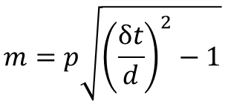
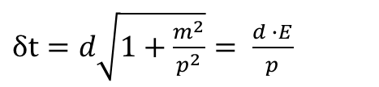


Time-of-flight Particle Identification
Given a relativistic particle with relativistic velocity $β$, the time of flight is:
$$δt= \frac{d}{β}$$
*in units of ns and feet
Beam
LAPPD
LAPPD
$δt=d\sqrt{1+\frac{m^{2}}{p^{2}}}= \frac{d ∙E}{p}$
Using the relation $E^{2}= m^{2}+ p^{2}$, we can solve for the particle’s mass:
$$d$$
$$m=p\sqrt{{\left(\frac{δt}{d}\right)}^{2}−1}$$
Readout Electronics
By reconstructing the mass with time-of-flight, we can identify the particle.
Software
Notes:
Using time-of-flight, we can reconstruct a particle’s mass and thus identify the particle.

Slide 3
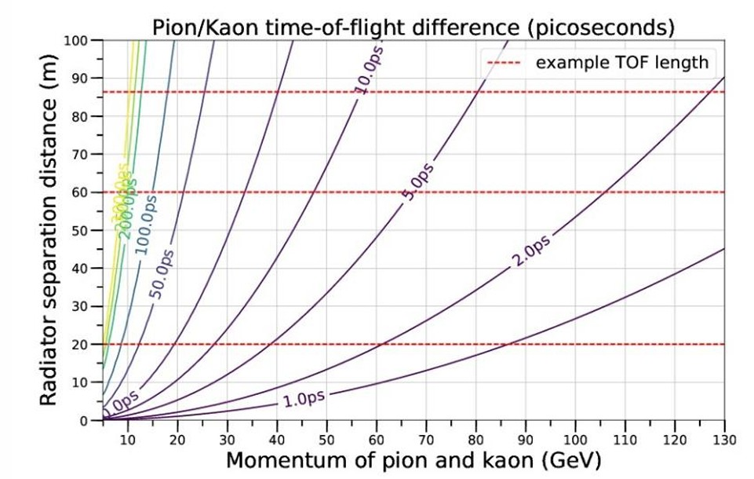
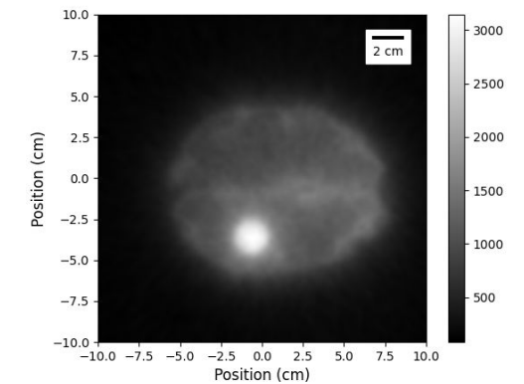
The picosecond regime
Picosecond timing enables the search for new physics at colliders: Electron Ion Collider (EIC), LHCb and more.
Test beams enable the calibration and development of other novel detector technologies
Better timing resolutions allow for better image resolution for Positron Emission Tomography: <10 ps is a long-standing goal of the industry.
Contours of detector timing resolution needed to distinguish 68.27% of pions and kaons as a function of momentum and path-length.
XCAT Brain phantom at 1/100th dose

Slide 4
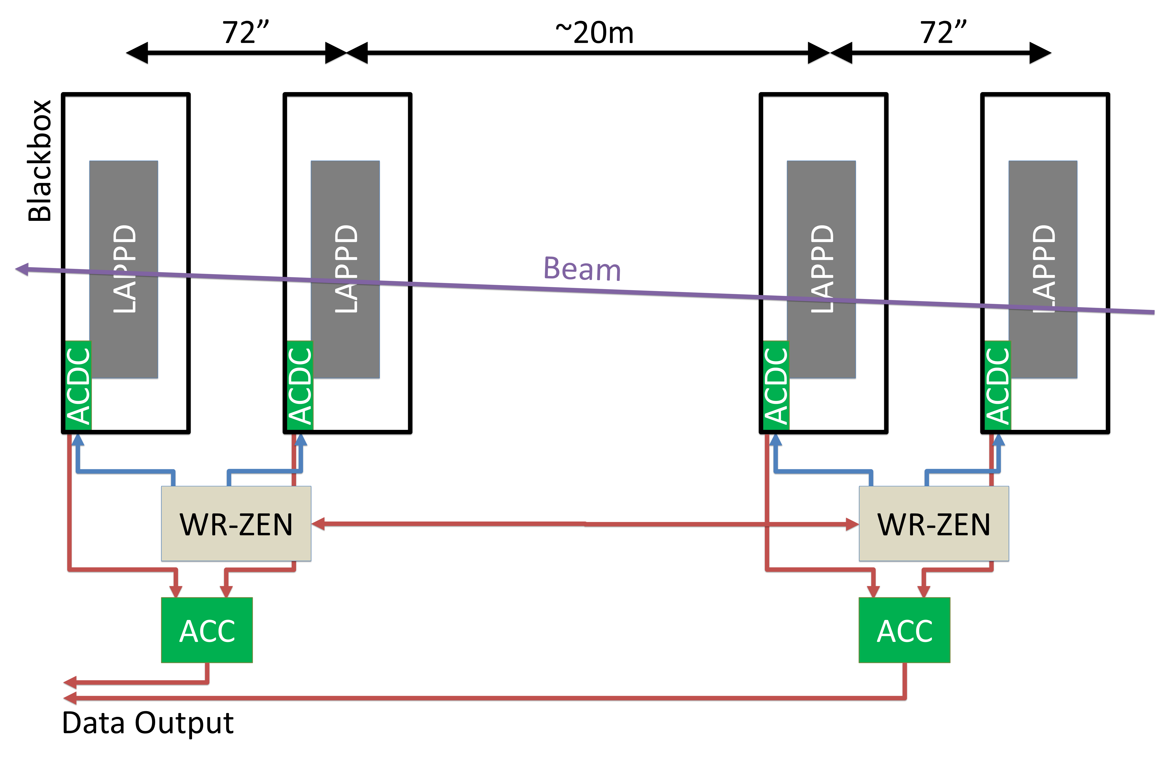
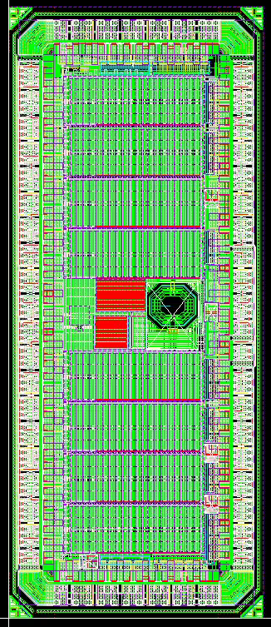
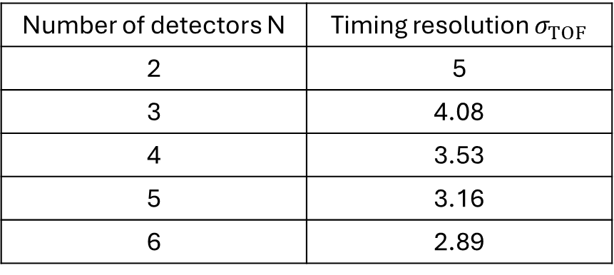
PSEC5/6 – An Application Specific Integrated Circuit (ASIC)
Timing detectors have demonstrated resolutions as low as 5 picoseconds.
More detectors in series = better resolution
However, the timing uncertainty from the electronics would remain.
Number of detectors N | Timing resolution $σ_{TOF}$
2 | 5
3 | 4.08
4 | 3.53
5 | 3.16
6 | 2.89
Current electronics gets to ~15 picoseconds. We aim to achieve a resolution of ~1 ps.
PSEC5 ASIC

Slide 5
PSEC6 Specifications
Process | 65nm TSMC
Signal to Noise | 1000
Sampling Rate | 40GSa/s (5GSa/s)
Fast Buffer Length | 6.4ns
Slow Buffer Length | 204.8ns
Analog Bandwidth | 4.9 GHz
Channels/Chip | 8
Area | 2.6 mm²
Max. Readout Rate | 40KHz
Institutions | UChicago & Fermilab
Switched Capacitor Array (SCA) based waveform-sampling ASIC
Designed in TSMC 65nm process
Requires stable 5.12 GHz sampling clock → PLL
First 10 GHz PLL in 65 nm for HEP experiment
Notes:
PSEC6 is a Switched Capacitor Array, or SCA, based waveform-sampling ASIC designed in TSMC 65 nanometer. It’s maximum sampling rate is 40 Gigasamples per second with a baseline rate of 5 Gigasamples per second, which requires a 5 Gigahertz stable sampling clock. Thus, we need to make a PLL, which is the first 10 gig PLL in 65 nm for HEP experiment to our knowledge.

Slide 6
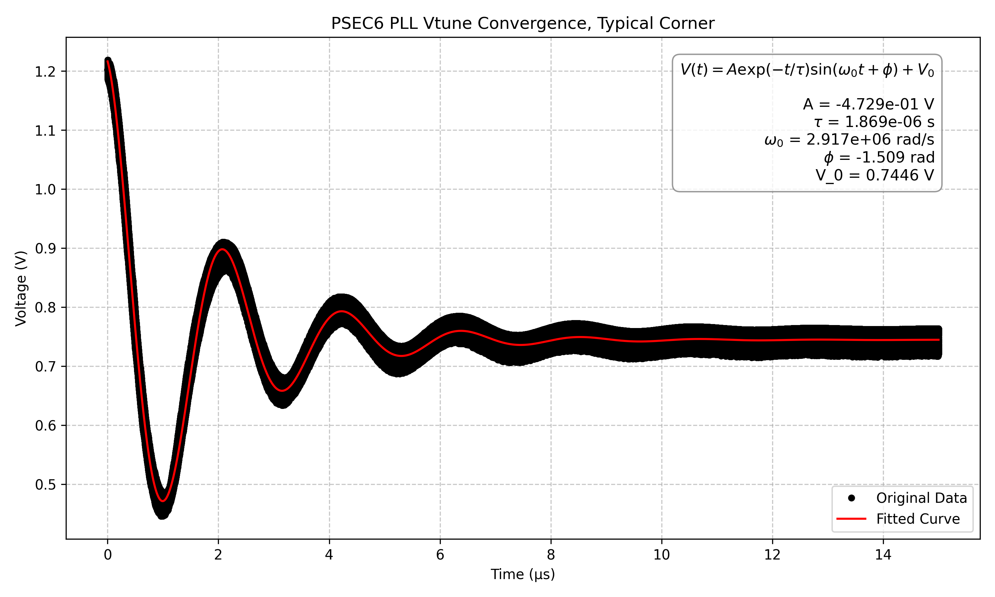
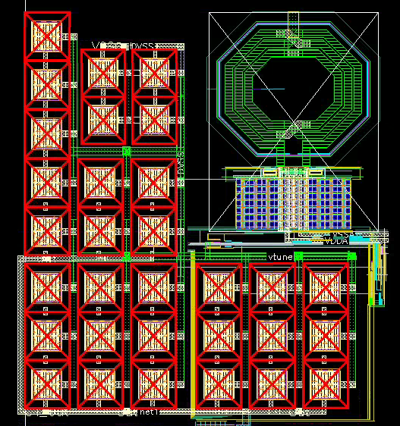
10.24 GHz Phase Locked Loop (PLL) in 65nm CMOS
65nm CMOS is one of the most commonly used processes in High Energy physics.
A PLL in 65nm CMOS has not been achieved in the High Energy Physics community.

Slide 7
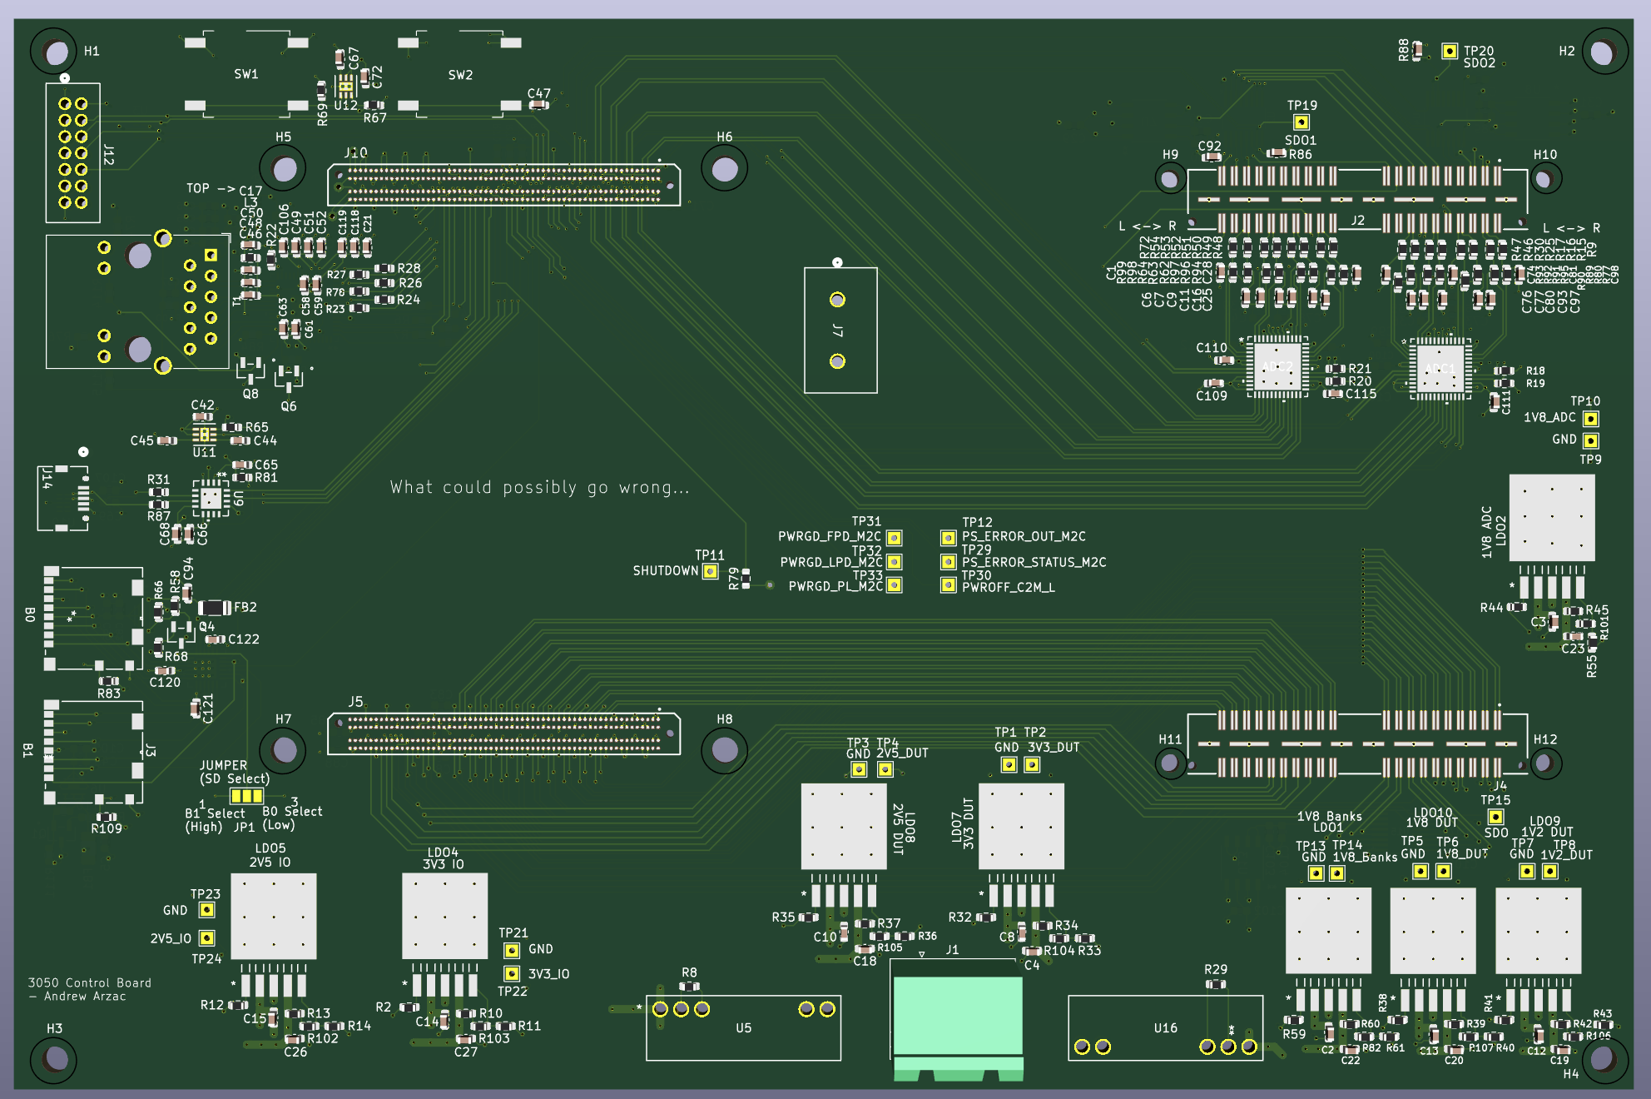
Design of a Modular Test/Readout System
FPGA based readout system
Uses AMD’s Kria K26 - Custom Zynq™ UltraScale+™ MPSoC
Customizable DUT board design
8 Channel 65MSPS ADC readout to FPGA
Kria K26 SOM
DUT Board

Slide 8
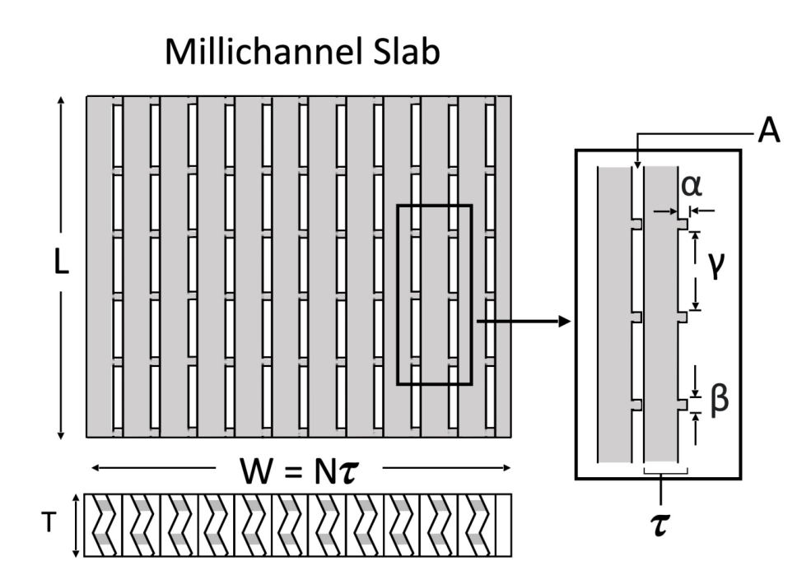
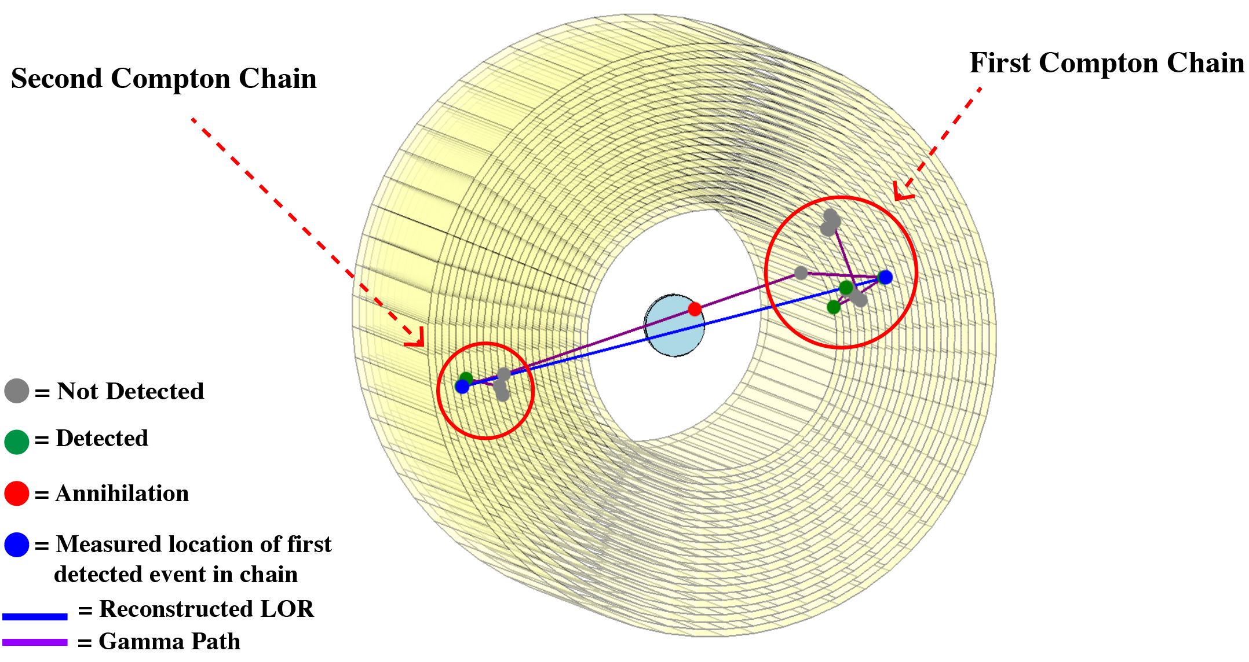
Low Dose TOF PET
Parameter | Value
Time Resolution (σₜ) | 0.1 ns
Axial Resolution (σ_z) | 0.3 mm
Tangential Resolution (σ_φ) | 0.3 mm
Radial Resolution (σ_r) | 7.3 mm
Spatial Resolution (FBP) | 0.57 mm FWHM
Spatial Resolution (EM) | 0.51 mm FWHM
Pixel Resolution | 0.2 mm
Gamma Energy | 511 keV
Dose Reduction Goal | >1000×
Goal is factor of > 1000 reduction in radiation dose

