Slide 1
Design of an 8 Channel 40 GS/sec 20 mW/Channel Waveform Sampling ASIC in 65 nm CMOS
Y. R.Yeung²,
D. Braga¹, T. England¹, F. Fahim¹, N. J. Pastika¹, P. M. Rubinov¹, X. Wang¹
A. Arzac², A. Datta², H. J. Frisch², M. Heintz², E. Oberla², J. Park²
E. Angelico³, H. D. Rico-Aniles⁴
1. Fermi National Accelerator Laboratory 2. University of Chicago 3. Stanford University 4. North Central College
Slide 1 of 22

Slide 2
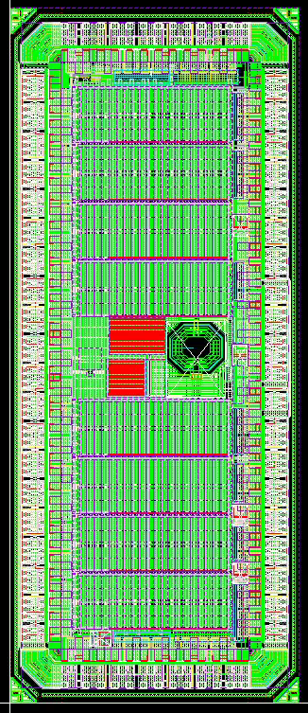
PSEC5 aims to deliver on a few key features
Low Power
Multi-Hit capability
40 GS/s Sampling Rate
4GHz Analog Bandwidth
Customizable Buffer Lengths
  Aims to achieve fast sampling and long analog buffer
<5ps timing resolution
Slide 2 of 22

Slide 3
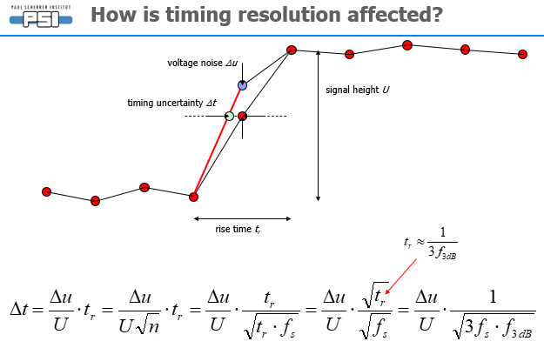
Primary goal – picosecond timing resolution
Ref. [1] Stefan Ritt; The role of analog bandwidth and signal-to-noise in timing for waveform digitizing; Timing Workshop, Chicago April 28th 2011
Therefore, an improved Δt can be achieved by:
Low Noise (from samples)
Minimizing Sampling time jitter
High Sampling Rate
High Analog Bandwidth
Where $f_{s}=$ Sampling Rate and$f_{3 dB}=$ Bandwidth
We intend to deliver a proof of concept at the Fermilab Test Beam Facility (FTBF).
Slide 3 of 22

Slide 4
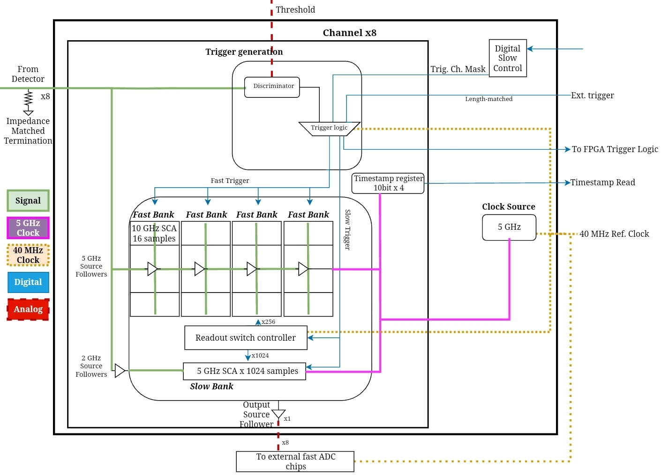
PSEC5 Block Diagram and Specs
Process | TSMC 65 nm
Dynamic range | 10 bits
Sampling Rate | 40 GSa/s (5 GSa/s)
Buffer Length | 6.4 ns(204.8 ns)
Analog Bandwidth | >4 GHz
Channels/Chip | 8
Area | 2.4 mm²
Slide 4 of 22

Slide 5
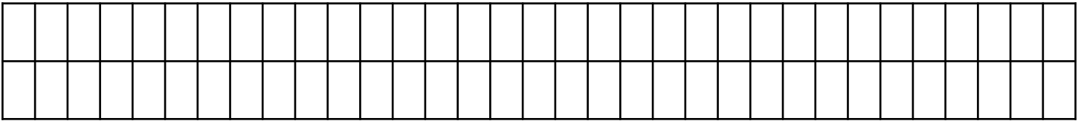
Architecture: Fast and Slow SCAs
A solution to the fast sampling and long analog buffer problem:
Fast Banks x4:
  64 samples each
  1.6 ns Buffer length
  Can be configured to run sequentially
Propagation delay ~800ps
A
Slow Bank:
  Up to 1024 samples
  204.8 ns Buffer length
  Captures the entire signal.
10bit counter
B
Hold delay ~800ps
Ref. [2] Jinseo Park, Design of an 8 Channel 40 GS/sec 20 mW/Channel Waveform Sampling ASIC in 65 nm CMOS, PM 2024
Slide 5 of 22

Slide 6
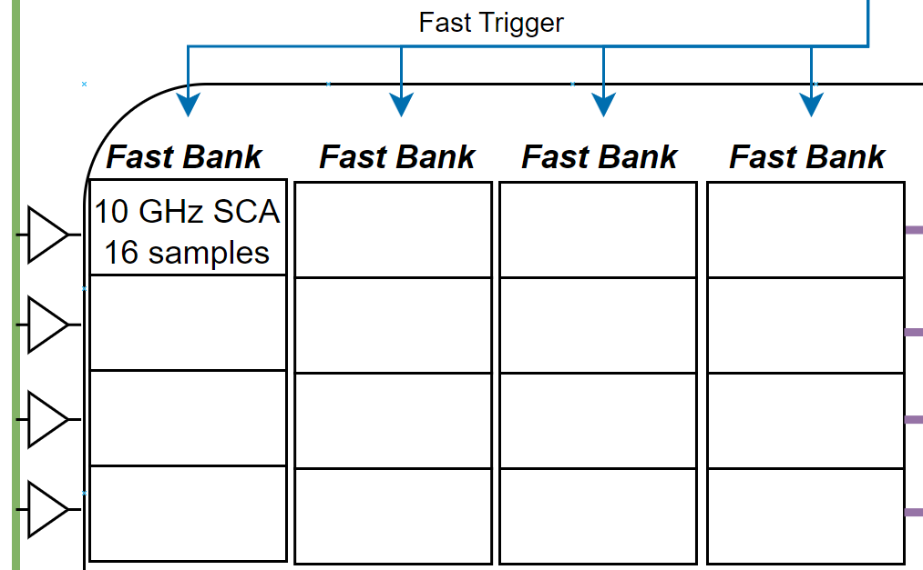
Fast Bank structure
~200um
0˚ 5GHz Clock
90˚
180˚
270˚
Ref. [2] Jinseo Park, Design of an 8 Channel 40 GS/sec 20 mW/Channel Waveform Sampling ASIC in 65 nm CMOS, PM 2024
Slide 6 of 22

Slide 7
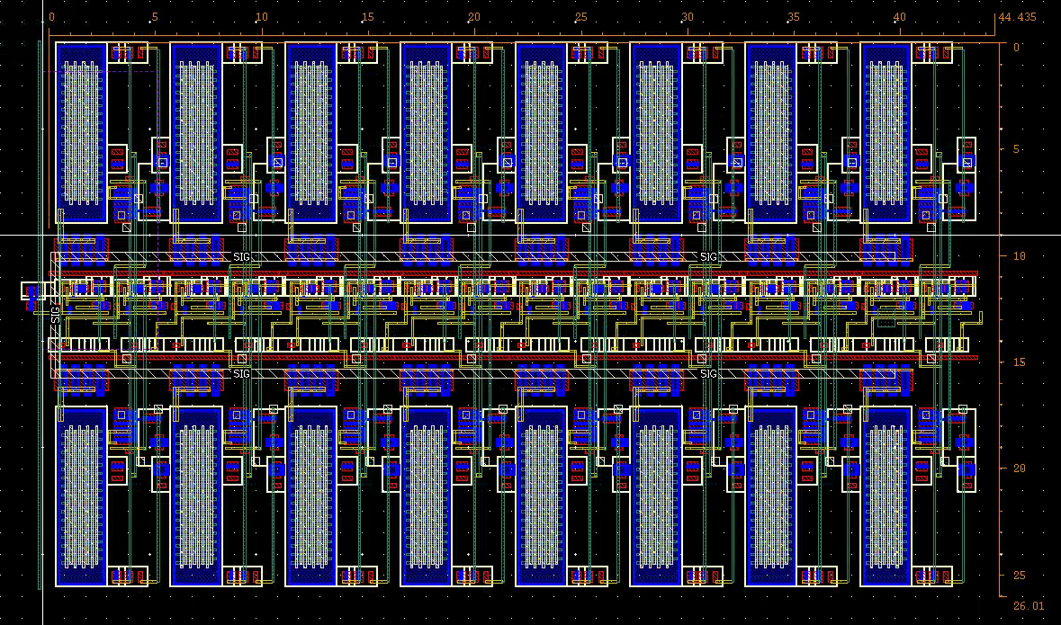
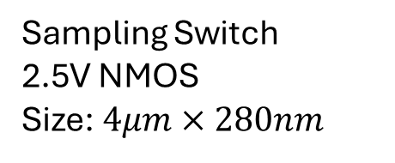
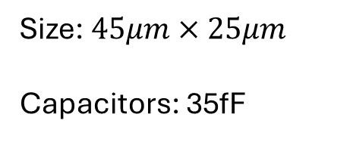
Single Column Layout
Size: $45μm×25μm$
Capacitors: 35fF
Sampling Switch
2.5V NMOS
Size: $4μm×280nm$
Ref. [2] Jinseo Park, Design of an 8 Channel 40 GS/sec 20 mW/Channel Waveform Sampling ASIC in 65 nm CMOS, PM 2024
Slide 7 of 22

Slide 8
Sampling Switch – why NMOS-2.5v?
 | CMOS | CMOS-2.5 V | CMOS-lvt | NMOS | NMOS-2.5v | NMOS-lvt | NMOS-hvt
V Range | 1.2 V | 2.5 V | 1.2 V | <1.2 V* | <2.5 V* | <1.2 V* | <1.2 V*
Cutoff Freq** | 0.6 GHz | 3.4 GHz | 2.3 GHz | 1 GHz | 6 GHz | 3.4 GHz | <0.1 GHz
Length | 60 nm | 280 nm | 60 nm | 60 nm | 280 nm | 60 nm | 60 nm
Hold Time**** | 68 ns | >10 μs | 1.7 ns | 71 ns | >20 μs | 2.6 ns | 2 µs
*Higher impedance as the signal voltage reaches vdd, noticeable at V>0.6vdd
****ff corner, 10% decay after sampling vdd.
**(Capacitor V Amplitude / Signal V Amplitude) reaches 0.7. ss corner, 0.1 V amplitude , DC bias = 0.5vdd
Ref. [3] Jinseo Park et al PSEC5 Godparent Review 2024
Slide 8 of 22

Slide 9
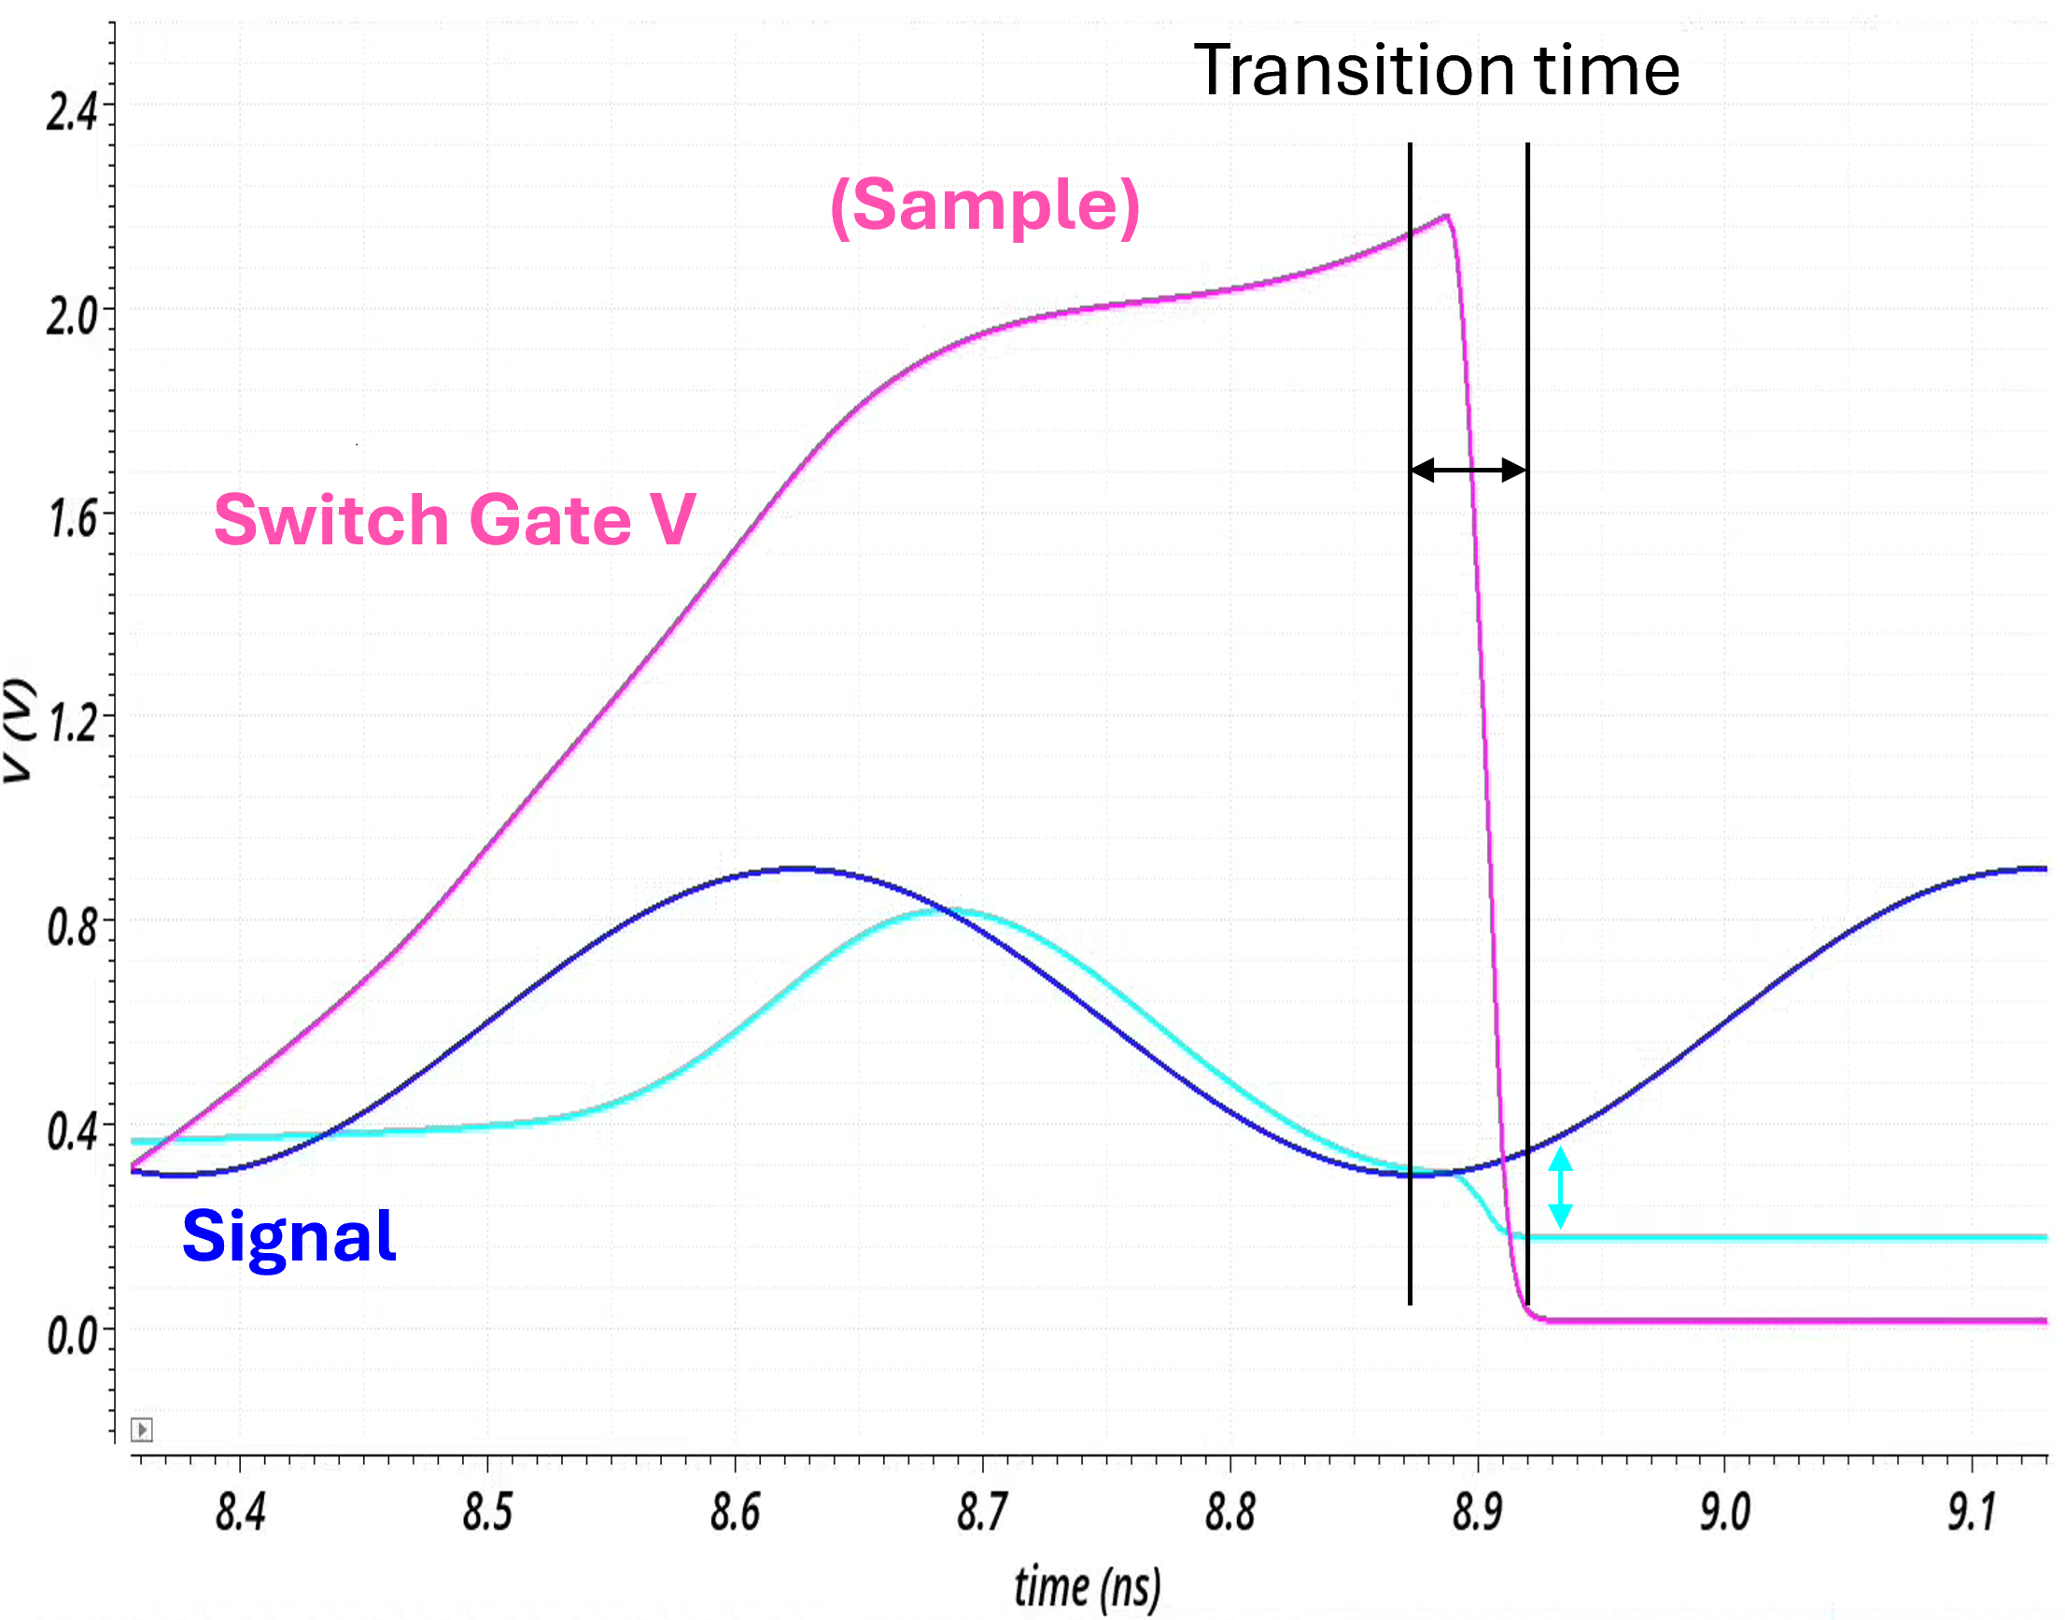
Switching Drift – Justifying an NMOS sampling switch
Transition time
The value of a capacitor drifts while it switches off from the signal line.
Drift consists of switch gate charge injection, which is a fixed value and is calibratable, and resistive drift, which is dependent on signal V.
It is essential to keep the
[Sample → Hold] transition time low.
→NMOS instead of CMOS for the sampling switch!
(Sample)
Switch Gate V
Signal
Resistive Drift
(Hold)
Ref. [2] Jinseo Park, Design of an 8 Channel 40 GS/sec 20 mW/Channel Waveform Sampling ASIC in 65 nm CMOS, PM 2024
Slide 9 of 22

Slide 10
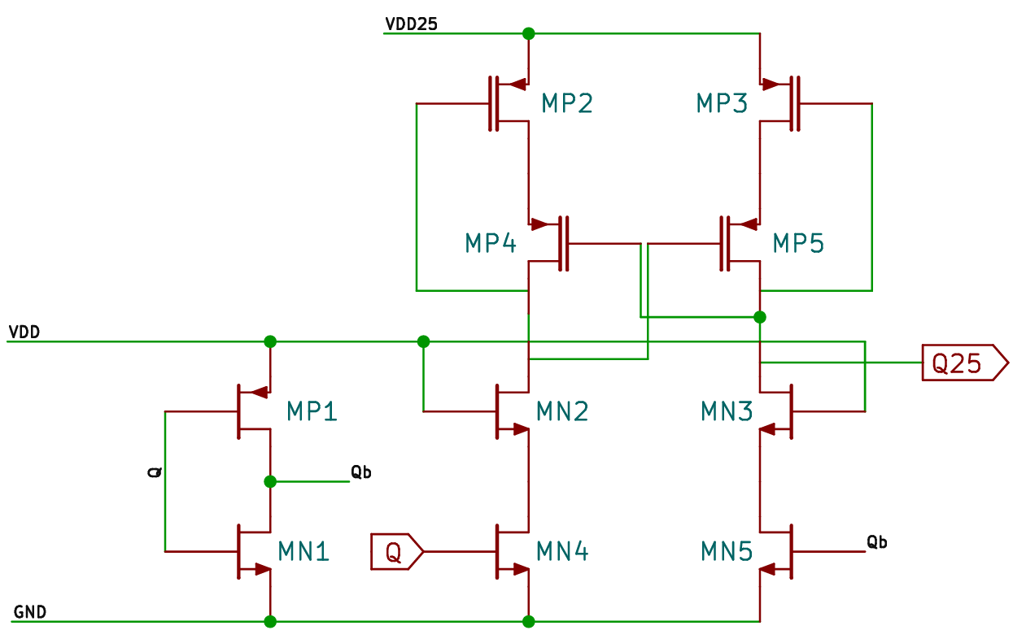
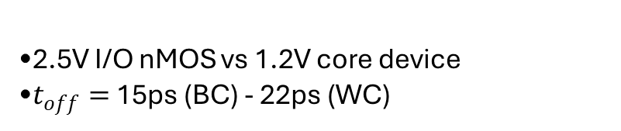
Minimizing Sampling Switch Resistance
2.5V I/O nMOS vs 1.2V core device
$t_{off}=$ 15ps (BC) - 22ps (WC)
We use a voltage level shifter to minimize switch resistance while keeping its gate voltage high.
Slide 10 of 22

Slide 11
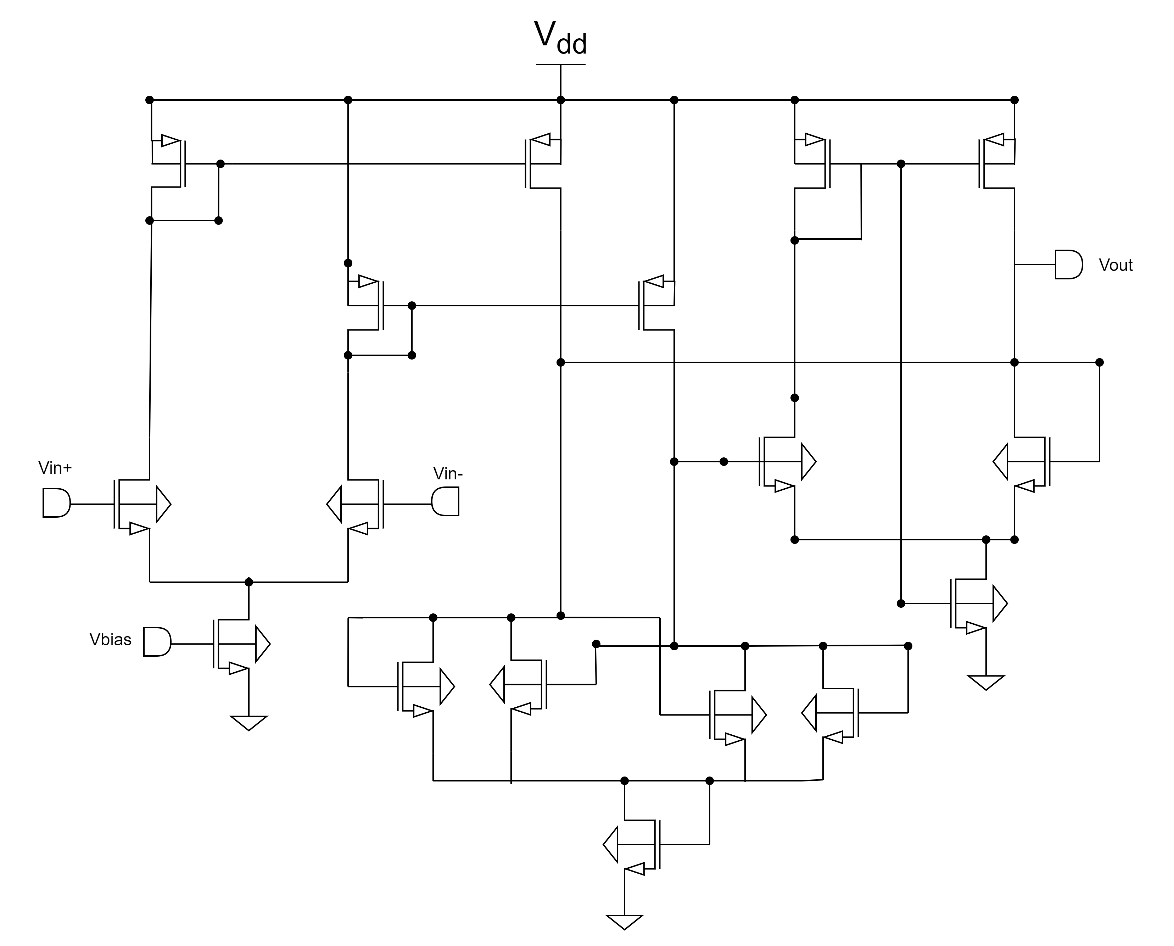
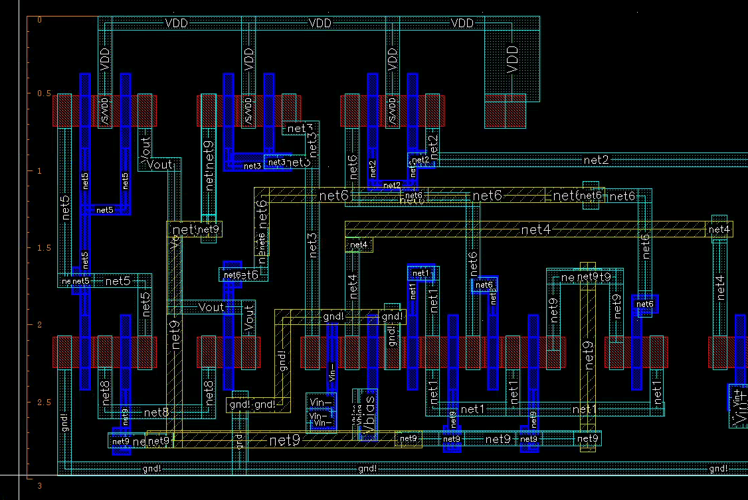
Discriminator – Triggering for the Fast SCA Banks
Rising‐edge delay is a consistent ~180 ps with <15 ps spread, while falling‐edge delay improves from ~310 ps down to ~165 ps as Vped rises, also with ≤15 ps variation
One discriminator per channel – flips to trigger fast SCA bank
Slide 11 of 22

Slide 12
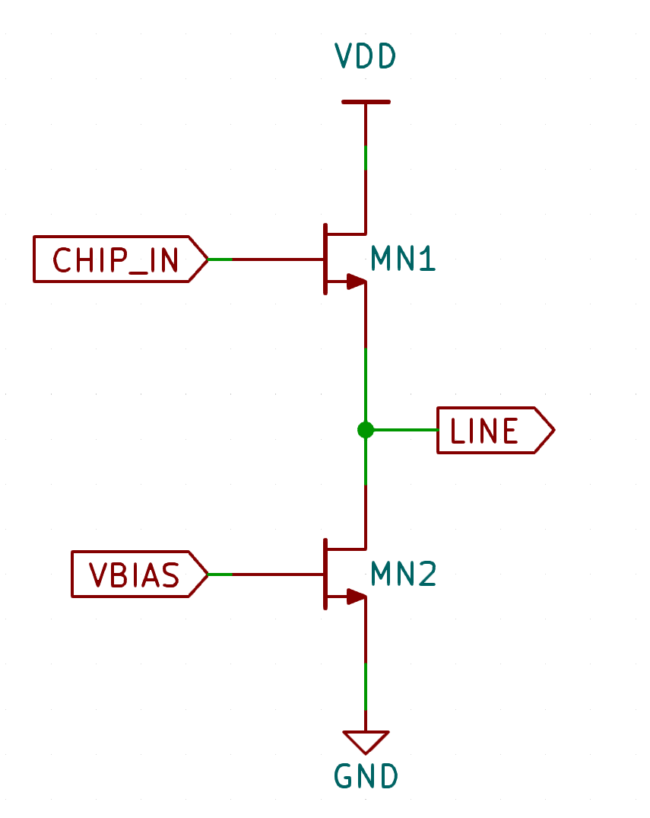
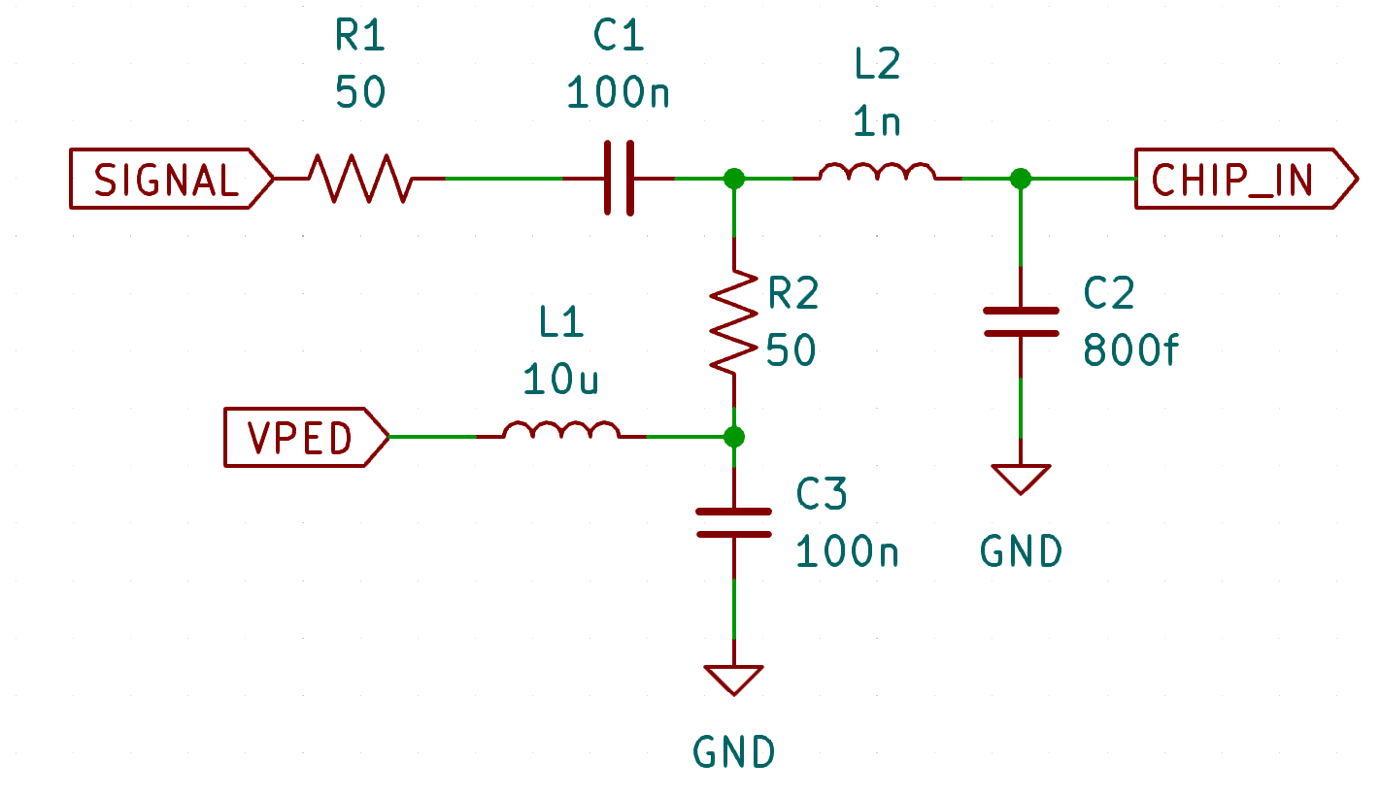
Main Signal Path Bandwidth
Equiv. of
Wire Bond + Pad + ESD
Onboard Components
Input Source Follower
Key Specs:
Source Follower Bandwidth 5 GHz
Wire-bond Bandwidth 4 GHz
Slow Bank Bandwidth 2 GHz
C1, C3, R2, L1 are components placed on board for capacitive coupling.L2 and C2 are the parasitic inductance and the capacitance of the wire bond and ESD combined
Pedestal Voltages are controlled by the FPGA
Overall bandwidth constrained by Wire- bonding: 4 GHz
Slide 12 of 22

Slide 13
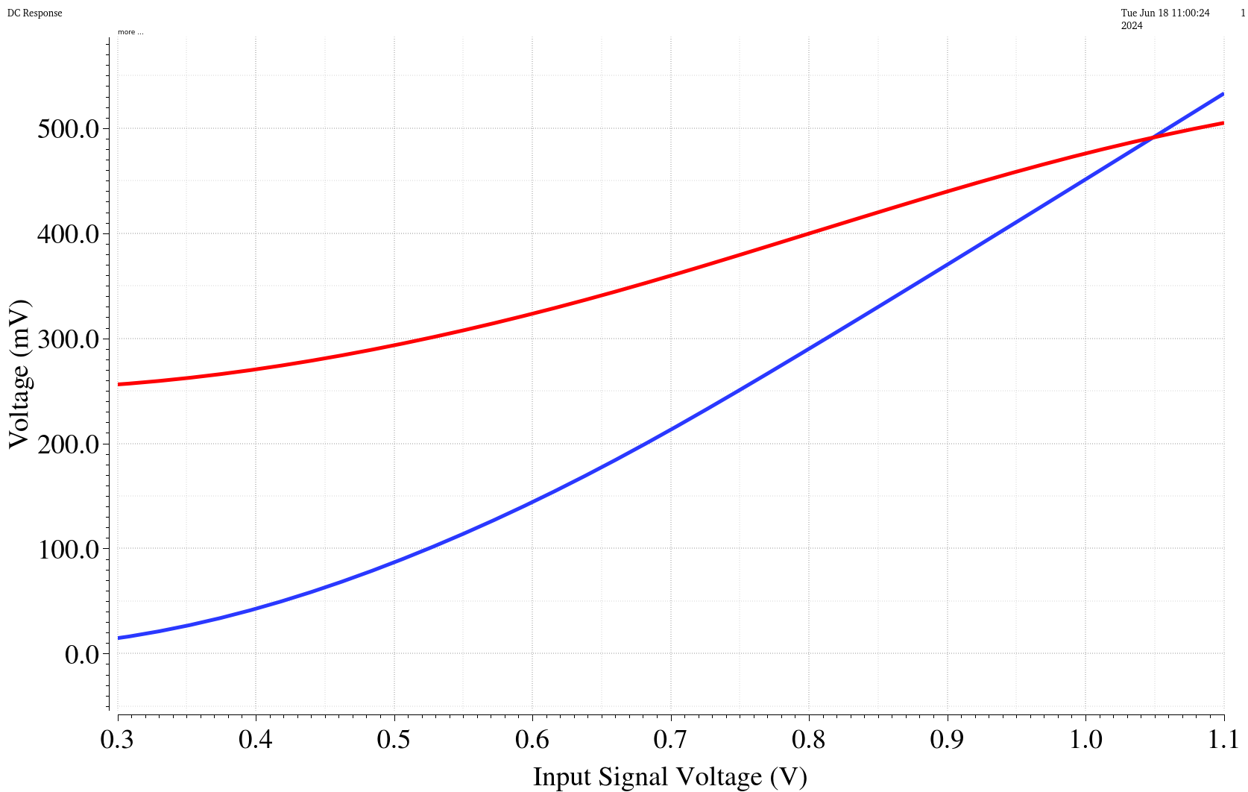
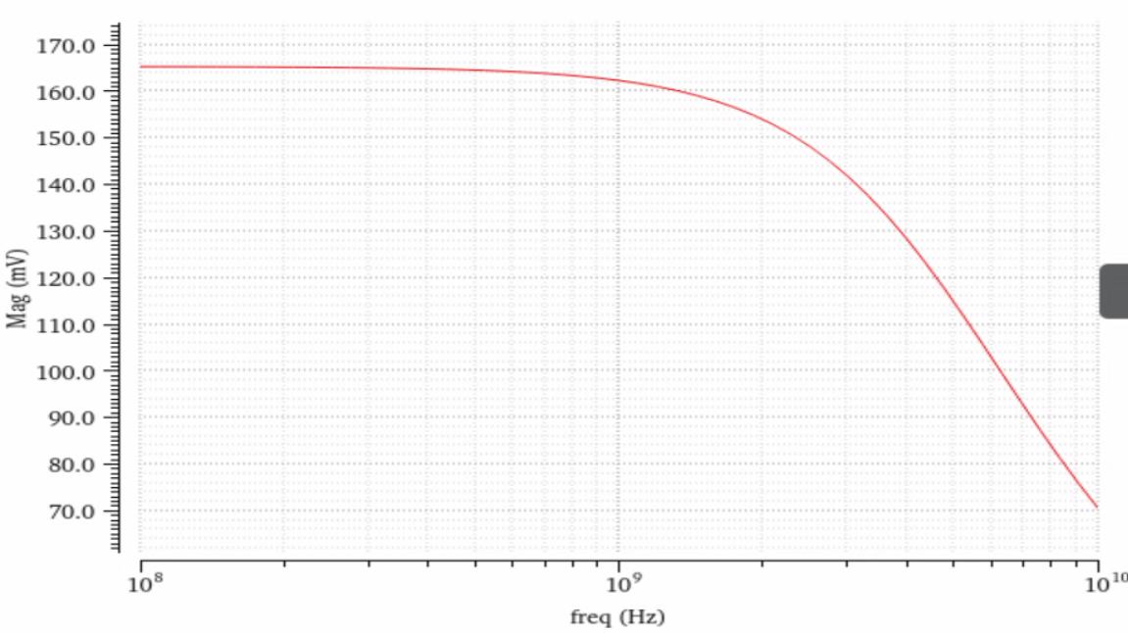
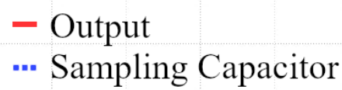
Signal Path performance
Mag / mV
Voltage Linearity Plot
AC Sweep (100 MHz – 10 GHz) – Input Buffer
Voltage / mV
-3dB – 4.9 GHz
Input Signal Voltage / V
Frequency / Hz
Buffer Achieves 4.9 GHz input bandwidth
Slide 13 of 22

Slide 14
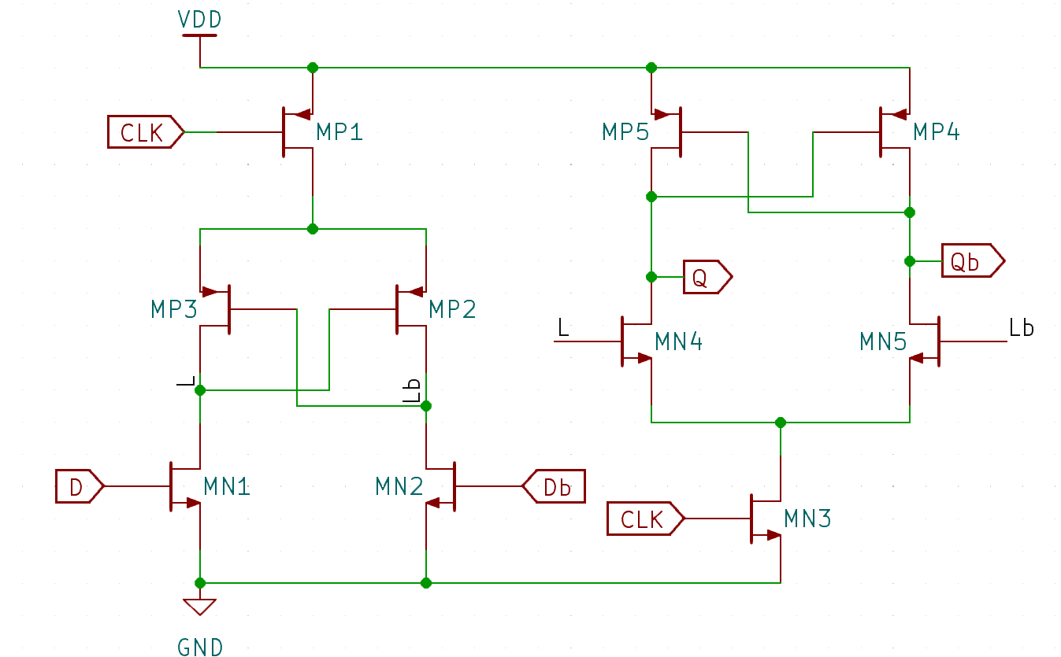
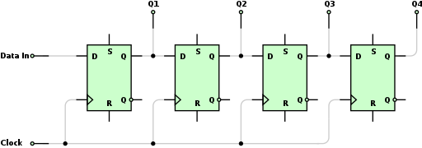
Reducing Clock Power: 40GS/s without 10GHz clk
Prepare slide to defend stability.
Using both clock edges, we can achieve 10 GS/s with half the frequency
Left: Schematic of Shift Register
Slide 14 of 22

Slide 15
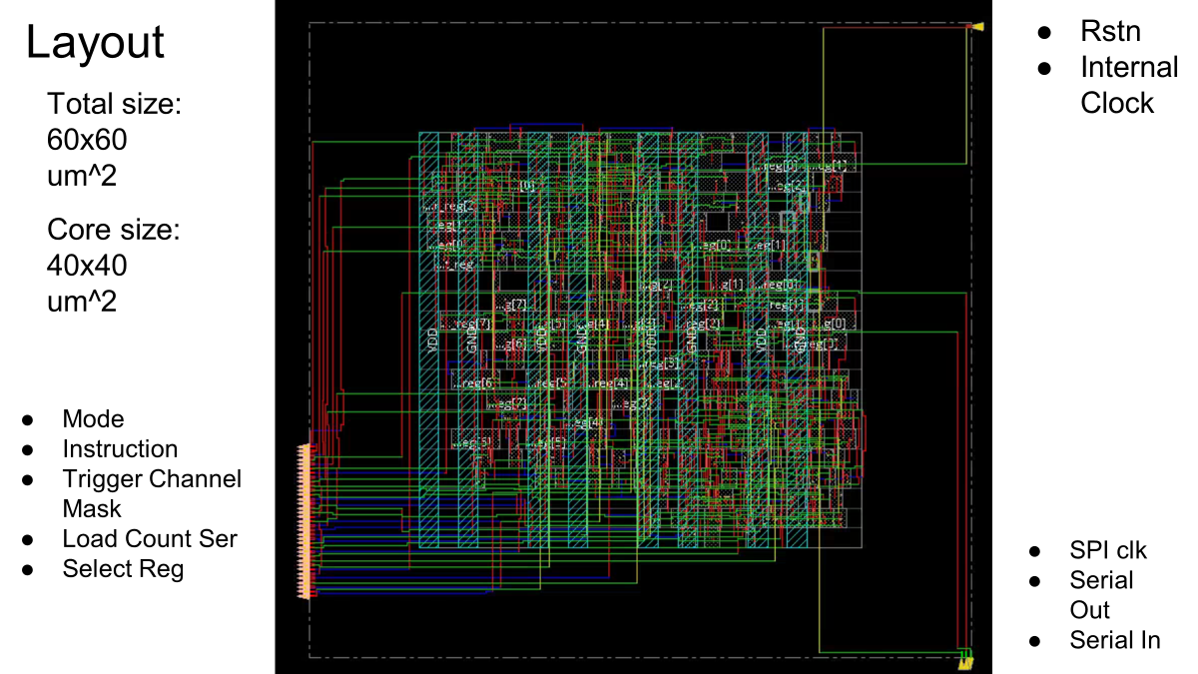
Digital Block
Ref. [4] Ahan Datta Design and Implementation for the Digital Block of PSEC5 CPAD 2024
Slide 15 of 22

Slide 16
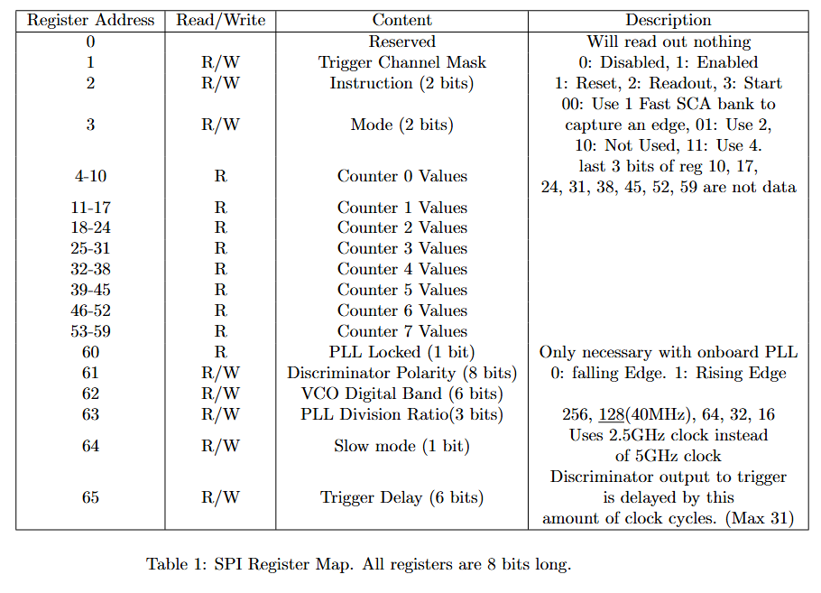
SPI Register Table
Slide 16 of 22

Slide 17
Schedule – boards are being fabricated
Schematic / Simulation | Sep. 2023
Layout | Mar. 2024
Post Layout Simulation | Apr. 2024
Layout Optimization | Jul. 2024
Tapeout | Sep. 2024
DUT Board Assembly | May. 2025
Control Board Assembly | May. 2025
Testbench | June 2025
Implementation at FTBF | TBD 2026
Slide 17 of 22

Slide 18
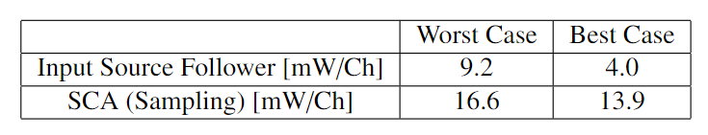
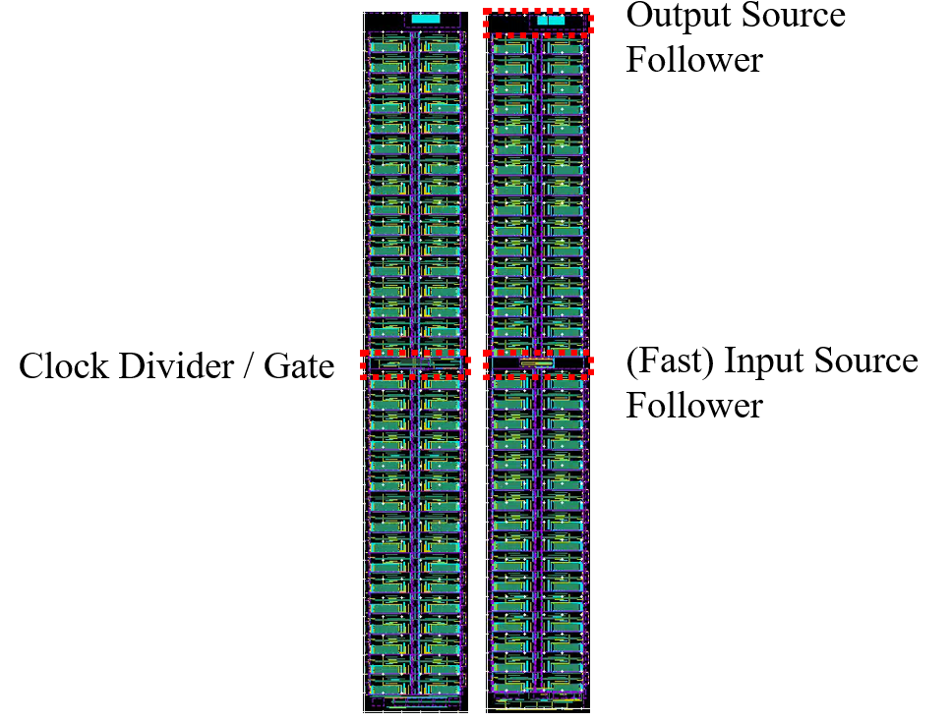
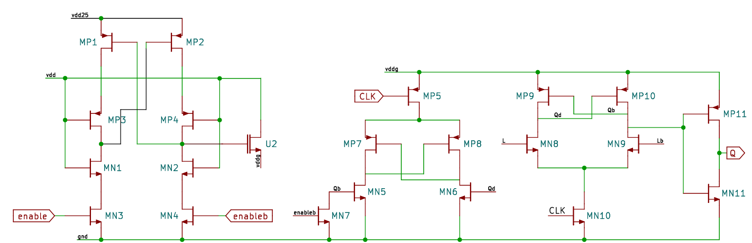
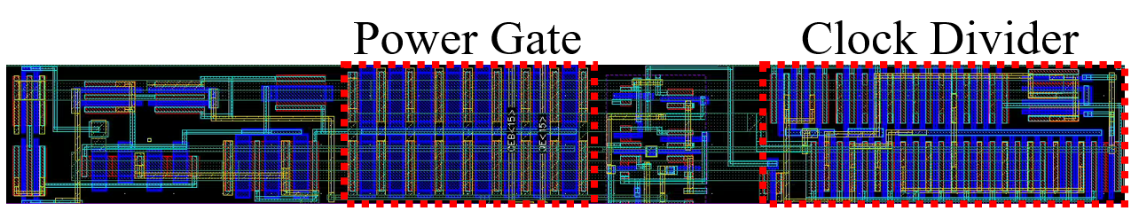
High bandwidth with low power consumption?
Table 1: Power consumption
Clock Gate Schematic (Top), Layout (Bottom)
Left: Slow SCA, Right: Fast SCA
20 mW/Channel achieved by: Clock Gate, Source Followers and Voltage shifters
Slide 18 of 22

Slide 19
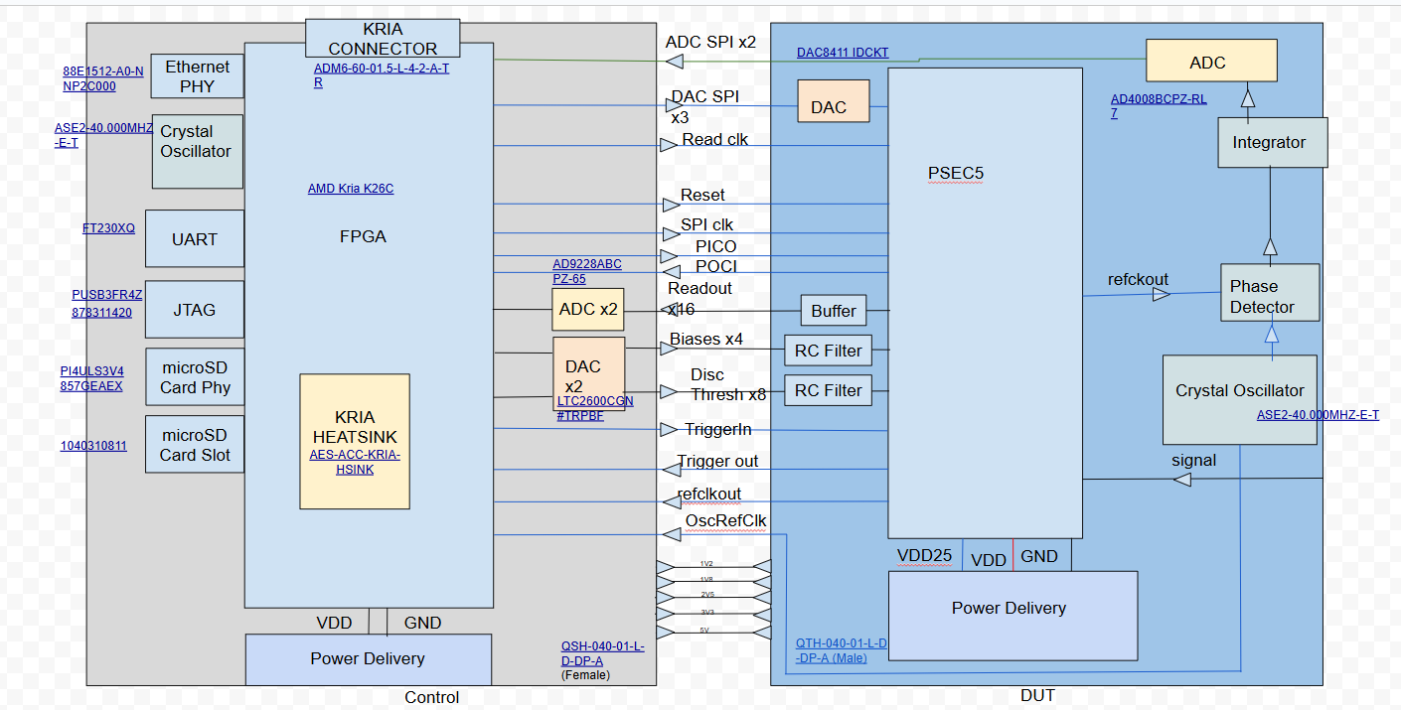
Objectives and Compromises
Process | TSMC 65 nm
Dynamic range | 10 bits
Sampling Rate | 40 GSa/s
Buffer Length | 6.4 ns(204.8 ns)
Analog Bandwidth | >4 GHz
Channels/Chip | 8
Area | 2.4 mm²
Multi-Hit Capability | Yes
Customizable Buffer | Yes
On-Chip 10 GHz PLL | No
On-Chip ADC | No
These components do not exist in 65nm CMOS - A test board is used to fill in the missing features
See Andrew Arzac’s talk A Modular Test System for the PSEC5 40 GS/s waveform-sampling ASIC, Fast 2025
Slide 19 of 22

Slide 20
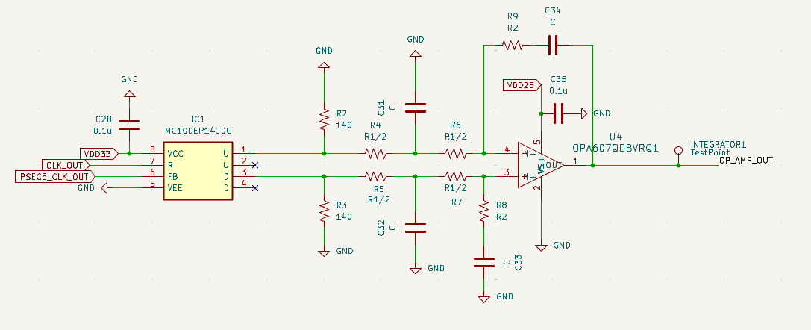
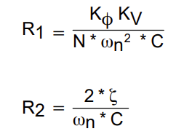

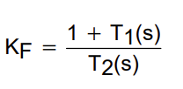
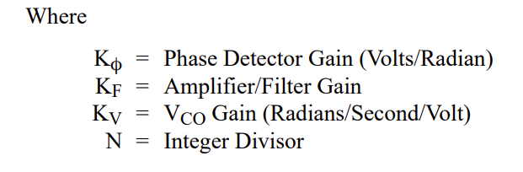
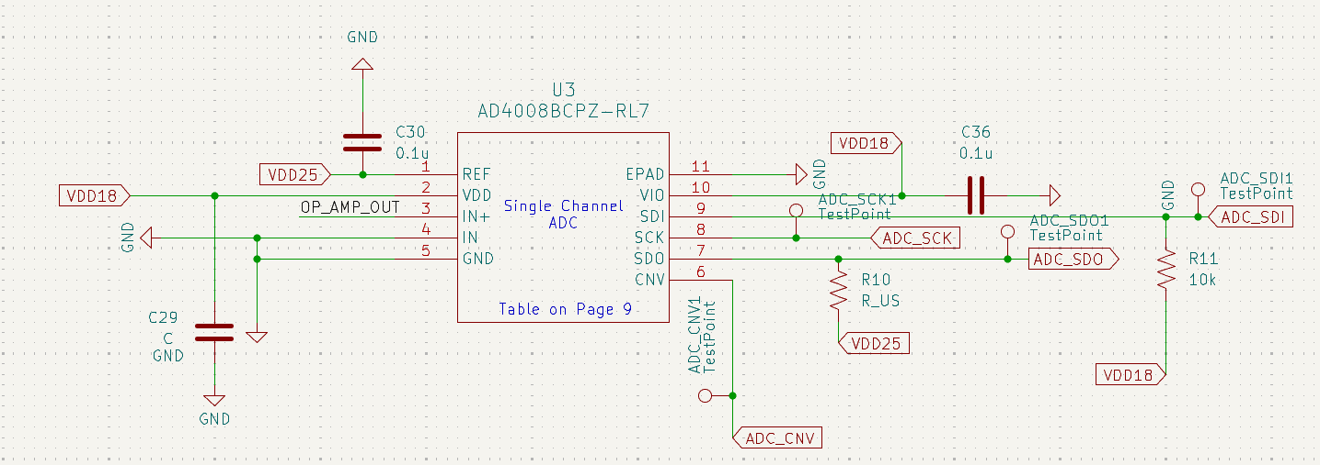
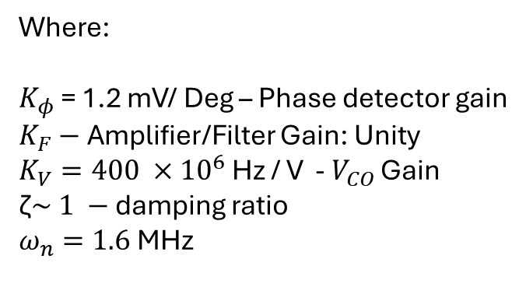
Compromise 1: “PLL” on board
Where:
$K_{φ}$ = 1.2 mV/ Deg – Phase detector gain
$K_{F}−$Amplifier/Filter Gain: Unity
$K_{V}=400 ×{10}^{6}$ Hz / V - $V_{CO}$ Gain
$\text{ζ}\sim 1 −$ damping ratio
$ω_{n}=1.6$ MHz
Chip clk is divided by 128, then compared to a 40MHz crystal oscillator
Slide 20 of 22

Slide 21
Compromise 2: Off-chip ADC - AD9228
Parameter | Datasheet Value
ADC | AD9228
Channels | 4 (each)
Resolution | 12 bits
Max Sample Rate | 65 MS/s
Input Bandwidth | 315 MHz full-power (–3 dB)
Analog Input Range | 2 V p-p differential (with internal 1 V reference)
SNR / ENOB | SNR ≈ 70 dB, ENOB ≈ 11.3 bits (f₁ = 2.4 MHz)
Power Consumption | 119 mW per channel at 65 MS/s (476 mW total for all 4 channels)
Latency | 8 pipeline clock cycles → 8 / 65 MHz ≈ 123 ns
PSEC5
RC Filter
ADC Driver
DUT Board
AMD Kria K26C
AD9228
Control Board
Two 4-Channel ADCs are used on the test board
Slide 21 of 22

Slide 22
Summary
We have designed and taped-out PSEC5 – a waveform digitizing ASIC with:
A goal of picosecond timing resolution for precise detector readout
Dual-mode sampling architecture enabling:
  204.8 ns capture window
  6.4 ns high-resolution windows for critical timing regions
  Multi-Hit capability
Intended for large-scale experiments:
  8 channels per chip
  20 mW/Channel power consumption
  65nm CMOS TSMC Process
Slide 22 of 22

Slide 23
Supplementary Slides

Slide 24
How do we achieve picosecond resolution with ~25ps sampling bins
Multiple samples during the rise time.
Triggered when the signal reaches the discriminator’s output – fast bank takes 64 samples.
Signal can be interpolated
Notes:
Rise time of LAPPD pulse 0.5 ns, using a fast bank – we are taking 64 samples within a 1.6ns timeframe. We will have multiple samples, and the waves can be reconstructed.

Slide 25
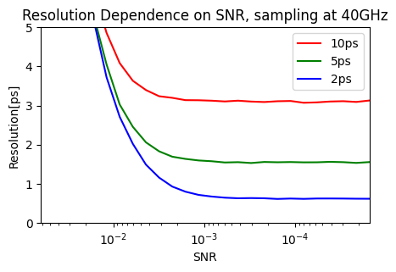
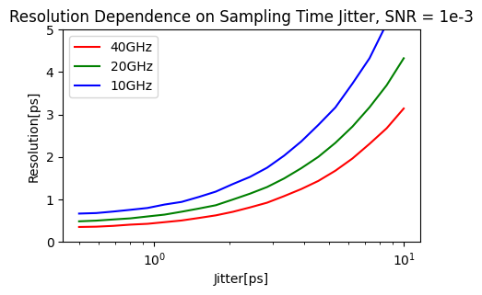
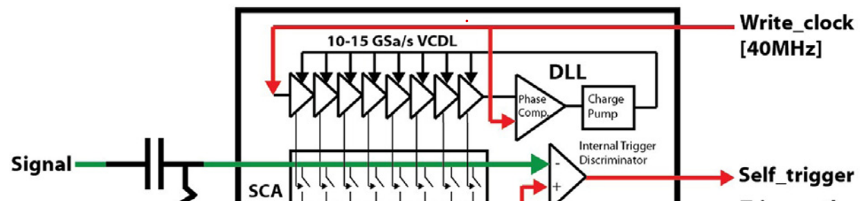
Sampling Time Uncertainty
At <1ps timing resolution region, it is a dominant component of the overall uncertainty.
Previous Chip PSEC4 employed Delay Locked Loop (DLL) to control sampling switches.
Process Variation is a major source of systematic timing uncertainty.
Diminishing return above 10 ENoB
Monte Carlo results based on Delagnes, arXiv:1606.05541
Notes:
Top Plot (Resolution vs. SNR at 40 GS/s)
At low SNR (<10 ENoB), adding bit-depth (higher SNR) dramatically improves Δt.
Beyond ~10 ENoB, you hit “diminishing returns”—you gain only a few hundred femtoseconds by pushing to 12+ ENoB.
Take-away: Aim for ~10 ENoB in your calibration to balance area/power vs. timing precision.
Bottom Plot (Resolution vs. Sampling Jitter at SNR=10³)
Even at perfect SNR, sampling-time jitter (σ<sub>j</sub>) drives Δt upward.
Doubling the sampling rate from 10 → 40 GS/s cuts the jitter contribution by ~√4, but you still need σ<sub>j</sub> ≲200 fs to stay <1 ps overall.
Take-away: Minimizing sampling edge jitter (via a low-noise PLL and matched Phase-Shift-Register) is as critical as SNR.
Time differences between samples are determined by a voltage-controlled delay line, which is an array of transistors, usually MOSFETs, in which a signal propagates through the array at a desired rate.
However, no chip manufacturing process is perfect, so each element of the VCDL has a different time offset.
It is necessary to measure each time offset to correctly sample a signal.

Slide 26
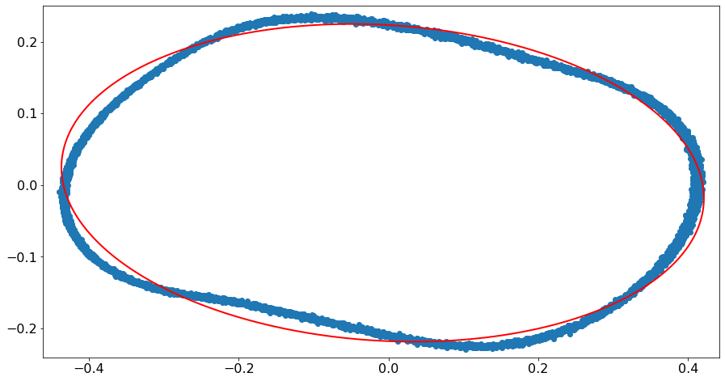
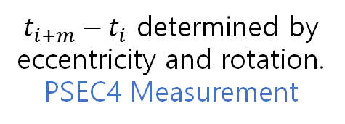



1. Measure many events of a sine wave.
2. Sum vs. Difference of two adjacent samples, over all events, form an ellipse.
3. Time offset can be determined from the coefficients.
Low SNR → fainter, more spread curve.
Nonlinearity → distorted curve
Event 1
Event 2
Input Voltage
$t_{i+m}−t_{i}$ determined by eccentricity and rotation.
PSEC4 Measurement
$$V_{i}−V_{i+m}[V]$$
sin(ωt+Δt)-sin(ωt)
Event 3
Event 4
$$V_{i}+V_{i+m}[V]$$
$$t_{i}{ t}_{i+m}$$
sin(ωt+Δt)+sin(ωt)
Time
Notes:
To reduce the sample time uncertainty, we have developed a method to measure the time offset of each sample.
1. Measure many events of a sine wave.
2. Plot Summation vs. Difference of two adjacent samples, over all events, should form an ellipse.
3. Time offset can be determined from the coefficients.
The diagram explains which event corresponds to which dot in the ellipse plot, which is the actual measurement data of PSEC4.
When you think about it, the plot does not have to be on two adjacent samples, but samples that are m samples apart. This way the effect of voltage noise of each sample on the time offset is smaller.
In other words, the sampled curve is more like a smooth ellipse as m gets larger.
However, the time difference cannot be larger than one fourth of the period of the sine wave, which in our case corresponded to m equal to about 10.
When we look at the right ellipse plot,
Higher voltage Noise results in a fainter, more spread curve.
The nonlinearity of the overall system results in a distorted curve

Slide 27
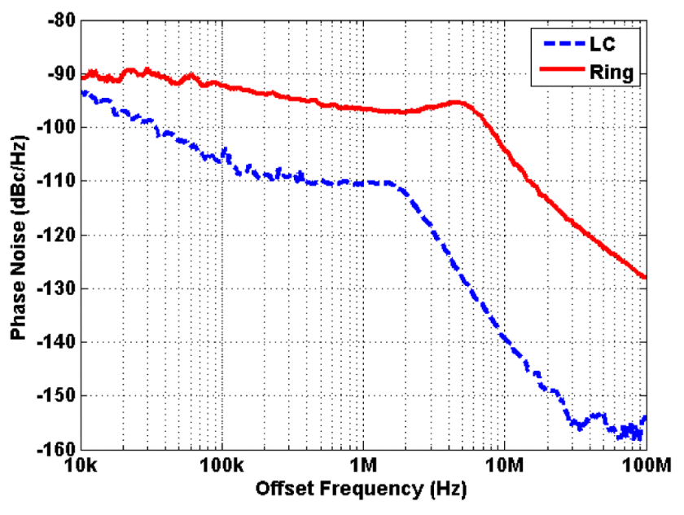
Timing uncertainty reduced by an optimized LC-oscillator based PLL
From abstract:
“Both independent PLLs have identical loop dynamics to allow a fair comparison …
Furthermore these circuits consume the same amount of power. The PLLs were processed in a commercial 65 nm CMOS technology.”
Ring: 5.6ps jitter
LC: 0.325ps jitter
J. Prinzie, J. Christiansen, P. Moreira, M. Steyaert and P. Leroux, "Comparison of a 65 nm CMOS Ring- and LC-Oscillator Based PLL in Terms of TID and SEU Sensitivity," in IEEE Transactions on Nuclear Science, vol. 64, no. 1, pp. 245-252, Jan. 2017.
Notes:
In PSEC4 we used a DLL to tame per-cell delays; process variation still left ~2–3 ps spread.
In PSEC5 we combine an LC-based PLL (0.3 ps RMS jitter) with per-cell template calibration to push the sampling-time uncertainty sub-ps.

Slide 28
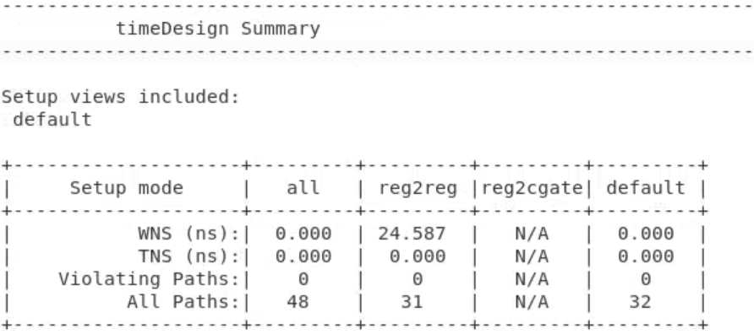
Post-Implementation Timing Verification
*WNS: Worst Negative Slack
*TNS: Total Negative Slack
Time remaining before next clock cycle. Positive is good
Given the previous constraints, we can verify if our design satisfies them in simulation.
Notes:
The results of the timing verification are given in terms of Worst Negative Slack, and Total Negative Slack. We want the worst negative slack to be positive, indicating that the chip is able to process the data per clock cycle in the longest datapath. The total negative slack should be zero, as we want no processing time greater than the clock period.

