Slide 1
Development of Bialkali Transfer Photocathodes for Large Area Micro-Channel Plate Based Photo Detectors
Junqi Xie¹, Marcel W. Demarteau¹, Henry J. Frisch^{1,2}, Joe Gregar¹, Richard Northrop², Alexander Paramonov¹, Anatoly Ronzhin³, Greg Sellberg³, Robert G. Wagner¹, Dean Walters¹, Zikri Yusof¹
On behalf of LAPPD Collaboration
¹Argonne National Laboratory, Argonne, IL
²University of Chicago, Chicago, IL
³Fermi National Accelerator Laboratory, Batavia, IL

Slide 2
Outline
Motivation
Small PMT Photocathode Growth and Characterization
Large Area Photocathode Growth and Characterization
Summary
Future Work

Slide 3
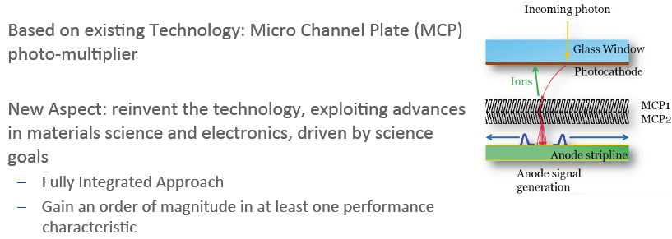
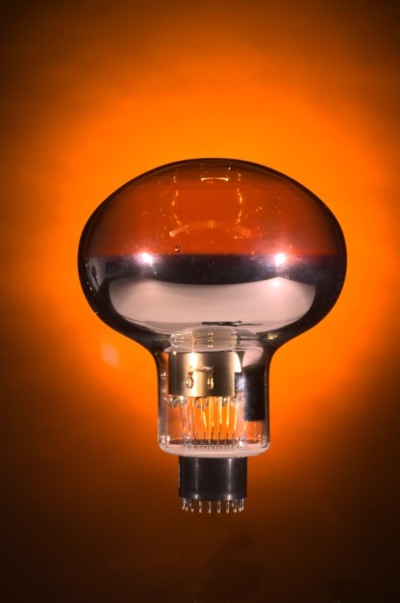
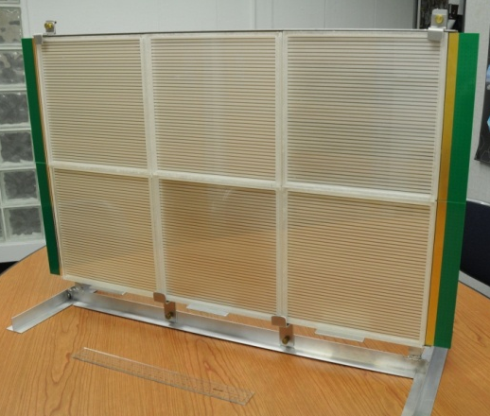
Motivation: LAPPD Approach
41 cm
61 cm
PMT
LAPPD
3

Slide 4
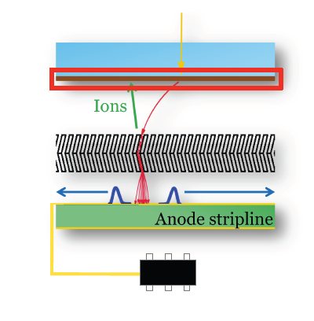
Motivation: Photocathode
Incoming photon
Glass Window
Photocathode:
Convertion of photons to electrons
Photocathode
MCP1
MCP2
Anode signal generation
Many fundamental detector properties such as dark current, quantum efficiency, response time, and lifetime are determined by the properties of the photocathode.

Slide 5
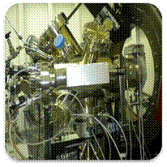
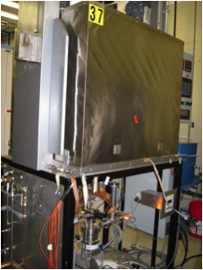
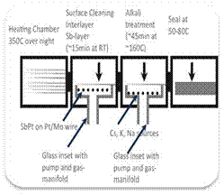
Resource: Infrastructure
Microscopic Property
Macroscopic Property
Industrial Fabrication
Basic Sciences Program
  Growth and Characterization Facility
  General Lab-Infrastructure
  User facility use
    APS
    NSLS
    Nano center BNL/ANL
Large Area Development
  Growth Equipment
  Source Development Infrastructure
Production Unit
(8’’X8’’) (not yet existing)
  Test Facility for Recipe optimization (industrial standard)
  Detector integration Facility

Slide 6
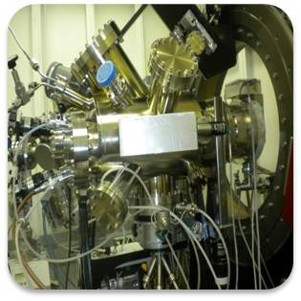
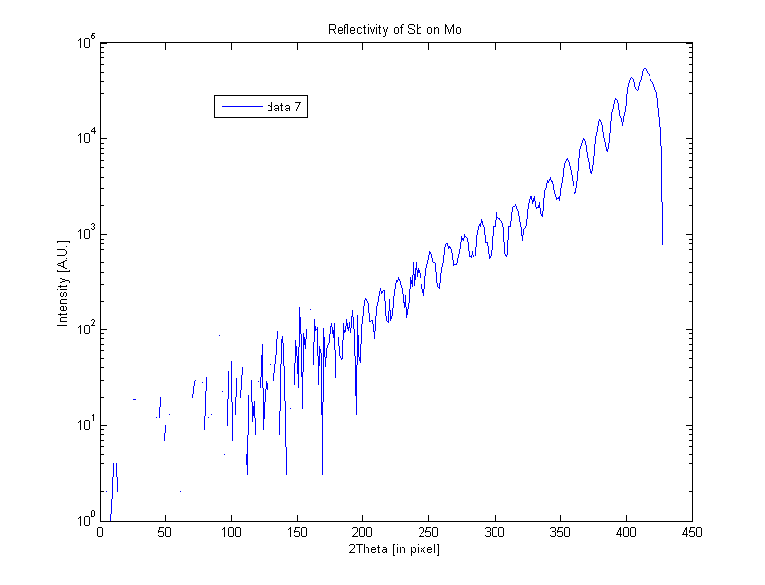
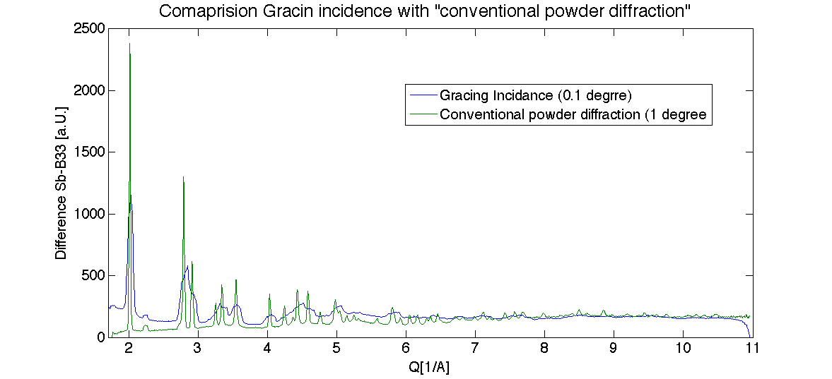
In-Situ Structural and Chemical Characterization
In-situ X-ray Scattering (by K. Attenkofer and S. Lee)
Movie like characterization
during the growth:
Macroscopic film properties
  Film thickness
  Roughness
Microscopic composition
  Which phases are present
  Lateral and transversal and homogenuity
  Crystalline size
  Preferential crystal growth
Surface composition
  Local workfunction
  Chemical composition
An Sb phase transition was observed from amorphous to crystalline at 7~8 nm by XRD.
In-situ Sb layer growth and K inter-diffusion process were monitored by real-time XRR.

Slide 7
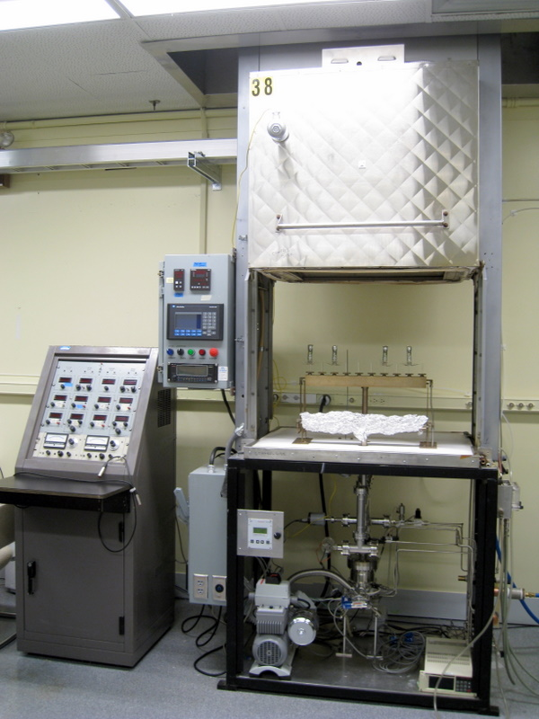
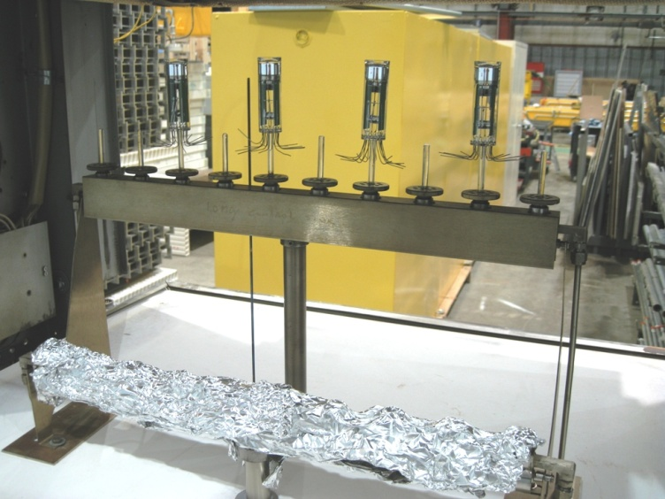
Small PMT Photocathode Growth Process
Oxygen discharge cleaning and oxidation;
Sb deposition monitoring via reflectivity measurement;
Bake out temperature, deposition temperature;
Control of alkali metals deposition.
Apply these to the fabrication of
large area photocathode.

Slide 8
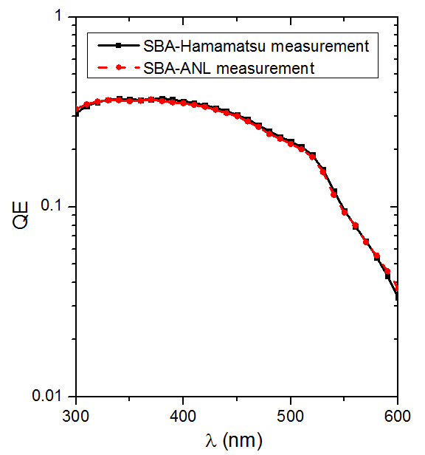
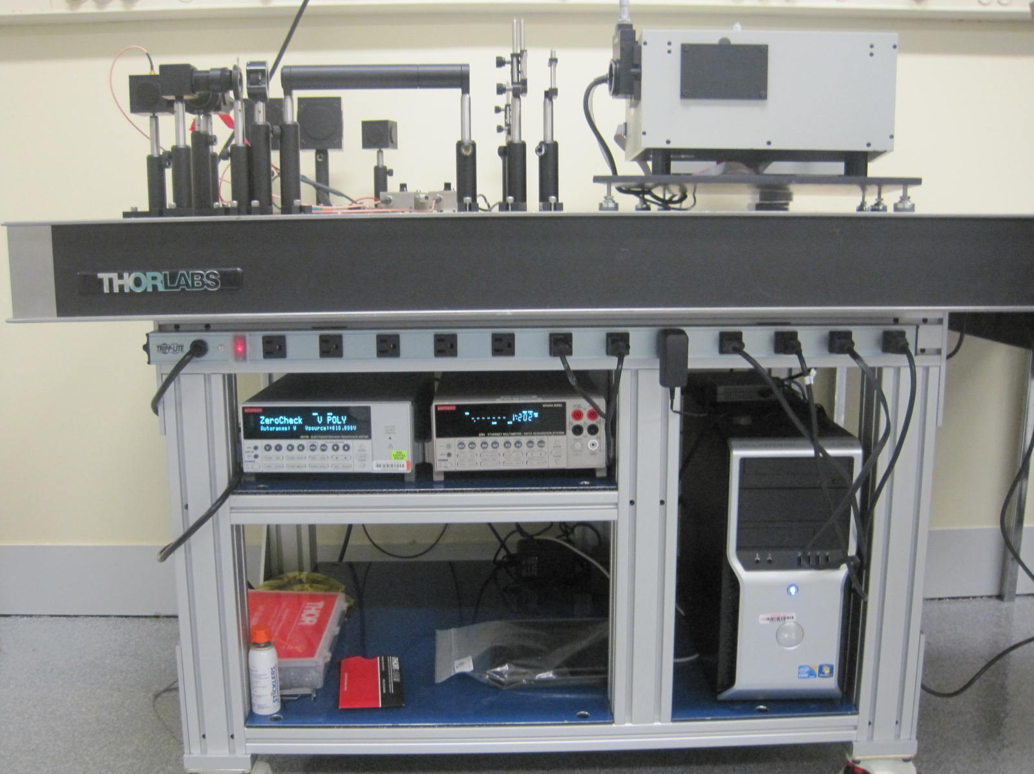
Commissioning of Optical Station
Movable optical station can be used for both in situ and ex situ optical and electrical measurements.
QE measurement by Hamamatsu and ANL optical station agree well with each other indicating the home-built optical station is reliable.

Slide 9
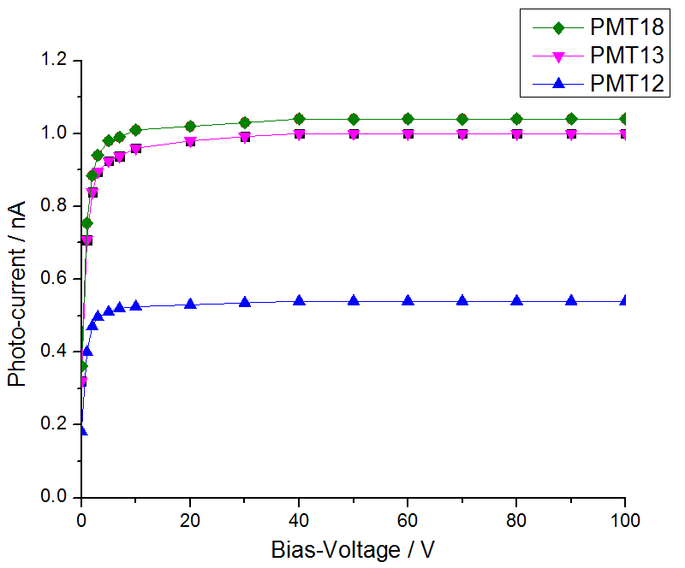
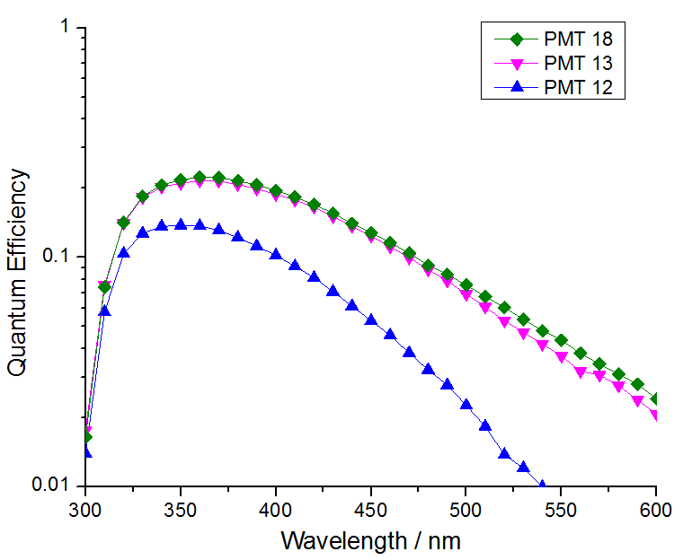
Small PMT Photocathode Characterization
I-V Characteristic
QE Measurement
Cathodes exhibit characteristic I-V behavior, with QE as high as 24% at 370 nm.
The quick drop at short wavelength is due to glass absorption.

Slide 10
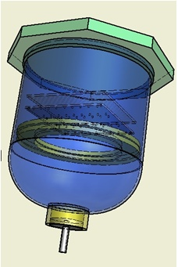
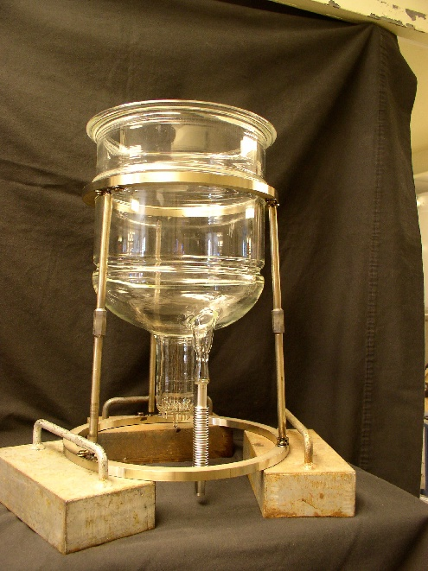
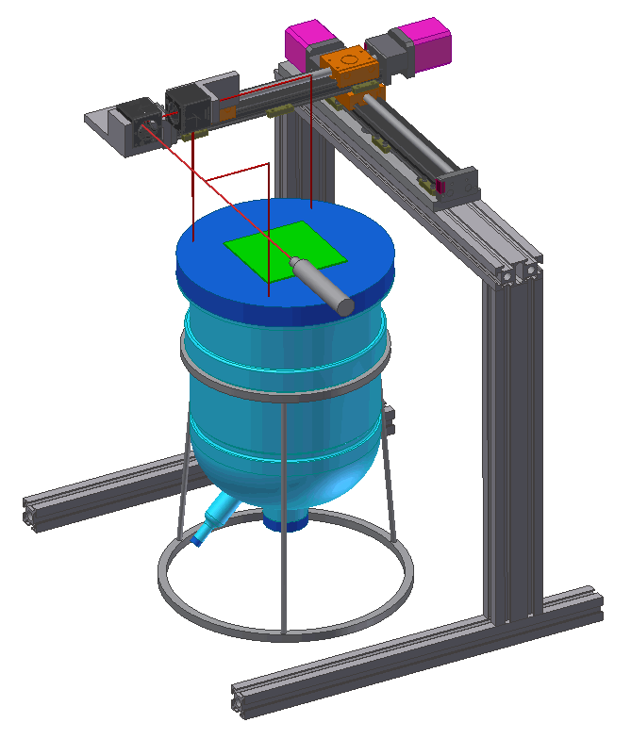
The Chalice Design
Design is based on the small PMT tube, the chalice can be seen as a LARGE PMT tube.
Top glass plate is replaceable for reuse.
Chalice structure is supported by external legs.
An X-Y scanner was designed and built for QE scan.

Slide 11
Sb Beads Arrangements for the Chalice
Numerical simulation of Sb thickness as a function of Sb beads arrangements and distance from window;
4 Sb beads arrangement
2.5” distance from the window;
This arrangement produces sufficient uniformity on a 4”x4” window as our starting point;
This assumes all the beads perform identically.

Slide 12
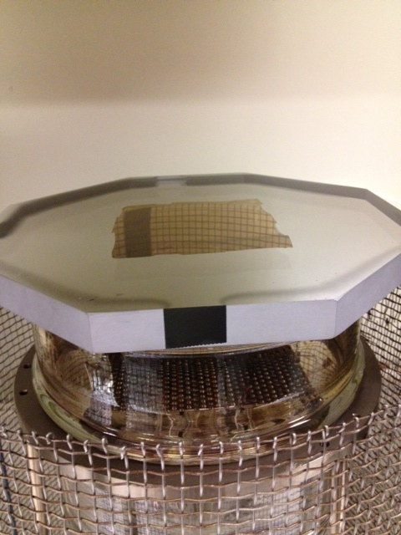
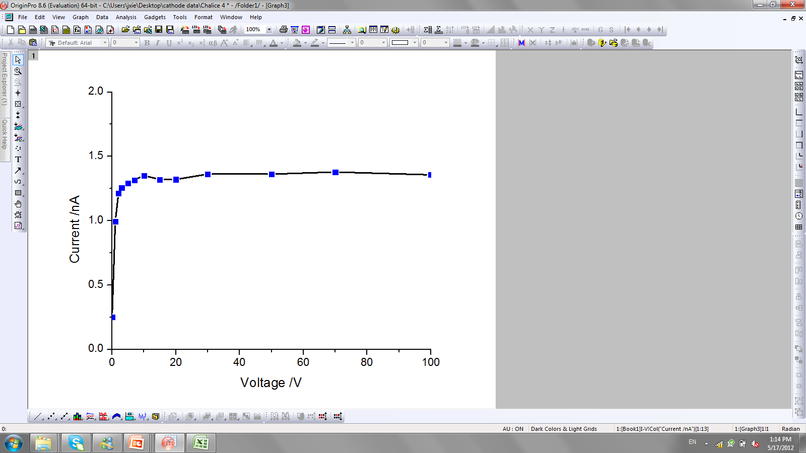
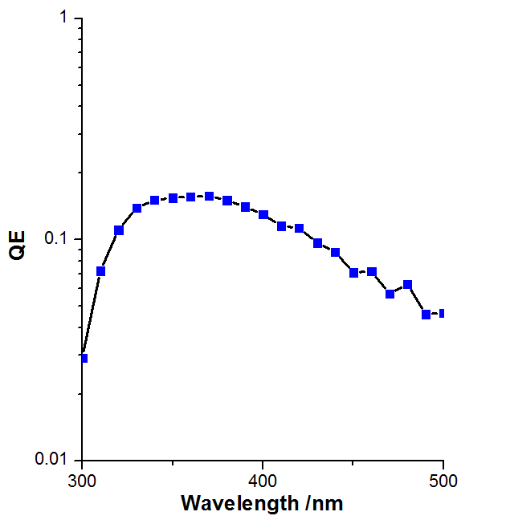
Chalice Photocathode Characterization
I-V Characteristic
QE Measurement
Plasma was not performed properly, due to low plasma power supply.

Slide 13
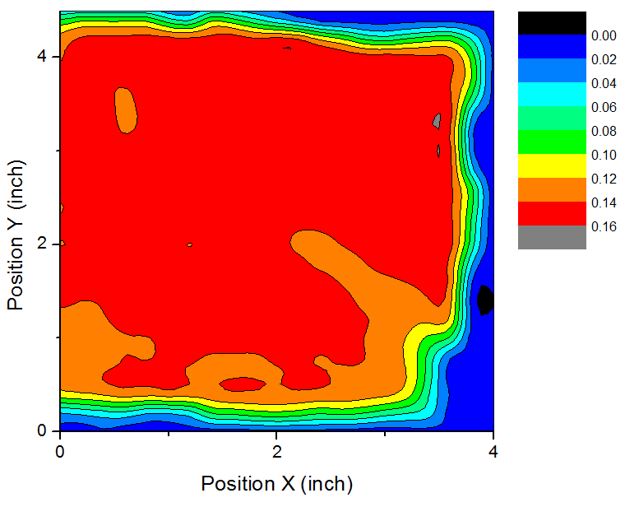
Chalice Photocathode Deposition
The QE mapping is obtained at 350 nm wavelength, scan step size: 0.2 inch
QE Scale
Sb bead
The blue area is the 4’’X4’’ window edge.
QE is uniform (15%) at a large area.

Slide 14
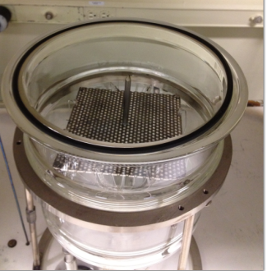
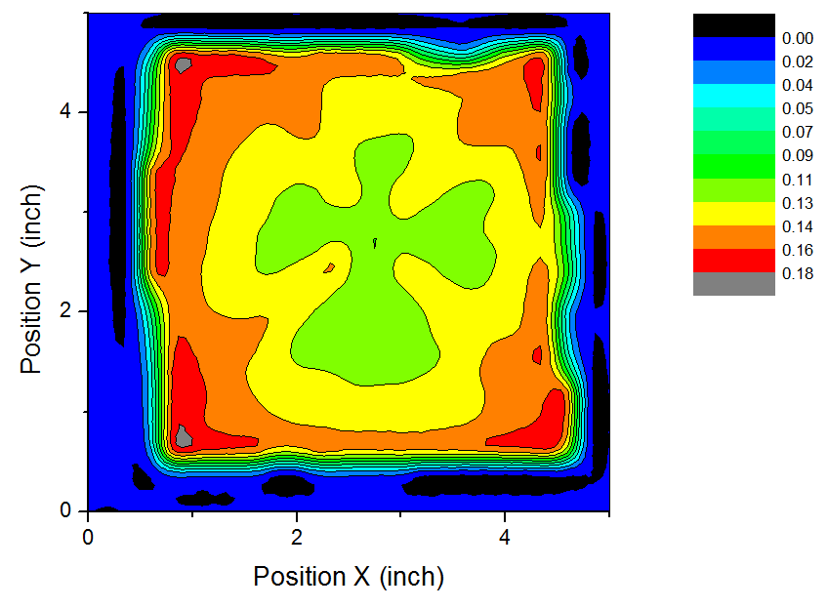
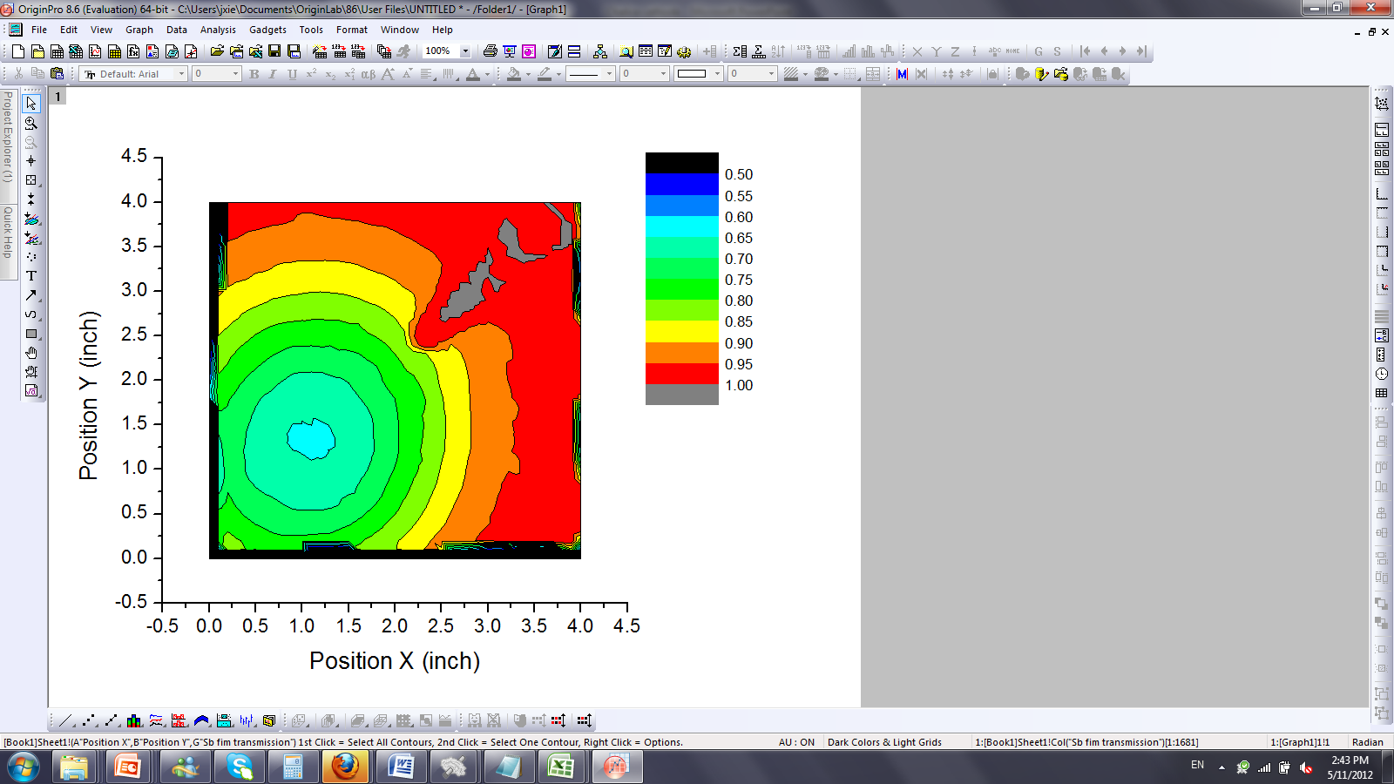
Comparison of QE Map and Sb Transmission Map
4 beads
1 bead
X
X
Sb bead
Center X: Lighting rod, which affect the Sb film deposition
QE Map
Sb Film Transmission Map

Slide 15
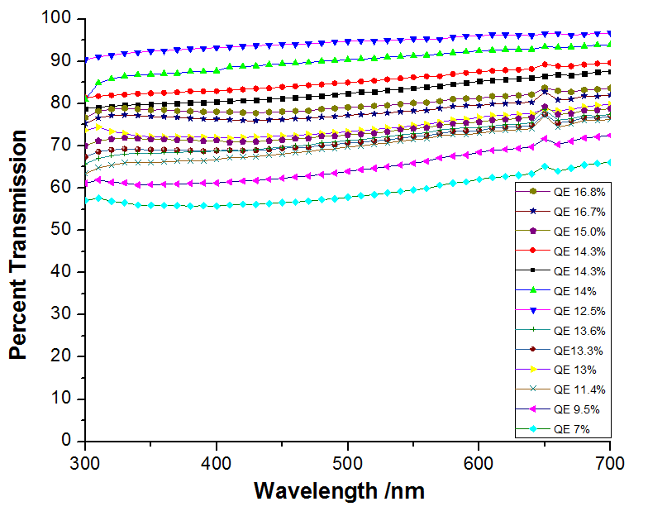
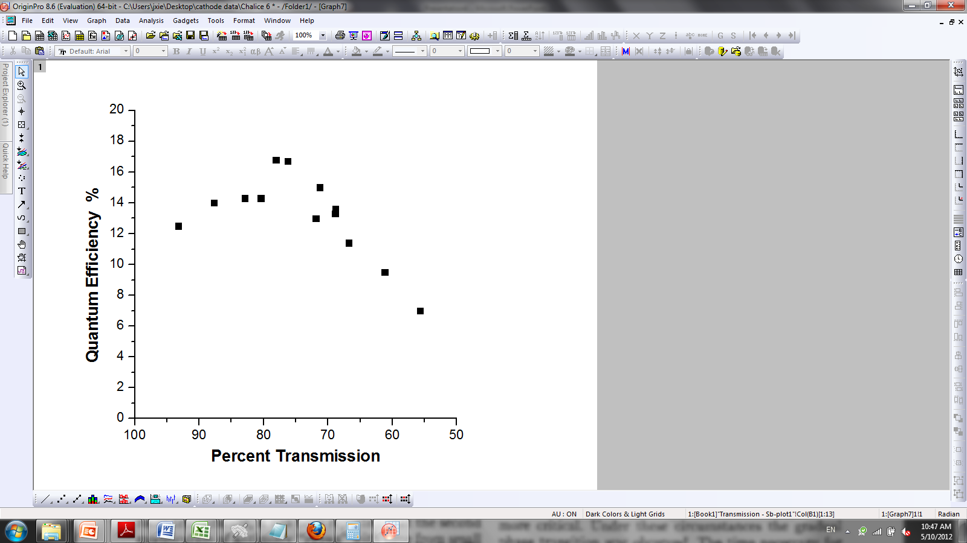
Sb Film Transmission Curve with Different Photocathode QE
Film transmission with known QE were measured and plotted.
Film transmission increases as wavelength increases without regarding the QE value
The film transmission values at 400 nm were chosen to plot the relation between KCs-Sb cathode QE and film transmission.
The highest QE is around 78% Sb transmission (400nm beam).

Slide 16
Summary
Photocathode growth and characterization instruments were set up.
PMT photocathodes with QE as high as 24% have been produced.
Large area (4’’X4’’) photocathode with uniform QE (15%) were achieved even without proper oxygen plasma cleaning and oxidation.
All photocathodes show typical I-V characteristics.
QE of the photocathode is related to base Sb layer thickness.
The optimized Sb thickness for KCs-Sb photocathode is around 78% transmission (400nm beam).
Next Steps
Work out the plasma configuration to obtain uniform photocathode.
Complete absolute reflection measurement of Sb films and relate to the film transmission data.
Study the effect of plasma cleaning and oxidation to the photocathode QE.
Optimize the process for higher QE cathode based on the micro and macro studies.

Slide 17
Back Up

Slide 18
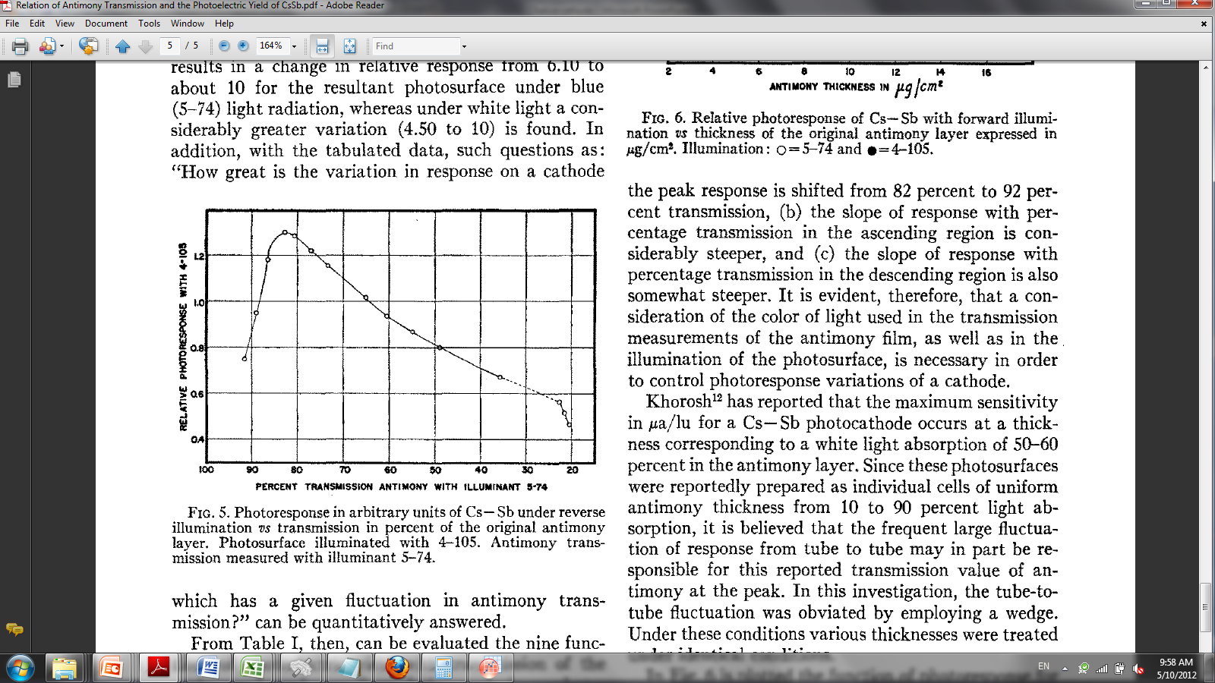
Relation between Cathode QE and Sb Film Transmission
KCs-Sb Photocathode
Cs-Sb Photocathode
Relate the QE of the KCs-Sb cathodes with the Sb film transmission at 400 nm.
MARTIN ROME, J. Appl. Phys, 26, 166, 1955
Note that the highest QE is around 78% Sb transmission (400nm beam), similar to that of Cs-Sb cathode at around 82% Sb transmission (blue light) as reported.

