Slide 1
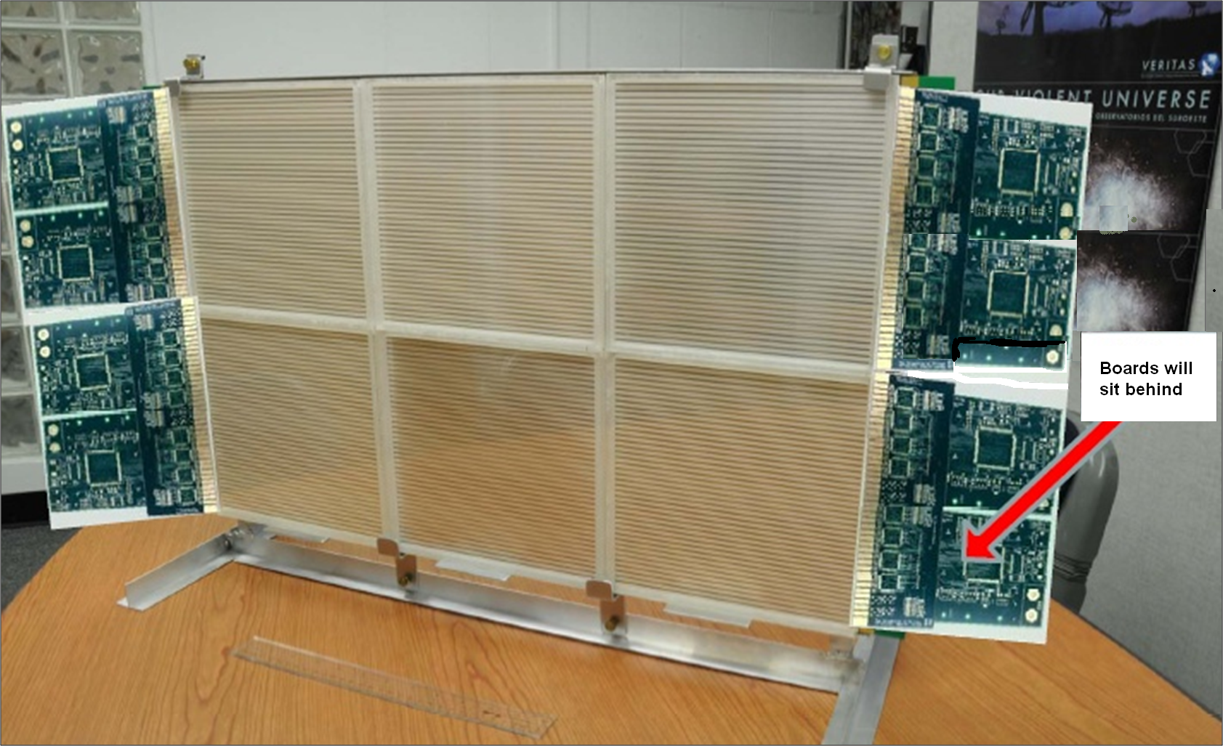
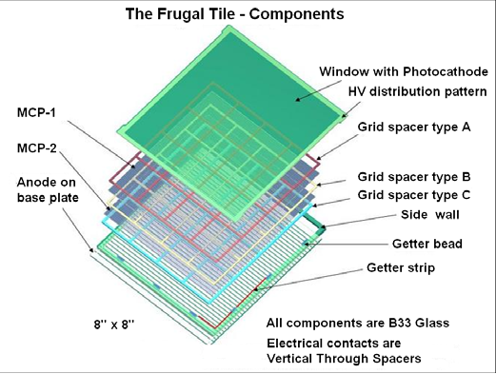
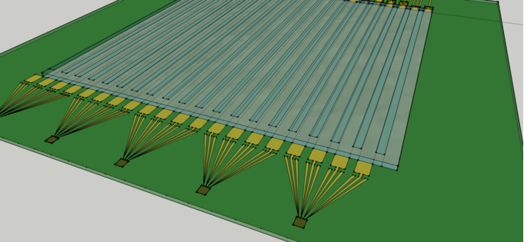
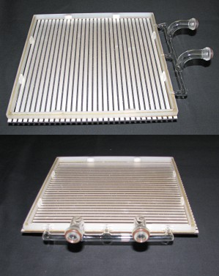
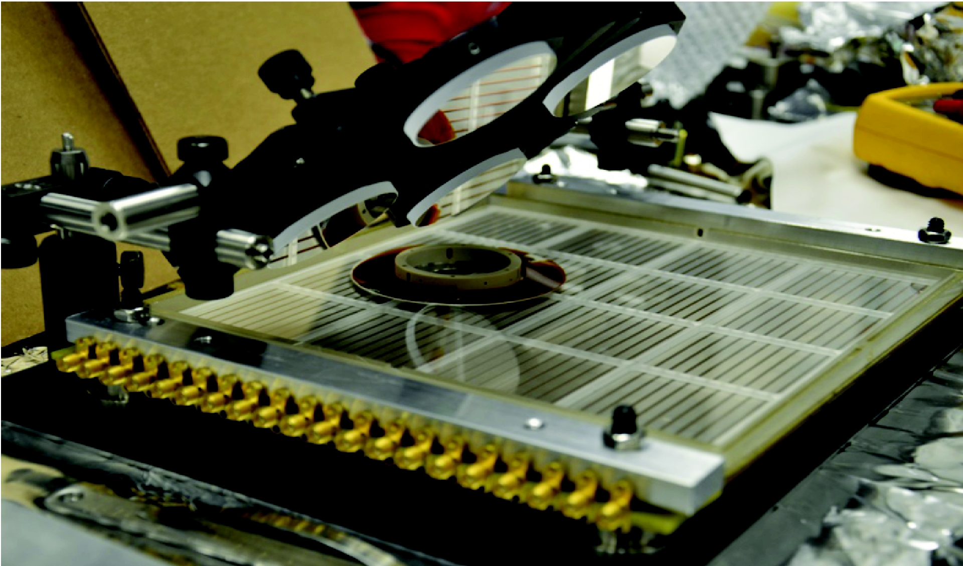
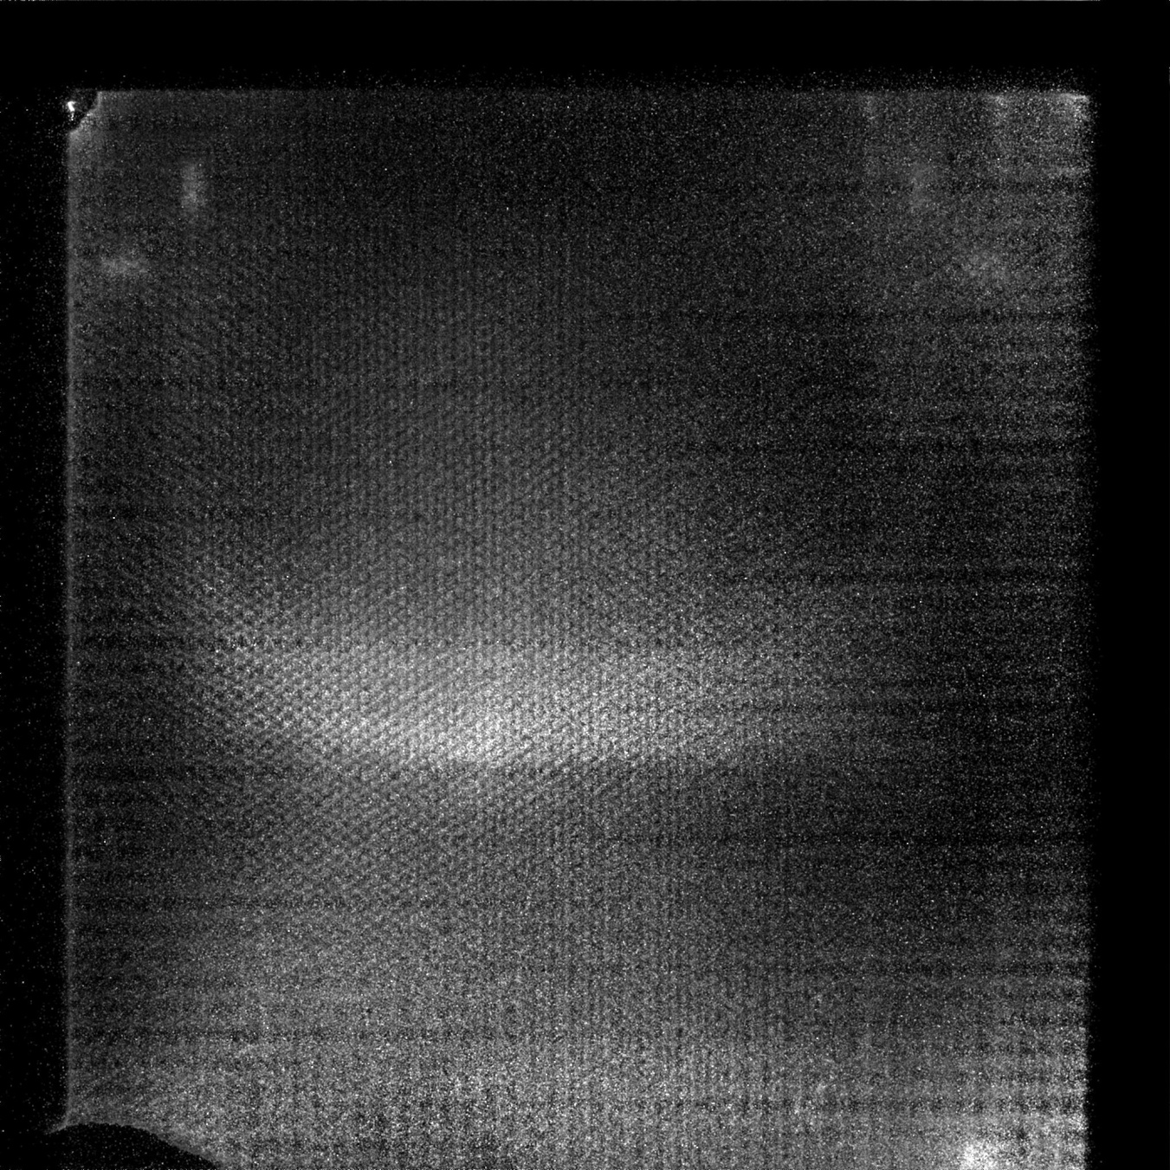
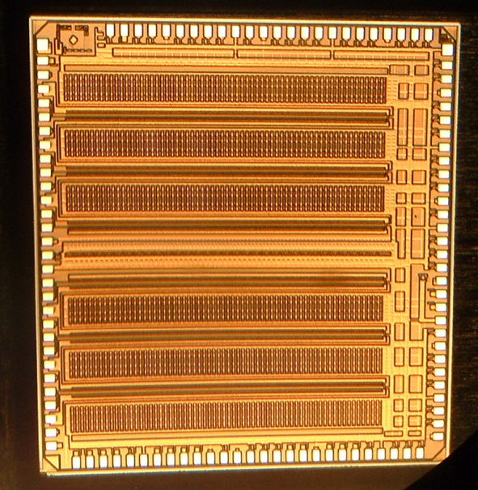
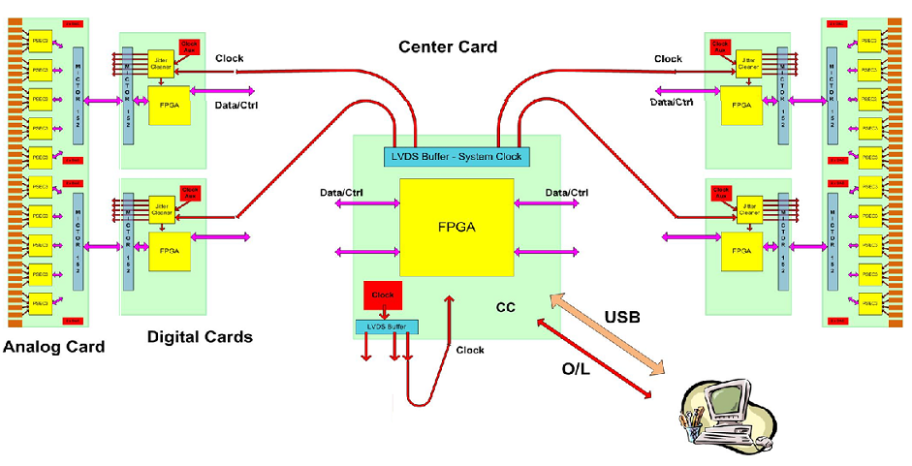
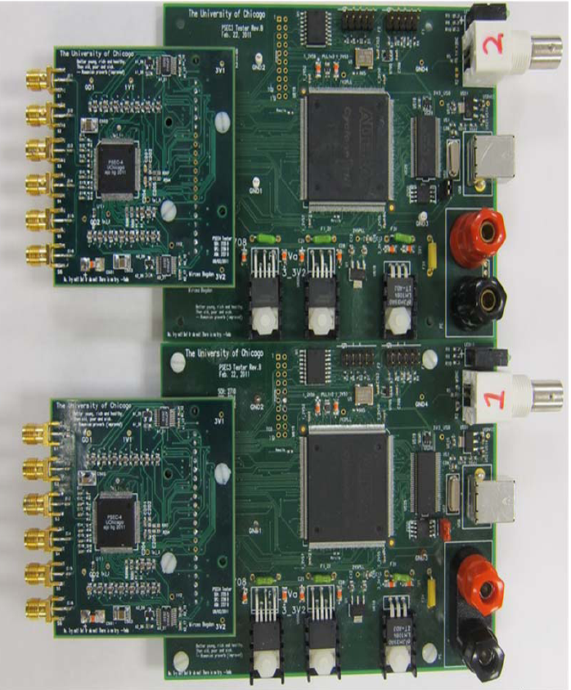
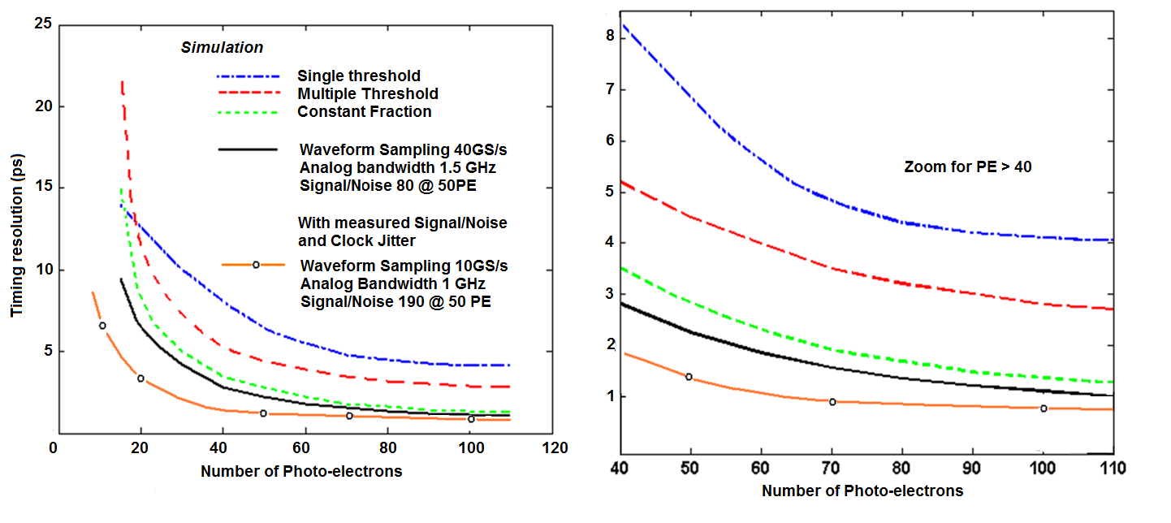
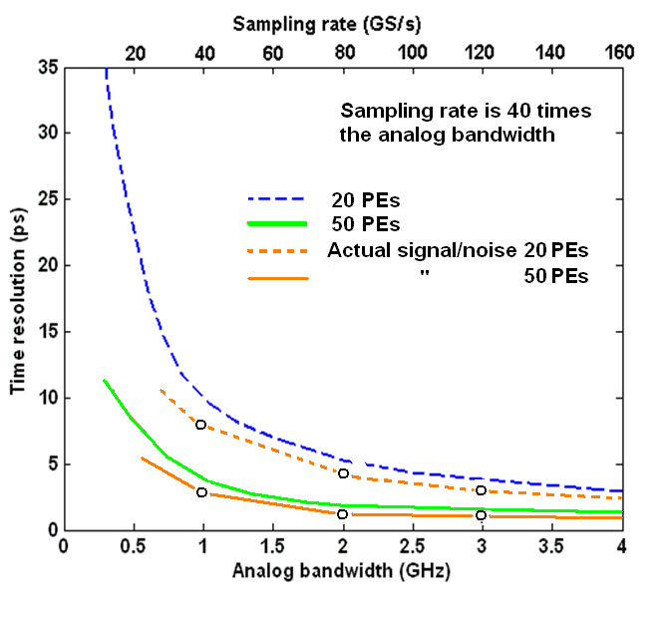
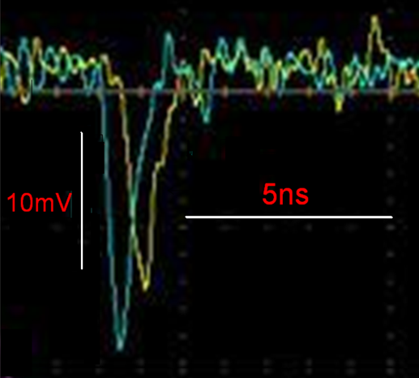

Development of Large Area Micro-Channel Plates Photo-Detectors (LAPPD) and Integrated Readout
¹Jean-Francois Genat on behalf of the LAPPD collaboration (http://psec.uchicago.edu/)
¹University of Chicago, ¹CNRS/IN2P3 France
16’’ x 24’’ Super-module (2 rows Tiles)
Large Area Micro-Channel Plate structure
Readout ICs PSEC4, See NP2 S75
Test setup for a 8’’ x 8’’ MCP
Transmission line readout with anodes
as an array of micro-strip electrodes
Actual transmission-line anodes
and B33 glass vessel
Test setup and first image for the 8’’x8’’MCP
Sampling/Timing
generation
PSEC 4 Readout IC (MOSIS IBM)
See H. Grabas and E. Oberla NP2-S75
8’’ x 8’’ MCP signals at the ends of a plate
PSEC4 readout IC photo
See H. Grabas and E. Oberla, NP2 S75
Full MCP readout system including Analog, Digital, and Central cards
Analog and Digital test cards
Measured 8’’ x 8’’ MCP signals at the
two ends of a transmission line anode
Timing resolution model using waveform sampling and measured Signal to Noise ratio
Timing resolution vs Analog Bandwidth
and Sampling rate

