Slide 1

A 20 GS/s sampling ASIC in 130nm CMOS technology.
Mircea Bogdan ¹, Henry J. Frisch ¹, Jean-Francois Genat ¹, Herve Grabas ¹,
Mary K. Heintz ¹, Samuel Meehan ¹ , Eric Oberla ¹, Larry L. Ruckman², Fukun Tang, ¹ and Gary S. Varner²,
¹ University of Chicago
² University of Hawaii
TWEPP 2010, Aachen , Germany

Slide 2
Outline
Context
Fast timing and Waveform analysis
Sampling Electronics
130nm CMOS Waveform Sampler Tests
Conclusion - Perspective
TWEPP2010, Sept 21st, Aachen, Germany, Jean-Francois Genat

Slide 3
Context
Fast photo-detectors :
Timing resolution:
Time of flights with accuracies in the 10-100ps range, sensitive to single photo-electron.
- Photomultipliers,
- Pin diodes
- Avalanche Photo-Diodes
- Solid state photomultipliers,
- Micro-channel plate
Position resolution:
- Pixilated structure:
- Multi-anode PMTs
- Solid state devices
- Transmission lines readout
- Micro-channel Plates
TWEPP2010, Sept 21st, Aachen, Germany, Jean-Francois Genat

Slide 4
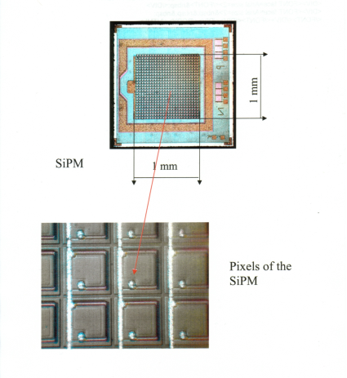
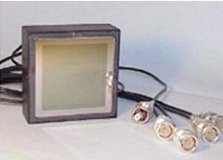
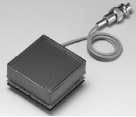
Timing-Imaging Devices
Multi-anodes PMTs Silicon-PMTs [10] Micro-Channel Plates [1]
Dynodes Quenched Geiger in Silicon Micro-Pores
Quantum Eff. 30% 90% 30%
Collection Eff. 90% 70% 70%
Rise-time 0.5-1ns 250ps 50-500ps
Timing resolution (1PE) 150ps 100ps 20-30ps
Pixel size 2x2mm² 50x50μm² 1.5x1.5mm²
Dark counts 1-10Hz 1-10MHz/pixel 1Hz-1kHz/cm²
Dead time 5ns 100-500ns 1μs
Magnetic field no yes 15kG
Radiation hardness 1kRad=noisex10 good (a-Si, Al₂O₃)
TWEPP2010, Sept 21st, Aachen, Germany, Jean-Francois Genat

Slide 5
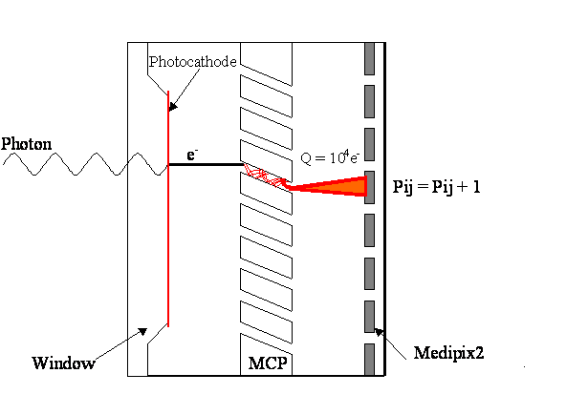
Timing Imaging Devices
Micro-Channel Plate Detectors
J. Vallerga
anodes
Delay lines
Timing Resolution: Single Photo-Electron Time Transit Spread:
TWEPP2010, Sept 21st, Aachen, Germany, Jean-Francois Genat

Slide 6
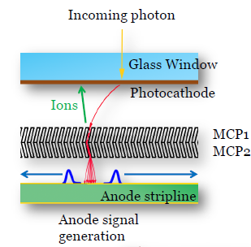
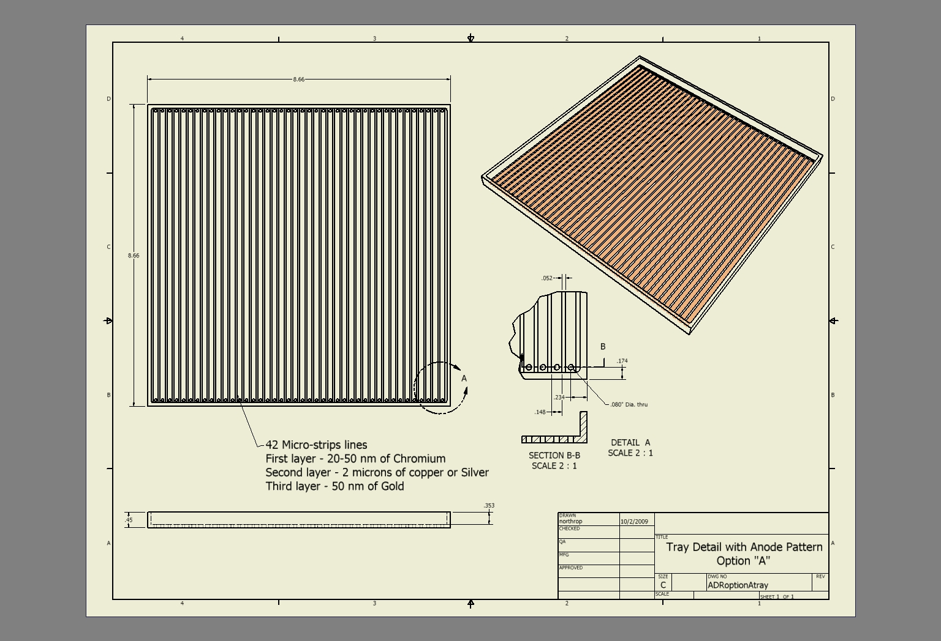
Large Area Pico-second Photo-Detectors
Objective:
Develop 20x20cm2 Micro-Channel Plate
- ~1mm space resolution
- a few ps timing resolution.
Effort distributed in 5 groups:
- Hermetic packaging
- Photocathode
- MCP
- Electronics
- Integration.
Teams :
3 Nat. Labs, 5 Universities, 3 companies.
Time scale:
3-5 years.
Funding:
Dept. Of Energy
Web page and docs:
http://psec.uchicago.edu
TWEPP2010, Sept 21st, Aachen, Germany, Jean-Francois Genat

Slide 7
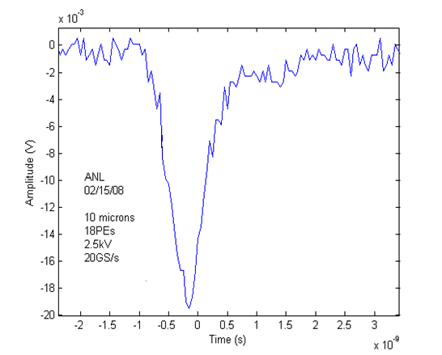
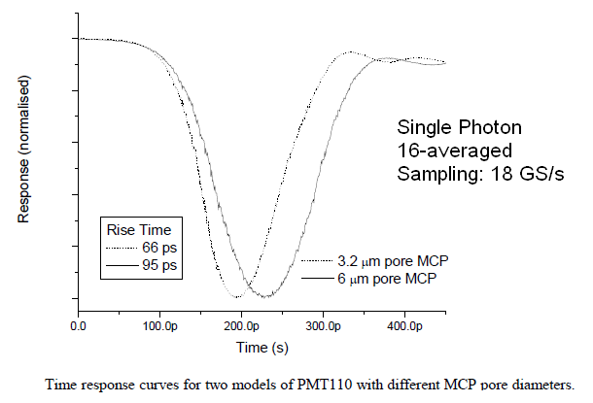
Fast Micro-Channel Plate signals
TTS= 10ps
2” x 2” imaging MCP (BURLE/PHOTONIS)
From Photek Data taken at Argonne National Lab
11 mm diameter Micro-Channel Plate signal 2” x 2” Micro-Channel Plate
Signal bandwidth: 10 GHz 2 GHz
Timing resolution:
Single Photoelectron Time Transit Spread: 10ps 30ps
TWEPP2010, Sept 21st, Aachen, Germany, Jean-Francois Genat

Slide 8
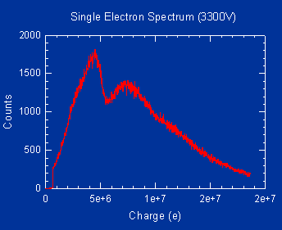
MCP Single Photo-Electron response
From Burle-Photonis (Paul Hink)
TWEPP2010, Sept 21st, Aachen, Germany, Jean-Francois Genat

Slide 9
Outline
Context
Fast timing and Waveform analysis
Sampling Electronics
130nm CMOS Waveform Sampler Tests
Conclusion - Perspective
TWEPP2010, Sept 21st, Aachen, Germany, Jean-Francois Genat

Slide 10
Timing resolution
Single Threshold
Time spread proportional to 1/rise-time and noise
TWEPP2010, Sept 21st, Aachen, Germany, Jean-Francois Genat

Slide 11
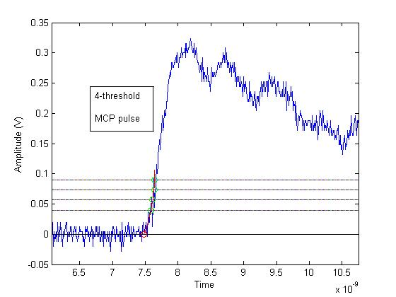
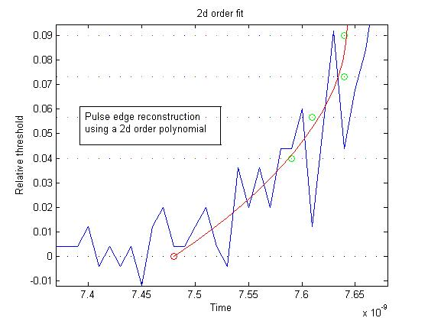
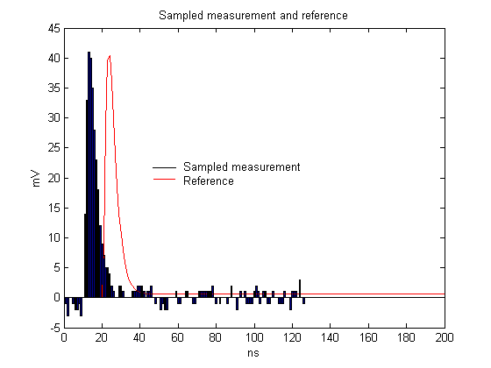
Timing techniques
ANALOG
Multi-threshold
Constant-fraction
Constant fraction
Leading
edge
Extrapolated time
Leading edge errors
Pulse sampling and Waveform analysis
DIGITAL
Sample, digitize,
Fit to the (known) waveform
Get time and amplitude
TWEPP2010, Sept 21st, Aachen, Germany, Jean-Francois Genat

Slide 12
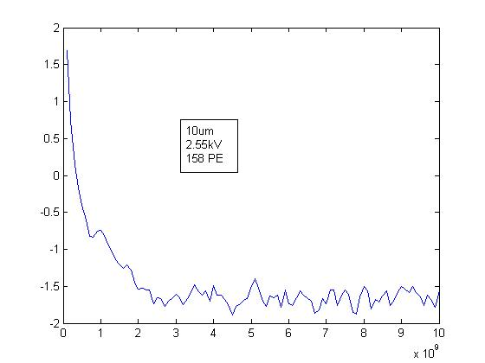
Picosecond Digital Electronics for
Micro-Channel Plate Detectors
Store the full detector information as a digital oscilloscope:
- Detector + electronics noise >> quantization noise (LSB/√12)
Sampling frequency > 2 x full Analog Bandwidth (Shannon-Nyquist)
ADC: Digitize on the fly, if the two above conditions can be fulfilled.
SCAs: If not, use Analog Memories, if input rate and ADC conversion time allows.
Fourier spectrum of a
2”x 2” MCP signal
Noise as small as possible
2 GHz
Slope as steep as possible
TWEPP2010, Sept 21st, Aachen, Germany, Jean-Francois Genat

Slide 13
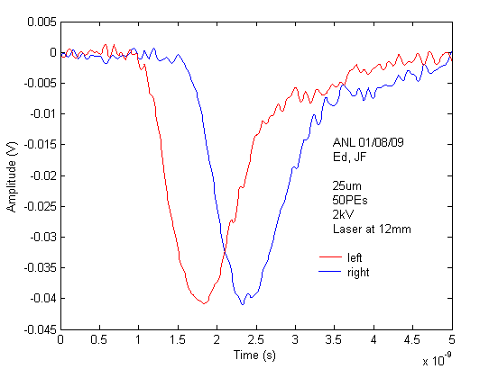
Position resolution. Transmission Line Readout
50 PEs
Oscilloscope
TDS6154C
Tektronix
25 μm pore MCP signal at the output of a ceramic transmission line
Laser 408nm, 50Ω, no amplification
TWEPP2010, Sept 21st, Aachen, Germany, Jean-Francois Genat

Slide 14
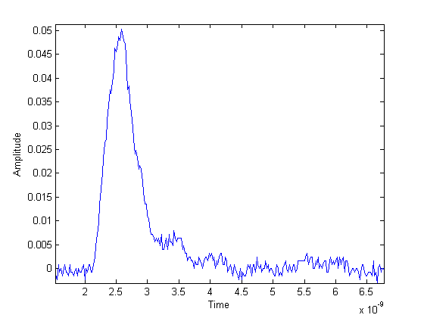
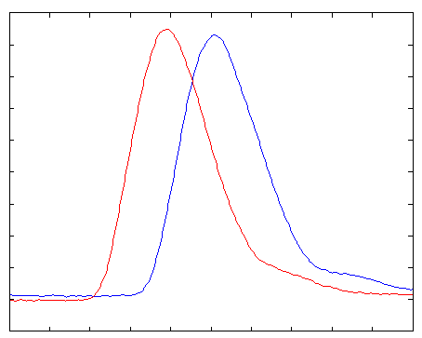
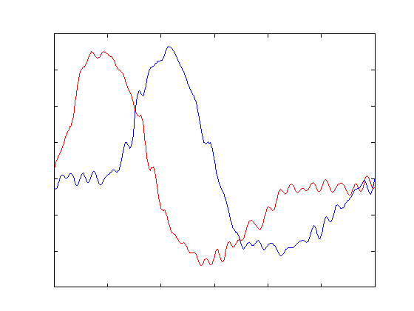
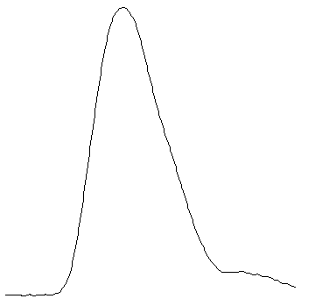
Digital Waveform Analysis
Fit to waveform
and derivative
templates
Psec Timing
and Charge
TWEPP2010, Sept 21st, Aachen, Germany, Jean-Francois Genat

Slide 15
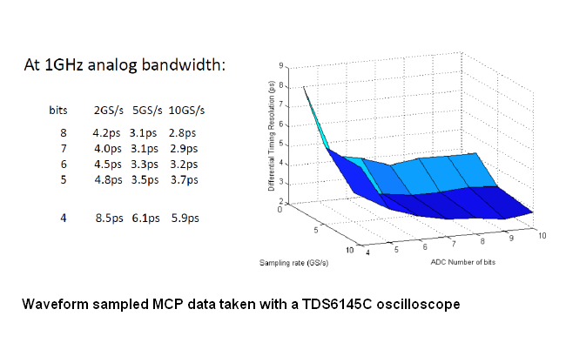
Timing resolution with Fast Waveform Sampling
TWEPP2010, Sept 21st, Aachen, Germany, Jean-Francois Genat

Slide 16
Outline
Context
Fast timing and Waveform analysis
Sampling Electronics
130nm CMOS Waveform Sampler Tests
Conclusion - Perspective
TWEPP2010, Sept 21st, Aachen, Germany, Jean-Francois Genat

Slide 17
Fast Waveform Sampling Electronics
Integration for large scale detectors ~ 10⁴⁻⁶ channels.
Control sampling rate, sampling depth, sampling window.
Self trigger for data sparsification, or/and common stop.
Low power.
High reliability
Very low cost for high quantities.
ASIC
TWEPP2010, Sept 21st, Aachen, Germany, Jean-Francois Genat

Slide 18
Fast Digital Electronics for
Micro-Channel Plate Detectors
A/D state of the art:
8-bit 1GS/s
10-bit 300 MS/s
16-bit 160 MS/s
Need at least 5 GS/s sampling rate, 10-12bit
There is no !
Fast analog storage + slower digitization, if input rate and dead-time allows.
Apply the best timing algorithm suited to the detector waveform
TWEPP2010, Sept 21st, Aachen, Germany, Jean-Francois Genat

Slide 19
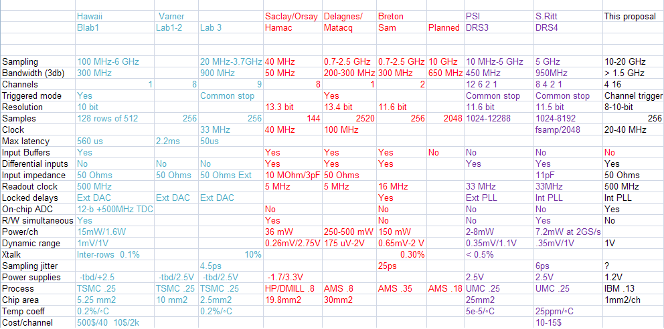
Sampling Chips Survey
TWEPP2010, Sept 21st, Aachen, Germany, Jean-Francois Genat

Slide 20
Sampling ASIC Sequence of operations
-1 Write: The timing generator runs continuously, outputs clock phases 100ps spaced.
Each phase closes a write switch during one sampling window.
-2 Trigger: Opens all the write switches. Analog input history stored in the capacitors.
40 MHz Clk
100ps
A/D converters
Analog
inputs
Digital
output
Mux
-2 A/D conversion: after a trigger starts all A/D conversions in parallel
Data available after 2 μs 2GHz counters)
-3 Read occurs after conversion (data can still be taken as in Phase 1)
TWEPP2010, Sept 21st, Aachen, Germany, Jean-Francois Genat

Slide 21
Outline
Context
Fast timing and Waveform analysis
Sampling Electronics
130nm CMOS Waveform Sampler
Next chip
Conclusion - Perspective
TWEPP2010, Sept 21st, Aachen, Germany, Jean-Francois Genat

Slide 22
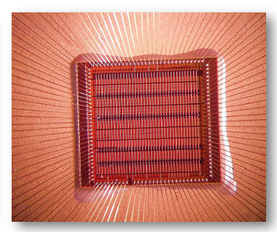
Waveform Sampler ASIC specs
Channels 4 + 1 test
Sampling rate 10-15 GS/s
Analog Bandwidth 1-2GHz
Self and External trigger
Dynamic range 800mV
Sampling window 400ps-800ps (or 8 delay cells)
DLL Timing generator Internal phase comparator and charge pump, external LP filter
DC Input impedance ½ 50Ω internal, ½ external
Conversion clock Adjustable 500MHz 1GHz internal ring oscillator.
Maximum conversion time 8us.
Read clock 40 MHz. Readout time (4-channel) 4 x 256 x 25ns=25.6 μs
Power 40mW/channel
Power supply 1.2V
Process IBM 8RF-DM (130nm CMOS)
TWEPP2010, Sept 21st, Aachen, Germany, Jean-Francois Genat

Slide 23
Block diagram
Clock
Timing Generator
Ch 0
Channel # 0 (256 sampling caps + 12-bit ADC)
Read
control
Ch 1
Analog in
Ch 3
Ch 4
Channel # 4 (timing)
Digital
out
Calibration
Channel #4 (calibration)
Read
TWEPP2010, Sept 21st, Aachen, Germany, Jean-Francois Genat

Slide 24
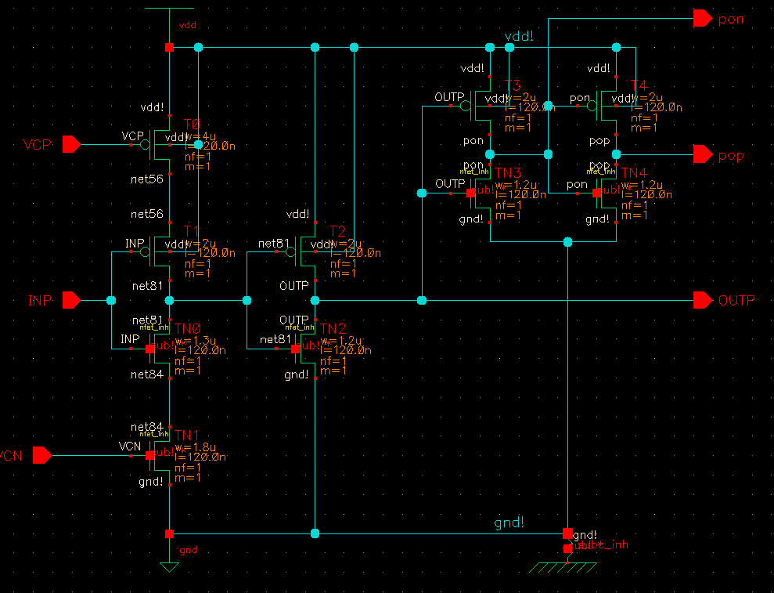
Timing Generator
Voltage Controlled Delay Cell
- 256 voltage controlled delay cells, 50-200ps each
- 20-80 MHz clock propagated
Voltage Controlled Delay Cell
Test structure:
Ring Oscillator: Two delay cells + inverter
TWEPP2010, Sept 21st, Aachen, Germany, Jean-Francois Genat

Slide 25
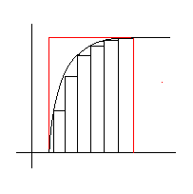
Analog Bandwidth and Sampling Window
On chip:
R_{in} is the resistance of the
closed write switch
R_{in}
V_{in}
C_{store}
Sampling window
- Analog bandwidth:
In practice, R_{in} and C_{store} are minimum, but limited by the stray capacitor of the switch, and the leakage current of the switch in the open state.
Sampling window
Number of switches closed at a time x sampling period
The Analog Bandwidth does not depend upon the Sampling Window width
Off chip:
Inductance of the wire bonds and pad capacitance:
Bump-bonding investigated vs wire bonding
TWEPP2010, Sept 21st, Aachen, Germany, Jean-Francois Genat

Slide 26
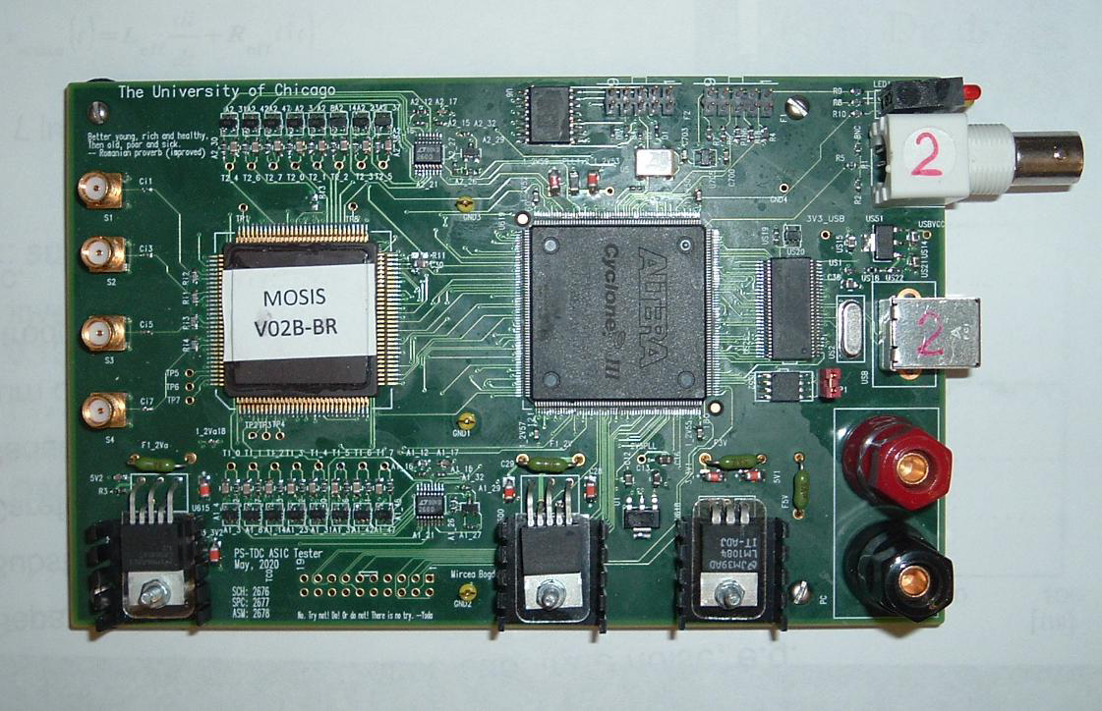
Sampler ASIC test card
TWEPP2010, Sept 21st, Aachen, Germany, Jean-Francois Genat

Slide 27
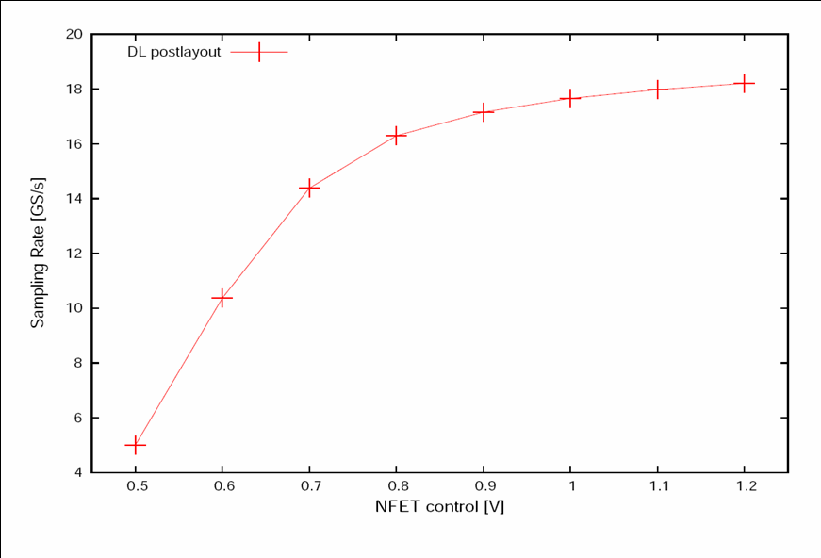
Timing Generator simulation
Sample rate
18 GS/s
TWEPP2010, Sept 21st, Aachen, Germany, Jean-Francois Genat

Slide 28
Timing Generator Tests
Sample rate
11 GS/s
TWEPP2010, Sept 21st, Aachen, Germany, Jean-Francois Genat

Slide 29
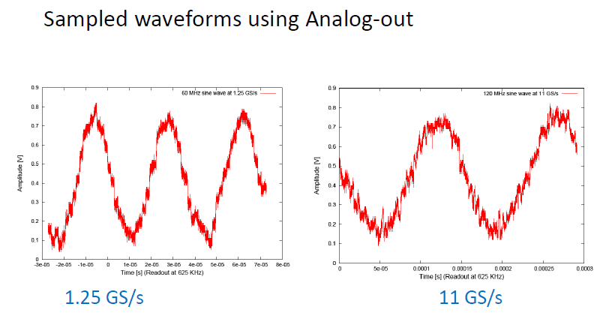
Sampling Rate tests
ADC not functional (still investigated)
Sampled waveforms using the analog output at 1.25 GS/s 11 GS/s .
Noise partly due to the test set-up. Under investigations.
TWEPP2010, Sept 21st, Aachen, Germany, Jean-Francois Genat

Slide 30
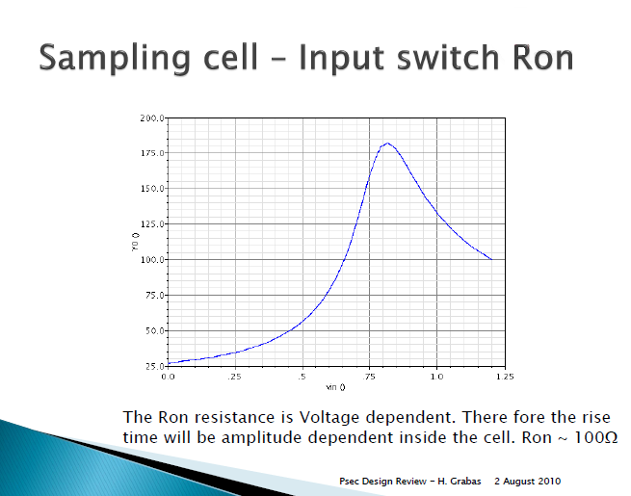
Analog bandwidth simulated
Sampling capacitor + input buffer
is ~100fF
Anticipated 3 dB bandwidth due to
the sampling network is:
1/(2π x 150Ω x 100fF)= 10 GHz
Add parasitics of the open switches
Post layout simulation provides 1.6 GHz
Bonding wire + pads + test card:
L=25nH, C=3pF
1/ [2π x sqrt(25 x 3e-12)]=580 MHz
Flip-chip version card developed
Sampling switch “on” resistance
TWEPP2010, Sept 21st, Aachen, Germany, Jean-Francois Genat

Slide 31
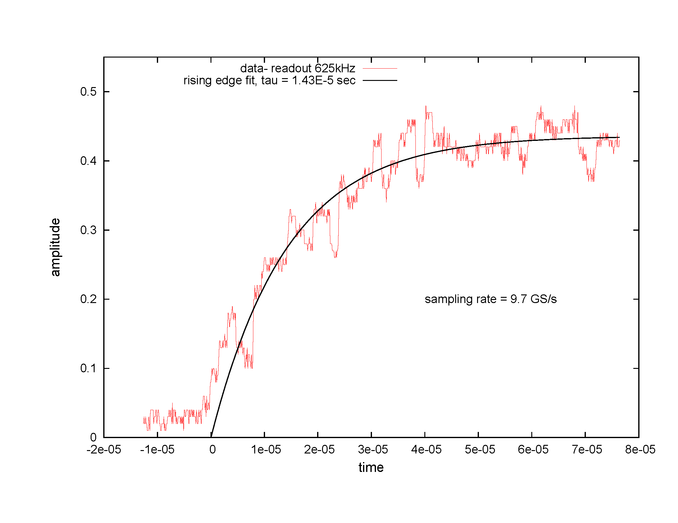
Analog bandwidth
Sampling of an edge clock at 9.7GS/s. Analog bandwidth is 14.3 μs x 625kHz/9.7GHz = 180 MHz
TWEPP2010, Sept 21st, Aachen, Germany, Jean-Francois Genat

Slide 32
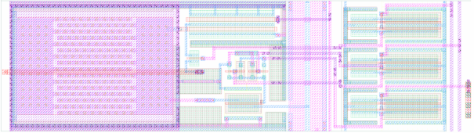
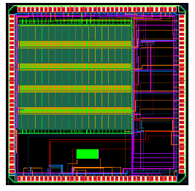
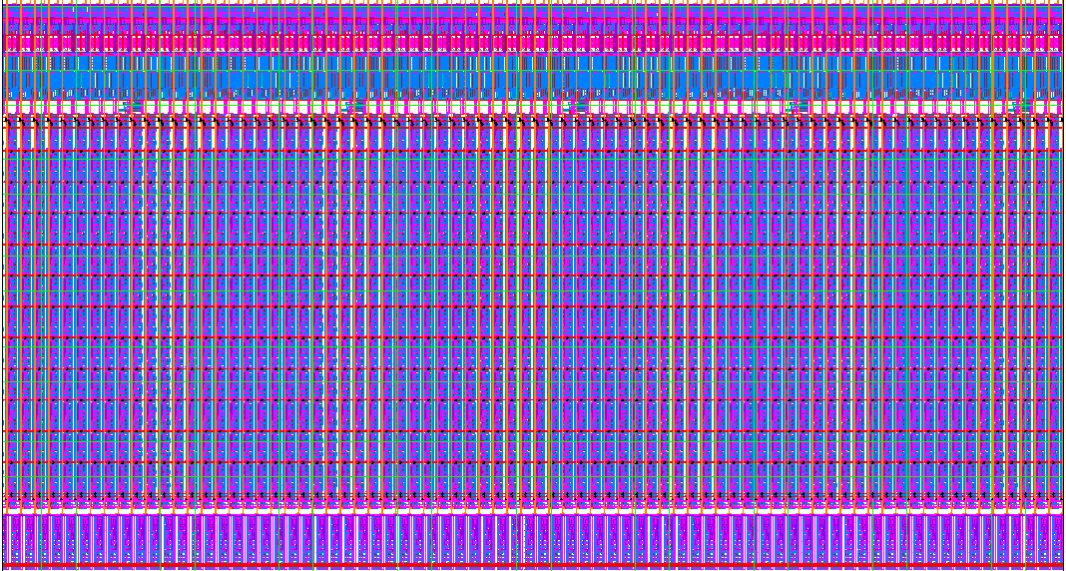
Layout (first version)
One sampling cell
One channel
CMOS 130nm IBM 4 x 4 mm²
TWEPP2010, Sept 21st, Aachen, Germany, Jean-Francois Genat

Slide 33
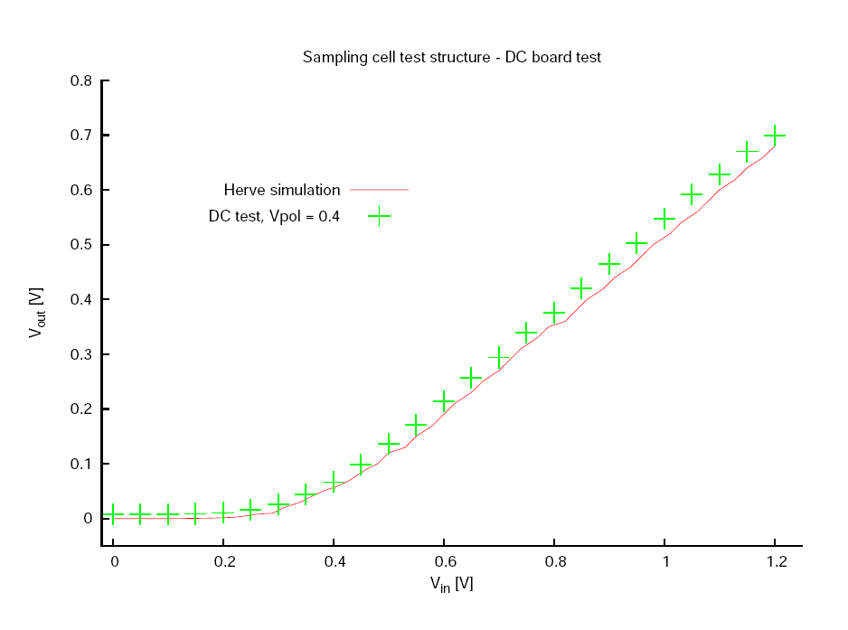
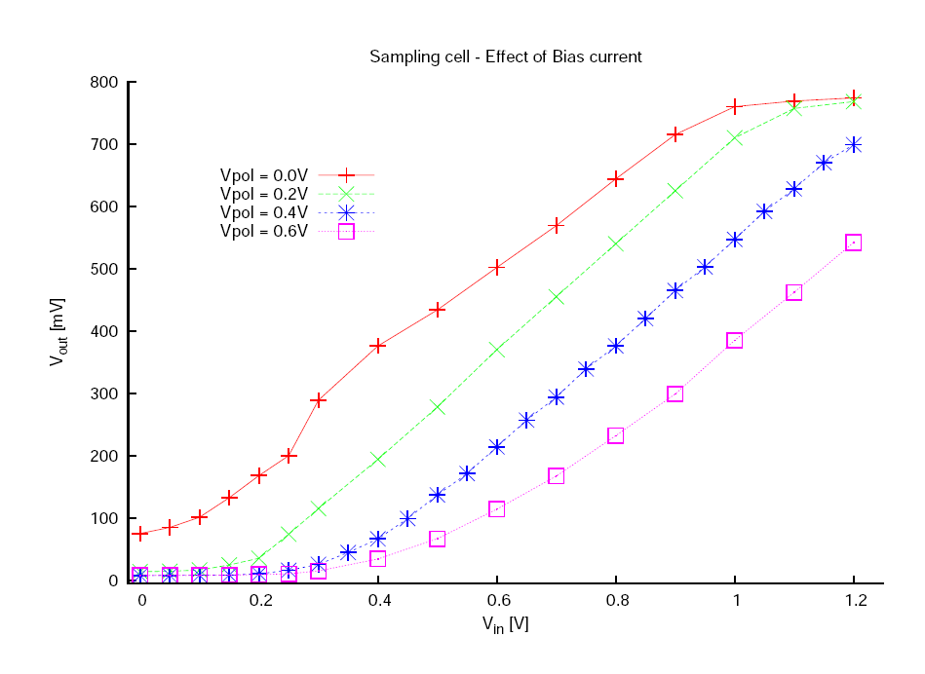
Tests: Measured Sampling cell (DC)
Measurements Simulation/Measurements
Optimum at 0.4V biasing
TWEPP2010, Sept 21st, Aachen, Germany, Jean-Francois Genat

Slide 34
ADC
Wilkinson:
All cells digitized in one conversion cycle
- Ramp generator
Comparators
Counter
Clocked by the ring oscillator at 1-2 GHz
- Not functional in this chip version, still under debugging
- Chip tested using a buffered analog output
TWEPP2010, Sept 21st, Aachen, Germany, Jean-Francois Genat

Slide 35
Outline
Context
Fast timing and Waveform analysis
Sampling Electronics
130nm CMOS Waveform Sampler
Conclusion - Perspective
TWEPP2010, Sept 21st, Aachen, Germany, Jean-Francois Genat

Slide 36
Conclusion Perspective
This 130nm CMOS ASIC:
- Sample rate 11.5 GS/s (15 anticipated)
- Analog bandwidth is 200 MHz (1.6GHz simulated)
Issues:
- Analog bandwidth reduced by test card environment
- ADC to be fixed
Next chips (expected December 2010) :
- ½ Hawaii- ½ Chicago
Hawaii: Chicago:
DAC Delay line with DLL structure
D Flip Flop Free running DLL with low Vt transistors
Charge Sensitive Amplifier Phase detector–Charge pump
LVDS Ring Oscillator
Ring Oscillator Two test Transmission lines
Differential storage cell
- Full 6-channel chip including
Four channels including input channel discriminators
One timing channel
One test channel
Input channel discriminators, internal PLL.
TWEPP2010, Sept 21st, Aachen, Germany, Jean-Francois Genat

Slide 37
References
[1] J.L. Wiza. Micro-channel Plate Detectors. Nucl. Instr. Meth. 162 (1979) 587-601.
[2] K. Inami, N. Kishimoto, Y. Enari, M. Nagamine, and T. Ohshima. Timing properties of MCP-PMT. Nucl. Instr. Meth. A560 (2006) 303-308., K. Inami. Timing properties of MCP-PMTs. Proceedings of Science. International Workshop on new Photon-Detectors, June 27-29 (2007). Kobe University, Japan.
[3] J. Va’vra, J. Benitez, J. Coleman, D. W. G. Leith, G. Mazaher, B. Ratcliff and J. Schwiening. A 30 ps Timing Resolution for Single Photons with Multi-pixel Burle MCP-PMT. Nucl. Instr. Meth. A572 (2007) 459-462.
[4] H. Kim et al. Electronics Developments for Fast Timing PET Detectors. Symposium on Radiation and Measurements Applications. June 2-5 (2008), Berkeley CA, USA.
[5] An extensive list of references on timing measurements can be found in: A.Mantyniemi, MS Thesis, Univ. of Oulu, 2004; ISBN 951-42-7460-I; ISBN 951-42-7460-X;
[6] S. Cova et al. Constant Fraction Circuits for Picosecond Photon Timing with Micro-channel Plate Photomultipliers. Review of Scientific Instruments, 64-1 (1993) 118-124.
[7] E. Delagnes, Y. Degerli, P. Goret, P. Nayman, F. Toussenel, and P. Vincent. SAM : A new GHz sampling ASIC for the HESS-II Front-End. Cerenkov Workshop (2005), and NIM A, Volume 567, Issue 1, p. 21-26, 2006
[8] S. Ritt. Design and Performance of the 5 GHz Waveform Digitizer Chip DRS3. Nuclear Instruments and Methods, (2007).
[9] G. Varner, L.L. Ruckman, A. Wong. The First version Buffered Large Analog Bandwidth (BLAB1) ASIC for high Luminosity Colliders and Extensive Radio Neutrino Detectors. Nucl. Inst. Meth. A591 (2008) 534.
[10] G.Bondarenko, B. Dolgoshein et al. Limited Geiger Mode Silicon Photodiodes with very high Gain. Nuclear Physics B, 61B (1998) 347-352.
[11] J-F Genat , G. Varner, F. Tang and H. Frisch. Signal Processing for Pico-second Resolution Timing Measurements. Nuclear Instruments and Methods, (2009).
[12] J. Christiansen. An Integrated CMOS 0.15 ns Digital. Timing Generator for TDC's and Clock Distribution. Systems, IEEE Trans. Nucl. Sci., Vol. 42, No4 (1995), p. 753
TWEPP2010, Sept 21st, Aachen, Germany, Jean-Francois Genat

Slide 38
Thanks for your attention !
TWEPP2010, Sept 21st, Aachen, Germany, Jean-Francois Genat

Slide 39
Backup

Slide 40
Sampling Cell
wr
rd
R_{in}
V_{in}
C_{in}
V_{out}
C_{storage}
V_{in}
wr
Principle
V_{in}
C_{in}
“Write” state 3 dB analog bandwidth is 1/(2πR_{in}C_{storage})
BUT parasitics (bonding wire + stray capacitors due to open switches) induce a much dominant pole !
- Flip-chip test card under development
- “Sampling window” N switches closed x sampling period
Analog bandwidth does not depend upon N
- Thermal kT/C switching noise = 250μV = one 12-bit ADC count
- Digital noise presumably higher. Fixed pattern noise due to Vt spreads of buffers
TWEPP2010, Sept 21st, Aachen, Germany, Jean-Francois Genat

Slide 41
5-15 GHz Timing Generator [12]
50ps step delays
40-160 MHz Clock in
0ps
32-64 cells
200ps 200ps 200ps 200ps
250ps
300ps
350ps
To switched capacitor array
TWEPP2010, Sept 21st, Aachen, Germany, Jean-Francois Genat

Slide 42
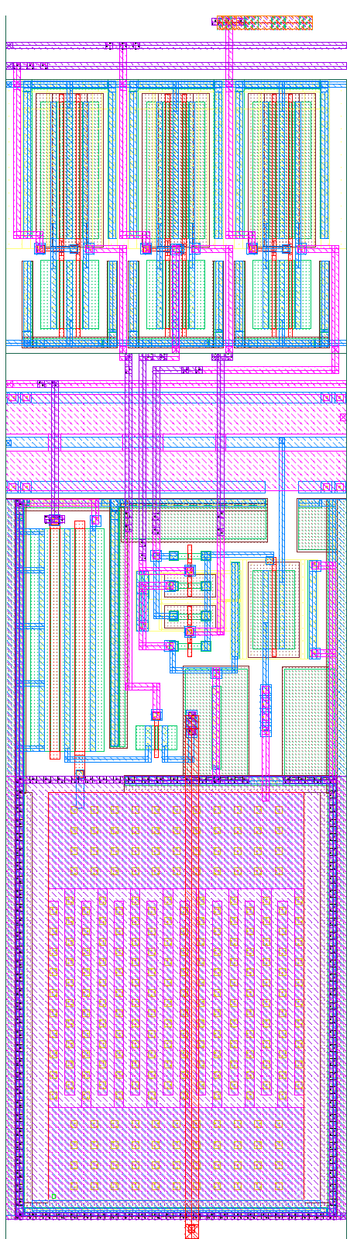
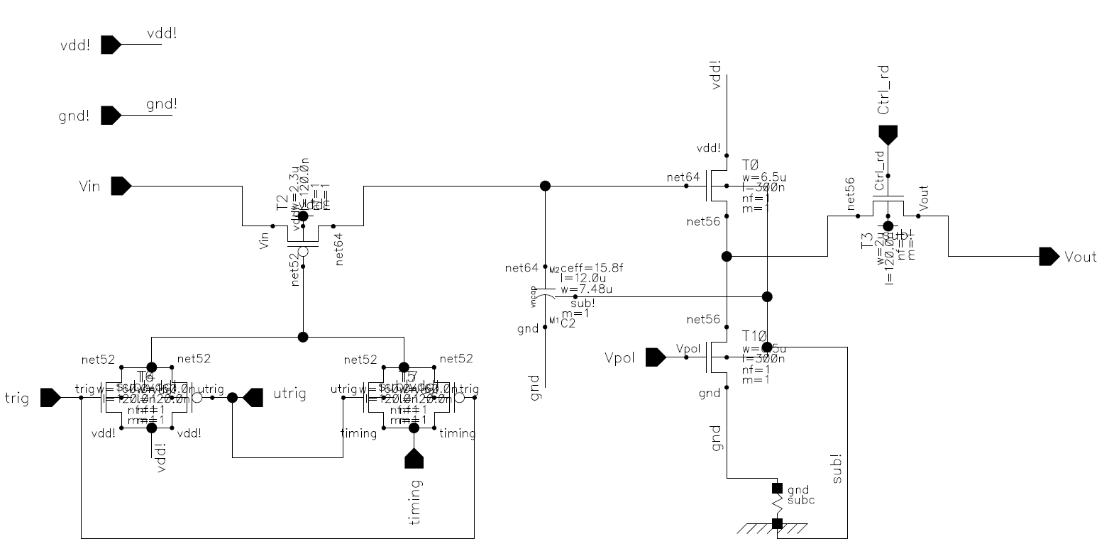
Sampling Cell version 1 (Herve Grabas)
Input switch
Storage capacitance & Nfet
Output switch
²
Current source
Multiplexer
Sampling Capacitance 100 fF
Switch resistance: 100 Ω
Analog bandwidth 1-2GHz
Layout
TWEPP2010, Sept 21st, Aachen, Germany, Jean-Francois Genat

Slide 43
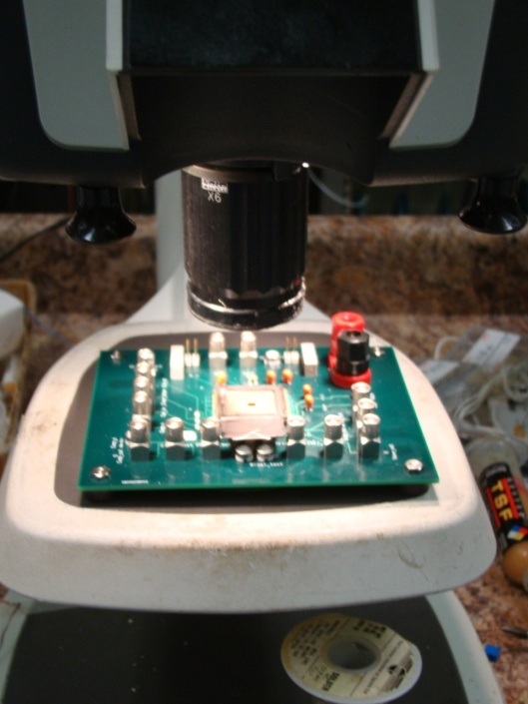
Tests (first version)
- First tests of packaged chips (presented here)
- DC power vs biases,
- Sampling cell response vs input
- ADC’s comparator
    - Leakages (voltage droop)
- Digital Readout
Fine tests to come… (chip is just being bump-bonded to PCB)
  Analog bandwidth
  Resolution, signal-to-noise
  Sampling cell response vs sampling window
  Crosstalk
  Max sampling rate
  Full ADC
  Linearities, dynamic range, readout speed
TWEPP2010, Sept 21st, Aachen, Germany, Jean-Francois Genat
Notes:
43

Slide 44
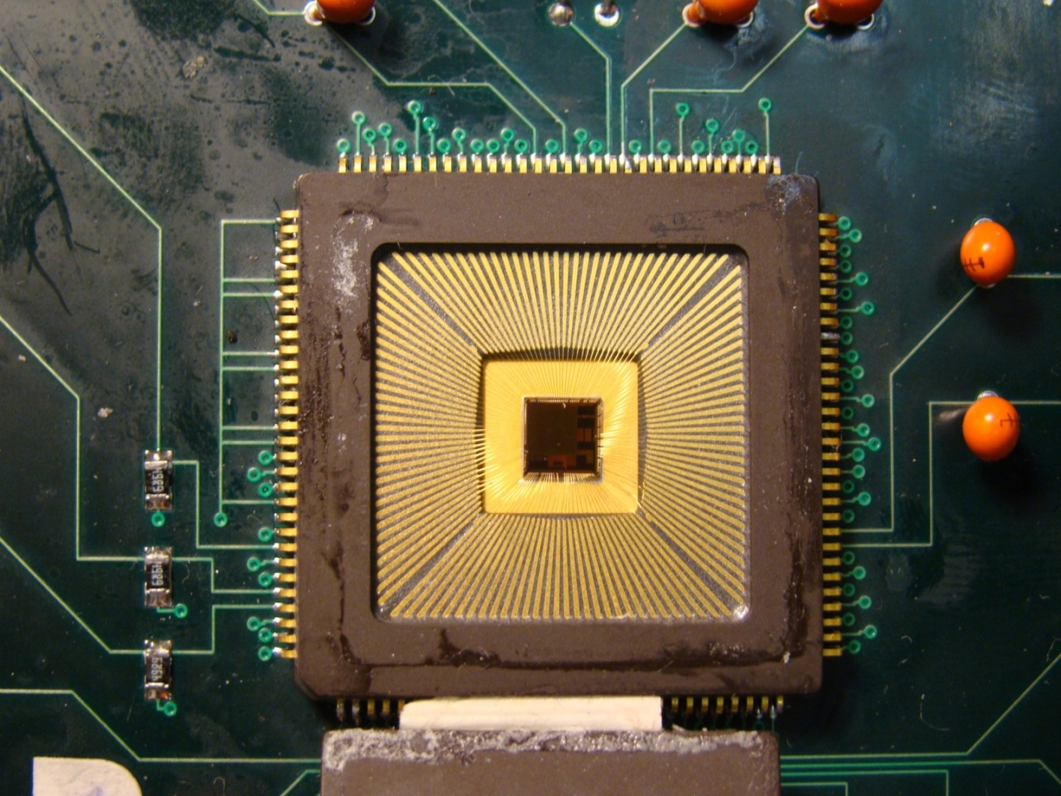
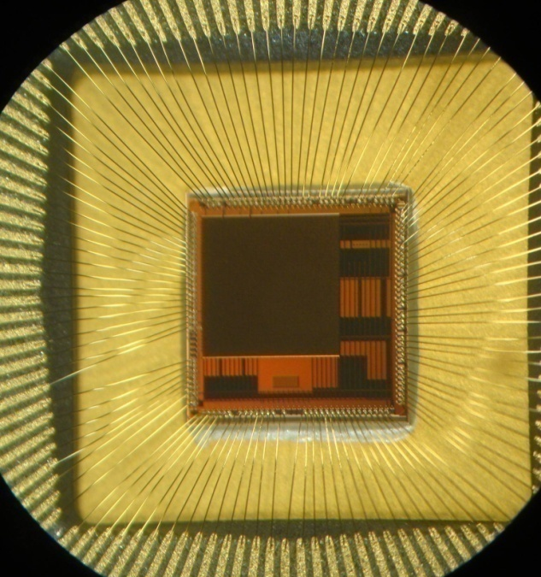
First version
Received October 21st 2009
Die to be bump-bonded on PCB
TWEPP2010, Sept 21st, Aachen, Germany, Jean-Francois Genat

Slide 45
Tests: Sampling cell Leakages
1 - input LOW, write switch CLOSED
2 - input HI, switch CLOSED
3 - input HI, switch OPEN
4 - input LOW, switch OPEN
1
2
3
4
Write switch Read switch
TWEPP2010, Sept 21st, Aachen, Germany, Jean-Francois Genat

Slide 46
Sampling Chips
Sampling Bandwidth Dyn. range Depth PLL ADC Trigger Techno
GS/s GHz bits bits
G. Varner (Hawaii) [9] 6 1.0 10 1024 no 12 experience .25μm
S. Ritt (PSI) [8] 6 .8 11.5 256 3.9ps no no .25μm
D. Breton/E. Delagnes 2.5 .5 13.4 250 20ps no no .35μm
(Orsay/Saclay) [7]
ASIC Deep Sub-Micron ( < .13μm ) CMOS processes allow today:
Sampling: 10-20 GHz
Bandwidth: > 1.5 GHz
Dyn. Range: 10 bit
TWEPP2010, Sept 21st, Aachen, Germany, Jean-Francois Genat

Slide 47
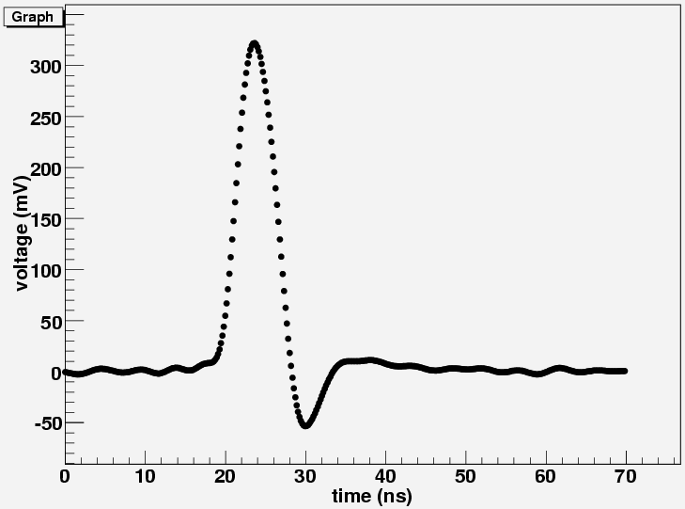
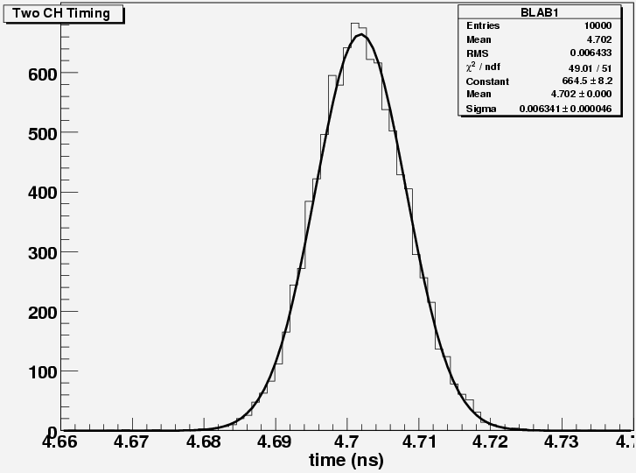
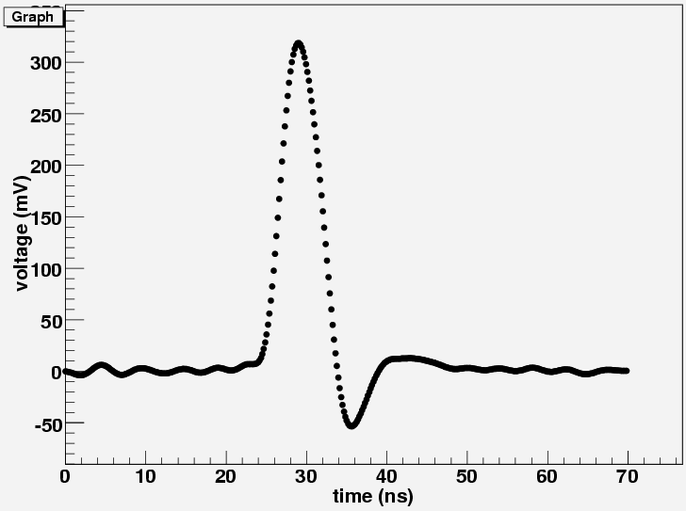
Existing ASICs: Labrador 3 [9]
Gary Varner
U-Hawaii
CH1
6.4 ps RMS
(4.5ps single)
CH2
250nm CMOS
TWEPP2010, Sept 21st, Aachen, Germany, Jean-Francois Genat

Slide 48
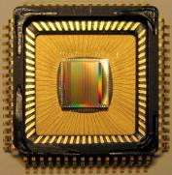
Waveform Digitizing Chip DRS4 [8]
Stefan Ritt
Paul Scherrer Institute
Switzerland
UMC 0.25 μm rad. hard
9 chn. each 1024 bins,
cascadable up to 8192
Sampling speed
0.2 … 5 GS/s
Bandwidth 950 MHz
17.5 mW/chn @ 2.5V
On-chip PLL stabilization
Readout speed using
ext. ADC: 30 ns * n_{samples}
SNR: 69 dB calibrated
Aperture jitter:
4 ps at 5 GS/s calibrated
No
No
250nm CMOS
TWEPP2010, Sept 21st, Aachen, Germany, Jean-Francois Genat

Slide 49
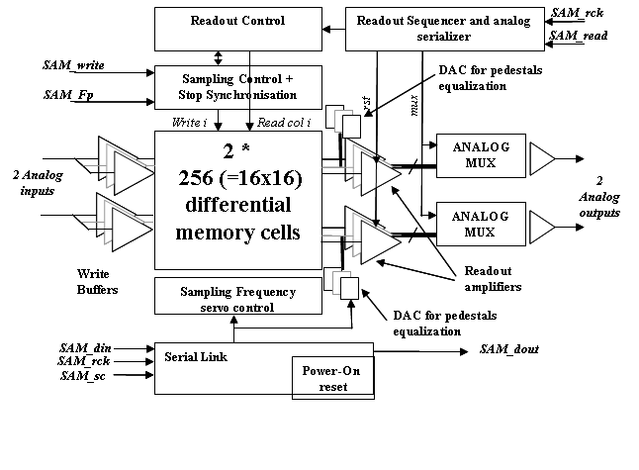
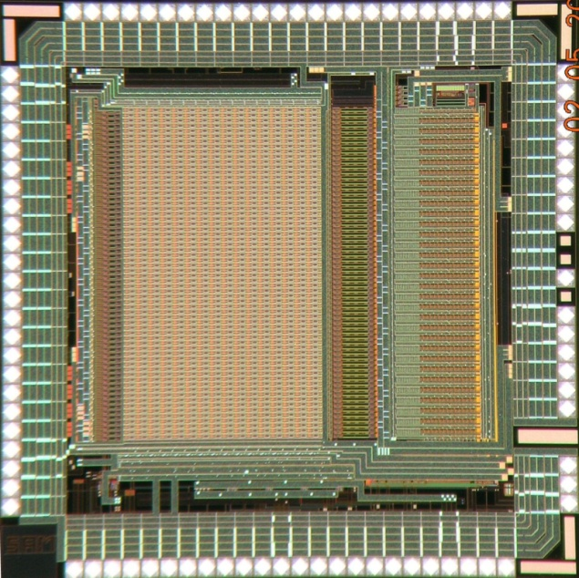
The SAM (Swift Analog Memory) ASIC [7]
D. Breton/E. Delagnes
Orsay/Saclay
2 differential channels
256 cells/channel
BW > 450 MHz
Sampling Freq 400MHz->3.2GHz
High Readout Speed > 16 MHz
Smart Read pointer
Few external signals
Many modes configurable by a serial link.
Auto-configuration @ power on
AMS 0.35 µm => low cost for medium size prod
NIM A, Volume 567, Issue 1, p. 21-26, 2006
6000 ASICs manufactured, tested and delivered in Q2 2007
TWEPP2010, Sept 21st, Aachen, Germany, Jean-Francois Genat

