Slide 1
Exploring the limiting factors of PSEC4 resolution
1
D. Braga, F. Fahim, N. J. Pastika, P. M. Rubinov, T. N. Zimmerman
N. Sullivan
H. J. Frisch, M. Heintz, E. Oberla, J. Park, C. Poe, F. Tang
G. S. Varner
B. W. Adams
C. Ertley
E. Angelico
2
3
4
5
6
7
1. Fermi National Accelerator Laboratory 2. Angstrom Research, Inc. 3. Enrico Fermi Institute, the University of Chicago 4. Univ. of Hawaii 5. Quantum Optics Applied Research 6. Southwest Research Institute 7. Stanford University
Notes:
Hi everyone. I’m Jin, and I will present the limiting factors of PSEC4 time resolution and the prospects of PSEC5 dealing with them.

Slide 2
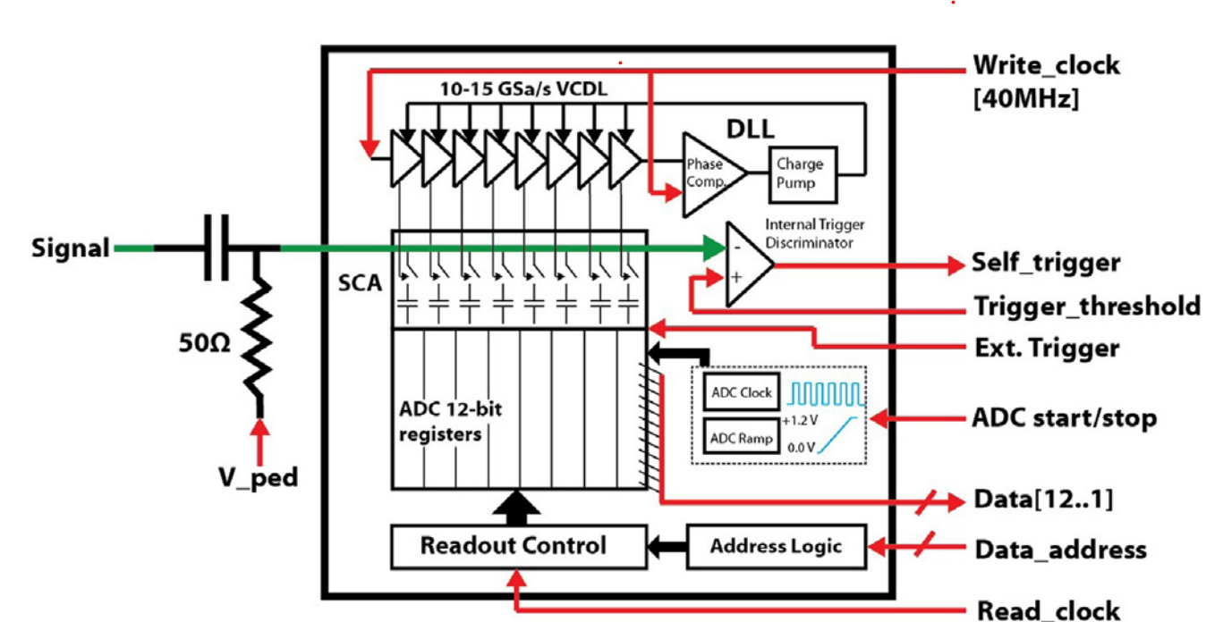
PSEC4 ASIC(2014)
12-bit depth
6 channel/chip
5ps resolution
130ns IBM 8RF
E. Oberla , J.-F. Genata, H. Grabasa, H. Frisch, K. Nishimura, G. Varner, arxiv.org/abs/1309.4397
Notes:
PSEC4 is a analog to digital converter ASIC we have been using for almost a decade now. It has 6 channels, 256 samples per channel, and about 10 gigasamples per second of sampling rate. The chip consists of switched capacitor array and SAR ADC.
We will focus on the components within the green dotted line because they determine the performance of the chip.
The signal goes into the chip from the left. First, its DC component is removed and set to a constant voltage, V_ped, which can be controlled by an FPGA for example.
Then there is a switched capacitor array, each capacitor connected to a 12 bit register and all capacitors share a single SAR ADC per channel, all incorporated in a single layout.
Because the bit depth is high enough, the primary limiting factor of timing resolution comes from the analog characteristic of the switched capacitor array.
I will further explain each component of interest through the next couple of slides.

Slide 3
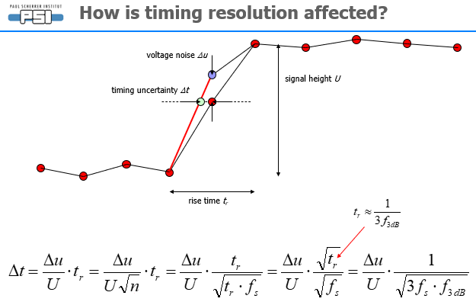
Timing resolution factors – PSEC4 studies
Must optimize four aspects:
Signal rise time
voltage noise of samples
sampling time jitter/uncertainty
Nonlinearity
Adopted from Stefan Ritt “The role of analog bandwidth and signal-to-noise in timing for
waveform digitizing“
Notes:
There are four factors that limit the timing resolution of our chip.
Signal rise time
voltage noise of samples
sampling time jitter/uncertainty
nonlinearity.
I will explain the calibration process which deals with these factors. We will focus on the last two points, as they are more fundamental timing resolution bottlenecks in the Switched Capacitor Array based ADC.

Slide 4
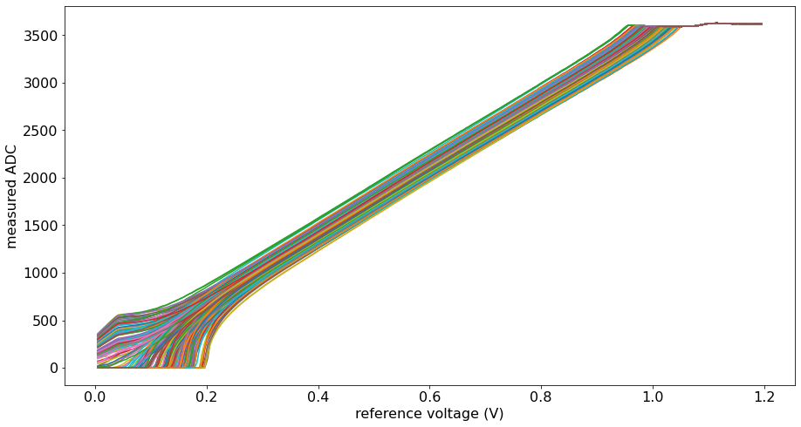
Voltage linearization of PSEC4
It is necessary to reconstruct voltage from ADC value. The curve differs for each capacitor.
1. V_ped is set to a voltage of interest, 0.0v-1.2v
2. PSEC4 is left in sampling mode for a few cycles, so that all capacitors are set to V_ped. ($σ_{V}≈0.5mV$)
3. Each register is read. Each curve corresponds to a capacitor.
Linearizable Domain
~0.75V
Notes:
First thing that bothered us next is the fact that due to the mechanical error in the construction of each capacitor switches,, shown in a green circle in the diagram on the right, the charge stored in each capacitor is not exactly proportional to the signal amplitude, so *the 12-bit number from each ADC and the actual input voltage appear not linear, and they differ for each capacitor.*
It is necessary to reconstruct input voltage value from 12-bit ADC readout value. We use the curves in the left plot for this, which is a differing characteristic for each capacitor in the array.
The way we measured this curve is very straightforward.
1. V_ped, in the red circle, is an independent variable which is represented by x axis in the left plot, is set to a voltage of interest, 0.0v-1.2v
2. PSEC4 is left in sampling mode for a few cycles, so that all capacitors are set to V_ped. The signal to noise ratio in this case is 0.5 millivolts.
3. Each register is read. Each curve corresponds to a capacitor.

Slide 5
Sample time calibration – Ellipse method
Time intervals between samples are determined by a VCDL.
Each element of the VCDL has a different time offset.
K. Nishimura, A. Romero-Wolf, A correlation-based timing calibration and diagnostic technique for fast digitizing ASICs(2011)
Notes:
Time difference between samples are determined by a voltage-controlled delay line, which is an array of transistors, usually MOSFETs, which a signal propagates through the array at a desired rate.
However, also due to uncertainties in the manufacturing process, each element of the VCDL has different time offset.
It is necessary to measure each time offset to correctly sample a signal.
(DLL can be improved to a modern PLL)
For this we used what is called ellipse method, which we attribute its first development to the paper below.

Slide 6
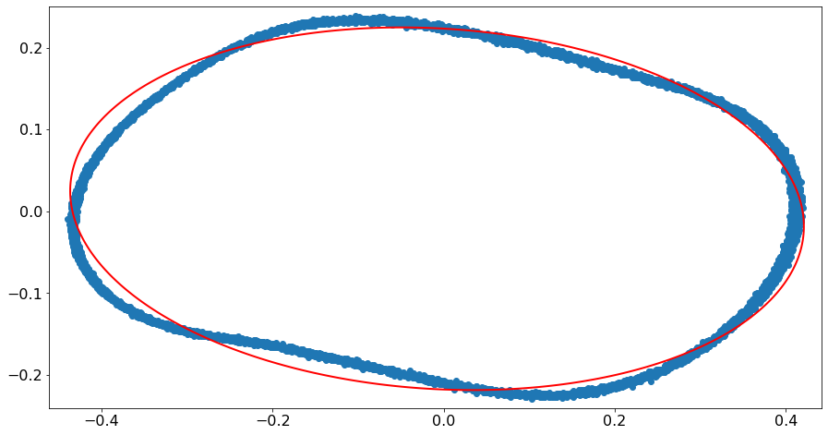
1. Measure many events of a sine wave.
2. Sum vs. Difference of two adjacent samples, over all events, form an ellipse.
3. Time offsets can be determined from the ellipse coefficients.
Event 1
Event 2
Input Voltage
$$V_{i}−V_{i+m}$$
$t_{i+m}−t_{i}$ determined by eccentricity and rotation.
Event 3
Event 4
$$V_{i}+V_{i+m}$$
$$t_{i}{ t}_{i+m}$$
Noise → fainter, more spread curve.
Nonlinearity → distorted curve
Time
Notes:
This is a brief overview of the ellipse method.
1. Measure many events of a sine wave.
2. Pick two sample position, no more apart than lambda over four of the input signal. Plot summation versus differnce of the samples of two position over all events, should form an ellipse.
3. Time offset can be determined from the coefficients.
The diagram explains which event corresponds to which dot in the ellipse plot.
When you think about it, the plot does not have to be on two adjacent samples, but samples which are m samples apart. This way the effect of voltage noise of each sample on the time offset is smaller.
In other words, the sampled curve is more like a smooth ellipse as m gets larger.
However, the time difference cannot be larger than one fourth of the period of the sine wave, which in our case corresponded to m equal to about 10.
When we look at the right ellipse plot,
Higher voltage Noise results in fainter, more spread curve.
Nonlinearity of the overall system results in distorted curve

Slide 7
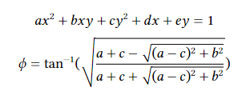
Notes:
We have developed a method to measure time offset of each sample.
1. Measure many events of a sine wave.
2. Plot Summation vs. Difference of two adjacent samples, over all events, should form an ellipse.
3. Time offset can be determined from the coefficients.
The diagram explains which event corresponds to which dot in the ellipse plot.
When you think about it, the plot does not have to be on two adjacent samples, but samples which are m samples apart. This way the effect of voltage noise of each sample on the time offset is smaller.
In other words, the sampled curve is more like a smooth ellipse as m gets larger.
However, the time difference cannot be larger than one fourth of the period of the sine wave, which in our case corresponded to m equal to about 10.
When we look at the right ellipse plot,
Higher voltage Noise results in fainter, more spread curve.
Nonlinearity of the overall system results in distorted curve

Slide 8
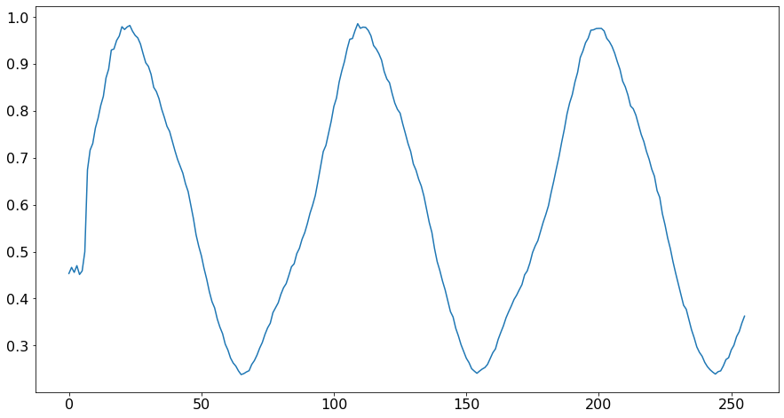
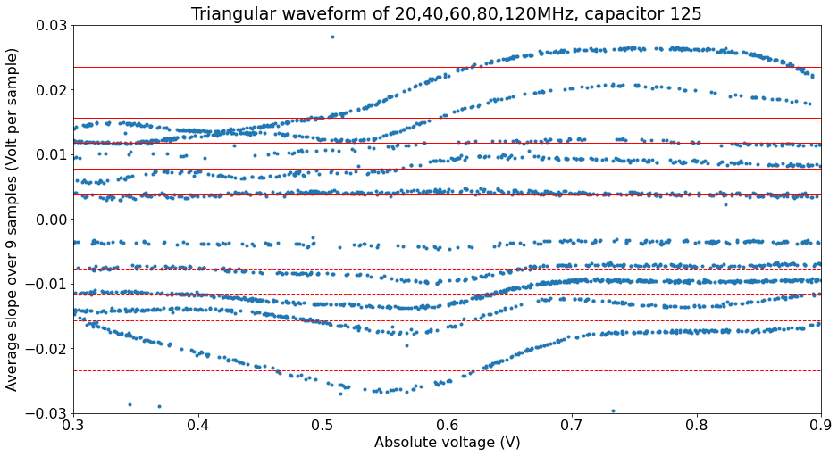
Nonlinearity - Measurement
Nonlinearity distorts sine wave input, introducing systematic errors in the ellipse method.
Notes:
The nonlinearity of PSEC4’s sampling system is easily seen in the measurements. We already saw that it distorts the sine wave so that the ellipse has systematic kinks on it. The nonlinearity is more visible when one sample a ramp to attain a voltage-slope curve, as you can see in the figure on the right hand side. The slope is positively biased when the absolute voltage is high, and negatively biased when the absolute voltage is low.

Slide 9
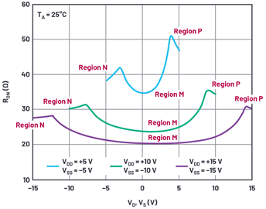
Nonlinearity - Microscopic
Adapted from E. Oberla et al., A 15 GSa/s, 1.5 GHz bandwidth waveform digitizing ASIC(2013)
B. Harvey, On Building Physically Accurate Analog Switch Macromodels, https://www.analog.com/en/analog-dialogue/raqs/raq-issue-173.html
Notes:
This nonlinearity can be mostly attributed to the voltage response of the cmos switch of the capacitor array.
Because it depends on the physical layout of each switch, it may be hard to calibrate the nonlinear effect. However, as we saw before, nonlinearity introduces a systemical error to time offsets.

Slide 10
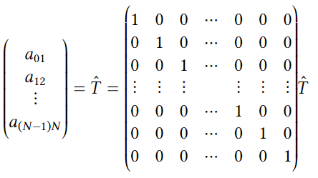
Weighted Least Squares Method
We want to estimate the following quantity:
Where $t_{i}$ is a time interval between $i$th and $i+1$th sample.
Conventional method of estimating $T$ is the following:
Where $a_{ij}$ is a measured time interval between the $i$th and $j$th samples.
Notes:
In order to attain time offsets that are resilient to nonlinearity, we developed a new method which is an application of the ellipse method and the weighted least squares method.
I will explain how this method works.
We want to estimate the following quantity T. where t I is a time interval between ith and I plus oneth sample.
In the conventional method we saw above, each entry of T is computed individually, from measurements a I i+one, which is a quantity computed from individual ellipses. However, we can imagine an identity matrix, between the estimator and the measurements.

Slide 11
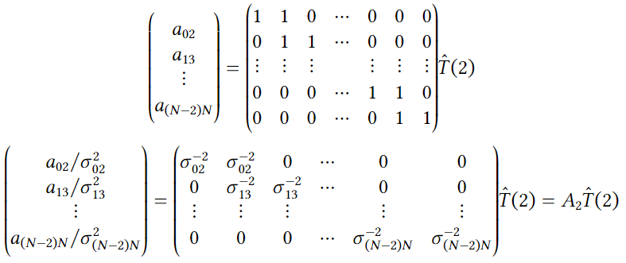
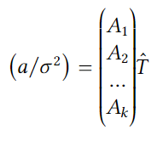
Weighted Least Squares Method
Consider measuring time intervals between $i$th and $i+2$th sample.
We can use the least squares method to compute $\hat{T}$.
Notes:
We proceed to drawing ellipse plots between capacitors that are not adjacent. For example, consider measuring time intervals between sample i and i+2.
We will have the following matrix, 1 appended to the each row at the column after the diagonal, between the estimator and the measurements.
We can further normalize the measurement values and the matrix, using the fitting uncertainty of each ellipse, so that the least squares method has unbiased weight.

Slide 12
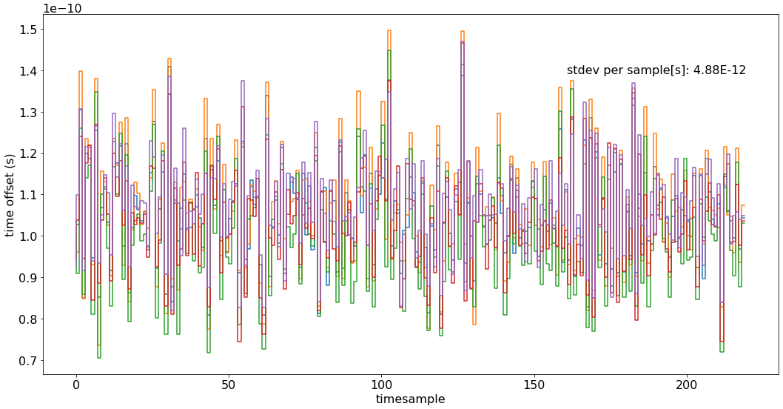
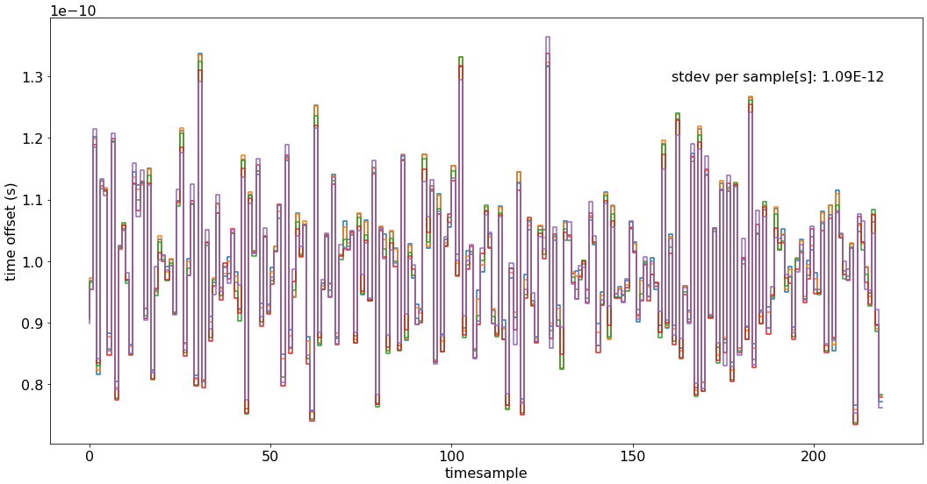
Only using N=1:
Weighted average N=1-6:
Notes:
Measured for different pedestal values, essentially different nonlinearity characteristics

Slide 13
PSEC5 Design Philosophy
Notes:
Moving toward the end of this talk, I want to share the design philosophy of PSEC5, our new chip under development.

Slide 14
Timing uncertainty reduced by an optimized LC-oscillator based PLL
From abstract: “Both independent PLLs have identical loop dynamics to allow a fair comparison … Furthermore these circuits consume the same amount of power. The PLLs were processed in a commercial 65 nm CMOS technology.”
Ring: 5.6ps jitter
LC: 0.325ps jitter
J. Prinzie, J. Christiansen, P. Moreira, M. Steyaert and P. Leroux, "Comparison of a 65 nm CMOS Ring- and LC-Oscillator Based PLL in Terms of TID and SEU Sensitivity," in IEEE Transactions on Nuclear Science,
vol. 64, no. 1, pp. 245-252, Jan. 2017.
Notes:
As I said before, we are currently using ring osc for the phase locked loop for the Voltage controlled delay line
This can be replaced to LC oscillator based phased locked loop to achieve better timing uncertainty.

Slide 15
Constant Fraction Discriminator
Notes:
As I said before, we are currently using ring osc for the phase locked loop for the Voltage controlled delay line
This can be replaced to LC oscillator based phased locked loop to achieve better timing uncertainty.

Slide 16
Comparison to other ASICs
SAMPIC | 3-10 | 2.5 | 64 | 16 | 10
H. Frisch et al., A High-Performance Multi-Channel Low-Power ASIC with One Pico-second Resolution for Emerging Detector Technologies in Positron-Emission Tomography, Particle Physics, and Astrophysics

Slide 17
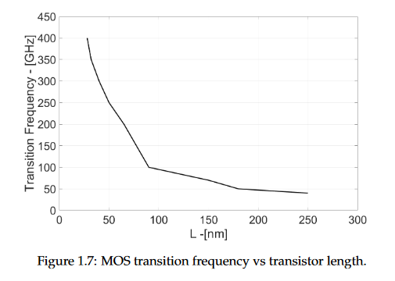
Great deal of work needs to be done but clear that 65nm CMOS technology superior characteristic to 130nm and older
Smaller process nodes give intrinsically faster transistors
Alessandra Pipino, Design of Analog Circuits in 28nm CMOS Technology for Physics Applications (2016)
Improved signal rise time
Improved or equal voltage noise of samples
Some selected results from literature:
(Romanova and Barzdenas: “A Review of Modern CMOS Transimpedance Amplifiers for OTDR Applications”, 2019)
Notes:
Great deal of work needs to be done but
One thing sure is that smaller process nodes give faster transistors.
This implies potentially
Improved signal rise time
Improved or equal voltage noise of samples

Slide 18
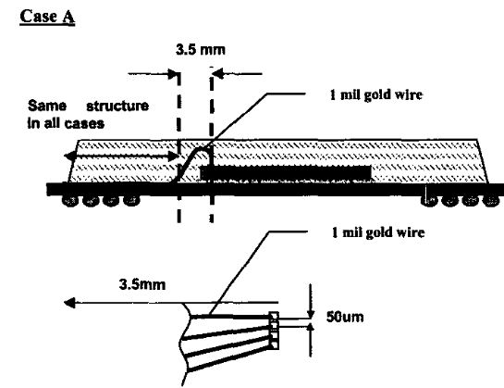
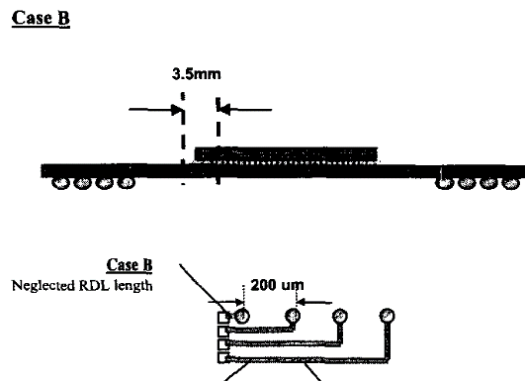
Improved packaging also important
 | $T_{r}$(ps) observed for 35ps risetime input pulse | Degradation (%)
Case A (wirebonded) | 65ps | 86%
Case B (flip-chip + RDL) | 42ps | 20%
$$T_{r}$$
Chi-Tsung Chiu, Sung-Mao Wu and Chi-Ping Hung, "High speed electrical performance comparison between bump with RDL and wire bond technologies," Proceedings of the 4th International Symposium on Electronic Materials and Packaging, 2002., 2002
Notes:
Also, we can improve the rising time of the pulse through better packaging, since shorter trace length results in lower degradation of rising time.

Slide 19
Time is right for a 1-psec timing chip!
Notes:
These three combined, here is the final table of specifications we expect for the new chip.
One final assertion of our team is that
1-psec timing chip is possible and it is the right time for it.

Slide 20
Citations(All from the doc lib)
Preliminary Specifications for a 1-Picosecond Resolution ASIC for the FTBF TOF System
A Modular Data Acquisition System using the 10 GSa/s PSEC4 Waveform Recording Chip
DEVELOPMENT OF LARGE-AREA MCP-PMT PHOTO-DETECTORS FOR A PRECISION TIME-OF-FLIGHT SYSTEM AT THE FERMILAB TEST BEAM FACILITY
Measurement Noise and Time-Base Calibration in ACDC Data

