Slide 1
Path to an Economical Low-Power Sub-psec Resolution ASIC
1
D. Braga, F. Fahim, N. J. Pastika, P. M. Rubinov, T. N. Zimmerman
N. Sullivan
H. J. Frisch, M. Heintz, E. Oberla, J. Park, C. Poe, F. Tang
G. S. Varner
B. W. Adams
C. Ertley
E. Angelico
2
3
4
5
6
7
1. Fermi National Accelerator Laboratory 2. Angstrom Research, Inc. 3. Enrico Fermi Institute, the University of Chicago 4. Univ. of Hawaii 5. Quantum Optics Applied Research 6. Southwest Research Institute 7. Stanford University
Notes:
Hi everyone. I’m Jin, and we will discuss why fast timing electronics is the future and what we have done and doing right now in the field.

Slide 2
Why Fast Timing?
Notes:
First, I want to highlight the importance of fast timing electronics.

Slide 3
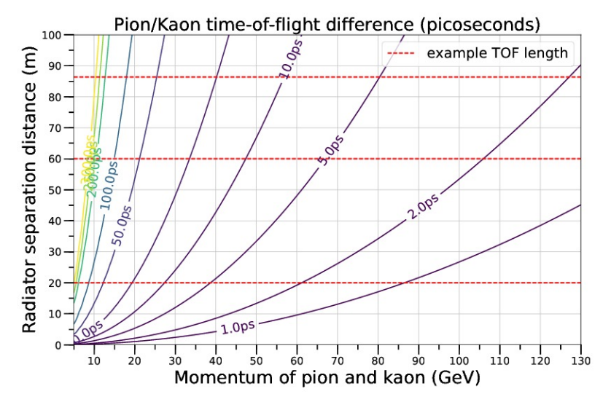
Why Fast Timing? Explained through Time of Flight (ToF) system
$$v= \frac{l}{t_{1}{−t}_{2}}, p=\frac{mv}{\sqrt{1−\frac{v^{2}}{c^{2}}}}$$
$${t=t}_{1}$$
$$l$$
$${t=t}_{2}$$
W. Badgett et al., Precision Time-of-Flight at the Fermilab Testbeam Facility (2018)
Notes:
We will look at time of flight system as an example.
When the speed of the particle is close to the speed of light, resolving small difference between v and c determines the momentum of the particle.
You can see what time scale we are on from the bottom plot.
We will look a few exemplary detector systems which can utilize this high resolving power.

Slide 4
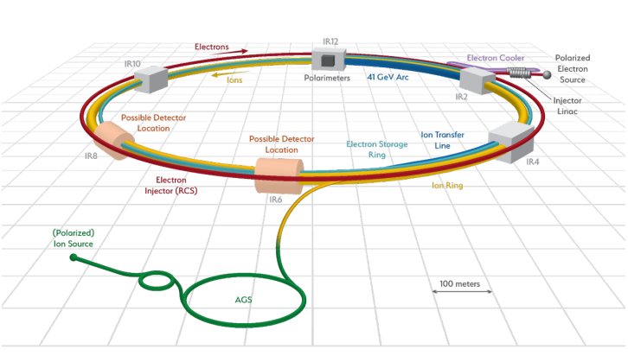
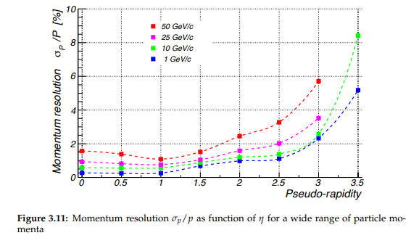
An Electron-Ion Collider Study(2019)
EIC is the local particle collider at BNL with $E_{CM}≈100\text{GeV}$ of ${10}^{34}{\text{cm}}^{−2}{\text{s}}^{−1}$.
Notes:
In the Electron-Ion collider in Brookhaven, the momentum resolution of the detector system will be at best 1% at 50 Giga electron volts. Looking back at our diagram of Pion and Kaons, for example, this resolution indeed corresponds to a region of sub picosecond time resolution. So it is evident that we need a fast timing electronics corresponding to the high performance detector system.

Slide 5
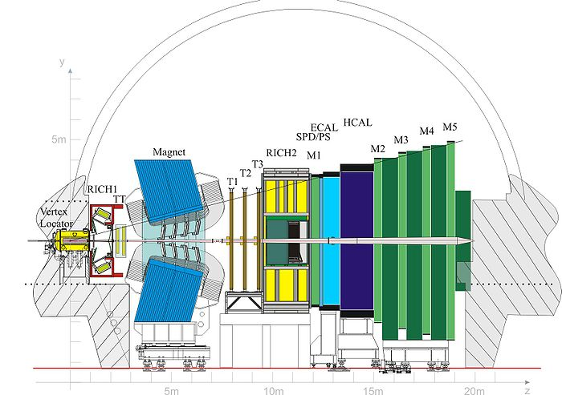
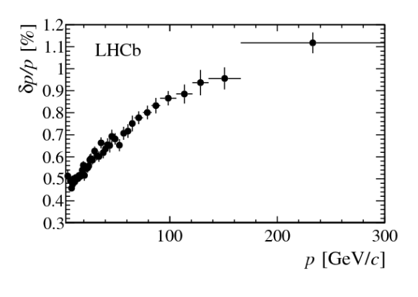
LHCb Detector Performance(2014)
The LHCb collaboration, https://arxiv.org/pdf/1412.6352.
Notes:
LHCb is another example of detector system with high momentum resolution, again at best 1% at 50 Giga electron volts and higher. And as I said, this indicates that we need a sub picosecond fast timing electronics.

Slide 6
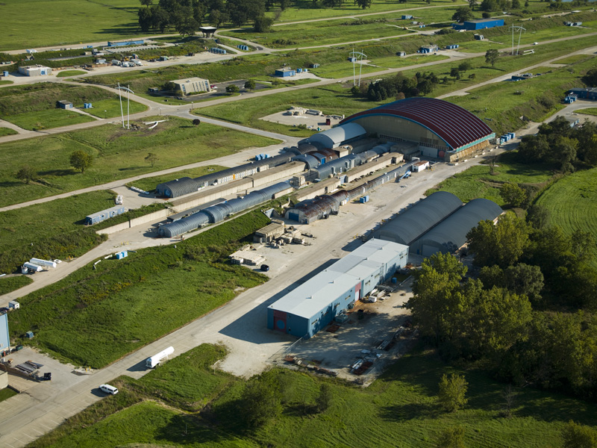
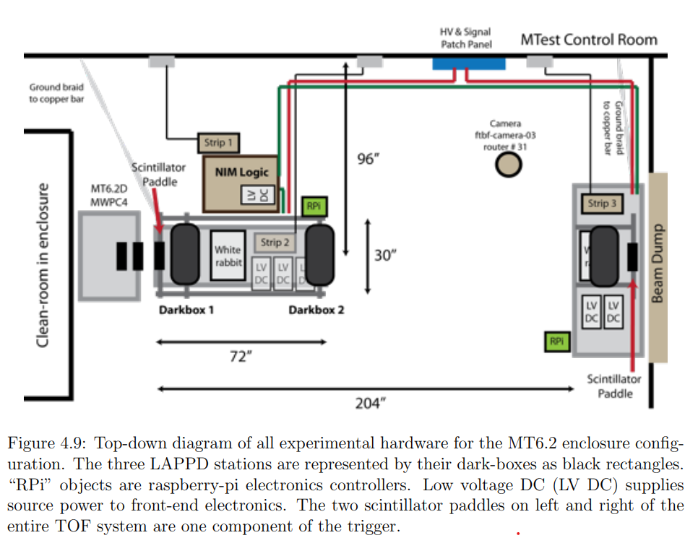
Fermilab Test Beam Facility
E. Angelico, Development of Large-Area MCP-PMT photo-detectors for a Precision Time-of-Flight System at the Fermilab Test Beam Facility(2020)
Further development of the system is now taking place in hands of Joe Pastika.
Notes:
Fianally, Fermilab test beam facility is the testbed of our chips and detector systems pushing fast timing boundaries.
Evan Angelico had set up a prototype time of flight system using our fast timing chip, psec4, and micro channel plate photomultiplier tube based detector which we call LAPPDs, the setup is shown in the diagram.
Further development of the system is now taking place in hands of Joe Pastika, Fermilab.

Slide 7
PSEC4 ASIC Measurement and Calibration
Notes:
Now, I will briefly discuss the structure of the fast timing chip we have right now.

Slide 8
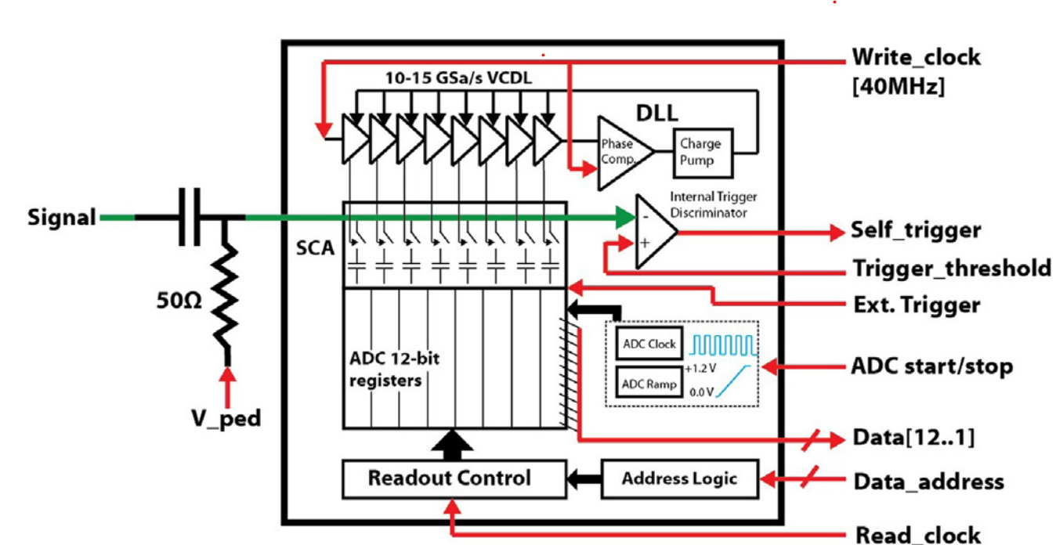
PSEC4 ASIC(2014)
12-bit depth
6 channel/chip
5ps resolution
130ns IBM 8RF
E. Oberla , J.-F. Genata, H. Grabasa, H. Frisch, K. Nishimura, G. Varner, arxiv.org/abs/1309.4397
Notes:
This is a brief structure of ASIC we have been using for almost a decade now. We will focus on the components within the green dotted line because they determine the performance of the chip.
The signal goes into the chip from the left. First, its DC component is removed and set to a constant voltage, V_ped, which can be controlled by an FPGA for example.
Then there is an array of 12 bit registers, the number of registers is equal to the total sample number. I will further explain each components of interest through next couple of slides.

Slide 9
Sample time calibration
Time between samples are determined by a VCDL.
Each element of the VCDL has different time offset.
Notes:
Time difference between samples are determined by a voltage-controlled delay line, which is an array of transistors, usually MOSFETs, which a signal propagates through the array at a desired rate.
However, no chip manufacturing process is perfect, so each element of the VCDL has different time offset.
It is necessary to measure each time offset to correctly sample a signal.

Slide 10
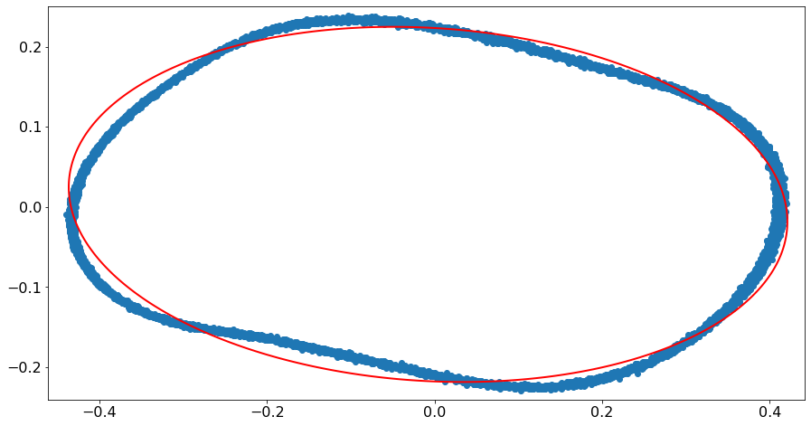
1. Measure many events of a sine wave.
2. Sum vs. Difference of two adjacent samples, over all events, form an ellipse.
3. Time offset can be determined from the coefficients.
Event 1
Event 2
Input Voltage
$$V_{i}−V_{i+m}$$
$t_{i+m}−t_{i}$ determined by eccentricity and rotation.
Event 3
Event 4
$$V_{i}+V_{i+m}$$
$$t_{i}{ t}_{i+m}$$
Noise → fainter, more spread curve.
Nonlinearity → distorted curve
Time
Notes:
We have developed a method to measure time offset of each sample.
1. Measure many events of a sine wave.
2. Plot Summation vs. Difference of two adjacent samples, over all events, should form an ellipse.
3. Time offset can be determined from the coefficients.
The diagram explains which event corresponds to which dot in the ellipse plot.
When you think about it, the plot does not have to be on two adjacent samples, but samples which are m samples apart. This way the effect of voltage noise of each sample on the time offset is smaller.
In other words, the sampled curve is more like a smooth ellipse as m gets larger.
However, the time difference cannot be larger than one fourth of the period of the sine wave, which in our case corresponded to m equal to about 10.
When we look at the right ellipse plot,
Higher voltage Noise results in fainter, more spread curve.
Nonlinearity of the overall system results in distorted curve

Slide 11
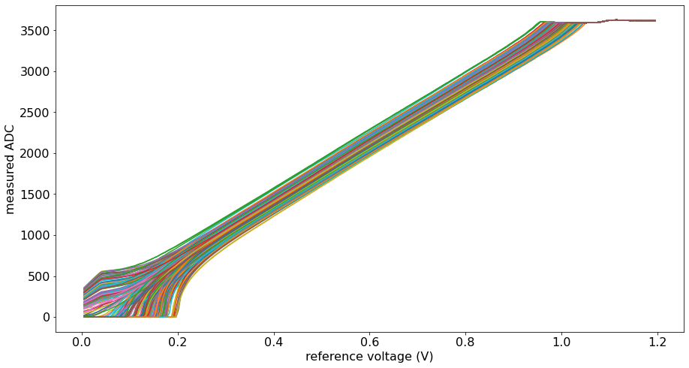
Voltage linearization
It is necessary to reconstruct voltage from ADC value. The curve differs for each capacitor.
1. V_ped is set to a voltage of interest, 0.0v-1.2v
2. PSEC4 is left in sampling mode for a few cycles, so that all capacitors are set to V_ped. ($σ_{V}≈0.5mV$)
3. Each register is read. Each curve corresponds to a capacitor.
Linearizable Domain
~0.75V
Notes:
What bothered us next is the fact that the capacitors, shown in a green circle in the diagram on the right, lose or gain charges during the short time between signal input and readout, so *the 12-bit number from each ADC and the actual input voltage appear not linear, and they differ for each capacitor.*
It is necessary to reconstruct input voltage value from 12-bit ADC readout value. We use the curves in the left plot for this, which is a differing characteristic for each capacitor in the array.
The way we measured this curve is very straightforward.
1. V_ped, in the red circle, is an independent variable which is represented by x axis in the left plot, is set to a voltage of interest, 0.0v-1.2v
2. PSEC4 is left in sampling mode for a few cycles, so that all capacitors are set to V_ped. The signal to noise ratio in this case is 0.5 millivolts.
3. Each register is read. Each curve corresponds to a capacitor.

Slide 12
Performance Measurement
Same signal fed into two different channels of the same readout board.
1. $Δt$ measured for many events.
2. Distribution of $Δt$ acquired.
Depends on the source
Sin
Pulse/square
Depends on algorithm determining $Δt$.
Signal
Trigger
Ch. 1
PSEC4
Ch. 2
$$Δt$$
t=0 when the VCDL loop starts
Notes:
After the forementioned calibration process,
We finally want to measure the performance of the chip, and one way to do so is to measure *time distribution of the sampled signal when sampling the same waveform many times.*
We set up an experiment where Same signal is fed into two different channels of the same readout board.
Then, delta t , the phase difference, is measured for each event the way described in figure on the right side.
1. $Δt$ measured for many events.
2. Distribution of $Δt$ acquired.
However, one should be aware that delta t depends on the signal source and the algorithm determining where the pulse starts.

Slide 13
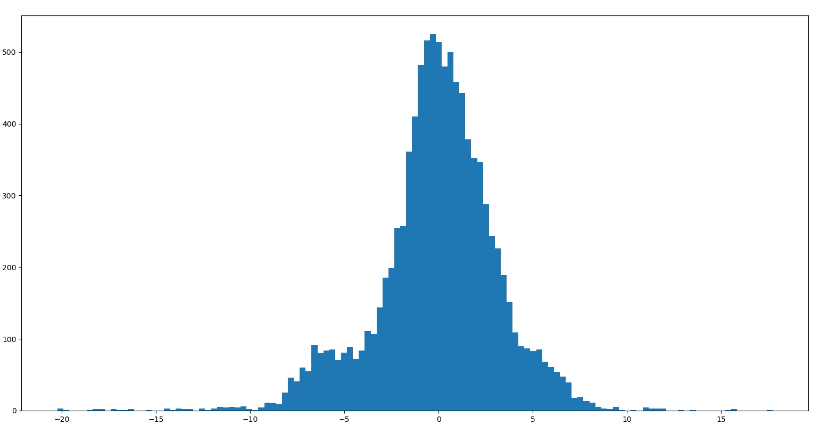
$σ_{t}=3.\text{22}\text{ps}$
# of Events
$$Δt$$
$Δt$ [ps]
Notes:
We have acquired timing resolution below 5ps through this method. This histogram displays ten thousand events and the standard deviation is about 3 picoseconds.
Delta T histogram

Slide 14
Setup over a distance
Two channels of each chip is used: one for signal, one for synchronization sine wave.
Sync. is a component of the total timing resolution.
>100m
Detector 1
Trigger
Detector 2
Trigger
Ch. 1
PSEC4
Ch. 1
PSEC4
Ch. 2
Ch. 2
F. Girela-Lopez, J. Lopez-Jimenez, M. Jimenez-Lopez, R. Rodriguez, E. Ros and J. Díaz,
IEEE 1588 High Accuracy Default Profile: Applications and Challenges in IEEE Access, vol. 8, pp. 45211-45220, 2020
Phase Sync’d
Sine wave
$Δt≪$1ps
Synchronization via optical fiber
WR
WR
Notes:
Same can be done for signal sources a long distance apart, for detector systems like time of flight system.
Two channels of each chip is used: one for signal, another for synchronization sine wave. So in total four channels are used.
The sync. Sine wave is generated by a special module, called white rabbit, which outputs phase synchronized sine waves Over long distance like over kilometers, via optical fiber communication. The phase jitter of this sine wave is way below 1ps for our application.
Sync. is a component of the total timing resolution of detector systems like this.

Slide 15
$$Δt$$
t=0 when the sine wave crosses zero.
Notes:
Again, this is how we determine delta t and t=0.
As I said, different algorithms can be used for different waveforms. In this case, the variation of delta t will increase by factor of 2, compared to close distance setup. Because the timing uncertainty of both the signal channel and the synchronization channel must be considered.

Slide 16
Future <1ps chip
Notes:
Moving toward the end of this talk, I want to assert that now is the right time for a 1 picosecond timing chip.

Slide 17
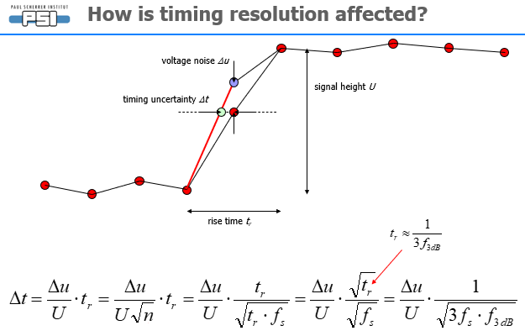
Time is right for a 1-psec timing chip
Must optimize three aspects:
Signal rise time
voltage noise of samples
sampling time jitter/uncertainty
Adopted from Stefan Ritt “The role of analog bandwidth and signal-to-noise in timing for waveform digitizing“
Notes:
We hope the new chip is better in three aspects we have discussed before in this talk.
Signal rise time
voltage noise of samples
sampling time jitter/uncertainty
As we can see from the equation at the bottom, these three are the factors contributing to the overall timing resolution.
And we will see that the improvements can be achieved by using more modern chipmaking processes.

Slide 18
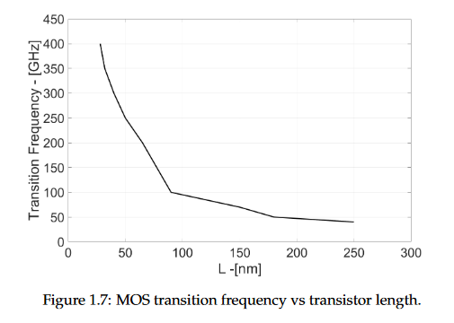
Great deal of work needs to be done but clear that 65nm CMOS technology superior characteristic to 130nm and older
Smaller process nodes give intrinsically faster transistors
Alessandra Pipino, Design of Analog Circuits in 28nm CMOS Technology for Physics Applications (2016)
Improved signal rise time
Improved or equal voltage noise of samples
Some selected results from literature:
(Romanova and Barzdenas: “A Review of Modern CMOS Transimpedance Amplifiers for OTDR Applications”, 2019)
Notes:
Great deal of work needs to be done but
One thing sure is that smaller process nodes give faster transistors.
This implies potentially
Improved signal rise time
Improved or equal voltage noise of samples

Slide 19
Timing uncertainty reduced by an optimized LC-oscillator based PLL
From abstract: “Both independent PLLs have identical loop dynamics to allow a fair comparison … Furthermore these circuits consume the same amount of power. The PLLs were processed in a commercial 65 nm CMOS technology.”
Ring: 5.6ps jitter
LC: 0.325ps jitter
J. Prinzie, J. Christiansen, P. Moreira, M. Steyaert and P. Leroux, "Comparison of a 65 nm CMOS Ring- and LC-Oscillator Based PLL in Terms of TID and SEU Sensitivity," in IEEE Transactions on Nuclear Science,
vol. 64, no. 1, pp. 245-252, Jan. 2017.
Notes:
As I said before, we are currently using ring osc for the phase locked loop for the Voltage controlled delay line
This can be replaced to LC oscillator based phased locked loop to achieve better timing uncertainty.

Slide 20
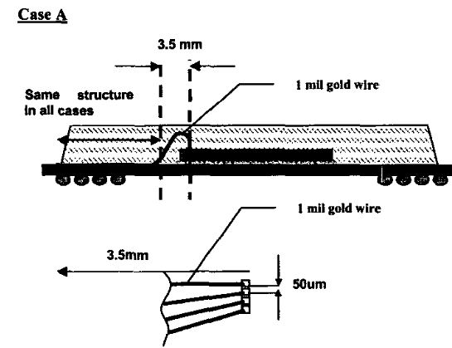
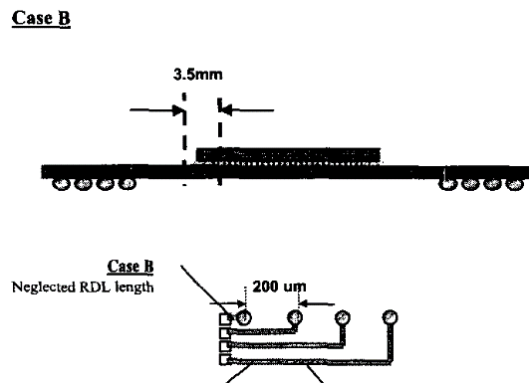
Improved packaging also important
 | $T_{r}$(ps) observed for 35ps risetime input pulse | Degradation (%)
Case A (wirebonded) | 65ps | 86%
Case B (flip-chip + RDL) | 42ps | 20%
$$T_{r}$$
Chi-Tsung Chiu, Sung-Mao Wu and Chi-Ping Hung, "High speed electrical performance comparison between bump with RDL and wire bond technologies," Proceedings of the 4th International Symposium on Electronic Materials and Packaging, 2002., 2002
Notes:
Also, we can improve the rising time of the pulse through better packaging, since shorter trace length results in lower degradation of rising time.

Slide 21
Time is right for a 1-psec timing chip!
Notes:
These three combined, here is the final table of specifications we expect for the new chip.
One final assertion of our team is that
1-psec timing chip is possible and it is the right time for it.

Slide 22
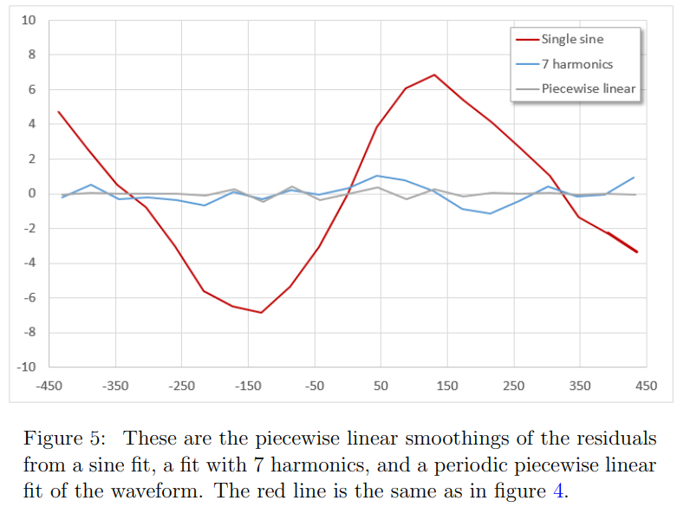
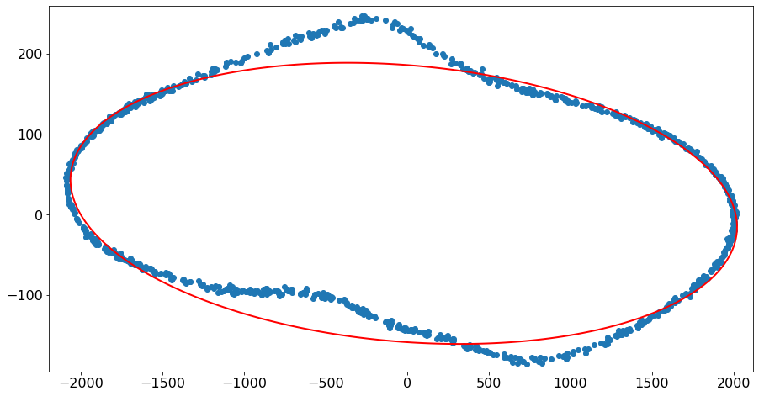
Nonlinearity

Slide 23
Citations(All from the doc lib)
Preliminary Specifications for a 1-Picosecond Resolution ASIC for the FTBF TOF System
A Modular Data Acquisition System using the 10 GSa/s PSEC4 Waveform Recording Chip
DEVELOPMENT OF LARGE-AREA MCP-PMT PHOTO-DETECTORS FOR A PRECISION TIME-OF-FLIGHT SYSTEM AT THE FERMILAB TEST BEAM FACILITY
Measurement Noise and Time-Base Calibration in ACDC Data

