Slide 1
N10.00008: Low-dose high-resolution TOF-PET using ionization-activated multi-state low-Z detector media
16th of March, 2022. APS March Meeting
Presenter: João F. Shida
Authors and collaborators: J.F.Shida, E.Spieglan, B.W.Adams, E.Angelico, K.Domurat-Sousa, A.Elagin, H.J.Frisch, P.La Riviere, A.H.Squires, V. Rawal

Slide 2
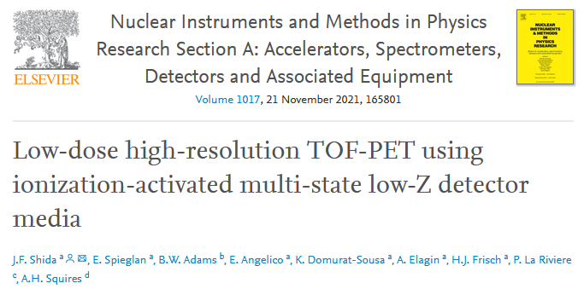
Positron Emission Tomography (PET)
PET
CT PET
Structure
Activity
03/16/2022
<number>

Slide 3
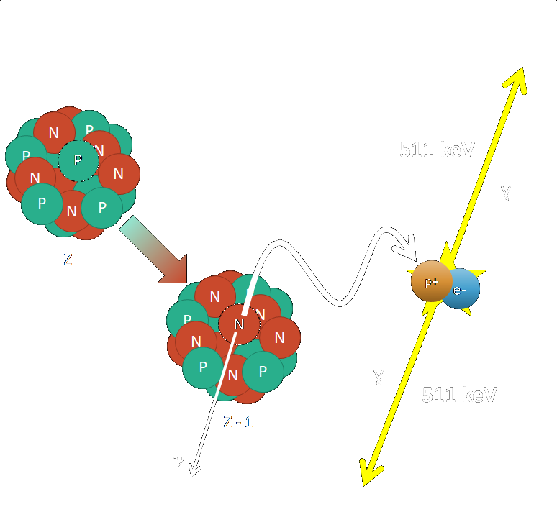
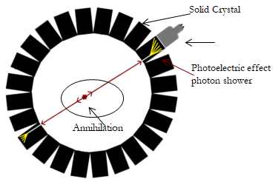
Positron Emission Tomography (PET)
PET
PET
Positron Emission…
…Tomography
03/16/2022
<number>

Slide 4
Positron Emission Tomography (PET)
PET: Resolution
Major factor in resolution: Width of crystal/photodetector: Non-physical limitation
03/16/2022
<number>

Slide 5
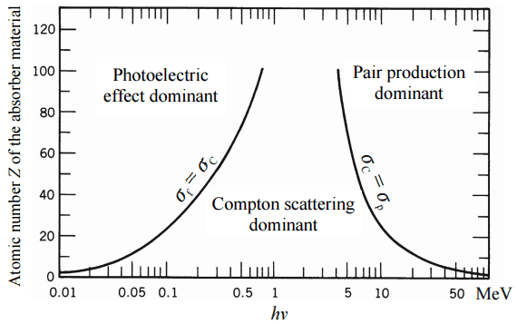
Positron Emission Tomography (PET)
Moving from High-Z to Low-Z
High-Z (>60)
Low-Z
(e.g. Carbon = 6)
Z | σ Photoelectric | σ Compton Scattering | σ Coherent Scattering
60 | 2.9E-2 | 7.1E-2 | 6.3E-3
6 | 6.5E-6 | 8.6E-2 | 1.5E-4
Data from XCOM database, cross-sections in cm/g^2
03/16/2022
At low-Z (organic liquid), Compton scattering dominates
<number>

Slide 6
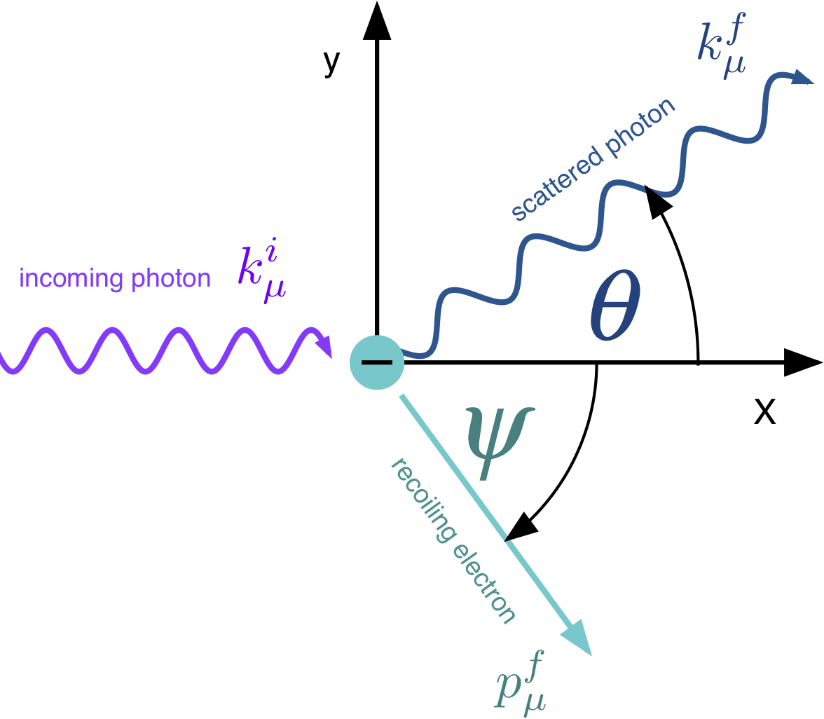
Positron Emission Tomography (PET)
Low-Z PET
03/16/2022
<number>

Slide 7
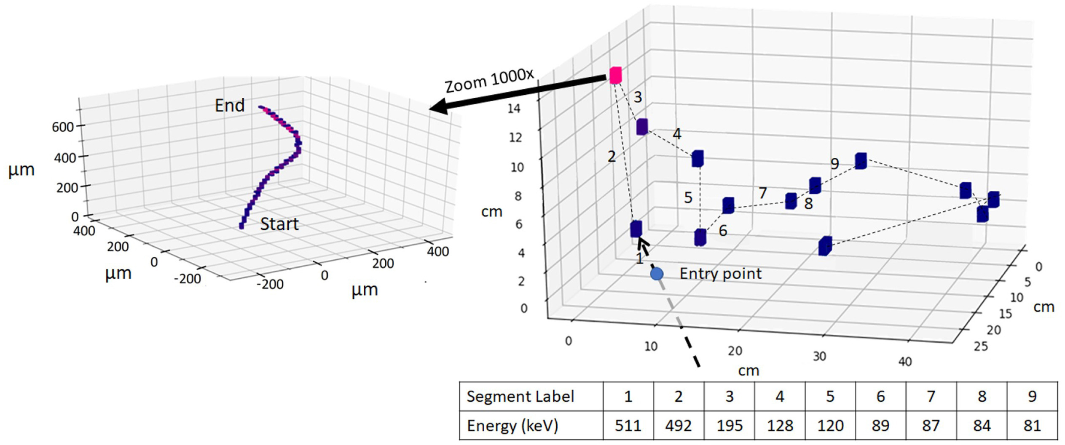
Positron Emission Tomography (PET)
Low-Z PET: Compton Kinematic Chain
γ
If we could see the electrons, we can reconstruct the chain
03/16/2022
<number>
GEANT4 Simulation of 511 keV Gamma in KAMLAND-ZEN scintillator (Z = 6). Simulation by Dr. Andrey Elagin

Slide 8
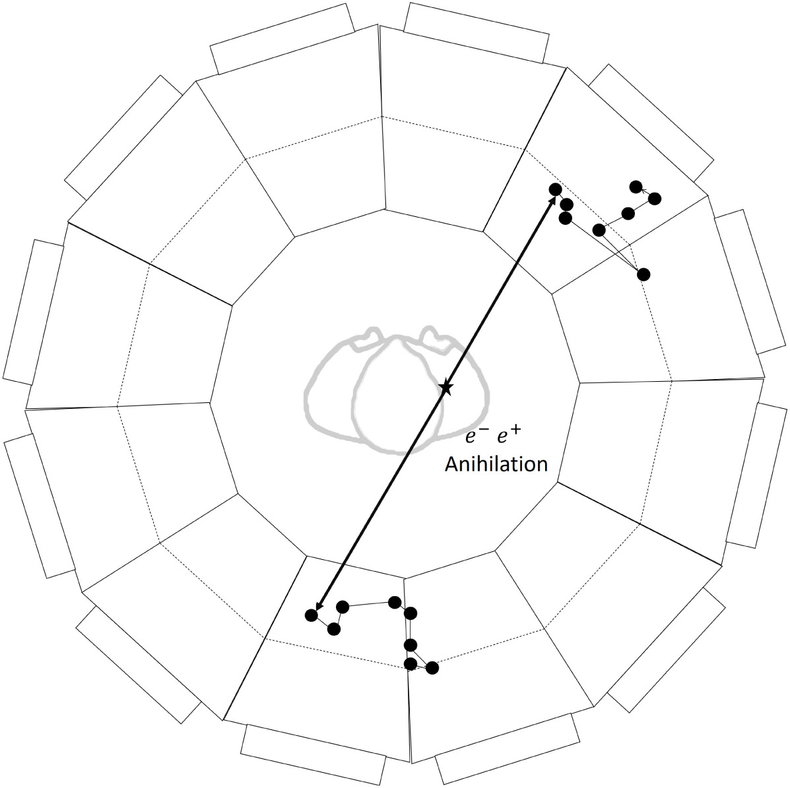
Example Application: Positron Emission Tomography
Low-Z PET
Resolution no longer tied to module size, but by reconstruction quality
03/16/2022
<number>

Slide 9
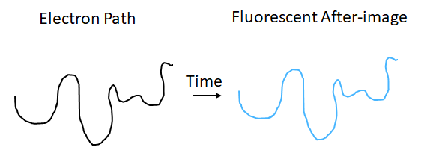
Positron Emission Tomography (PET)
Low-Z PET: Fluorescence “bubble chamber”
Problem reduces to taking pictures of electrons

Slide 10
Searching for a metastable media
Switching Dyes
03/16/2022
Cartoon taken from “Using Switchable Fluorescent Molecules to Image Tracks and Measure Energy in Large Liquid Double Beta Decay Detectors”, Presented at CPAD 2019, Eric Spieglan
<number>

Slide 11
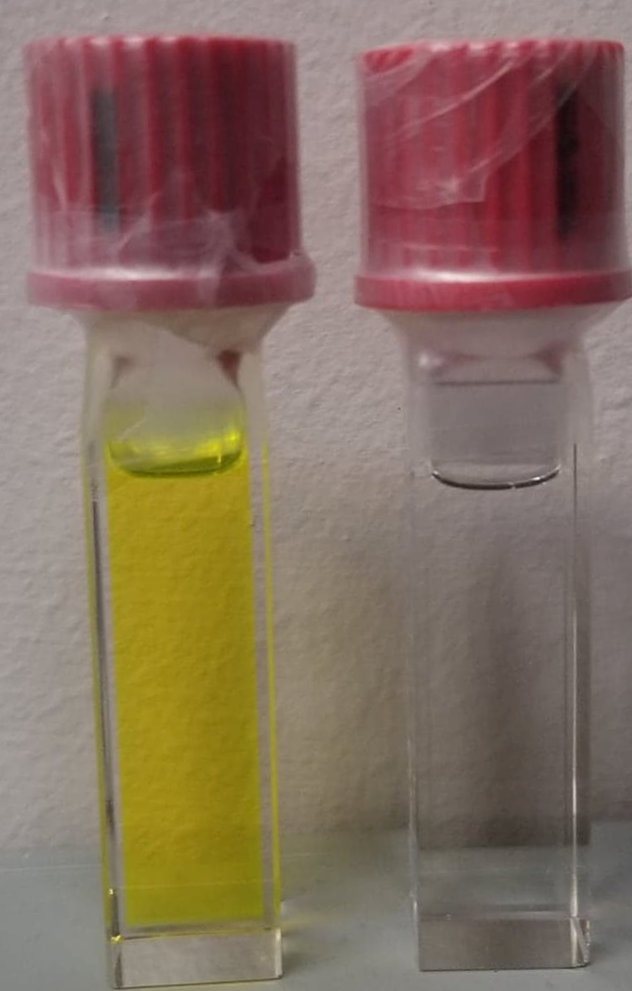
Searching for a metastable media
Switching Dyes
UV Light
365 nm
Does not absorb in visible
Absorbs in the green
Vis.
03/16/2022
<number>

Slide 12
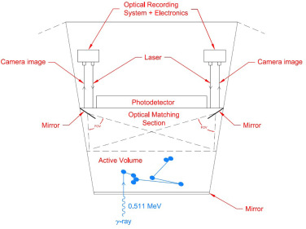
Positron Emission Tomography (PET)
Example implementation

Slide 13
Positron Emission Tomography (PET)
Current Directions
1. Photochemical characterization of switching systems for use in Low-Z PET
Collaboration with Prof. Allison Squires at The University of Chicago Pritzker School of Molecular Engineering and Prof. Rawal at the Chemistry Dept.
2. Simulation of a forward model for a Low-Z PET scanner and reconstruction methods
Collaboration with Prof. Patrick La Riviere at The University of Chicago Department of Radiology
Authors and collaborators:
E.Spieglan, B.W.Adams, E.Angelico, K.Domurat-Sousa, A.Elagin, H.J.Frisch, P.La Riviere, A.H.Squires, V. Rawal

Slide 14
Backup Slides
03/16/2022
<number>

Slide 15
Charged particle as the switch
Energy transfers from electron to Switching Dye
03/16/2022
<number>

Slide 16
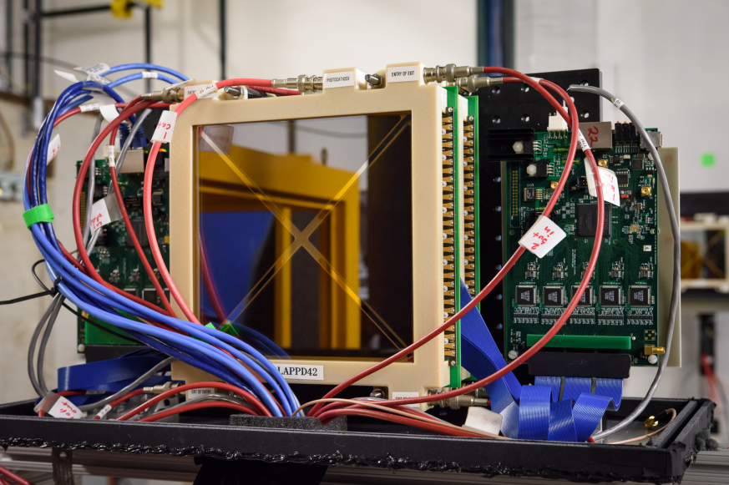
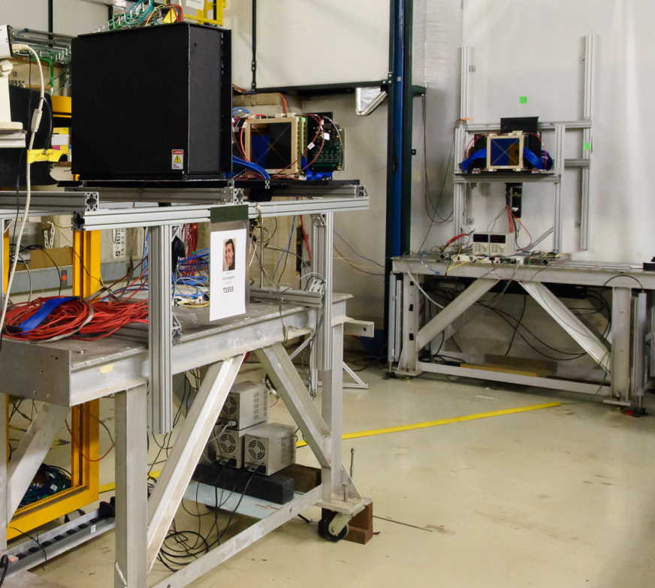
Context: Photodetector development and Picosecond timing in HEP experiments
LAPPDs
Photo credit: Giulio Stancari, Fermilab
Evan Angelico`s PhD thesis
03/16/2022
<number>

Slide 17
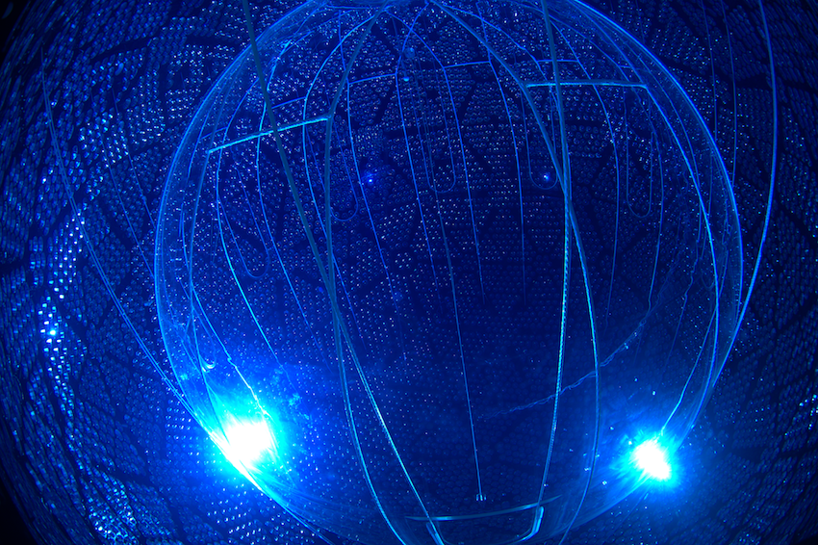
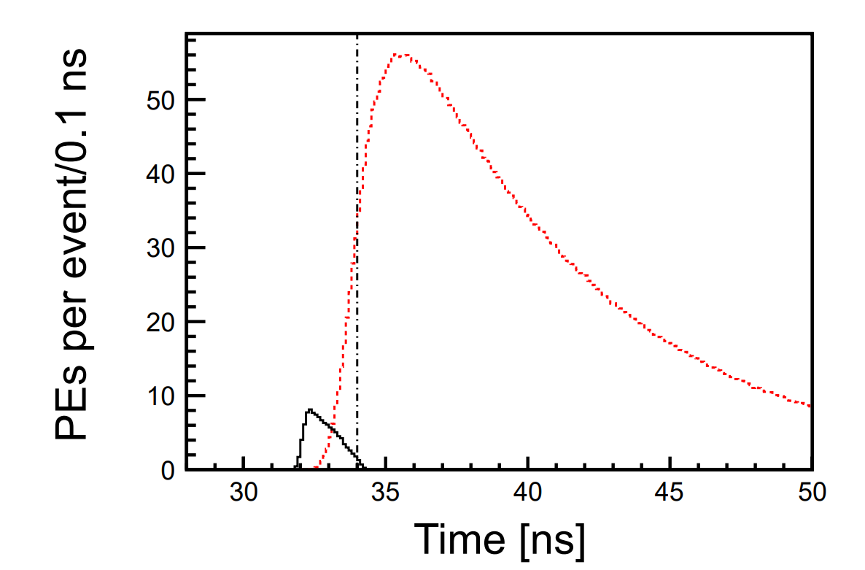
Context: Photodetector development and Picosecond timing in HEP experiments
Neutrino-less BB-Decay
arXiv:1307.5813
03/16/2022
<number>

Slide 18
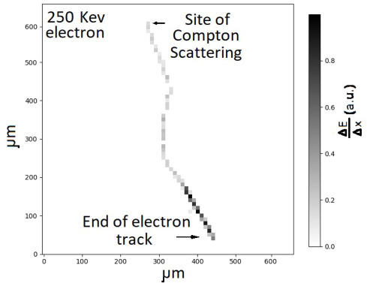
Positron Emission Tomography (PET)
Low-Z PET: Scattered Electron path
GEANT4 simulation of a 250 keV electron by Andrey Elagin

Slide 19
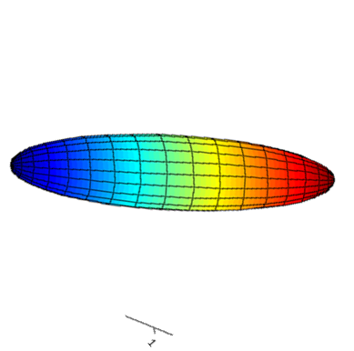
Using the new information: LOR
Uncertainty along the axis: tens of centimeters
Uncertainty transverse to axis: Tens of microns
3D Likelihood Gaussian
“Needle” Shaped

Slide 20
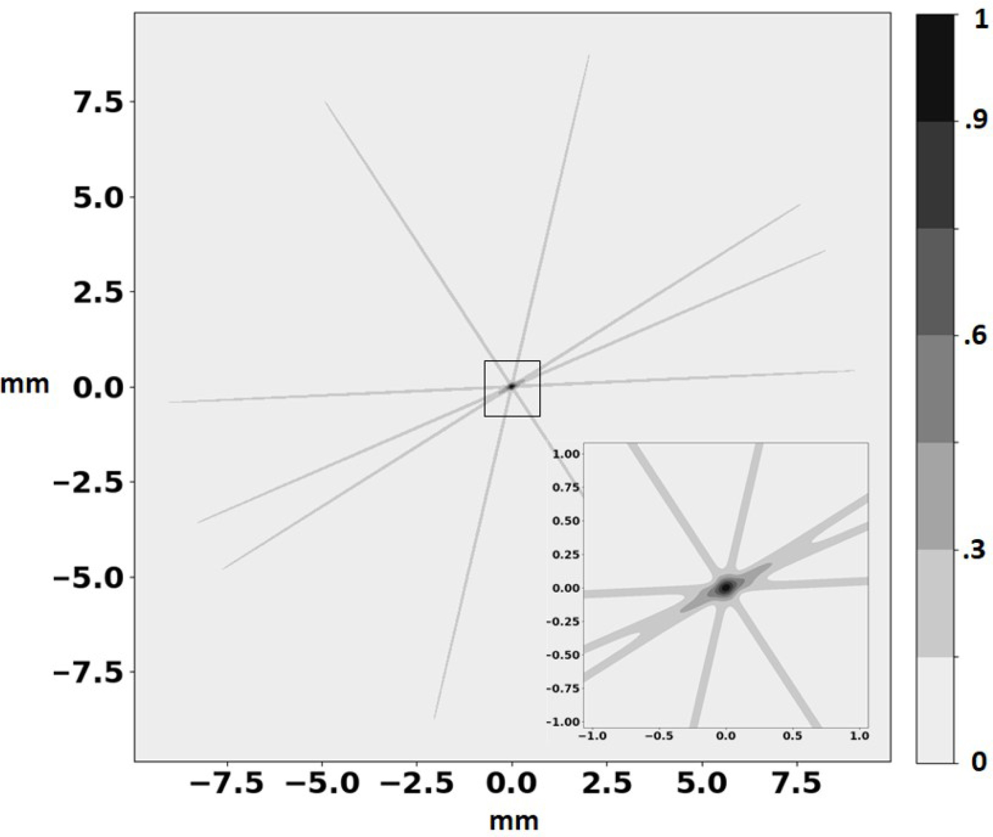
Using the new information: LOR

Slide 21
Using the new information: Backprojection
Simulation
Backprojection
1000x reduced dose simulation
With the help of Prof. Patrick La Riviere

Slide 22
How to pronounce João
Zhu-uhw-oh
gioh-uhw-oh

