Slide 1
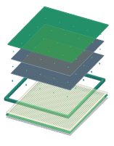
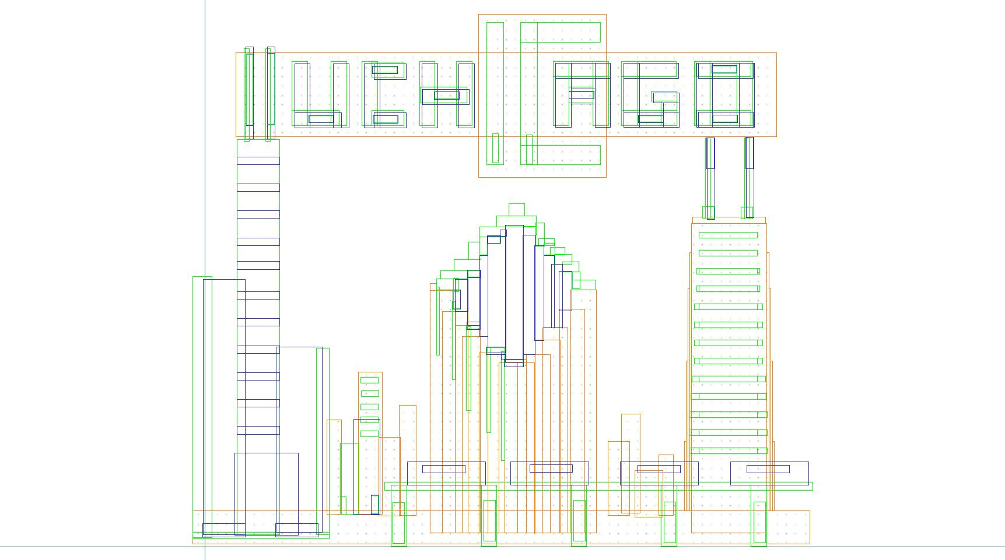
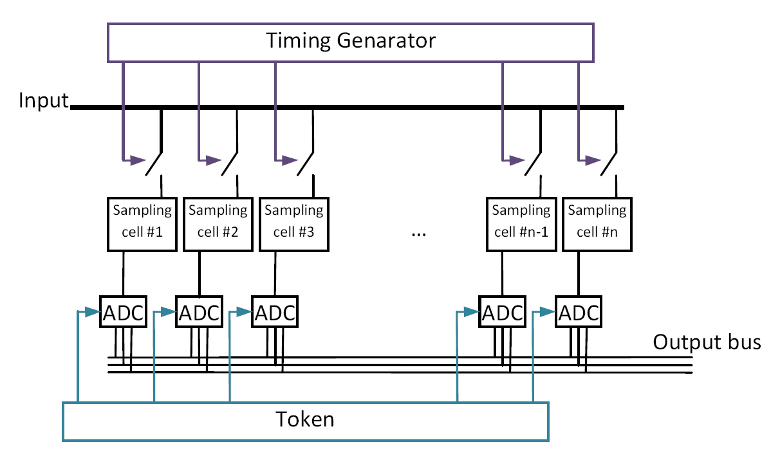
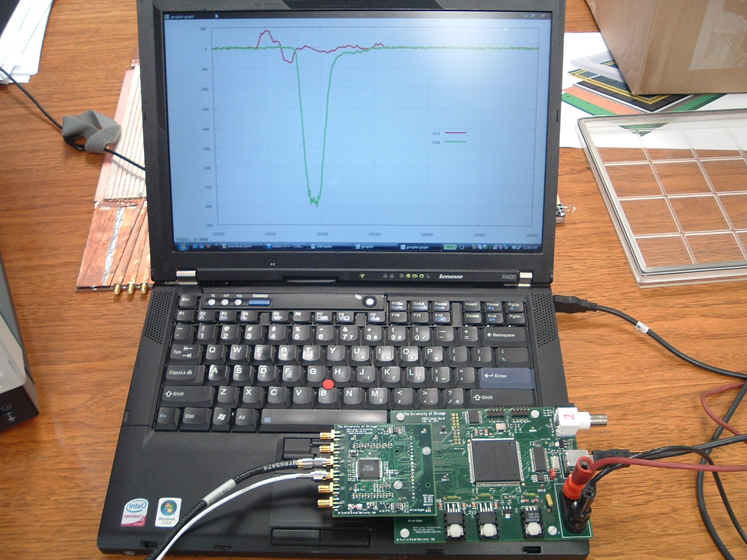
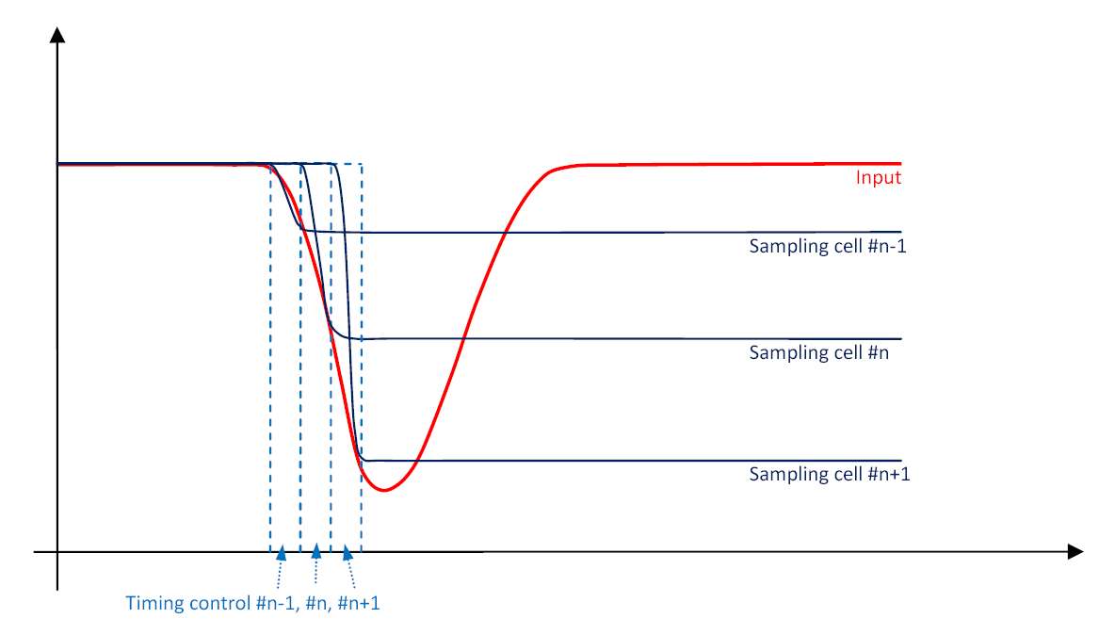
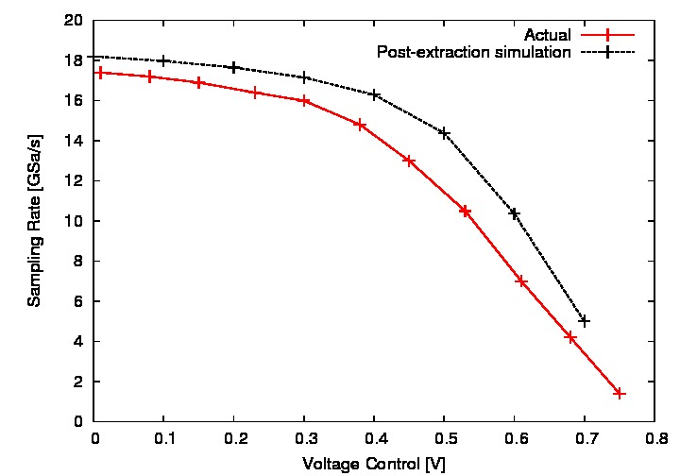
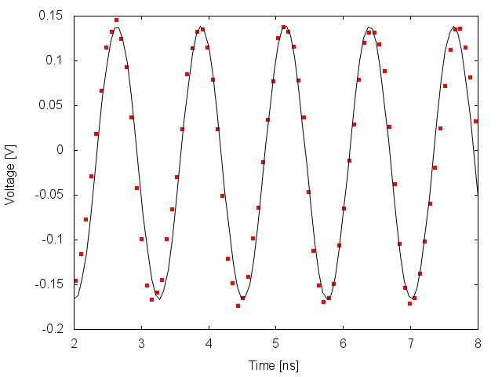
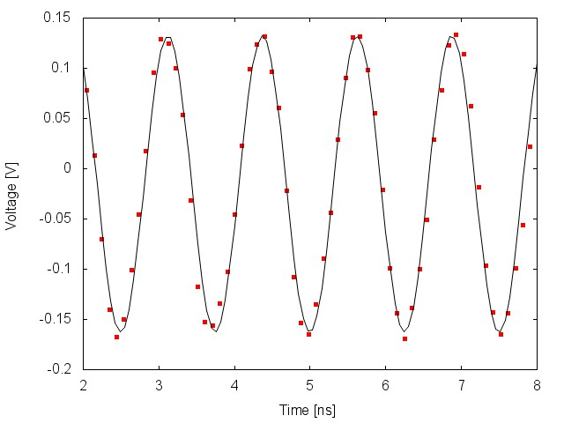
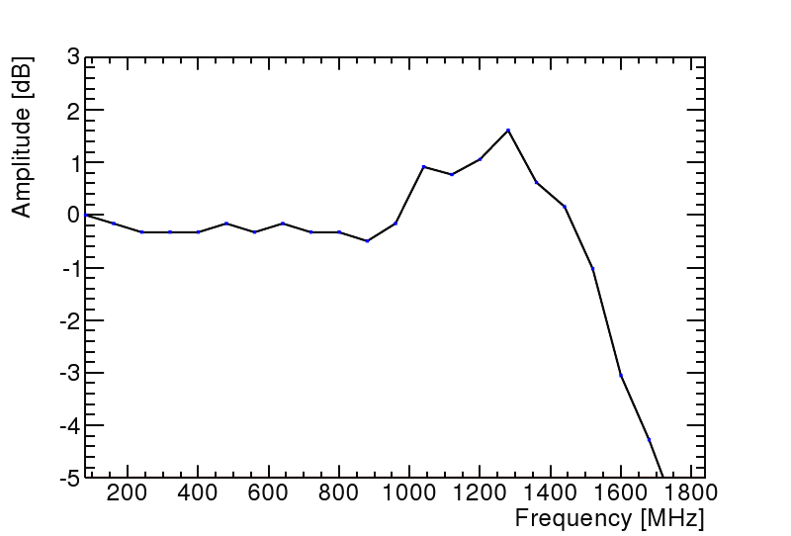
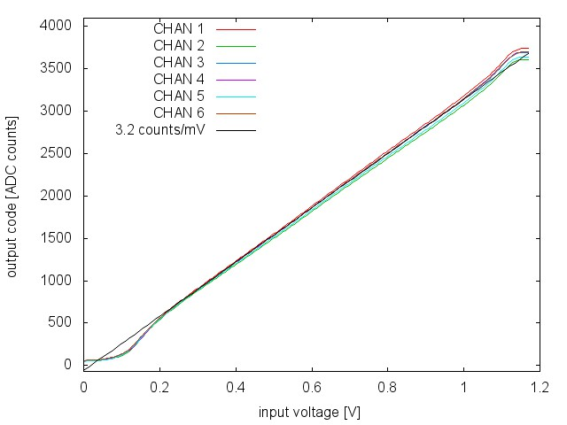
A 6-Channel Fast Waveform Sampling ASIC in 0.13µm CMOS technology
Eric Oberla* & Hervé Grabas**
on behalf of the Large-Area Picosecond Photo-Detectors (LAPPD) Collaboration
(http://psec.uchicago.edu)
*University of Chicago
**CEA Saclay
Abstract
We describe here the design characterization of PSEC-4: a custom analog and digital integrated circuit designed in the IBM-8RF 0.13 µm process intended for fast (>10 GSa/s), low-power waveform digitizing. As part of the Large-Area Picosecond Photo-Detector (LAPPD) collaboration, this ASIC has been designed for the front-end transmission line readout of large area micro-channel plates (MCP), among other potential applications. With 6 channels, PSEC-4 has a buffer depth of 256 analog samples on each channel, a chip-parallel 1.5 GHz Wilkinson ADC, and a serial data readout that includes the capability for region-of-interest windowing to reduce dead time. A switched-capacitor array architecture was implemented and sampling lock is possible with an on-chip delay locked loop (DLL) with a measured jitter of better than 15 ps. Chip performance results, including sampling rates up to 17 GSa/s, RMS noise less than 1 mV, and an analog bandwidth (ABW) of 1.6 GHz, are presented.
Principle of Operation
PSEC-4 die & Evaluation Board
Timing Generator
Channel Block Diagram
256-sample switched capacitor array architecture
Parallel 1.5 GHz Wilkinson digitization
Serial data readout (token)
Sample & Hold:
Delay line generates timing strobe with 100ps separation between cells (@ 10GSa/s):
6-channel “oscilloscope on a chip” (1.6 GHz,10-15 GS/s)
Evaluation board uses USB 2.0 interface + PC data acquisition software
PSEC-4 ASIC
PSEC-4 Results
 | ACTUAL PERFORMANCE
Sampling Rate | 2.5-15 GSa/s
# Channels | 6 (or 2)
Sampling Depth | 256 (or 768) points
Sampling Window | Depth*(Sampling Rate)⁻¹
Input Noise | <1 mV RMS
Analog Bandwidth | 1.5 GHz
ADC conversion | Up to 12 bit @ 1.5 GHz
Dynamic Range | 0.1-1.1 V
Latency | 2 µs (min) – 16 µs (max)
Internal Trigger | yes
Sampling Rate
Noise
σ ~ 0.75mV
Digitized Waveforms
Frequency Response
Linearity
Sampling rate : 10 GSa/s
Sampling rate : 13.3 GSa/s
f_{3dB} = 1.6 GHz
Input: 800MHz, 300 mV_{pp} sine
Only pedestal correction applied to PSEC-4 output
Time-base calibrations in progress

