Slide 1
Considerations about Large area - Low cost Fast Imaging Photo-detectors
Jean-Francois GENAT
University of Chicago, LPNHE Paris
Workshop on Timing Detectors , Krakow, November 29th 2010

Slide 2
With the help of
John Anderson, Klaus Attenkofer, Mircea Bogdan, Dominique Breton, Gary Drake,
Eric Delagnes, Henry Frisch, Herve Grabas, Mary K. Heintz, Edward May, Samuel Meehan, Eric Oberla, Larry L. Ruckman, Fukun Tang, Gary Varner, Jaroslav Va’Vra
and many others…
Jean-Francois Genat, Workshop on Timing Detectors, Krakow, November 29th 2010

Slide 3
Outline
Introduction
Fast imaging Photo-detectors
Micro-Channel Plates signals
Large area devices
Conclusion
Jean-Francois Genat, Workshop on Timing Detectors, Krakow, November 29th 2010

Slide 4
Photo-detectors
Vacuum devices
- Photo-Multipliers Tubes (PMTs)
- Micro-Channel Plates (MCPs)
Solid state devices
- Charge Coupled Devices (CCDs)
- Avalanche Photo-diodes (APDs)
- Silicon Photo-multipliers, (SiPMs) (Geiger mode APDs)
Jean-Francois Genat, Workshop on Timing Detectors, Krakow, November 29th 2010

Slide 5
Fast Imaging Photo-detectors
Vacuum devices
- Large area, large fill factor
- Full-custom Photo-cathode
- Electron multiplication, high gain
- Low noise (photo-cathode noise)
- Some sensitivity to magnetic fields (depends on device)
Solid state semi-conductor devices
- Size limited to a wafer, limited filling factor, high $/cm²
- Spectral response of ½ conductor (Si, GaAs…)
- Multiplication in high electric fields (depleted PN junctions)
- Noisy due to reverse currents avalanches
- Noise very sensitive to irradiation
- Some on-detector signal processing possible, (3D)
- No sensitivity to magnetic field
Jean-Francois Genat, Workshop on Timing Detectors, Krakow, November 29th 2010

Slide 6
Outline
Introduction
Fast Timing Imaging Photo-detectors
Micro-Channel Plates signals
Large area devices
Conclusion
Jean-Francois Genat, Workshop on Timing Detectors, Krakow, November 29th 2010

Slide 7
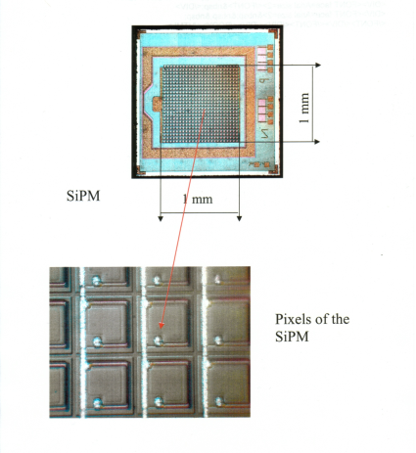
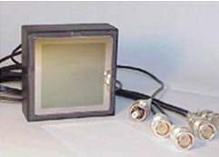
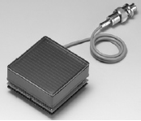
Timing-Imaging Devices
Multi-anodes PMTs Silicon-PMTs [10] Micro-Channel Plates [1]
Dynodes Quenched Geiger in Silicon Micro-Pores
Quantum Eff. 30% 90% 30%
Collection Eff. 90% 70% 70%
Rise-time 0.5-1ns 250ps 50-500ps
Timing resolution (1PE) 150ps 100ps 20-30ps
Pixel size 2x2mm² 50x50μm² 1.5x1.5mm²
Detector size 1 x 3.5 cm² arrays of 1.2x1.2 cm² 2.54x2.54cm²
Dark counts 1-10Hz/cm2 1-10MHz/mm² 1Hz-1kHz/cm²
Dead time 5ns 100-500ns 1μs
Magnetic field no yes 15kG
Radiation hardness 1kRad=noisex10 good (a-Si, Al₂O₃)
Jean-Francois Genat, Workshop on Timing Detectors, Krakow, November 29th 2010

Slide 8
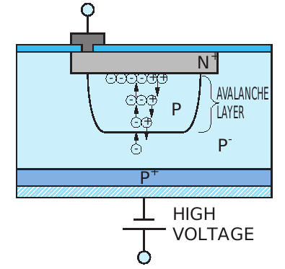
Fast Timing-Imaging Devices Silicon Photo-multipliers
Reverse biased PN junction operated over breakdown voltage
Avalanche quenched by a series resistance
High QE, but low fill factor (electrodes access, series resistor)
- High Gain 10⁵⁻⁶
- Noise: Reverse current triggers avalanches
- Carriers trapped on impurities: Afterpulses
- Optical crosstalk
- Some recovery time (series resistor)
- Cheap, but not (up to now) very large area
From Martin Haigh, Univ Oxford
Jean-Francois Genat, Workshop on Timing Detectors, Krakow, November 29th 2010

Slide 9
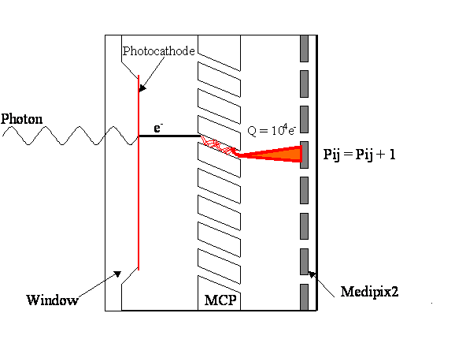
Fast Timing-Imaging Devices Micro-Channel Plate Detectors
Timing
J. Vallerga
anodes
Segmented Anodes
Large area devices: 2D Transmission line readout
Jean-Francois Genat, Workshop on Timing Detectors, Krakow, November 29th 2010

Slide 10
Outline
Introduction
Fast Timing Imaging Photo-detectors
Micro-Channel Plate signals
Large area devices
Conclusion
Jean-Francois Genat, Workshop on Timing Detectors, Krakow, November 29th 2010

Slide 11
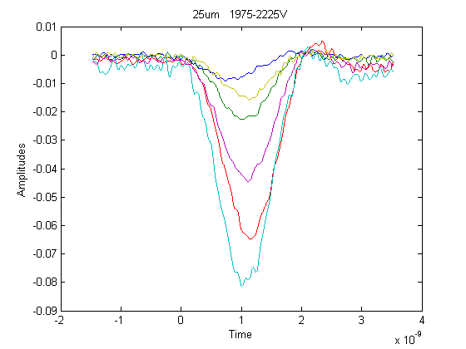
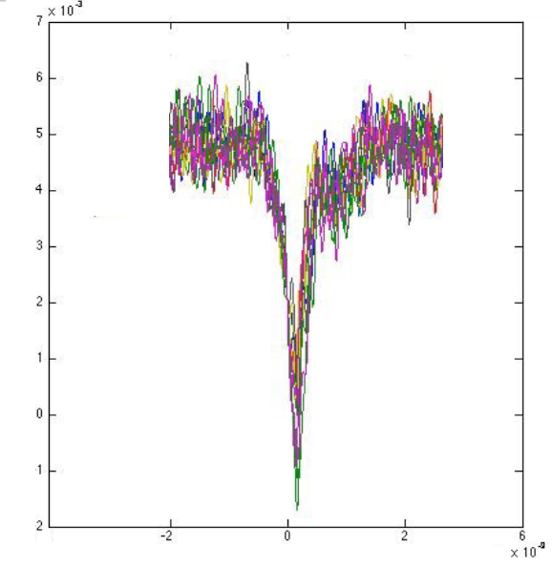
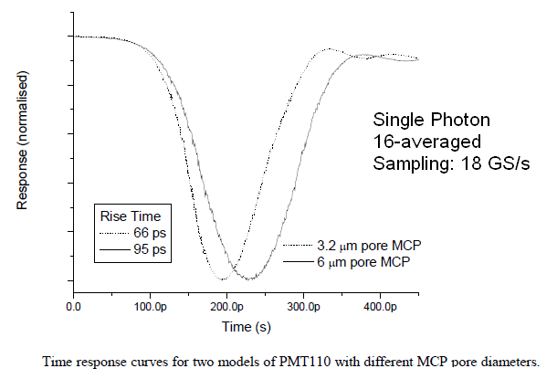
MCP signals
Segmented anodes, Burle-Photonis Glass + ALD MCPs (from Matt Wetstein, ANL)
Ideal pulse is a triangle
Jean-Francois Genat, Workshop on Timing Detectors, Krakow, November 29th 2010

Slide 12
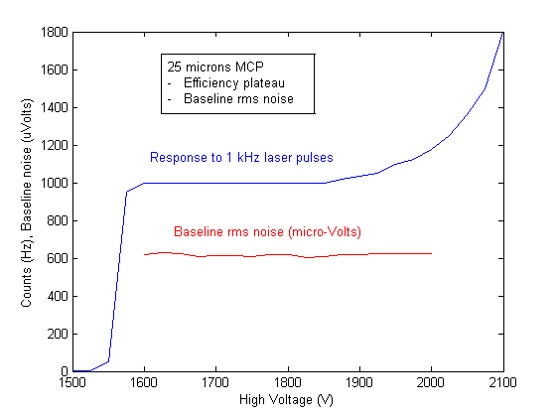
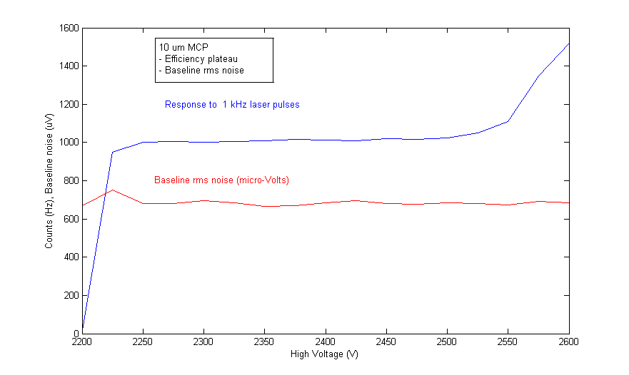
MCPs Efficiency and Baseline noise
ORTEC CFD set at 3PEs
ORTEC CFD set at 3PEs
Efficiency plateau and baseline noise (left: 25 μm, right 10 μm)
Plateaux are 250V for both MCPs
10 μm MCP shows double and triple after-pulses (not included in the count rates)
Jean-Francois Genat, Workshop on Timing Detectors, Krakow, November 29th 2010

Slide 13
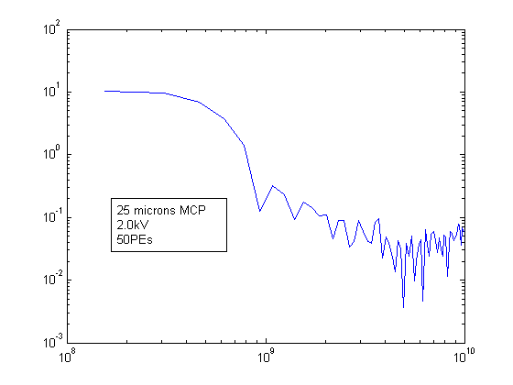
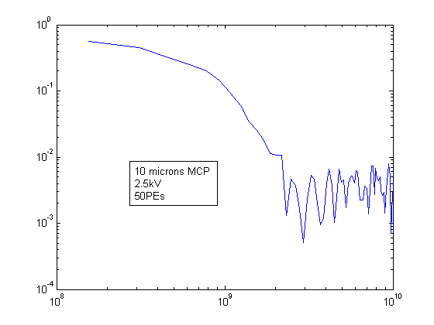
MCP signals spectra
25 microns at 2 kV, 50 Photo-electrons
10 microns at 2.5 kV “
Data taken at Argonne
(Ed May’s laser test stand)
Jean-Francois Genat, Workshop on Timing Detectors, Krakow, November 29th 2010

Slide 14
MCPs: Timing resolution
SLAC, (Jerry Va’Vra)
Chicago, (H. Frisch), Argonne (E. May), Hawaii (G. Varner)
Nagoya (K. Inami),
Louvain, CERN (K. Piotrzkowski),
LBNL, Brookhaven, UTA and many others
30-40ps Time Transit Spread (single photo-electron response)
Jean-Francois Genat, Workshop on Timing Detectors, Krakow, November 29th 2010

Slide 15
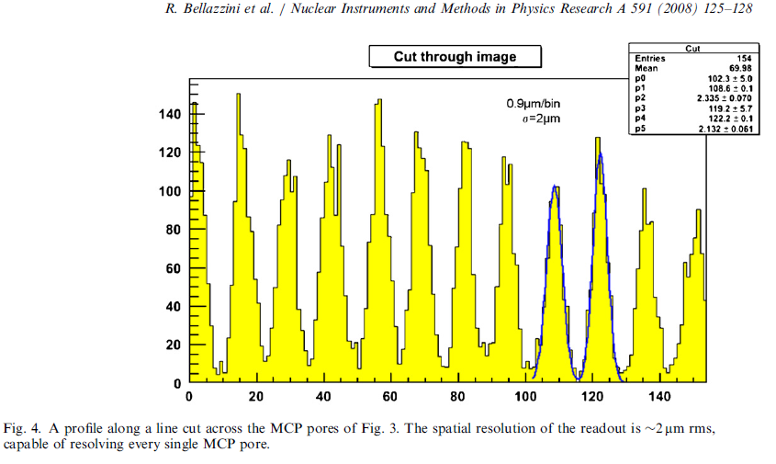
MCPs: Position resolution
analog charge division
High precision
analog measurements.
But
integration time= 200ns
Jean-Francois Genat, Workshop on Timing Detectors, Krakow, November 29th 2010

Slide 16
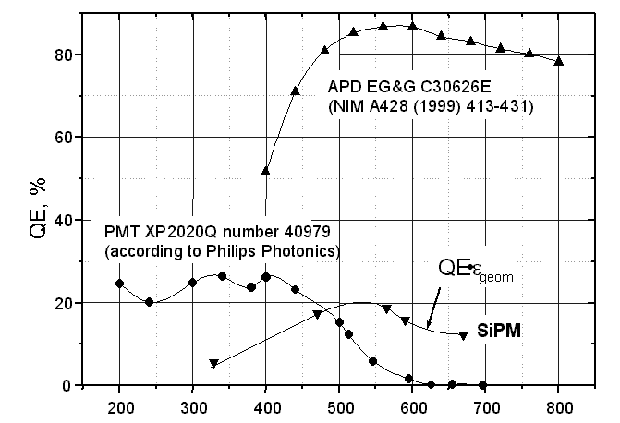
Spectral response, Compared Photon Detection Efficiency
PMT, APD, and Silicon PM Photon Detection Efficiencies
B. Dolgoshein (MEPHY Moscow)
Jean-Francois Genat, Workshop on Timing Detectors, Krakow, November 29th 2010

Slide 17
Impulse noise: 0.2 cts/sec/cm². Mainly from photo-cathode - High compared to gaseous proportional counters, - Low compared to other solid-state devices Contamination by potassium and rubidium Improved cleaning should lead to less dark noise
Noise
Siegmund, O.H.W.; Vallerga, J.; Wargelin, B. IEEE Transactions on Nuclear Science, Volume 35, Issue 1, Feb 1988 Page(s): 524 - 528
Jean-Francois Genat, Workshop on Timing Detectors, Krakow, November 29th 2010

Slide 18
- Ions feedback and molecules diffusion to the photo-cathode A few 100 A Aluminum foil to trap ions (K. Inami) Insulate gaps - Lifetime extended to a few C/cm² - Not much loss in PDE Visit: arXiv:1010.1057v1 [physics.ins-det]
MCPs Life time
Jean-Francois Genat, Workshop on Timing Detectors, Krakow, November 29th 2010

Slide 19
Outline
Introduction
Fast Timing Imaging Photo-detectors
Micro-Channel Plate signals
Large area devices
Conclusion
Jean-Francois Genat, Workshop on Timing Detectors, Krakow, November 29th 2010

Slide 20
CCDs, Pixels (no timing)
Piet De Moor (IMEC), TWEPP 2010
Jean-Francois Genat, Workshop on Timing Detectors, Krakow, November 29th 2010

Slide 21
CCDs, Pixels
Piet De Moor (IMEC), TWEPP 2010
Jean-Francois Genat, Workshop on Timing Detectors, Krakow, November 29th 2010

Slide 22
Imagers: Pixels Insulation
Piet De Moor (IMEC), TWEPP 2010
Jean-Francois Genat, Workshop on Timing Detectors, Krakow, November 29th 2010

Slide 23
Solder Mass Transfer Process – “Gang Ball Placement”
The ultimate low-cost solder ball placement process is the mass transfer of solder spheres on the whole wafer at the same time.
Stencil grid with predefined holes and vacuum is used to lift the solder sphere.
Solder bumping defects can be repaired with the singe solder ball placement systems
Limited by ball size, minimum 60 µm at present therefore suitable for 100 mm pitch
Pac Tech foresees 40 µm bumps coming in 1-2 years.
Solder mass transfer is very efficient process to attach the solder spheres to wafer
Bump-bonding
Sami Vaehaenen (CERN), TWEPP 2010
Jean-Francois Genat, Workshop on Timing Detectors, Krakow, November 29th 2010

Slide 24
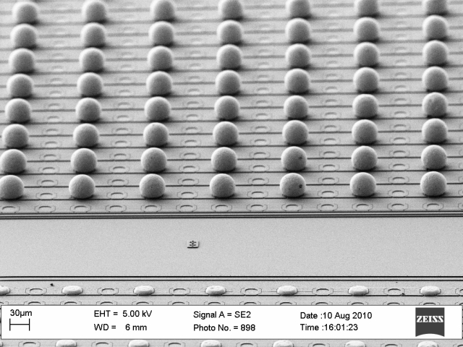
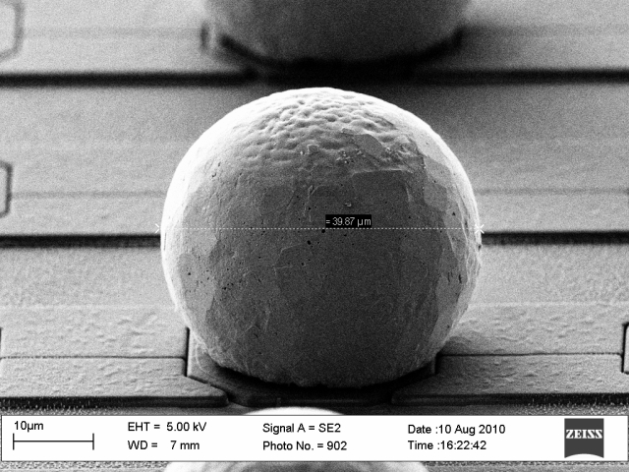
Solder Ball Placement Test
40 µm sized solder balls (very advanced) were jetted (spitting process) on a Timepix chips with ENEPIG UBM with 110 µm pitch at Pac Tech.
Individual shear tests were done (30 bumps), giving an average shear force of 8 grams / bump (good results).
Looking forward to do more SBB tests on Timepix chips
Sami Vaehaenen (CERN), TWEPP 2010
Jean-Francois Genat, Workshop on Timing Detectors, Krakow, November 29th 2010

Slide 25
Piet De Moor (IMEC), TWEPP 2010
Jean-Francois Genat, Workshop on Timing Detectors, Krakow, November 29th 2010

Slide 26
Piet De Moor (IMEC), TWEPP 2010
Jean-Francois Genat, Workshop on Timing Detectors, Krakow, November 29th 2010

Slide 27
Large Area Si-PMs
Silicon Photo-multipliers
Product Brief
©2010 SensL Technologies Ltd. - Rev. 1.3 All Rights Reserved SensL Array4p9 (Ireland)
Large area position sensitive silicon photomultiplier matrix in a four side scalable package
SensL Array4p9 is a low cost, large area silicon photomultiplier matrix for position sensitive low light detection.
Jean-Francois Genat, Workshop on Timing Detectors, Krakow, November 29th 2010

Slide 28
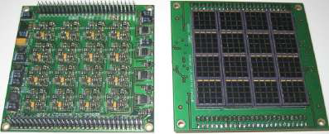
Large Area Si-PMs (SensL, Ireland)
Features and Benefits
• 61.28mm x 61.28mm Large Area Silicon Photomultiplier
• 256 Multichannel SPM detector
• 3mm x 3mm individual pixels
• Uses SensL’s SPMArray4
• Detectors Socket Mount
• 3MHz max count rate
• Cross-wire readout
• 12 bit Energy sampling ADC
• 500ps precision time stamp
• Direct USB interface to PC/ openPET interface
• GUI software
• 2Mbyte Data Buffer
• Power by single +5V supply, <1A current consumption (supplied)
Applications
• PET Camera
• Radiation Imaging
• Nuclear & Particle Physics
• Mammography
• Gamma Camera
• SPECT
• X-Ray
• Scintillation Crystal Readout
Jean-Francois Genat, Workshop on Timing Detectors, Krakow, November 29th 2010

Slide 29
Large Area Picosecond Photo-Detectors (LAPPD)
Wide collaboration
- Chicago
- Argonne
- Hawaii
- Fermilab
- LBNL
- Three private companies
MCP R&D:
- Develop large 8’’ x 8”” MCP panels
- Develop readout electronics
- Develop complete multi-module systems
Jean-Francois Genat, Workshop on Timing Detectors, Krakow, November 29th 2010

Slide 30
LAPPD effort: Many directions to develop fast large area photo-detectors
Photo-cathode R&D
- Optimize regular Bialkali material (QE and CE)
- GaAs
- Explore other compound materials
MCP R&D:
- Use of nanotechnologies to improve Secondary Emission
- Atomic Layer Deposition
- Anodic Aluminum Oxidation
- Glass still used, sized to large area.
Large Area Devices
2D readout
- Transmission lines N² -> 2N
Electronics integrated into multi-channel ASICs
- Waveform sampling and digital signal processing
Jean-Francois Genat, Workshop on Timing Detectors, Krakow, November 29th 2010

Slide 31
Pico-second timing and 2D position for large area detectors with delay lines:
Delay lines readout and pulse sampling provide
- Fast timing (2-10ps)
- One dimension with delay lines readout 100mm- 1mm
Transverse dimension can be obtained from centroids
Less electronics channels for large area sensors
Pico-second electronics
t₁, a₁
t₂, a₂
Pico-second electronics
½ (t₁+ t₂) = time
v(t₁-t₂) = longitudinal position
Σ α_{i} a_{i} / Σ α_{i} = transverse position
Jean-Francois Genat, Workshop on Timing Detectors, Krakow, November 29th 2010

Slide 32
2D readout: Differential Timing Resolution
Processing of data taken at Argonne
on Ed May’s laser test stand
Measured differential timing resolution from T-line readout (10um MCP tube, 160PEs) for:
2-10GS/s sampling rates,
1 GHz 3dB analog bandwidth,
- 4-10 bit ADC resolutions.
5GS/s and 8 bits precision sufficient
Jean-Francois Genat, Workshop on Timing Detectors, Krakow, November 29th 2010

Slide 33
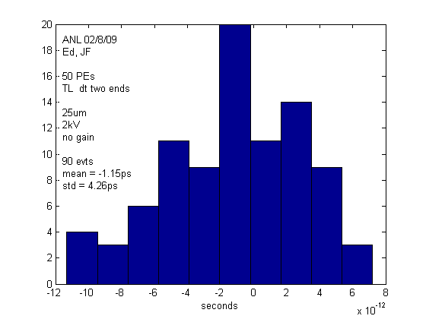
Position resolution with pico-second timing
Processing of data taken at Argonne
on Ed May’s laser test stand
Transmission line readout using fast timing
Resolution < 200 μm with 50 PEs
8’’ x 8’’ plates are investigated
Jean-Francois Genat, Workshop on Timing Detectors, Krakow, November 29th 2010

Slide 34
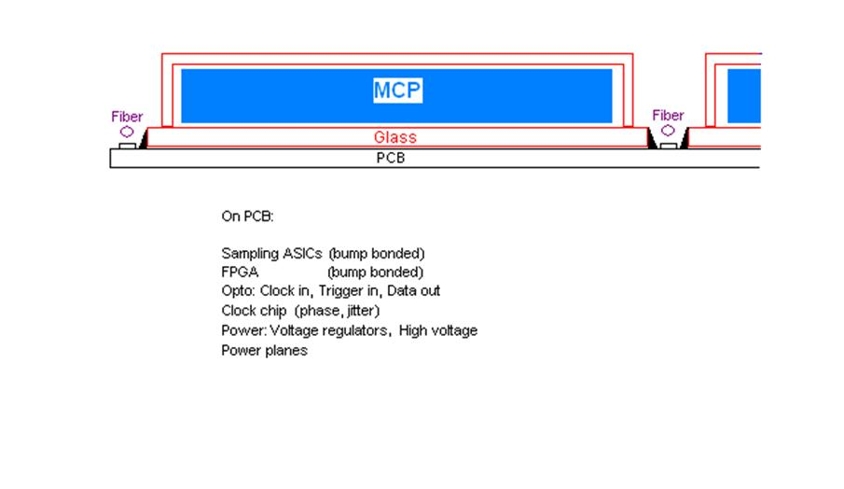
LAPPD: 8’’x 8’’ MCPs module sketch
Photo-cathode
MCP device uniformity
Spacers (hold atmospheric pressure)
Delay lines anodes
Hermetic packaging
Readout electronics
See Herve Grabas talk
Visit http://psec.uchicago.edu
Jean-Francois Genat, Workshop on Timing Detectors, Krakow, November 29th 2010

Slide 35
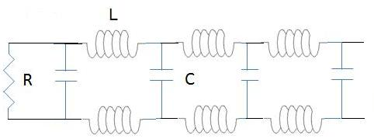
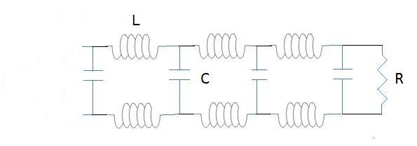
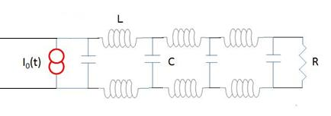
Transmission lines MCP model
The fraction of delay line seen by the pulse is on the order of the distance it can propagate during its rise-time:
Typically: l = c/2 x 250ps = 4 cm = 3pF only
The initial electron deposition spreads along the delay line, but also in the transverse direction due to crosstalk
Jean-Francois Genat, Workshop on Timing Detectors, Krakow, November 29th 2010

Slide 36
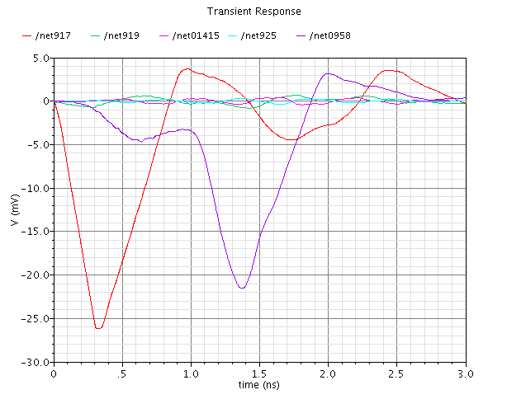
Transmission lines MCP model
The signals at the two ends, and crosstalk on the three first neighbors
Current pulse is applied at one end (simulation)
Uniformity is +/- 20%,
Crosstalk 15, 12, 10% on three first neighbors
Jean-Francois Genat, Workshop on Timing Detectors, Krakow, November 29th 2010

Slide 37
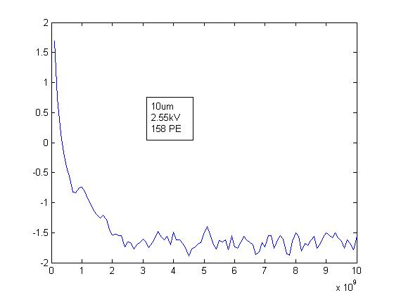
Picosecond Electronics for Large Area Micro-Channel Plate Detectors
Store the full detector information as with a digital oscilloscope:
- Detector + electronics noise >> quantization noise (LSB/√12)
Sampling frequency > 2 x full Analog Bandwidth (Shannon-Nyquist)
Ideal approach:
Digitize on the fly, if the two above conditions can be fulfilled.
If not, loss of precision due to A/D conversion and/or loss of timing information
Fourier spectrum of a
2”x 2” MCP signal
Noise as small as possible
2 GHz
Slope as steep as possible
Jean-Francois Genat, Workshop on Timing Detectors, Krakow, November 29th 2010

Slide 38
Fast Sampling Electronics
Integration in custom ASIC for large scale detectors ~ 10⁴⁻⁶ channels,
Self or external trigger,
Low power,
Full digital (serial) interface,
High reliability and availability,
Low cost.
See Herve Grabas talk
Jean-Francois Genat, Workshop on Timing Detectors, Krakow, November 29th 2010

Slide 39
Electronics: Sampled Micro-Channel Plate signals
Assume: a typical noise at 1mV (detector+system)
LSB set to 1mV for a 1V dynamic range (quantization noise 300μV),
50-200ps rise-time
Fast timing ad 2D readout:
8 bit, 2.5-10 GHz full analog bandwidth > 5-20 GS/s sampling rate
Readout electronics
Deep sub-micron CMOS ASICs: faster: larger analog bandwidth, sampling rate
improved radiation hardness
multi-channel: cheap, 1-10$/ch
Jean-Francois Genat, Workshop on Timing Detectors, Krakow, November 29th 2010

Slide 40
Outline
Introduction
Fast Timing Imaging Photo-detectors
Micro-Channel Plate signals
Large area devices
Conclusion
Jean-Francois Genat, Workshop on Timing Detectors, Krakow, November 29th 2010

Slide 41
Conclusion
Large Area Micro-Channel Plates should provide at low cost:
- Very fast timing (10-100ps)
2D position (100μm-1mm)
Still a long way to get a full device working…
Photo-cathodes
Hermetic packaging, spacers
MCP device uniformity
Readout electronics
Very large devices in view
Jean-Francois Genat, Workshop on Timing Detectors, Krakow, November 29th 2010

Slide 42
Thanks for your attention !
Jean-Francois Genat, Workshop on Timing Detectors, Krakow, November 29th 2010

Slide 43
Jean-Francois Genat, Workshop on Timing Detectors, Krakow, November 29th 2010

